Slide 1




MAR BASELIOS INSTITUTE OF TECHNOLOGY AND SCIENCE NELLIMATTOM, KOTHAMANGALAM
DEPARTMENT OF
COMPUTER SCIENCE AND ENGINEERING
A Mini Project On
FarmEco Assist AI
Presented by:
VISMAYA JOSEPH (MBI23CS136)
VINAYATHRI GOPAN (MBI23CS134)
TISA TIJO (MBI23CS133)
NATHEN LEJI (MBI23CS108)
S6CSEC (GROUP C8)
Guided by:
Sameena K M
Assistant Professor
CSE Department

Slide 2
CONTENTS
FarmEco Assist AI
CSE Dept.
Introduction
System Architecture
Technical Specifications
Data Flow Diagram
System Workflow
Implementation - Code structure
Implementation - UI Screenshots
Project Progress
Conclusion

Slide 3
INTRODUCTION
FarmEco Assist AI
CSE Dept.
A modern solution developed to transform traditional farming operations through Artificial Intelligence and data analytics.
Effectively manages farm profitability by optimizing when to sell crops and how to utilize farm waste efficiently.
Ensures faster access to climate-smart advisory services, enhancing convenience without the need for expensive consultants.
Enhances overall farm sustainability by simplifying complex carbon market concepts and ensuring better resource utilization.

Slide 4
INTRODUCTION
FarmEco Assist AI
CSE Dept.
The Problem: Small farmers face volatile markets, harmful waste disposal habits (stubble burning), and a lack of awareness regarding carbon credits.
The Solution: A unified Python-based web application to provide economic intelligence and environmental sustainability advice. This unifies price prediction,waste reuse and carbon income estimation into a single platform.
Objective: To enhance farmer income and promote climate-positive transitions.

Slide 5
SYSTEM ARCHITECTURE
FarmEco Assist AI
CSE Dept.
(THE 3 MODULES)
The system consolidates three intelligent modules:
FarmPulse (Price Volatility Alert):
Forecasts market movement to generate "sell-risk" alerts.
AgroWaste (Waste Reuse Recommendation):
Suggests optimal reuse pathways (compost/fuel) for crop residues.
CarbonCredit (Income Advisory):
Assesses carbon-reduction potential and estimates annual earnings.

Slide 6
TECHNICAL SPECIFICATIONS
FarmEco Assist AI
CSE Dept.
Frontend: Streamlit (Python-based UI framework).
Backend: Python modules for logic and ML prediction.
Database: SQLite (Lightweight file-based database).
ML Models: Linear Regression (Price/Earnings), Decision Tree Classifier (Carbon Eligibility), and Rule-based Recommender.
Libraries: pandas, numpy, scikit-learn, joblib, matplotlib, sqlite3.

Slide 7
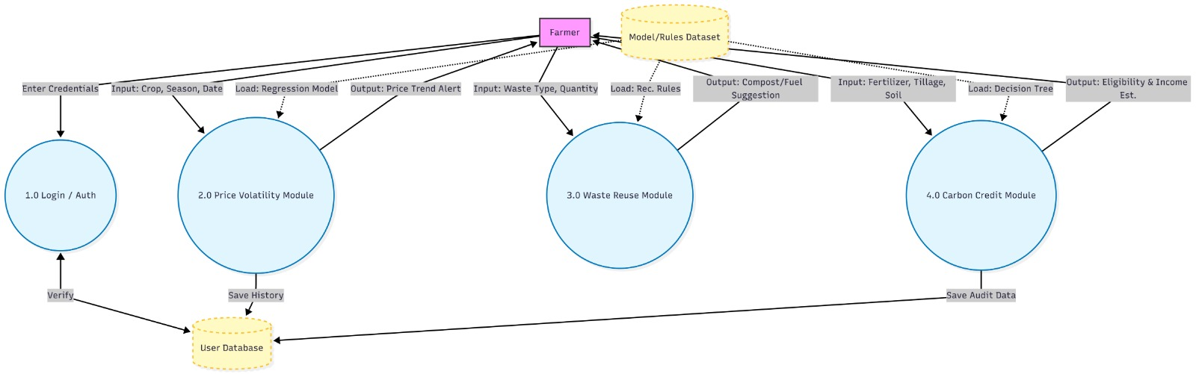
FarmEco Assist AI
CSE Dept.
DATA FLOW DIAGRAM

Slide 8
SYSTEM WORKFLOW
FarmEco Assist AI
CSE Dept.
User Interaction: Farmer enters credentials or module-specific data (Crop, Waste Type, Soil data).
Processing: Logic flows through the Login/Auth module, then to specific ML modules.
Data Persistence: Results and history are saved to the SQLite User Database.
Model Integration: Modules load specific datasets and trained models (Regression/Decision Trees) to generate output

Slide 9
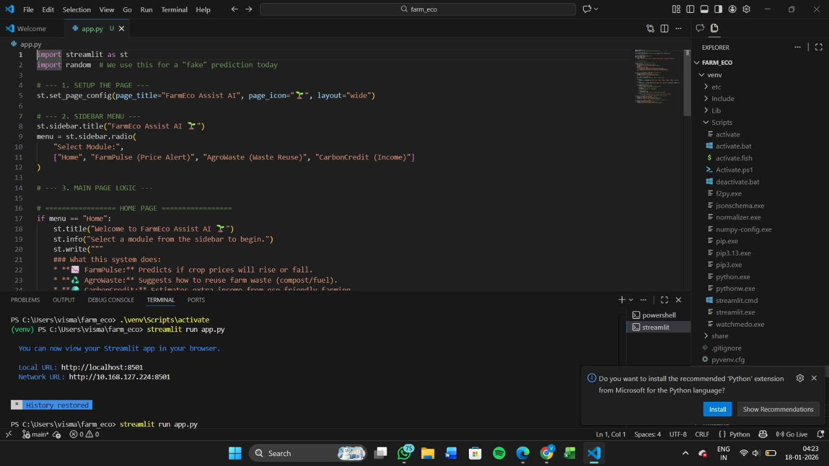
IMPLEMENTATION – Code Structure
FarmEco Assist AI
CSE Dept.

Slide 10
SOFTWARE ARCHITECTURE & DESIGN
FarmEco Assist AI
CSE Dept.
Application Logic: Built using streamlit for page configuration and sidebar navigation.
Modular Design: Uses a radio menu to toggle between "Home," "FarmPulse," "AgroWaste," and "CarbonCredit".
Environment: Developed in a Python virtual environment (venv) and run locally via streamlit run app.py.

Slide 11
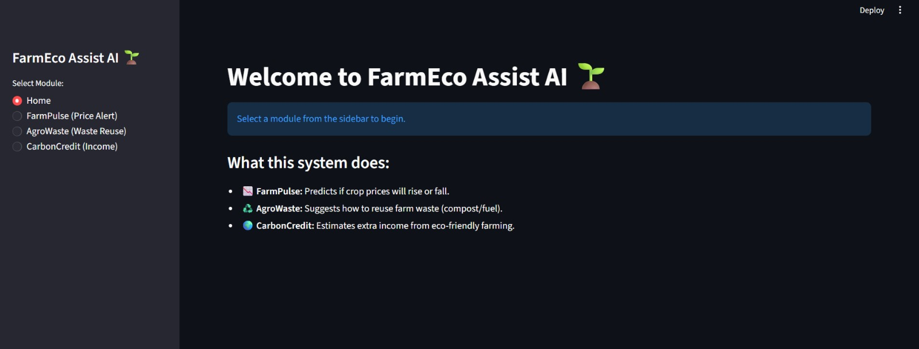
IMPLEMENTATION-UI Screenshots
FarmEco Assist AI
CSE Dept.
.

Slide 12
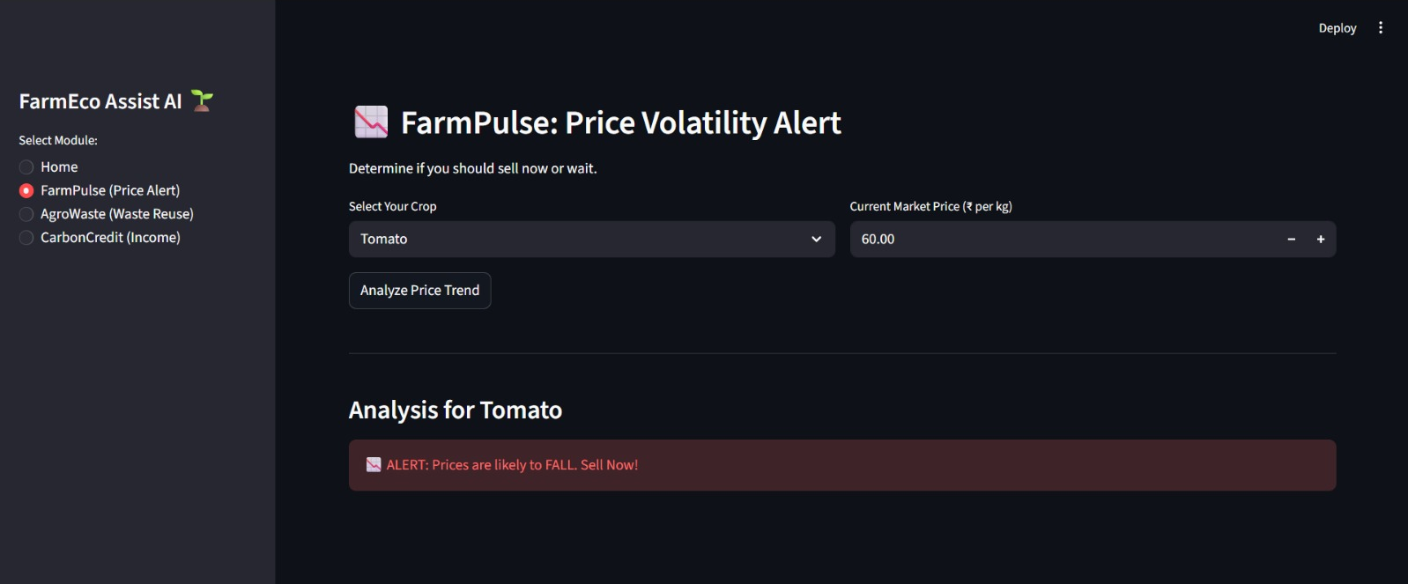
IMPLEMENTATION-UI Screenshots
FarmEco Assist AI
CSE Dept.

Slide 13
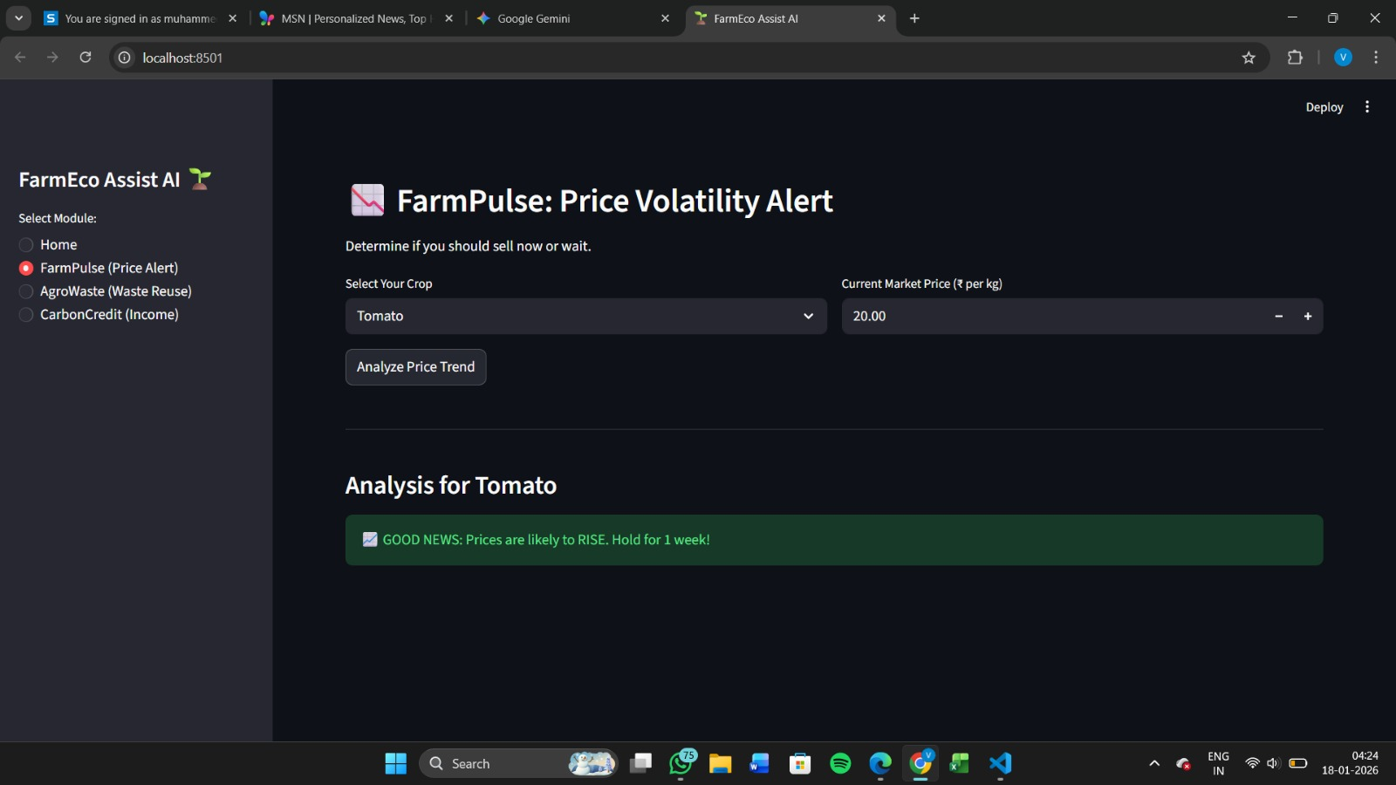
IMPLEMENTATION-UI Screenshots
FarmEco Assist AI
CSE Dept.

Slide 14
Front-End Features & User Experience
FarmEco Assist AI
CSE Dept.
​Home Page: Provides a clear overview of system capabilities (FarmPulse, AgroWaste, CarbonCredit) and module navigation via the sidebar.
​FarmPulse Interface: Allows users to select a crop (e.g., Tomato) and enter current market prices (₹ per kg) for analysis.
​Dynamic Alerts: The system displays a green "GOOD NEWS" banner for price rises (Hold for 1 week!) or a red "ALERT" banner for price falls (Sell Now!).
​Integrated Design: All modules operate over a common farmer profile within a unified Python and Streamlit web application.

Slide 15
PROJECT PROGRESS (30% COMPLETION)
FarmEco Assist AI
CSE Dept.
Completed Tasks:
System Requirement Specification (SRS) and Abstract finalized.
Streamlit UI skeleton and sidebar navigation implemented.
Database schema designed for SQLite integration.
Initial logic for the FarmPulse module developed.
15

Slide 16
Future Roadmap
FarmEco Assist AI
CSE Dept.
Next Steps:
Training ML models with historical datasets.This involves sourcing and cleaning extensive CSV datasets for various crops to ensure the Linear Regression model can accurately forecast seasonal price fluctuations.
Finalizing the Carbon Credit estimation logic. ​We are developing a mathematical formula to translate raw environmental data into an estimated annual income, providing farmers with a clear financial incentive for sustainable transitions.
Integrating all modules with the backend database. We will implement full CRUD (Create, Read, Update, Delete) operations using SQLite to ensure that farmer profiles and previous "FarmPulse" queries are saved across sessions

Slide 17
CONCLUSION
FarmEco Assist AI
CSE Dept.
Social Impact: Offers a cost-efficient tool for marginal farmers to improve their livelihoods.
Innovation: Demonstrates potential for future research and patentable agricultural technology.
​Established Foundation: We have successfully developed the core architecture of FarmEco Assist AI, integrating a functional Streamlit interface with a modular backend design.
​Proof of Concept: The FarmPulse module demonstrates that real-time price volatility alerts can be effectively generated through Python-based logic, providing a clear "Hold" or "Sell" directive to the user.
​Scalability & Readiness: With the SQLite database schema and UI navigation finalized, the system is ready for the integration of more complex machine learning models in the next phase.
​Vision for Completion: The progress made so far confirms the feasibility of creating a cost-efficient, unified platform that balances economic intelligence with climate-positive agricultural practices.
17

Slide 18
THANK YOU
FarmEco Assist AI
CSE Dept.
18

