Slide 1
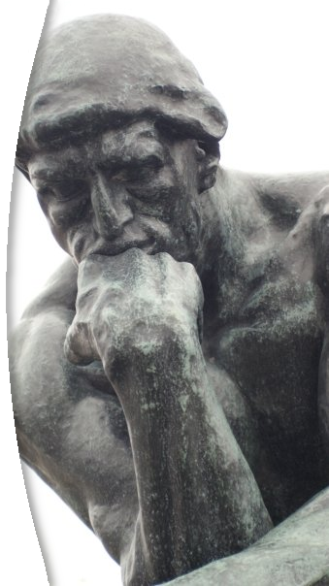

Thinking
Open
Joel Graff

Slide 2
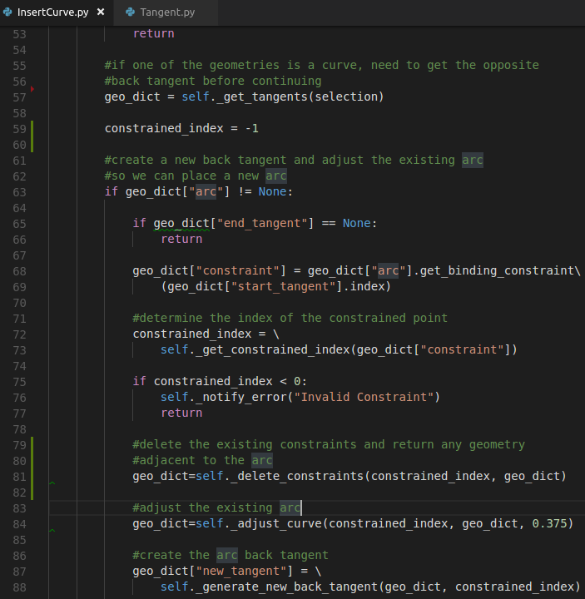
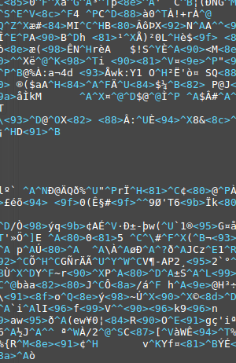
Human-Readable
Source Code
Machine-Readable
“Binary”

Slide 3
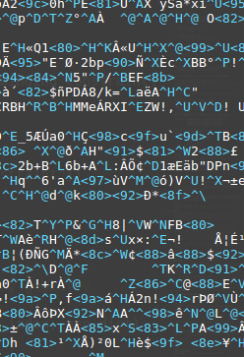
Compile
Source Code
(plain text)
Binary (EXE)
Free
Open Source
Proprietary
Closed Source

Slide 4
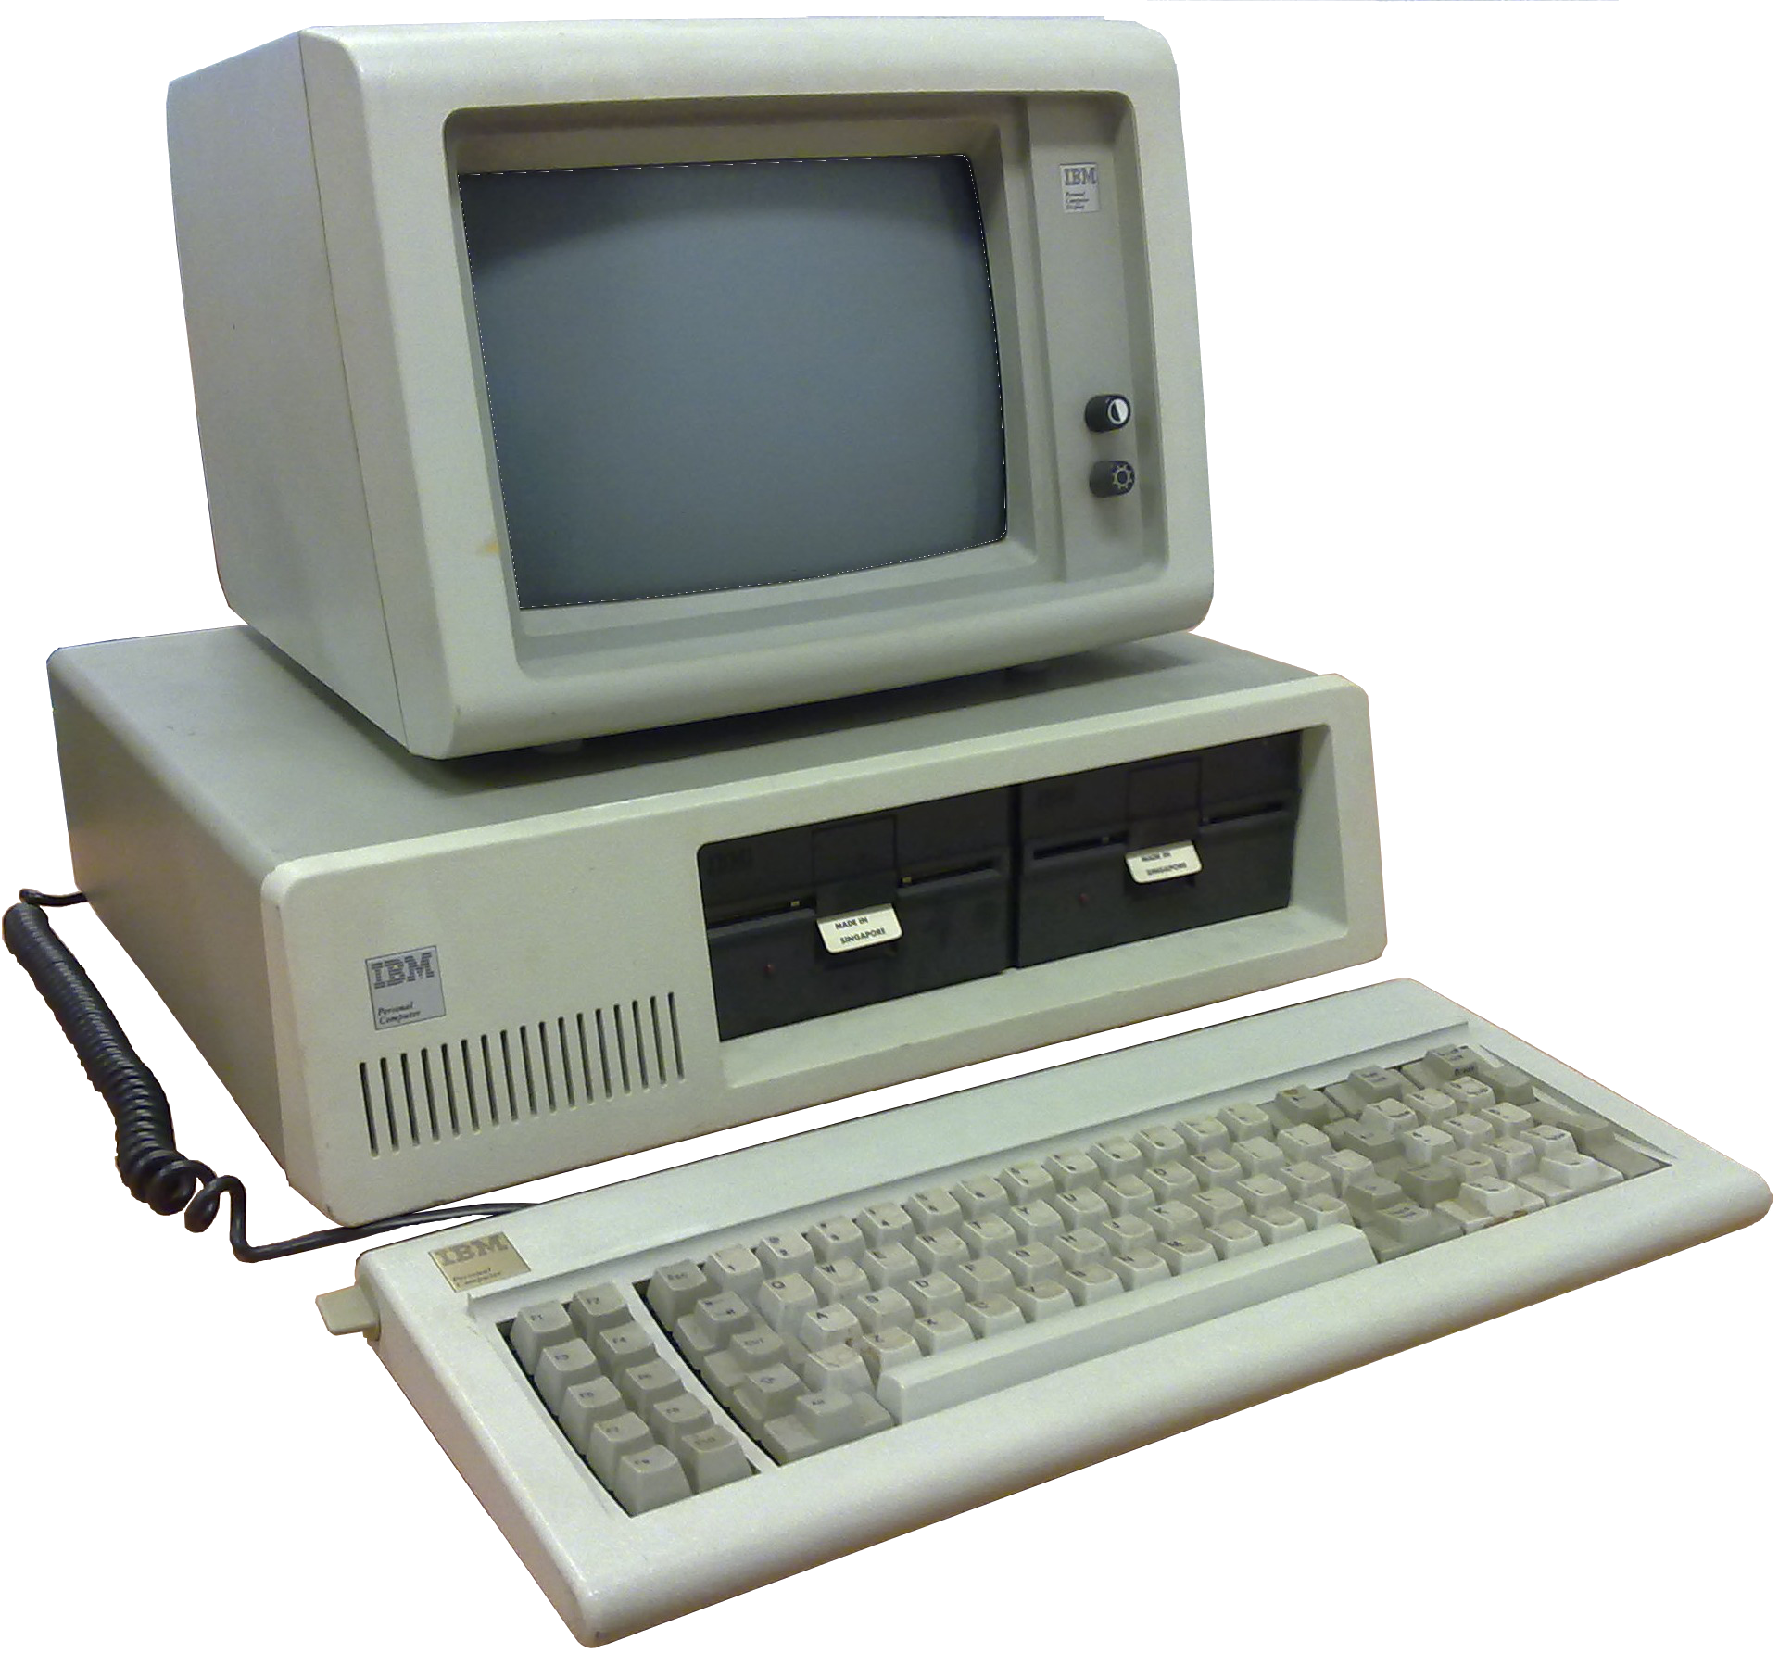

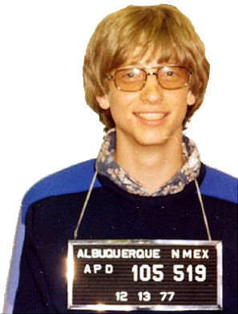

Slide 5

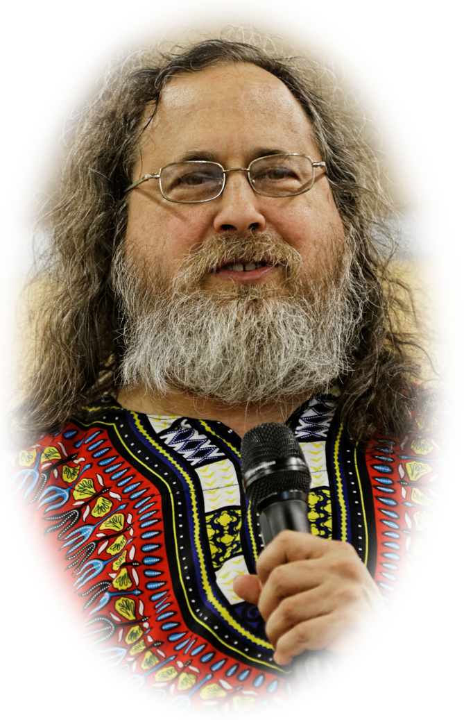

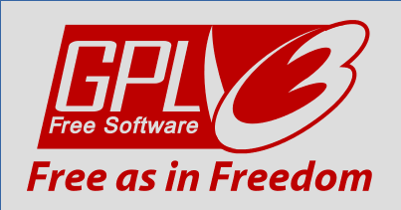

Slide 6

“When you upload, submit, store, send or receive content to or through our Services, you give Google (and those we work with) a worldwide license to use, host, store, reproduce, modify, create derivative works, ... communicate, publish, publicly perform, publicly display and distribute such content. The rights you grant in this license are for the limited purpose of operating, promoting, and improving our Services, and to develop new ones. This license continues even if you stop using our Services...”
“Our automated systems analyze your content (including emails) to provide you personally relevant product features, such as customized search results, tailored advertising, and spam and malware detection. This analysis occurs as the content is sent, received, and when it is stored. “

Slide 7
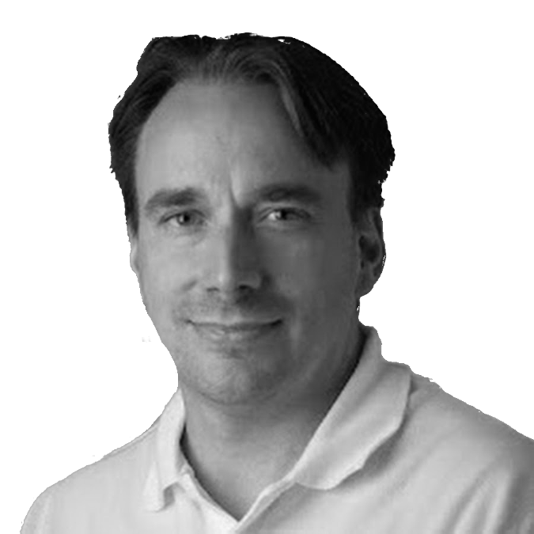




Tux!
“Linux”

Slide 8
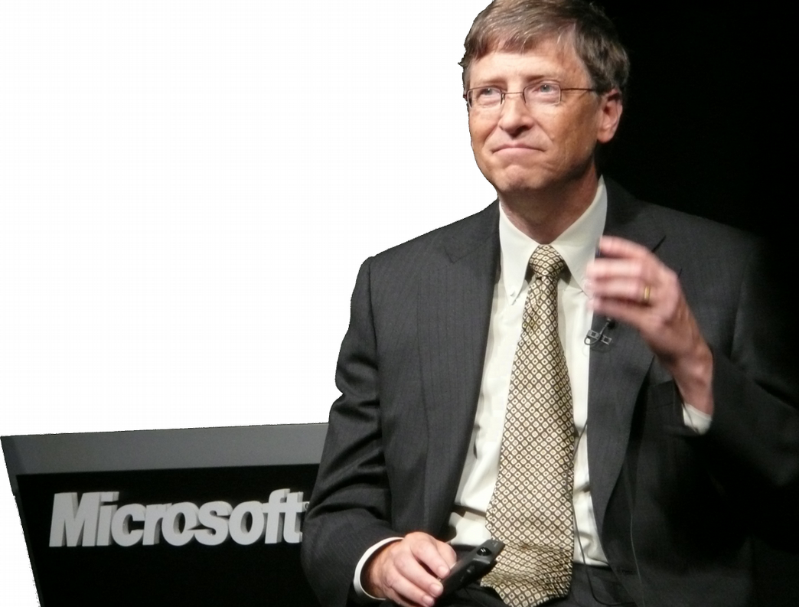
“Our most potent operating system competitor is Linux and the phenomena around Open Source and free software.”
“The academic community,
start up companies, foreign governments ... are putting
their best work into Linux.”

Slide 9
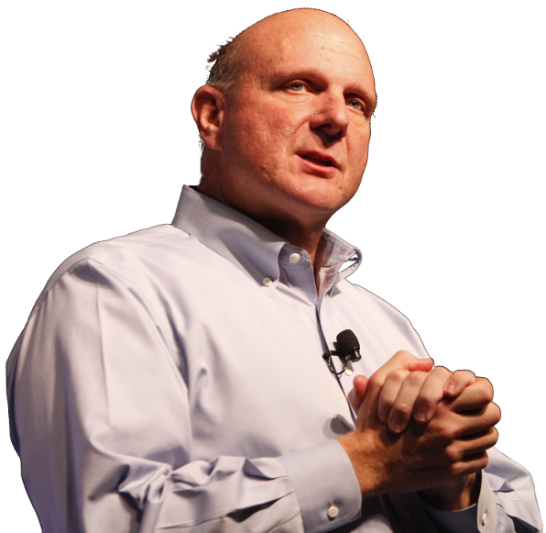
"Linux is a cancer that attaches itself in an intellectual property sense to everything it touches"
Microsoft CEO Steve Ballmer
June, 2001
40%

Slide 10
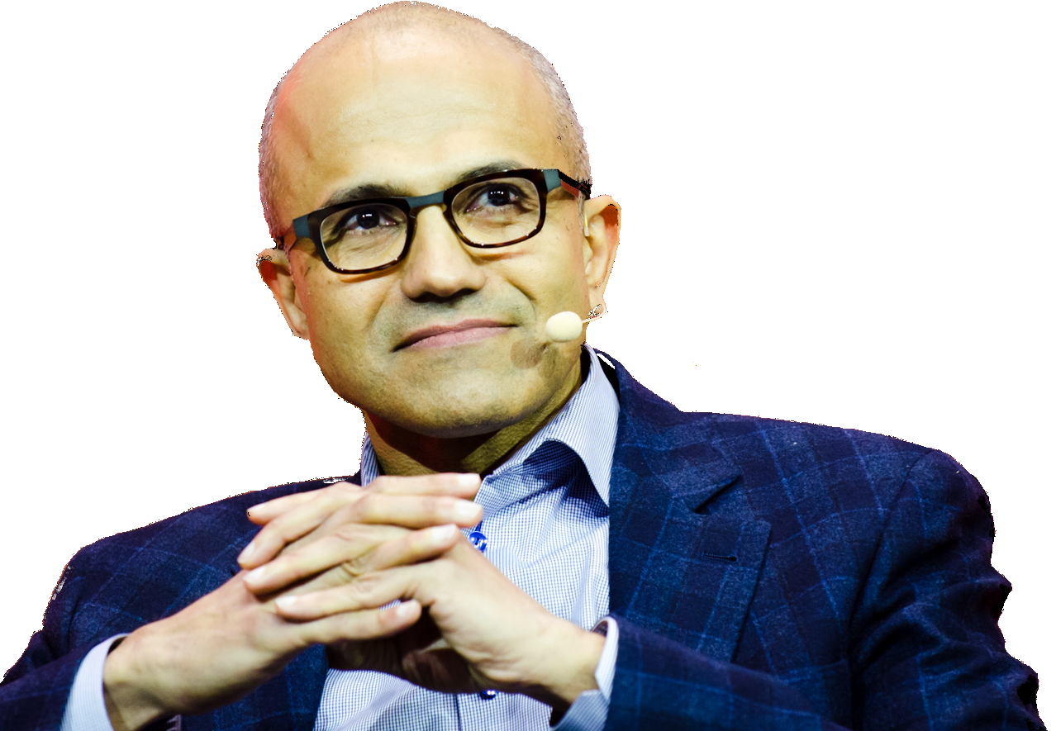
"Microsoft loves Open Source"
"Microsoft loves Linux"
Satya Nadella,
CEO, Microsoft
50%

Slide 11
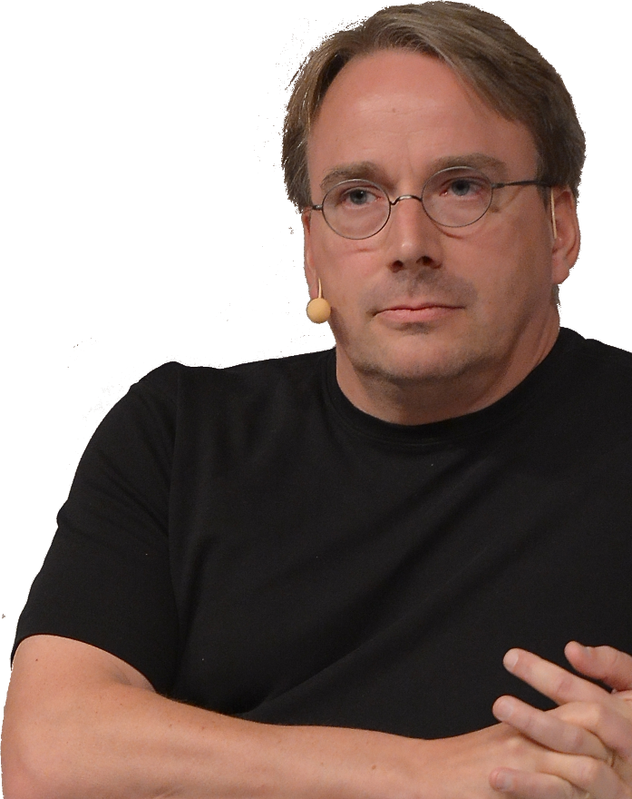
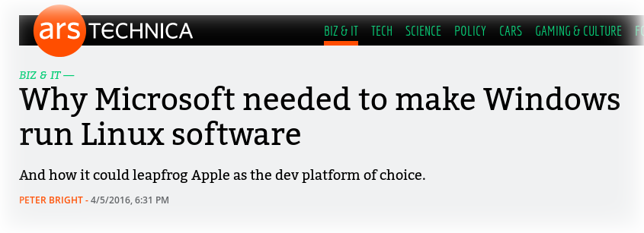
“If Microsoft ever does
applications for Linux,
it means I’ve won.”

Slide 12
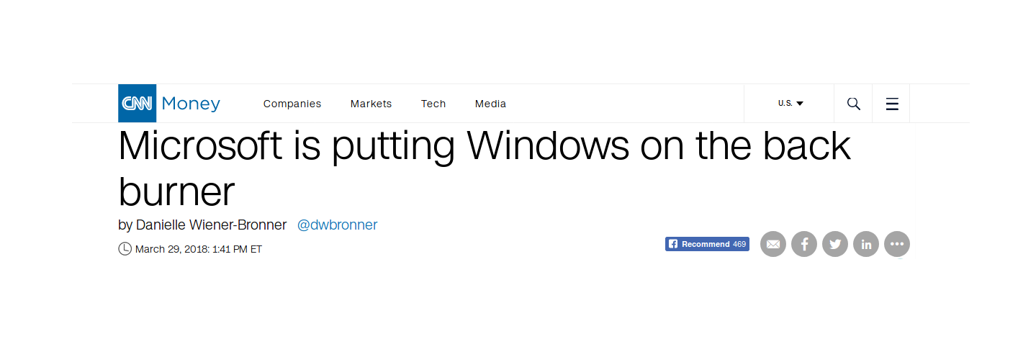
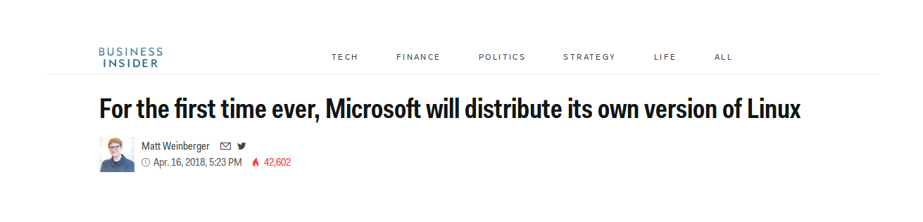
The Cloud
User adoption
Ubiquitous mobile devices
Subscription licensing
Convergence in the cloud

Slide 13

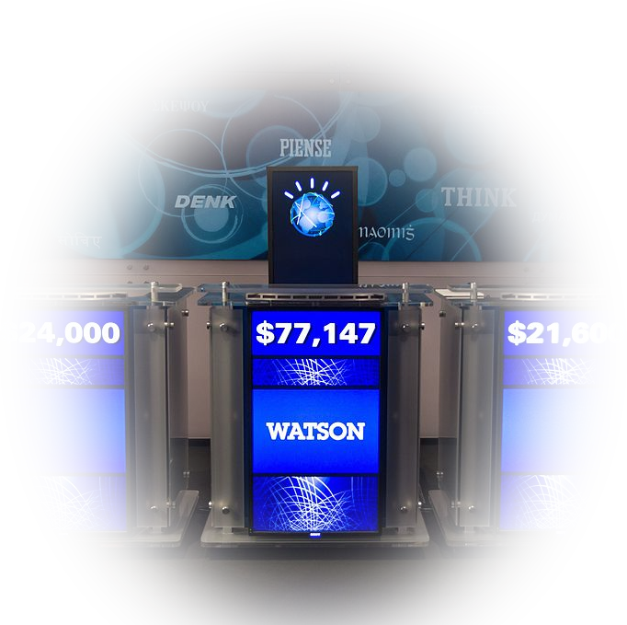
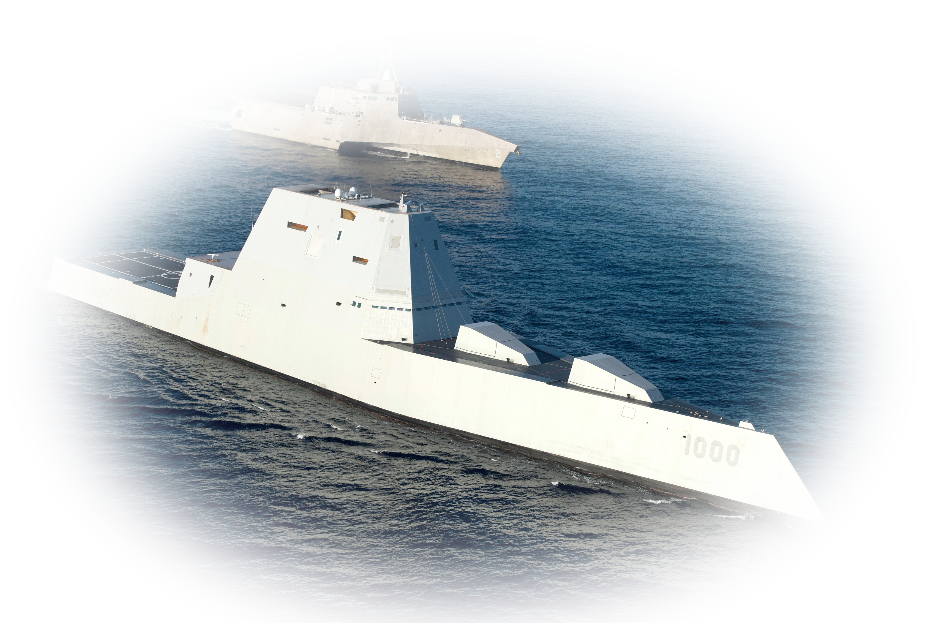
The Linux Kernel Project
  World’s largest software project
  4,000+ developers / 500 + companies
  Top 500 super computers
  Military warships and drones
  Over half of the internet

Slide 14
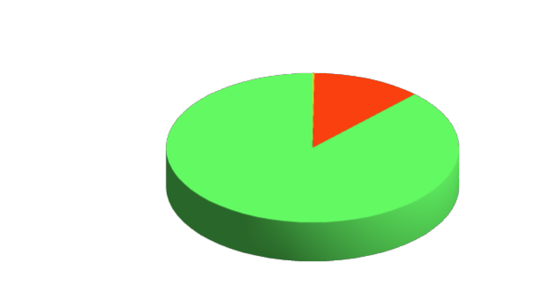
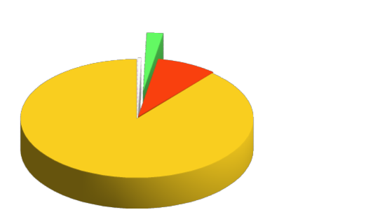
Mobile
IOS
Android (Linux)
Market Share
OSX
Linux
Windows
Desktop

Slide 15
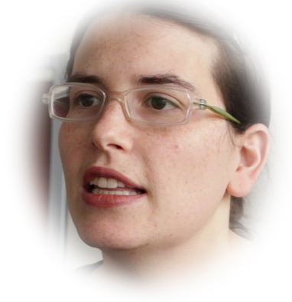
“It is impossible now for me to see software freedom as anything other than of core importance to our society as a whole.”
“My life depends on the proprietary software that is literally connected to my heart. I can't review the code, and I know that there have been no proper procedures for its review by anyone else.”
Karen Sandler
Executive Director,
Software Freedom Conservancy

Slide 16
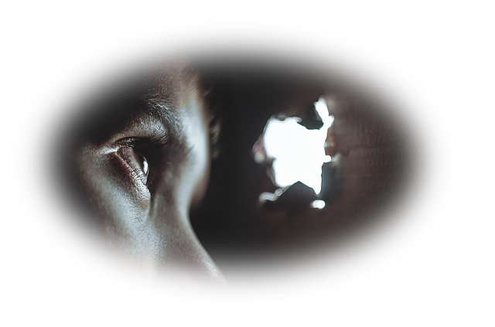


The Business Case
Security
Total Cost of
Ownership
Sustainability

Slide 17
Security
Spyware, Back Doors and Viruses! Oh My!
Open Source is sensitive to data privacy / security
Proprietary vendors make money on your data

Slide 18
Total Cost of Ownership (TCO)
Infrastructure
  No proprietary hardware
  Older hardware support
Future-Proof
  Scales for free
  Vendor neutrality
Licensing
  User freedom
  No license fees
Support
  Free (community)
  Paid (corporate)

Slide 19
Sustainability
Rule #1:
Open Source software never dies
Rule #2:
Proprietary software must be
profitable

Slide 20

Comparing Alternatives
?
?
?
?
?

Slide 21
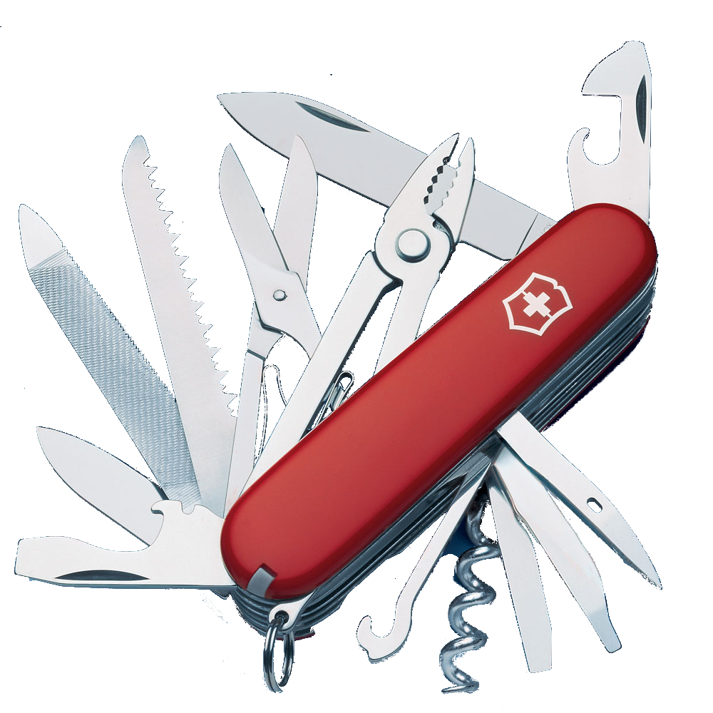
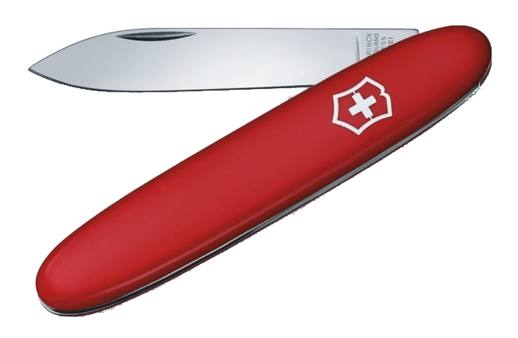
Feature Parity Fallacy
How much do you really need?

Slide 22
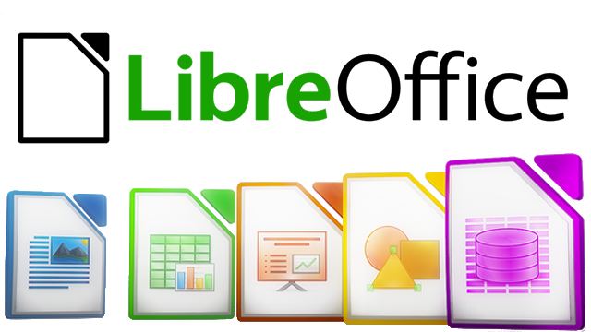
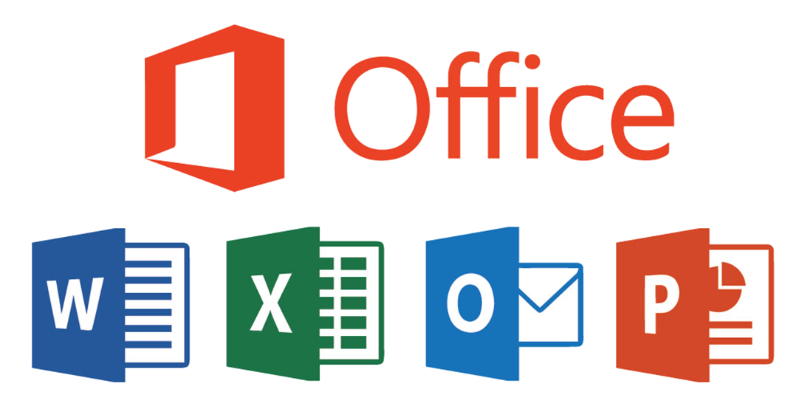
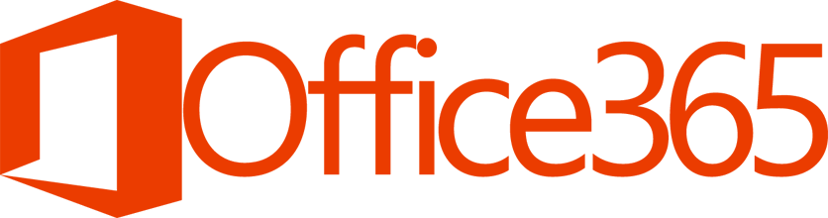

Office Suites

Slide 23
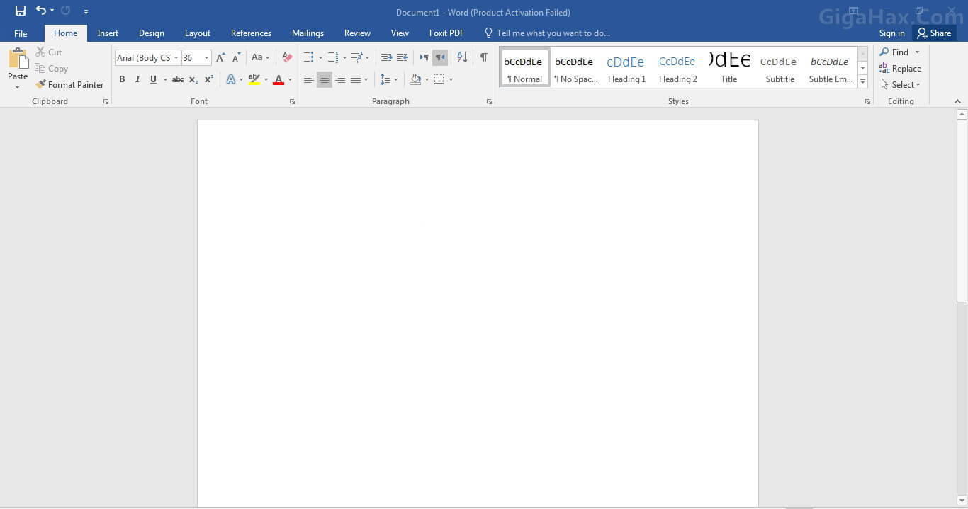
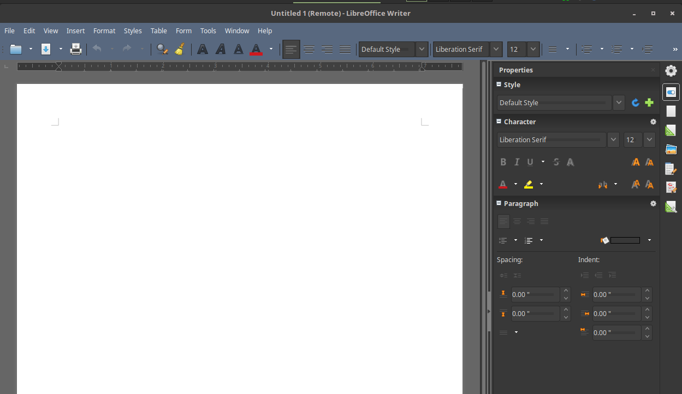

Slide 24





Business

Slide 25





Graphics
Adobe
Illustrator
Inkscape
Gimp
Adobe
Photoshop
Krita

Slide 26

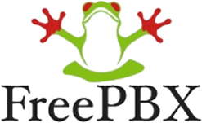
Phone Systems
Sauk Valley Community College
  Less infrastructure
  Simpler maintenance
  Lower cost

Slide 27
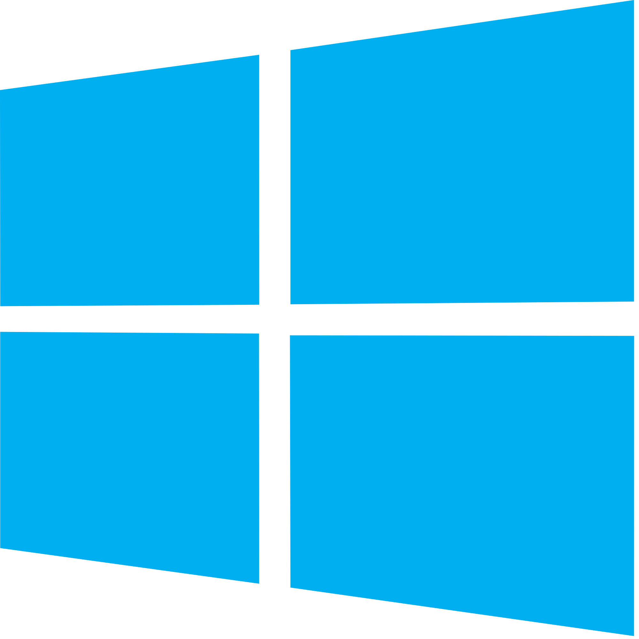

Operating Systems
Stability
Bit Rot
Kernel Panic
Security
Spyware
Viruses
Package management
Installing / removing
Updates

Slide 28
Operating Systems
Hardware Support
Older and newer systems
~80 architectures
Low resource demand
Compatibility
Cross platform
File systems

Slide 29

Self-Hosted Cloud Solutions
File synchronization
  Compatible with Google, Amazon, and Dropbox
Online office suite with Collabora Online
Audio / Video conferencing
Calendar / contacts
Email

Slide 30
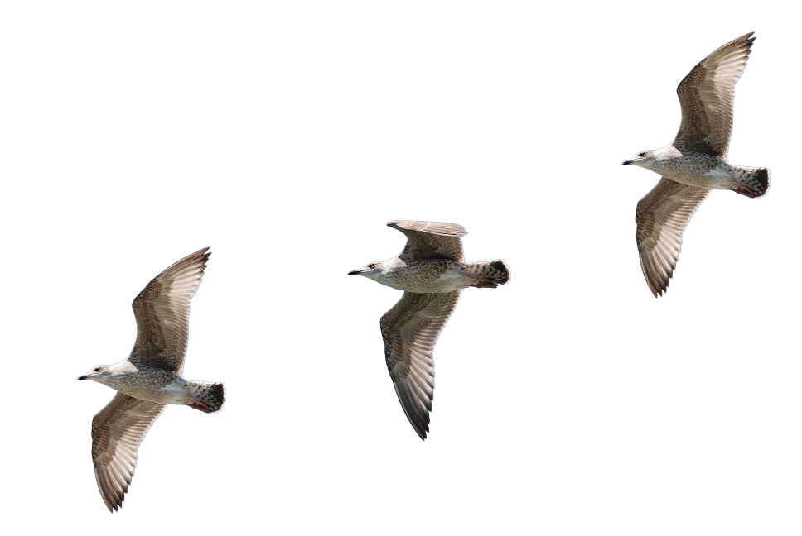
Migration Strategies
The sooner, the better
Low-Hanging Fruit
Install alongside
Commit your data
Long-term plan

Slide 31
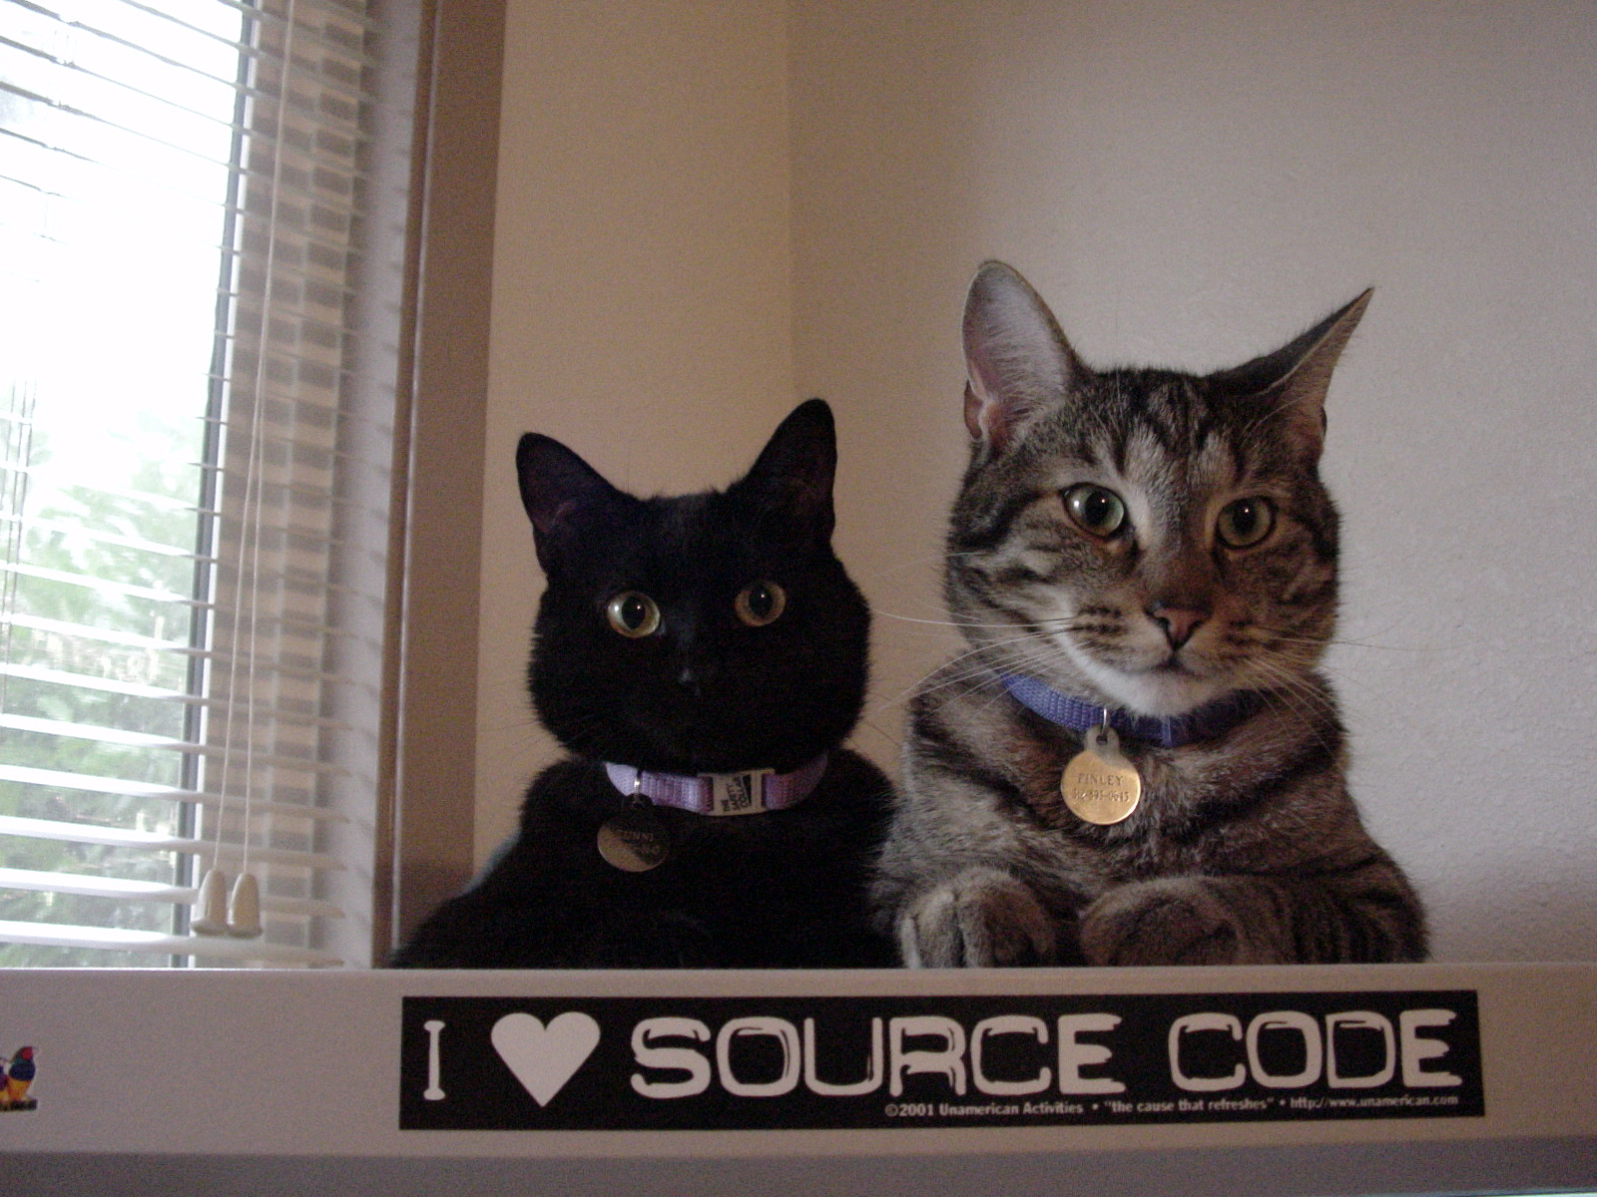

Slide 32
Image Credits
“Richard Stallman”, by Thesupermat, licensed under CC-BY-SA, 3.0
“Linus Torvalds”, by Krd, licensed under CC-BY-SA, 3.0
“Steve Ballmer keynotes at PDC10”, by MicrosoftPDC, licensed under CC-BY, 2.0
“Satya Nadella – LeWeb Day 1”, by Heisenberg Media, licensed under CC-BY, 2.0
“Karen Sandler (Patent Absurdity)”, by Luca Lucarini, licensed under CC-BY-SA, 3.0
“MS DOS”, by Quanwangdokg 10 licensed under CC-BY-SA, 3.0
“MS DOS”, by Quanwangdokg 10 licensed under CC-BY-SA, 3.0
“MS DOS”, by Quanwangdokg 10 licensed under CC-BY-SA, 3.0
“Microsoft Bill Gates”, by Masaru Kamikura, licensed under CC-BY, 2.0
“Bill Gates 1977”, by Albuquerque NM police department, public domain
“IBM PC Model 5150”, by Ruben de Rijcke licensed under CC-BY-SA, 3.0
“Universal Recycling Symbol”, by Chris Buckley, public domain
“Firefox logo”, by The Mozilla Foundation licensed under CC-BY, 3.0
“Free Software Foundation logo”, by Li Jiang, public domain
“GPLv3 logo” by the Free Software Foundation, public domain
“Open Source Kittens” by Kirsten, licensed under CC-BY, 2.0
“USS Zumwalt” by US Navy, licensed under CC-BY, 2.0
“Internet Logo” by the Tango project, public domain
“Open Source Initiative logo”, by Simon Phipps licensed under CC-BY, 2.5

