Slide 1
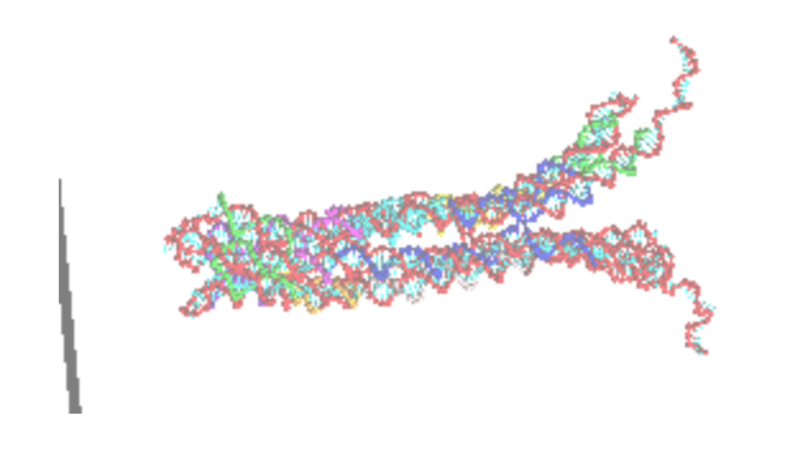
oxDNAlien: Variable tether Lengths, Sequences, Cinches & Connectors
JOEL HOCHSTETTER
09-07-20

Slide 2
What I did?
Improved set-up
Implemented barrel with finite height in oxDNA (previously 8 'infinite' force planes arranged in an octagon made barrel).
Used actual sequences (previously used random sequences)
Wrote scripts to generate cinches and connectors in cadnano and oxDNA
Now running Monte Carlo simulations (previously using Molecular Dynamics) to better sample possible configurations. 1e8 MC steps ran for each config
Simulations:
Simulated free tethered pore (no cinches or connectors) for a range of lengths and for different sequences.
Compared cinches + connectors with free pore for tether length 120 with original sequences
Side question: Is it possible for the pore to flip within the barrel? (Answer: appears not)

Slide 3
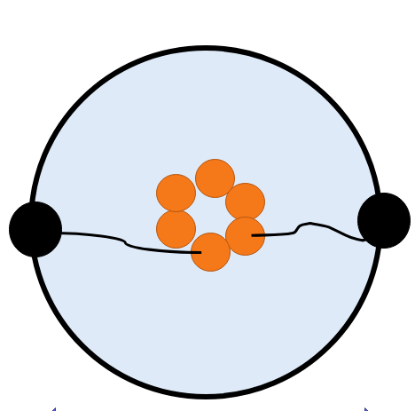
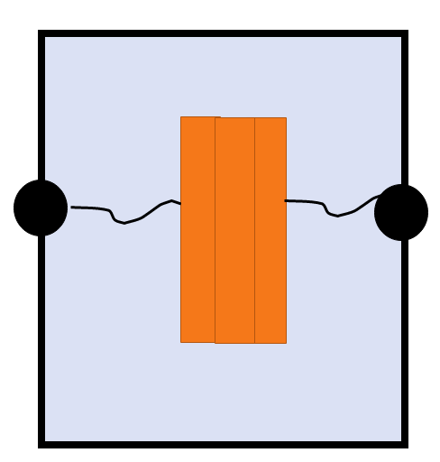
Set-up revisited
Force cylinder (details next slide) constrains barrel
End nucleotides of the tether are fixed to a certain position. Harmonic force on these nt (F=kx, with k = 600 pN/nm). These nt stay within 0.4nm of fixed location in simulations
Side view
Top view
θ
z
52nm
r
18 nm

Slide 4
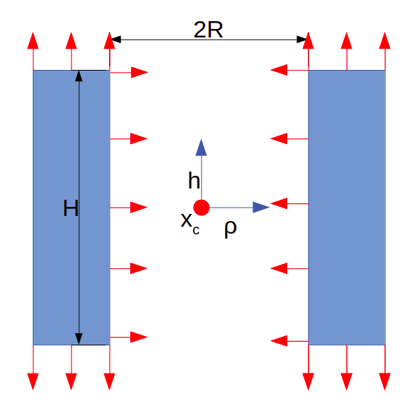
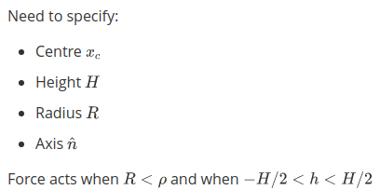
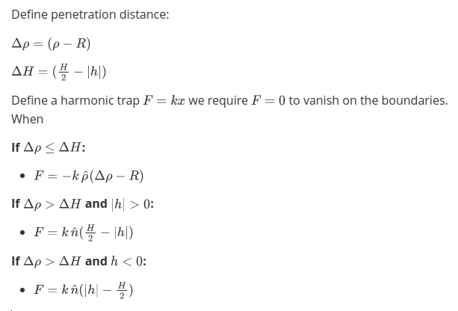
Set-up: Nature of the "barrel" force
The force acts when nucleotides are inside the barrel. Red arrows indicate directions
Treat as harmonic force (F=kx). Is there a better nature of force?
Note the force vector is discontinuous at border of barrel:
Magnitude is continuous
Direction is not

Slide 5
Quantities of interest
z-position relative to tether docking height and radial position for
Bottom nucleotide on pore
Middle nucleotide on pore
Top nucleotide on pore
Minimum nucleotide on pore
Average over all pore nucleotides
Fraction of time that pore is visible (taken from minimum nucleotide)
Number of bonds formed in tether
Bond defined as H bonding energy < -0.1 SU of energy (4.1e-21 J)
Follows convention from oxDNA website

Slide 6
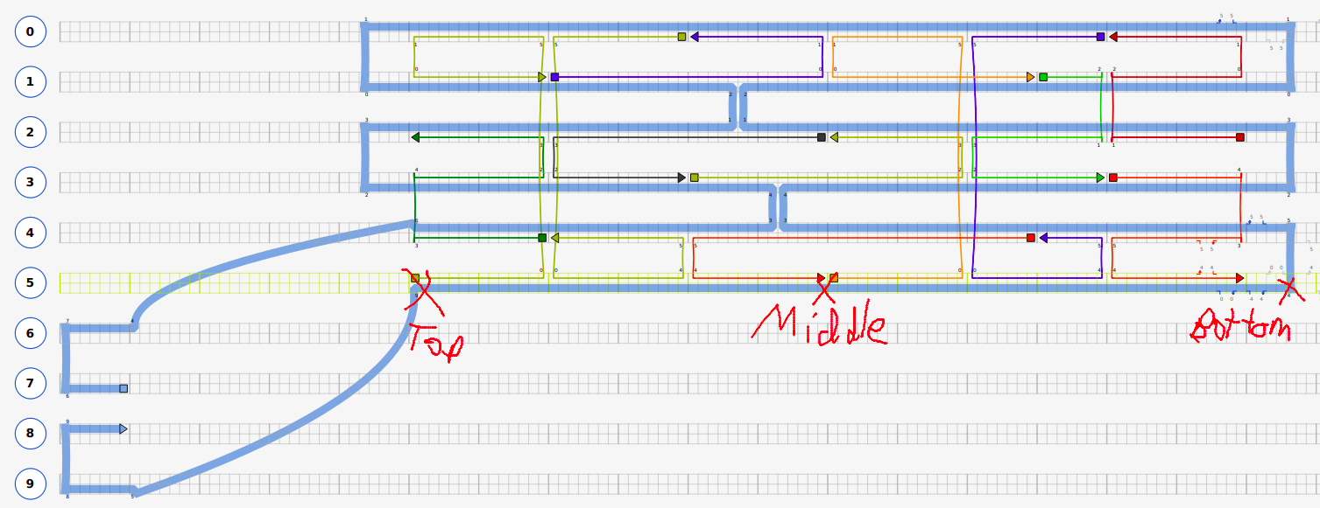
Cadnano design: 190604_TC_pore_cinch1.json
Definitions of nucleotides: top, middle, bottom is shown
Shown has tether length = 15nt (total of 30 tether nucleotides, 15 on each side of pore). This is varied.

Slide 7
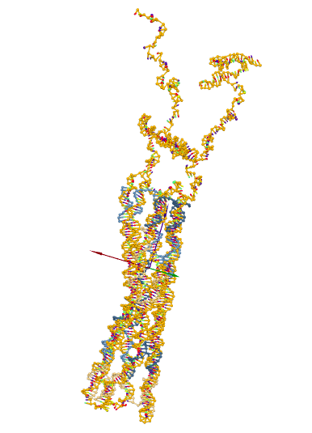
Question 1: What is the effect of tether length and sequence on pore mobility?

Slide 8
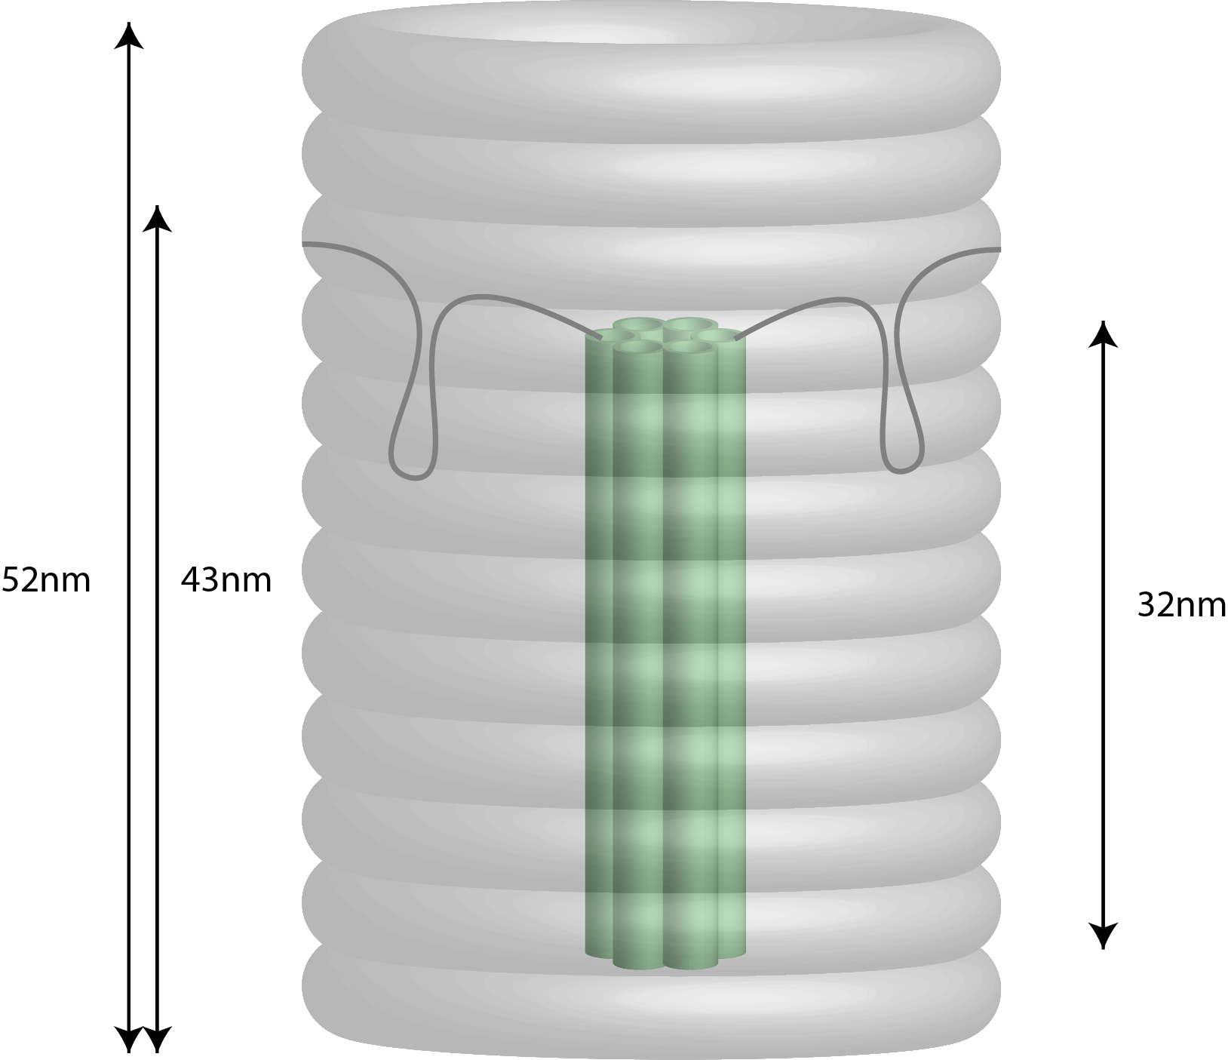
Simulation protocol
Simulated free tethered pore (no cinches or connectors) for a range of lengths and for different sequences.
Tether lengths (number of bp on each side of tether):
15, 30, 45, 60, 75, 90, 105,120,135,150
Sequences:
Original sequences
Permutation of 700 to original sequence
Original sequence with tether All T (to control for hairpin formation of pore)
Tether docking heights:
Tether at centre of barrel (used in simulations last time)
Tether in actual position (above centre of barrel by 17nm)

Slide 9
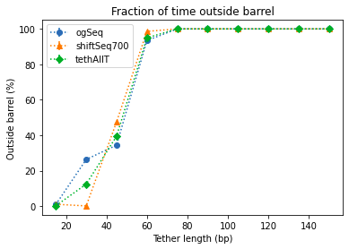
Results: Fraction of time outside the pore
Fraction of time outside barrel increases with increasing tether length
Above length ~ 50 the pore spends almost 100% of its time outside the barrel
Some differences by sequence but no clear trend

Slide 10
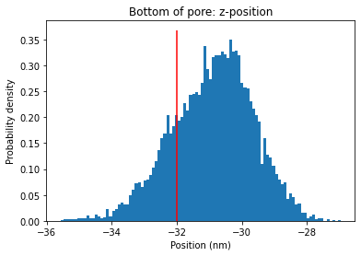
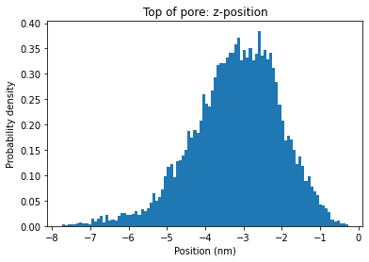
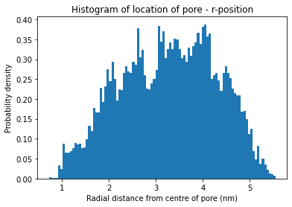
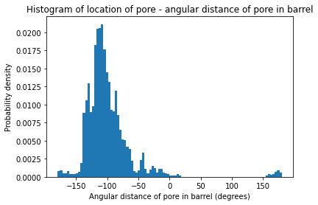
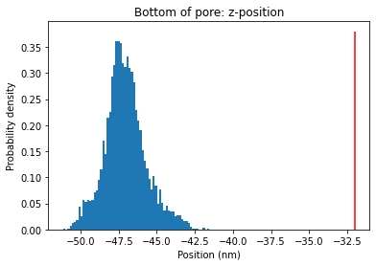
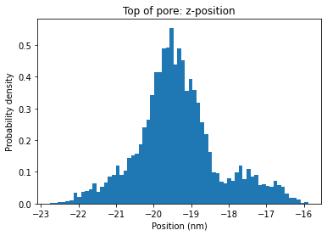
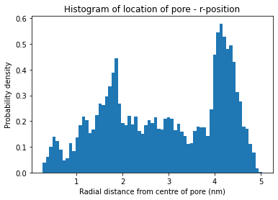
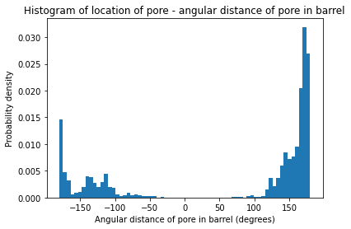
Example position distributions (original seqs)
Len 45
Len 120

Slide 11
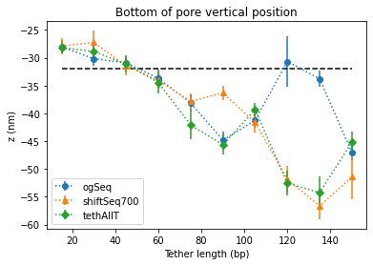
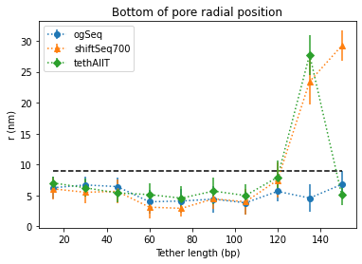
Results: Average location bottom of pore
Z-position decreases as tether length increases
Radial position no significant changes for pore inside barrel.
At long tether lengths pore can dangle over side of barrel (higher radius)

Slide 12
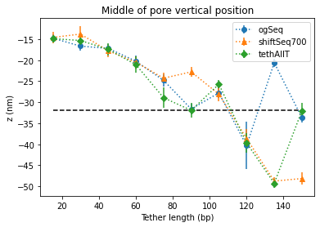
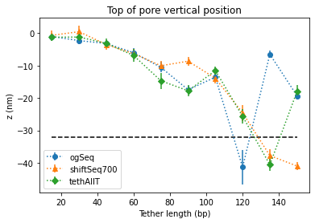
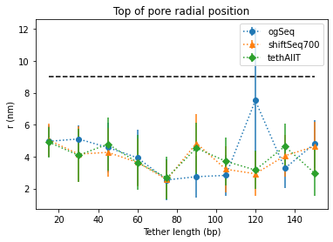
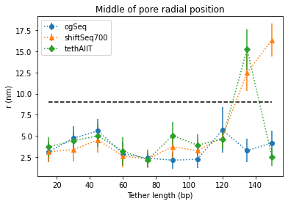
Results: location of middle/top of pore
Like before for radial position
Vertical position shows same trend but is shifted

Slide 13
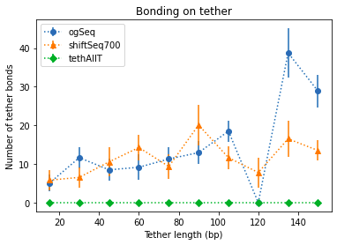
Results: Number of tether bonds
Number of tether bonds (and standard deviation) tends to increase as tether length increases.
There is some variation when sequences are altered.
Where the bonds are not just number of bonds is important for hairpin formation. I could track this in future

Slide 14
Question 2: How do cinches or connectors change the mobility of the pore?

Slide 15
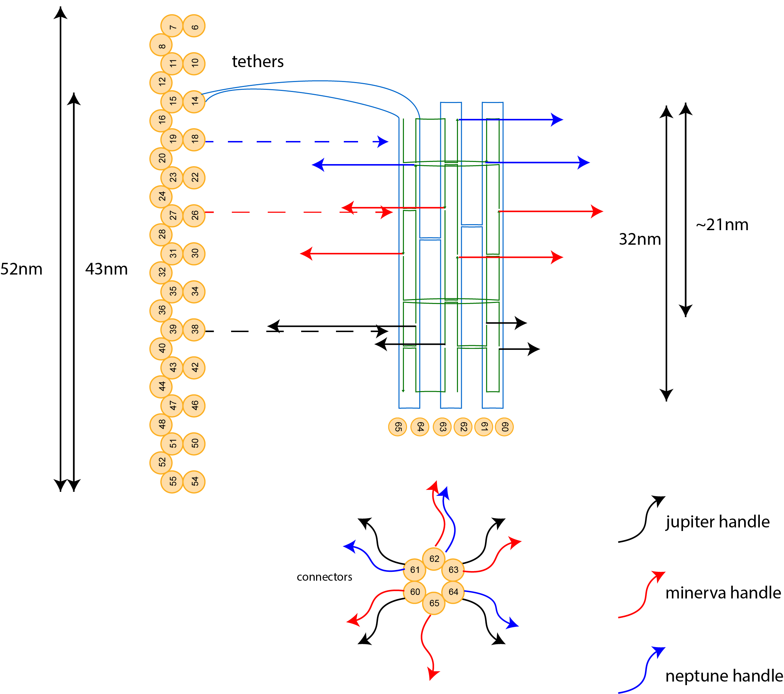
Simulation protocol
For pore docked in actual position (17nm above centre of pore), with tether of length 120 compared:
Free pore
1 connector level (black)
3 connector levels
Cinches with spacer of 5 to end of tether
Cinches with spacer of 10 to end of tether

Slide 16
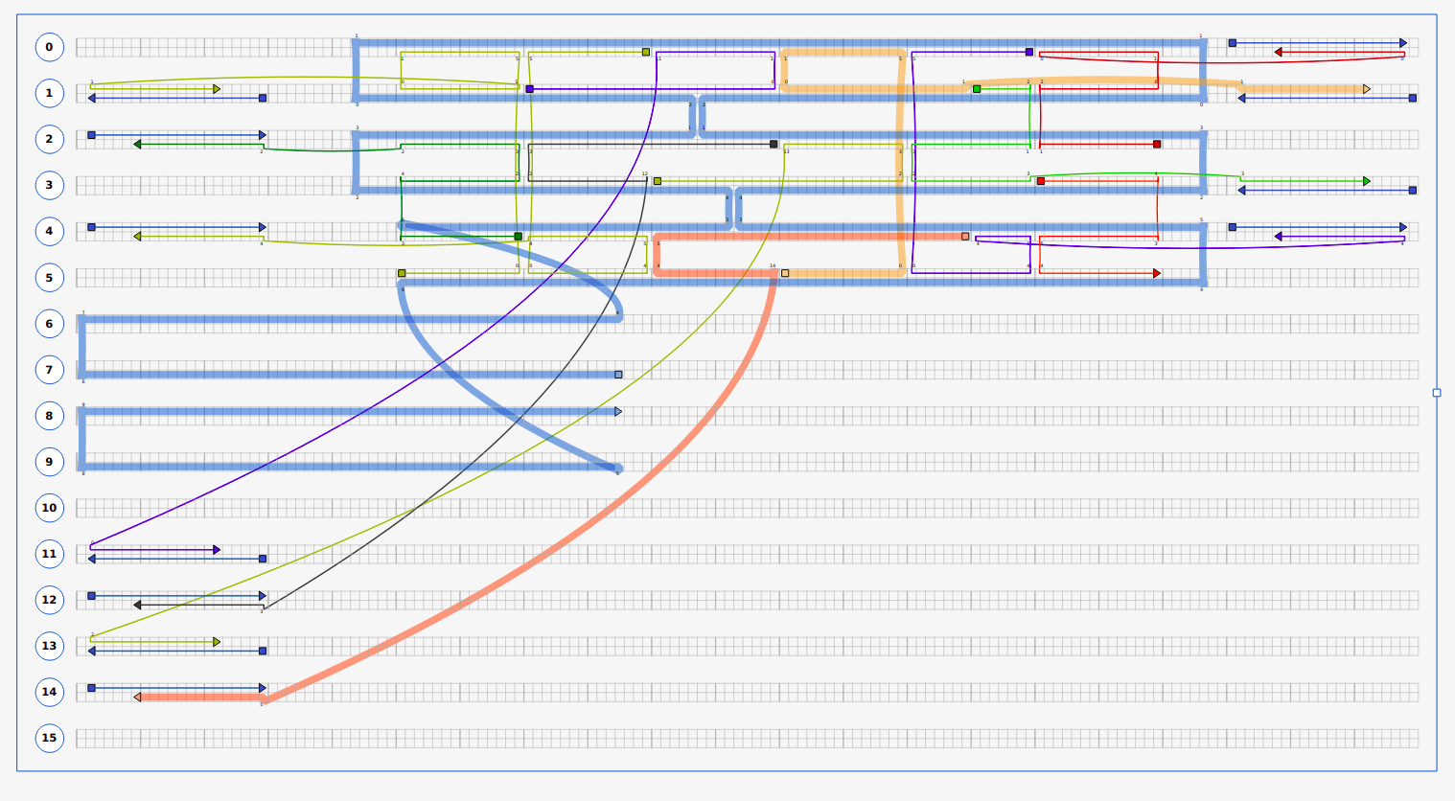
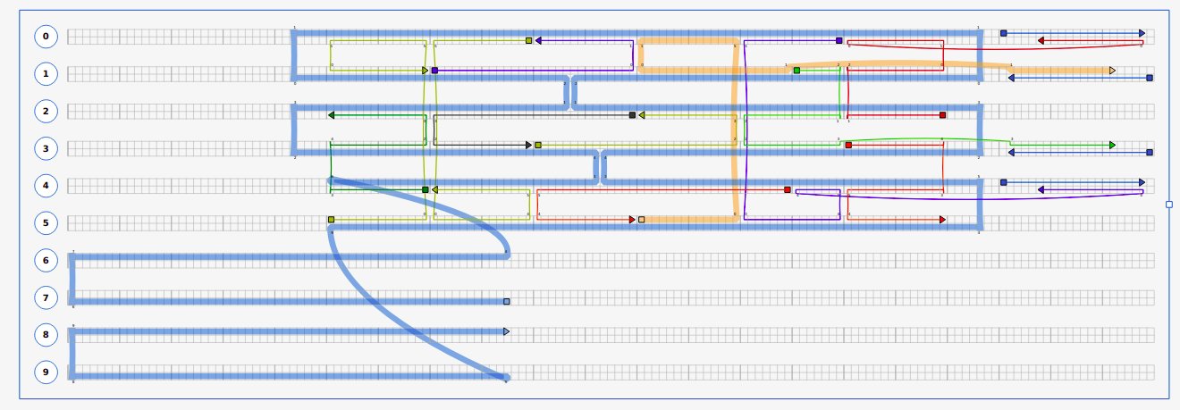
cadnano designs: with connectors
1 connector:
3 connectors:

Slide 17
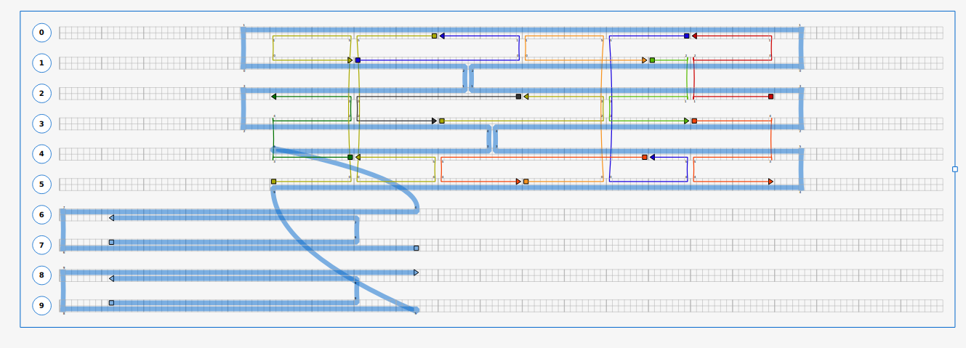
cadnano design: with cinches
Spacer is number of nt at the end of the pore. I compared 5 to 10

Slide 18
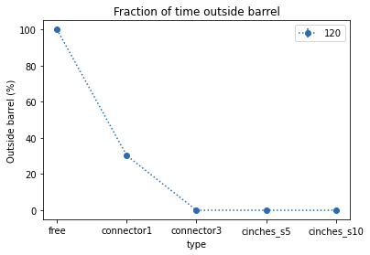
Results: Fraction of time outside the pore
1 connector is large improvement from free pore but not perfect
Conn3 and cinches perfect at keeping pore in the barrel
Different to experiment where cinches don't work
Discrepancies with experiment:
Maybe pore folds facing up
Or folds outside barrel

Slide 19
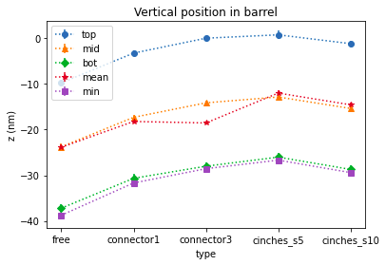
Results: Vertical position of pore (32nm = end)
All cinch and connector configurations raise bottom of pore above bottom of barrel.
Cinches s5 is most rigid constraint
Cinch s10 is comparable to 3 connectors
1 connector is least firm holding of pore

Slide 20
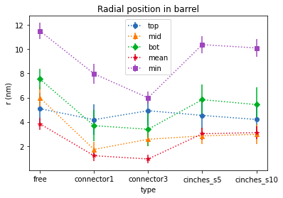
Results: Radial position of pore
Connectors hold the pore more tightly towards the centre of the barrel
Cinches hold pore towards centre of barrel but no difference s5 vs s10
Pore has net tilt outward
I.e. r bottom > r top

Slide 21
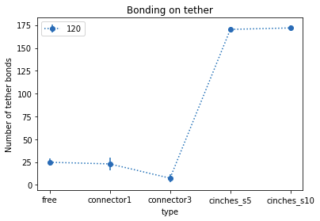
Results: Number of tether bonds
Note: Cinch-tether bonds includes bonds between cinches and tether
Free has similar number of bonds to 1 connector
3 connectors has less bonds than free (less room to move)
Even though number of cinch-tether bonds is same in design s5 has less bonds
Implies s5 is not long enough

Slide 22
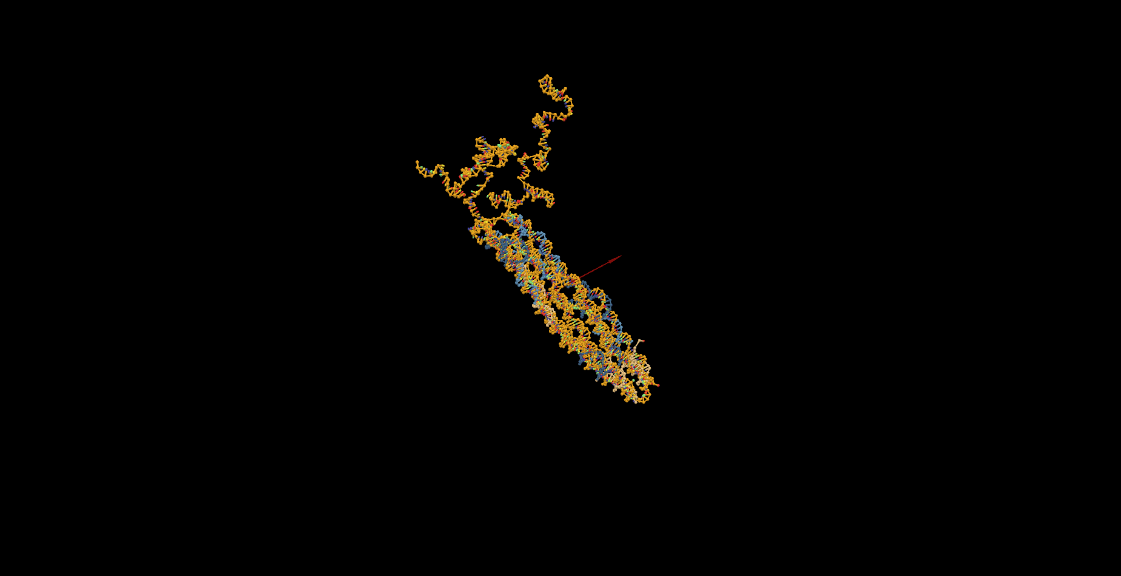
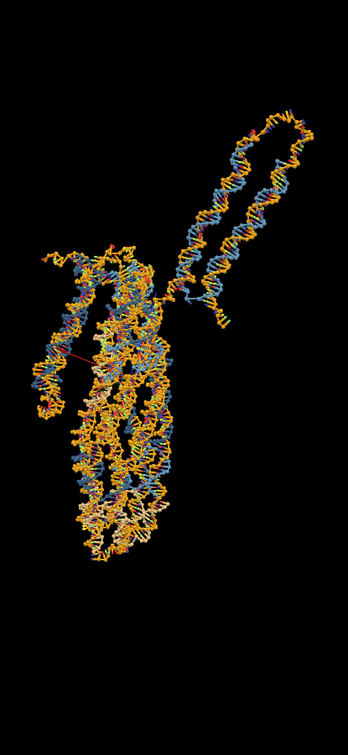
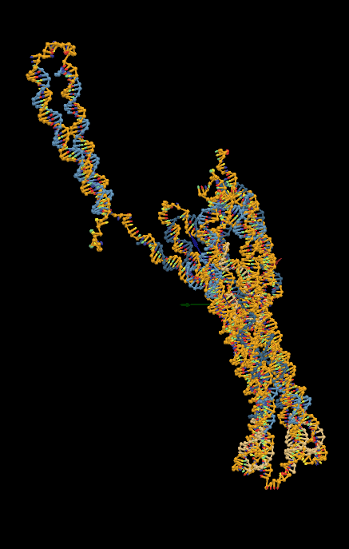
Videos: Free vs cinches
Free
Cinch: spacer 5
Cinch: spacer 10

Slide 23
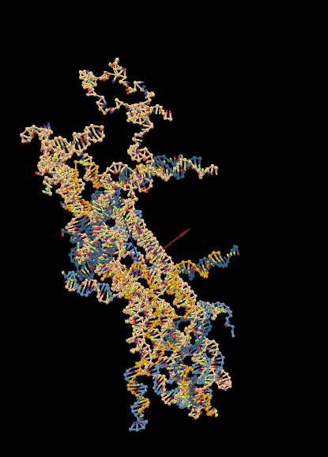
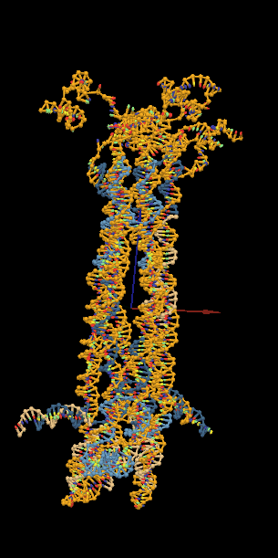
Videos: Free vs connectors
Free
1 connector
3 connectors

Slide 24
Question 3: Can the pore flip within barrel?

Slide 25
Side question: Can the pore flip?
Method: Used forces to try and flip the pore:
Applied upwards force to all nucleotides below tether docking height
F = k (z – z0) : where z0 is height of tether docking location
Increased strength of force until the pore structure is destroyed
Tried with tether lengths 15 and 120
Result:
Only "destroyed" pores were able to flip
Appears not

Slide 26
Summary
Tether length and sequences
As length is increase pore lives closer to centre of the barrel
Above length of 50bp pore is outside barrel most of the time.
The differences between mobility for different sequences doesn't appear to be very significant.
Longer tethers form more base pairs, effectively shortening tether length
Cinches vs connectors:
Cinches seem to keep pore 100% in a barrel. Shorter spacer is better
3 connector levels keeps pore inside barrel. 1 connector outside barrel 40% of time
Free pore outside barrel 100% of time for this length
Pore flipping doesn't seem to occur but can the pore fold upside down in experiment?

Slide 27
Outlook
Can I understand why cinches don't work experimentally but do in simulation?
Can I simulate docking of pore, or transitions between configurations?
Simulate other pores (e.g. a longer version of the pore
Any other ideas?

