Slide 1
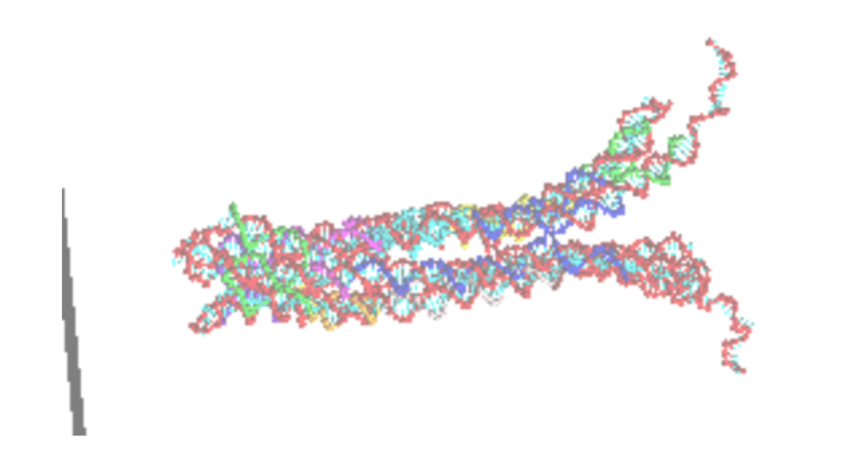
oxDNAlien:
Cinches and Connectors Analysis
JOEL HOCHSTETTER
18-12-20

Slide 2
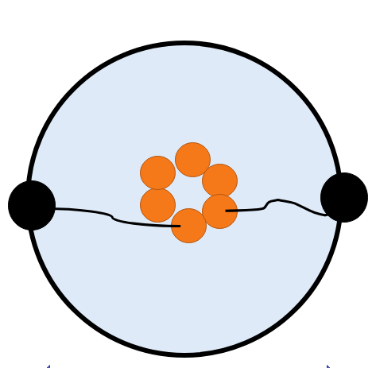
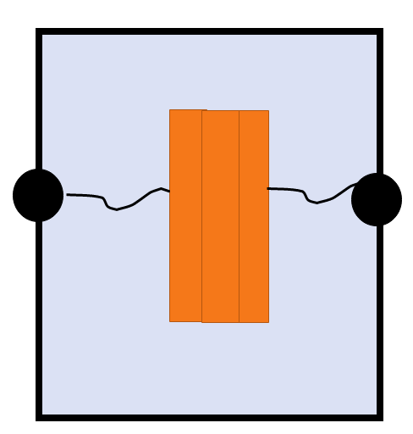
Set-up revisited
Force cylinder (details next slide) constrains barrel
End nucleotides of the tether are fixed to a certain position. Harmonic force on these nt (F=kx, with k = 600 pN/nm). These nt stay within 0.4nm of fixed location in simulations
Side view
Top view
θ
z
52nm
r
18 nm

Slide 3
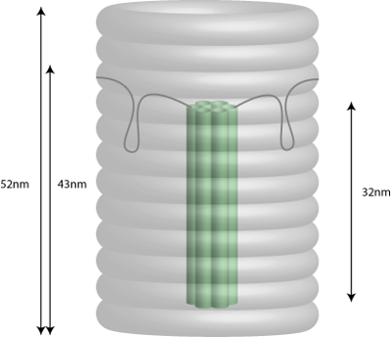
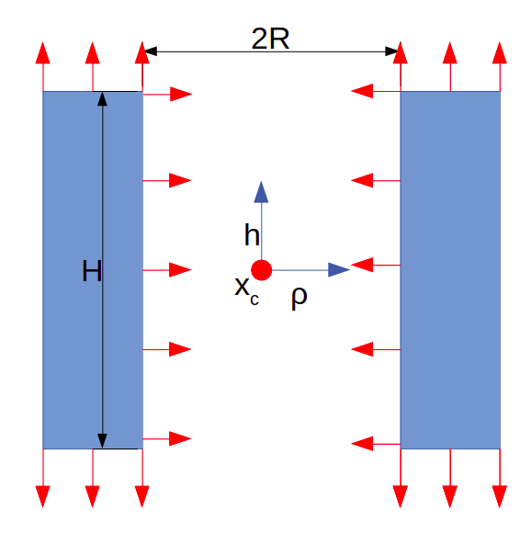
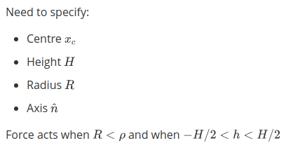
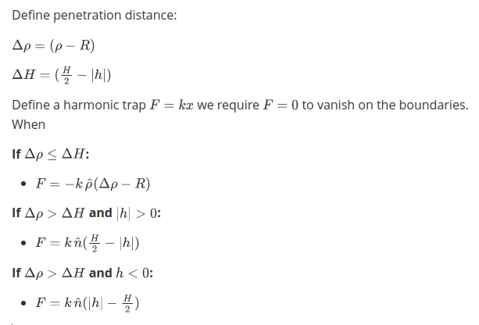
Set-up: Nature of the "barrel" force
The force acts when nucleotides are inside the barrel. Red arrows indicate directions
Treat as harmonic force (F=kx).
Limitations
Force vector is discontinuous at border of barrel: Magnitude is continuous but direction is not
Barrel has infinite outer diameter

Slide 4
Quantities of interest
z-position relative to tether docking height and radial position for
Bottom nucleotide on pore
Middle nucleotide on pore
Top nucleotide on pore
Minimum nucleotide on pore
Average over all pore nucleotides
Fraction of time that pore is visible (taken from minimum nucleotide)
Number of bonds formed in tether
Bond defined as H bonding energy < -0.1 SU of energy (4.1e-21 J)
Follows convention from oxDNA website

Slide 5
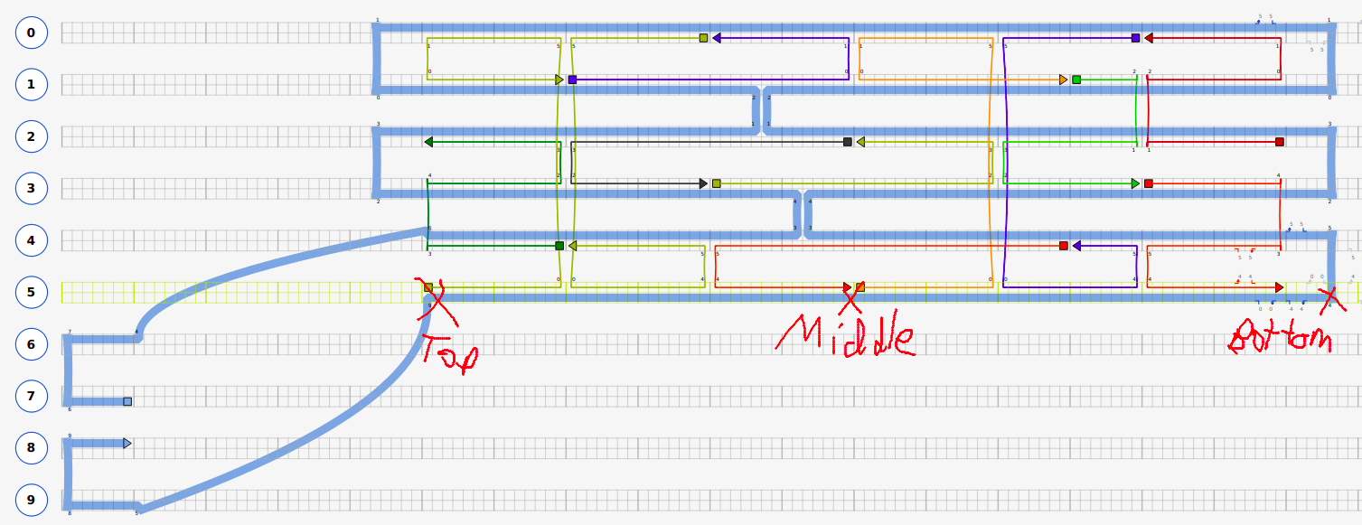
Cadnano design: 190604_TC_pore_cinch1.json
Definitions of nucleotides: top, middle, bottom is shown
Shown has tether length = 15nt (total of 30 tether nucleotides, 15 on each side of pore). This is varied.

Slide 6
Question 1: Why don't variations of cinches work?

Slide 7
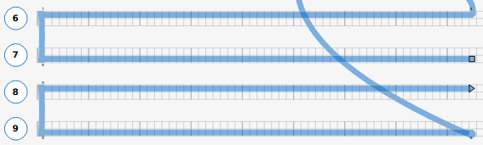
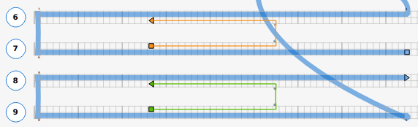
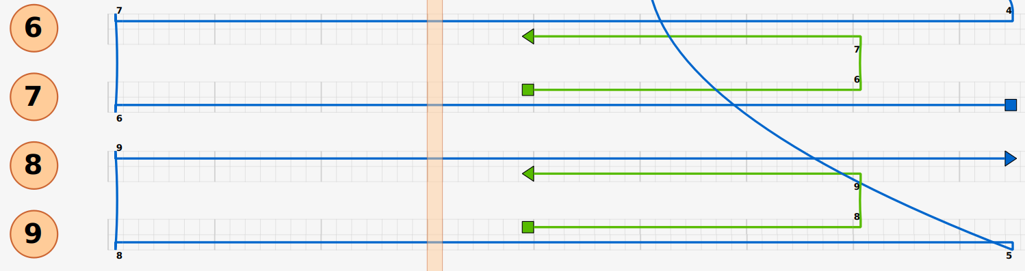
Cinch variations
free
free
42x2, s4
42x2, s6
46, s10
42x2, s0
42, s42
42, z42
z42x2
Cinch length
42, s42
Spacer length
46, s10

Slide 8
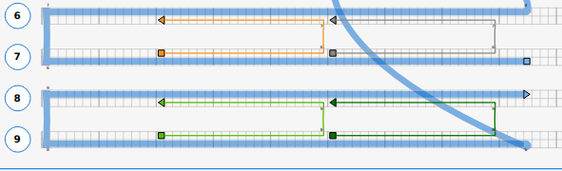
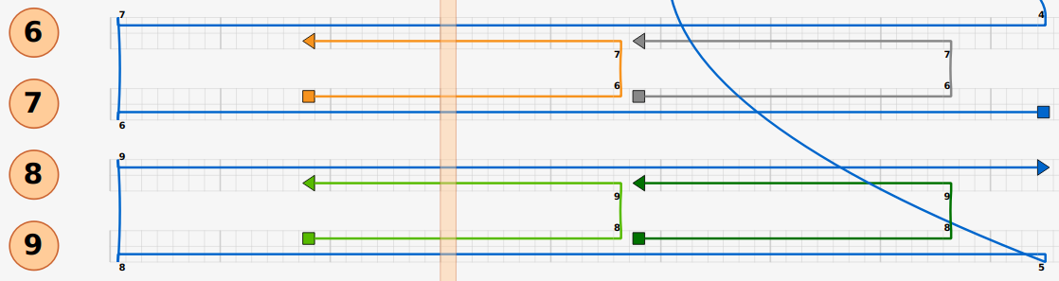
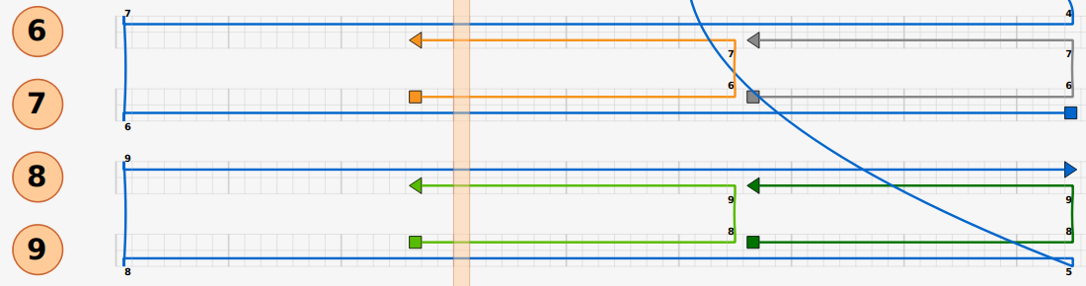
Cinch variations: different length + spacers
42x2, s4
42x2, s6
42x2, s0

Slide 9
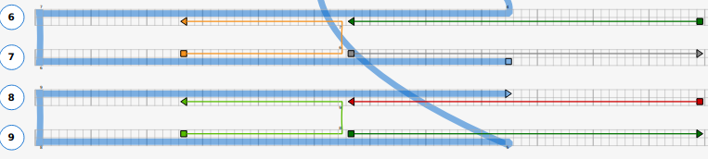
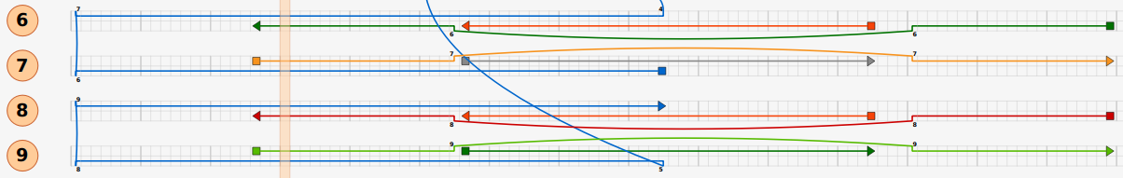
Cinch variations: one-sided
42, z42
z42x2

Slide 10
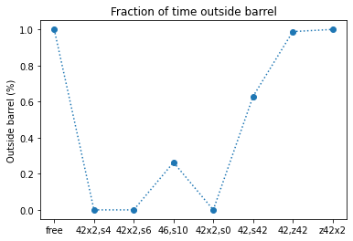
Cinch results: fraction outside barrel
Cinches work provided spacing at the end isn't too high
One sided cinches don't work (99-100% of time outside)

Slide 11
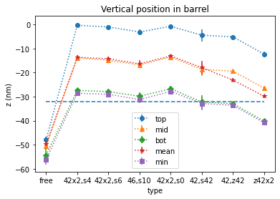
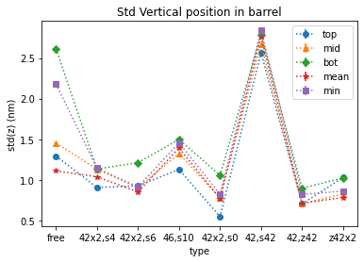
Cinch results: vertical positions
Cinches work in simulations, but not one-sided versions
High variability is 42,s42 (possibly undersampled). Less constrained than z42 unexpected

Slide 12
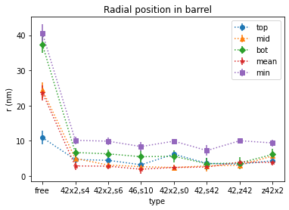
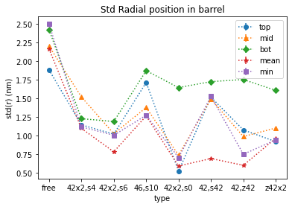
Cinch results: radial positions
Radial constraints comparable for all cinches
Free pore spends most of time outside the barrel at high radius

Slide 13
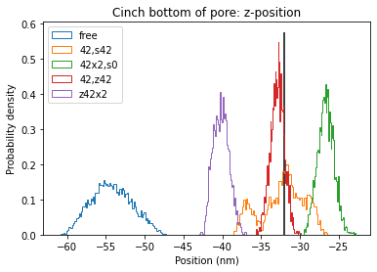
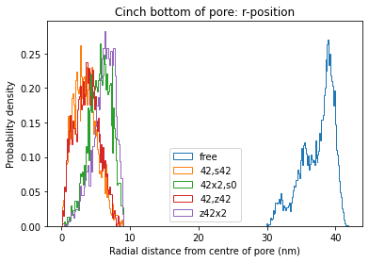
Cinch results: position histograms
Cinches reduce spread of distribution
Location / type of cinches change equilibrium position
Bimodal for s42: suggests two states maybe?
Skew depends on occurrence of inner cinch
Any cinches constrain pore radially (within barrel r)

Slide 14
Cinches: future work
Start with no cinches and estimate ratio that end up in each of the configurations
Get to bottom of s42 anomaly

Slide 15
Question 2: Which connectors configuration is optimal?

Slide 16
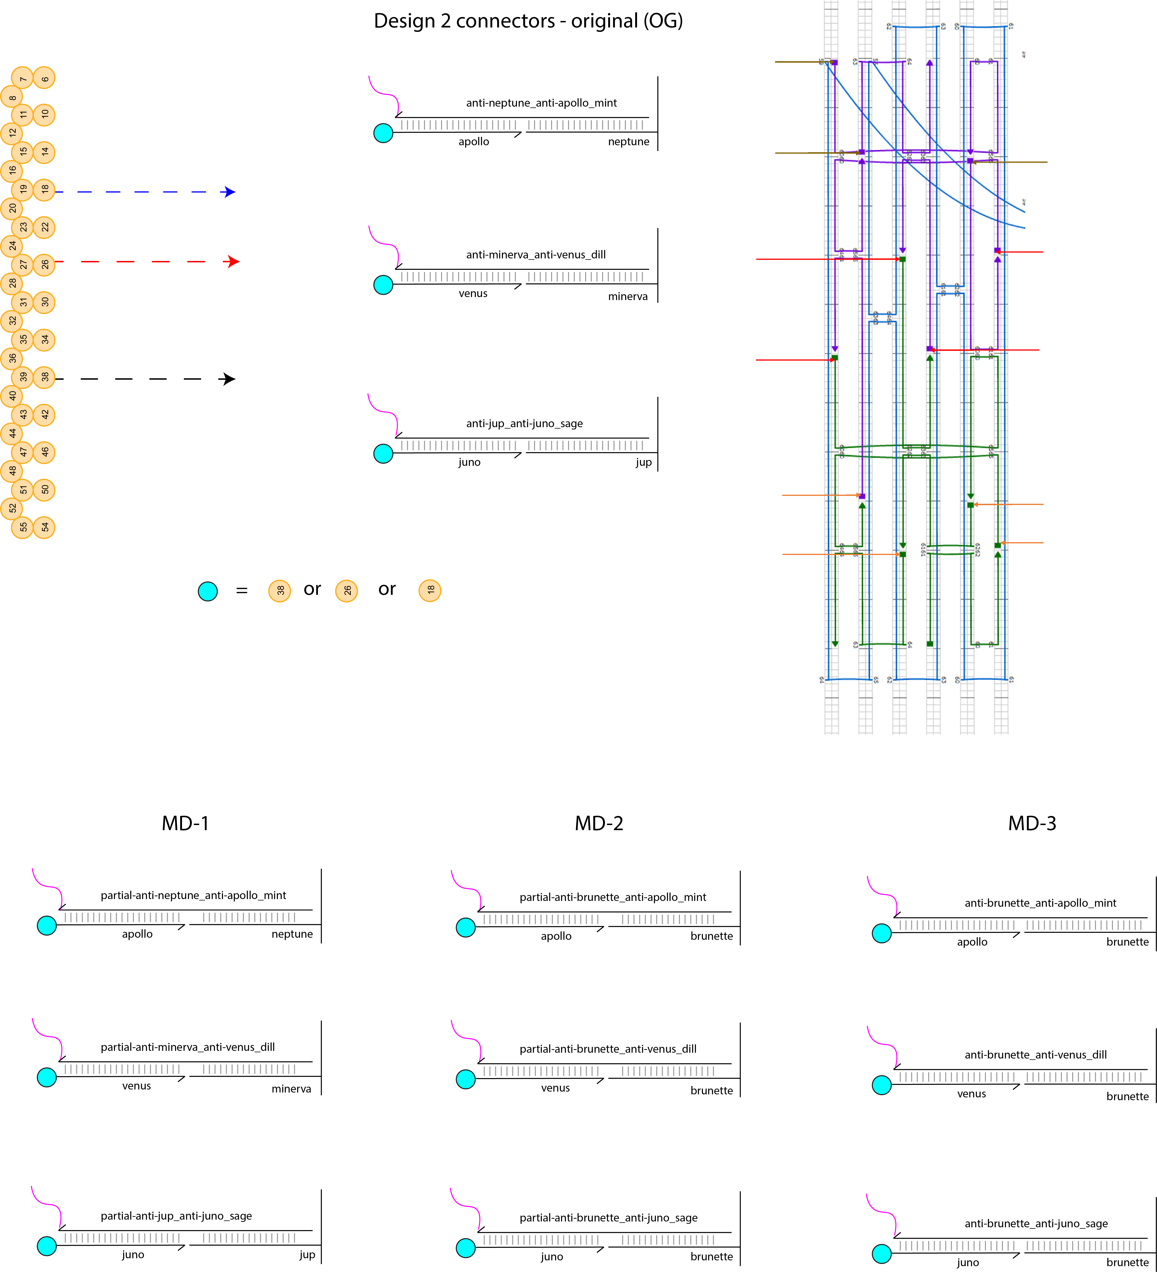
Connectors set-up

Slide 17
Connectors sequences
MD0
anti21-anti21. Same seqs MD1
MD1
separate9-anti10-separate2-anti21
MD2
separate9-anti10-separate2-anti21.
MD3
anti21-anti21. No spacer

Slide 18
Connectors: Simulation protocol
Initialize design with no connectors
Simulate ~100 us x 20 different seeds
Take one of these simulations.
Simulate another ~100 us x 20 different seeds

Slide 19
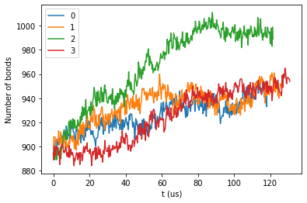
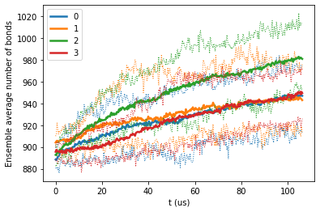
Conn Results: far-from-equilibrium relaxation
Single instance
Averaged over ensemble
Noticeable transitions between states
(I.e. jump in no. Bonds by ~21bp)
Thin lines are maximum and minimum of ensemble
MD2 transitions towards "docked" much quicker

Slide 20
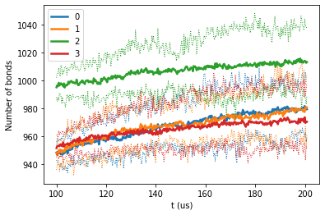
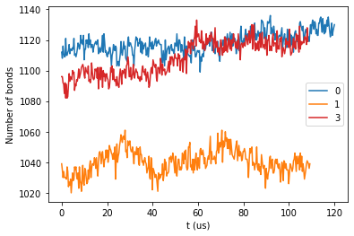
Conn Results: relaxation later times
Compared with started in "docked" configuration
Still not relaxed after 2-week sim time

Slide 21
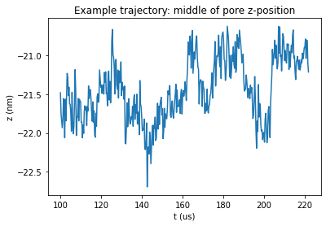
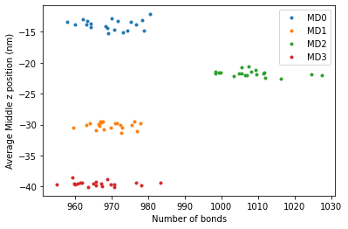
Conn results: example trajectory
Not sampled long enough for results to be meaningful
e.g. for MD2
Locations are very correlated to initial position
Even 2 week sampling time is not enough

Slide 22
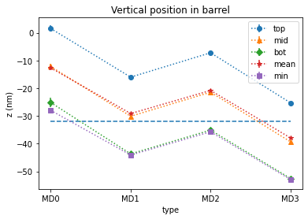
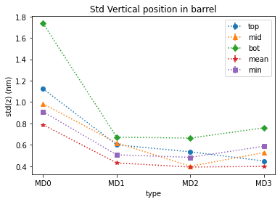
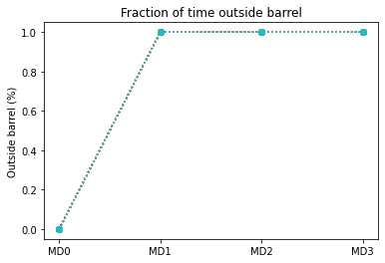
Conn Results: vertical position
From this: MD0 ok and MD1-3 not ok
But actually, this can be explained by bonding and correlations

Slide 23
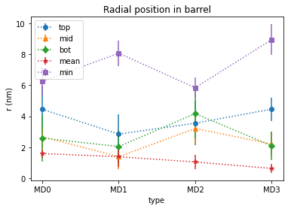
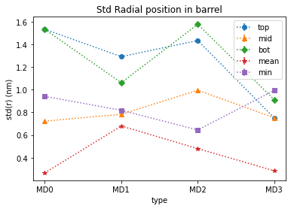
Conn Results: Radial position

Slide 24
Connectors: to do
Run for longer to get to "docked" states
Continue with same seed each time so results decorrelate
Try and speed up by changing Monte Carlo time-step, or using Molecular Dynamics
Take a different approach:
Start in docked configuration and sample over states

Slide 25
Summary
Cinches work if initialized correctly
Do not work if "one-sided" connections form
Connectors:
MD2 forms connector bonds (transitions to locked state) much more quickly than the others
Needs even longer simulation time to obtain experimentally comparable results

Slide 26
Future
Write summary of how oxDNA simulations work
Fixing anomalous datapoint (42, s42)
Probability of transition to different cinch states
Test different numbers of connectors at each level (3-4-4 instead of 6)
Test other sequence variations of MD2 (Blonde, Jupiter, Minerva, Neptune, imotif, Gquad)
Anything else?

Slide 27
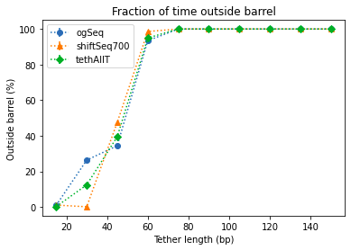
Past results: Changing tether lengths
Fraction of time outside barrel increases with increasing tether length
Above length ~ 50 the pore spends almost 100% of its time outside the barrel
Some differences by sequence but no clear trend

Slide 28
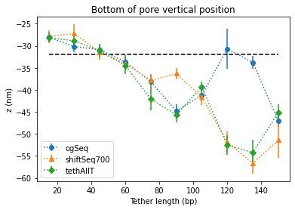
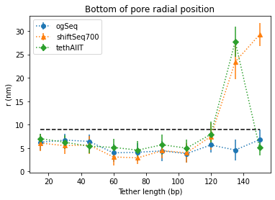
Past results: Average location bottom of pore
Z-position decreases as tether length increases
Radial position no significant changes for pore inside barrel.
At long tether lengths pore can dangle over side of barrel (higher radius)

