Slide 1
Language Classification

Slide 2
Problem Statement
How accurately can we classify different languages?

Slide 3
Solution
Model was successfully predicting language based on user input’s text

Slide 4
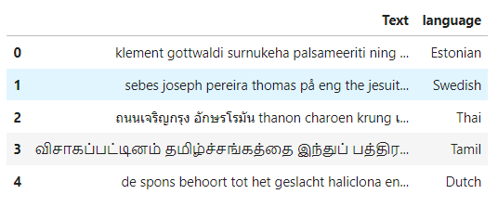
Data
Source: https://www.kaggle.com/search?q=language+detection

Slide 5
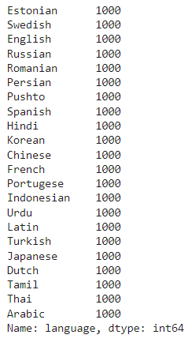
Data Summary
There are 22 different languages
Each languages contain 1000 different text message

Slide 6
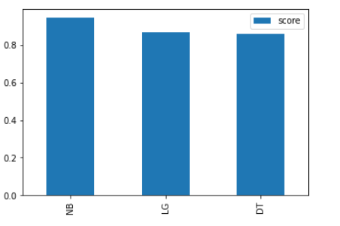
Model
3 models were used
Logistic regression
Decision Tree Classifier
Multinomial NB

Slide 7
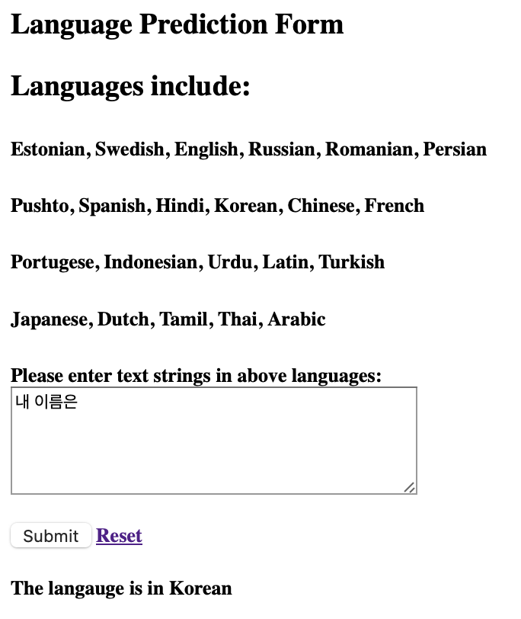
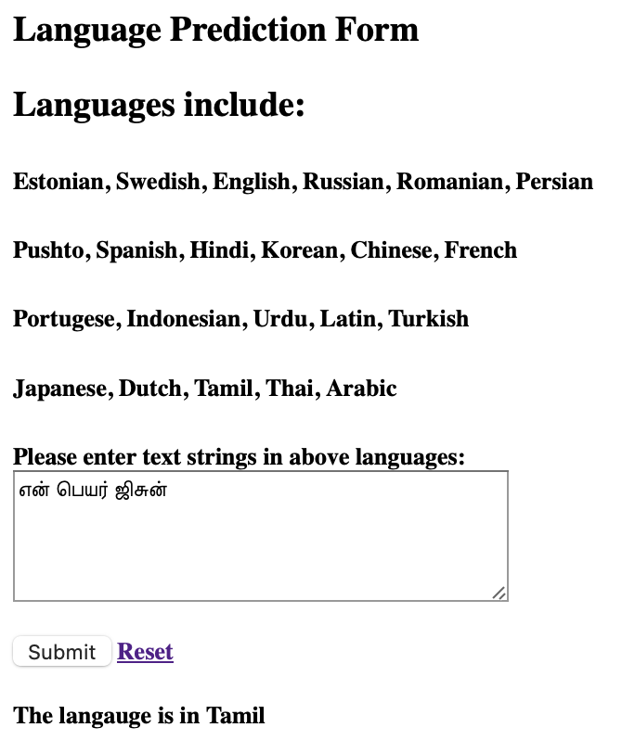
Simple App Interface

Slide 8
Future Study
Adding more variety of text in more languages
Maybe can translate from one language to another?

Slide 9
Conclusion
This project was a success
The app was able to detect the language of input text
We can further develop the app to support more languages and more functions

