Slide 1
IT Ticket Analysis
~ Joel Iman A

Slide 2
Problem Statement
How can we optimize IT support operations using insights derived from ticketing data?
Our goal is to identify inefficiencies, assess agent performance, and guide decisions on staffing and training.

Slide 3
About the Data
The dataset includes IT ticket logs from 2016 to 2020.
It covers attributes like ticket ID, category, resolution time, priority, satisfaction rating, severity, and agent details.

Slide 4
KPI & Filter Overview
• Total Tickets: 97,498
• Avg. Satisfaction Rate: 4.1
• Total Agents: 50
Interactive slicers: Priority and Year

Slide 5
Count of Ticket IDs Over Time
This column chart tracks the number of tickets created each year from 2016 to 2020. There is a noticeable upward trend, with the highest volume seen in 2020. This indicates increasing demand for IT support services and helps forecast future workload and resource planning.

Slide 6
Ticket Count by Request Category
This chart displays the distribution of tickets across various request types such as hardware, software, and access-related issues. It helps identify which categories receive the most support requests, allowing IT managers to focus improvements and resource allocation where it matters most.

Slide 7
Satisfaction Rate by Time
This line chart shows the trend of average satisfaction rates over the years. A steady improvement in satisfaction scores indicates that service quality is increasing. This can help justify investments made in support processes and guide further refinements.

Slide 8
Avg. Resolution Time by Category (Quarter-wise)
This chart provides a breakdown of how quickly tickets in each category are resolved across different quarters. Categories with consistently high resolution times may require workflow optimizations, automation, or targeted training to improve efficiency.

Slide 9
Satisfaction Rate by Age Group
This chart compares average satisfaction scores among different age groups of employees. Notable variations across groups may highlight the need for personalized support experiences, especially if older or younger users express lower satisfaction.

Slide 10
Ticket Count by Severity
This bar chart illustrates the number of tickets by their severity level ranging from minor to urgent. Most tickets fall under the “Normal” category, while only a few are marked “Urgent.” This can help in prioritizing tickets and ensuring urgent ones receive prompt attention.

Slide 11
Ticket Count by Priority
This chart shows the number of tickets by their assigned priority level. A large proportion of tickets remain unassigned or marked with low priority, which could suggest delays or inefficiencies in triaging and ticket management. Addressing this can improve overall responsiveness.

Slide 12
Distribution of Satisfaction Score
This histogram represents how satisfaction scores are distributed across all tickets. It provides a clear view of user sentiment, whether it's generally high, low, or scattered. This helps assess the consistency of service quality and user experience.

Slide 13
Distribution of Resolution Time
This chart displays how ticket resolution times are spread across different time buckets. It shows whether most tickets are resolved quickly or if there is a long tail of unresolved or delayed issues. This helps identify areas that need efficiency improvements.

Slide 14
Key Takeaways
Ticket volume peaked in 2020, showing rising support demand.
System and Login Access were the most frequent issue types.
Satisfaction scores improved steadily over the years.
Hardware/System issues had the longest resolution times.
Many tickets were left “Unassigned” in priority classification.
Younger and older agents showed higher satisfaction performance.

Slide 15
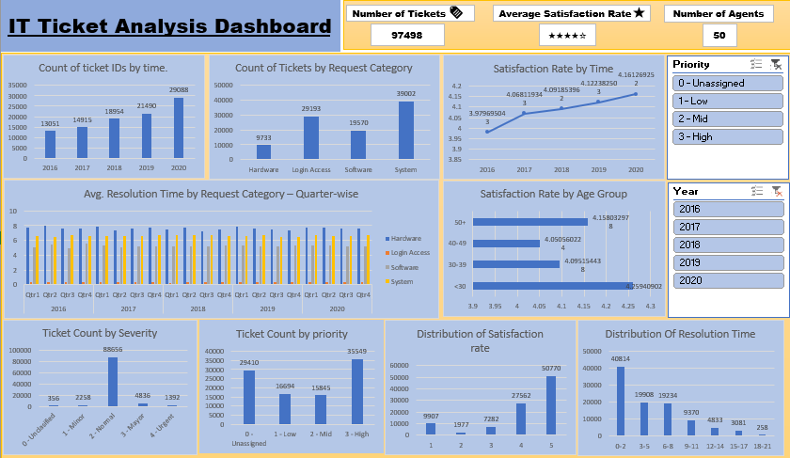
Final Dashboard

Slide 16
Conclusion
Ticket volumes are rising, highlighting the need for scalable IT support
processes.
Satisfaction scores are stable overall but vary significantly among agents.
Certain agents face high workloads, indicating a need for better workload
distribution.
Mismatches between ticket priority and severity expose inefficiencies in the
system.
Focused training for underperformers can improve resolution time and
satisfaction.
Investing in process improvements and tool upgrades will boost long-term
performance.

