Slide 1
ZEPHYR Weather Station with air quality Measurement for environmental aerial condition study
GROUP 10
TEAM MEMBERS
JOEL JACKSON JOHN AJC21EC048
DENIL C VARGHESE AJC21EC038
BINU AJMAL SHAH AJC21EC034

Slide 2
CONTENTS
INTRODUCTION
OBJECTIVE
BLOCK DIAGRAM
NOVELTY
CIRCUIT DIAGRAM
COST OF MATERIALS

Slide 3
INTRODUCTION
The primary goal is to create a sophisticated, adaptive, and connected system that goes beyond traditional fire detection methods .
By empowering users with timely information, the system aims to facilitate effective decision-making during emergencies, contributing to enhanced overall safety and well-being.
Additionally, it incorporates a weather station to enhance fire risk assessments and improve overall safety measures.
It aims to empower users with timely information for effective decision-making during emergencies.

Slide 4
OBJECTIVE
Air Quality Monitoring: The objective of the pollution detection and notification system using ESP32 is to create a device capable of monitoring air quality and alerting users when pollution levels exceed predefined thresholds.
Early Warning System: Provide an early warning to occupants in case of a potential fire hazard, allowing them to take prompt action and evacuate the premises.
Remote Monitoring: Enable remote monitoring of the smoke detector status and alerts through the ESP32, allowing users to receive notifications on their mobile devices or other connected platform.
Multi-Sensor Capabilities: Incorporate additional sensors, such as temperature and humidity sensors, to enhance the overall fire detection capabilities and provide a more comprehensive view of the environment.

Slide 5
Review Of Literature
Survey of the Existing Methods in Air Quality Measurement Devices
Sl. no | Authors | Title | Journal/Year of Publication | Method | Performance Parameters Noticed
1 | Mohamad Syafiq Mohamad Adenan, et al | Smart Smoke Detector | https://doi.org/10.36079/lamintang.ijortas-0301.198, March 2021
2 | Nikhil Komalapati, et al | Smart Fire Detection and Surveillance System Using IOT | 2021 International Conference on Artificial Intelligence and Smart Systems (ICAIS)
3 | Uddesh U Naik et al | Iot Based Air Pollution Monitoring System | International Journal of Scientific Research & Engineering Trends Volume 9, Issue 3, May-Jun-2023
4 | V. Hura, L. Monastyrskii | IoT-Based Solution for Detection of Air Quality using ESP32 | ISSN 2710 – 1673 Artificial Intelligence 2023
5 | Umar Muhammad et al | Environmental Condition Measurement system with a Station using ESP32 | Vol. 21 No. 1 (2023): MEDIA ELEKTRIK

Slide 6
PROPOSED METHOD

Slide 7
BLOCK DIAGRAM
Cloud Server
Monitor
Gas Sensor
ESP32
Personal Computer
Barometer
Wireless Router
Excel File
Smartphones
Temp. and humidity

Slide 8
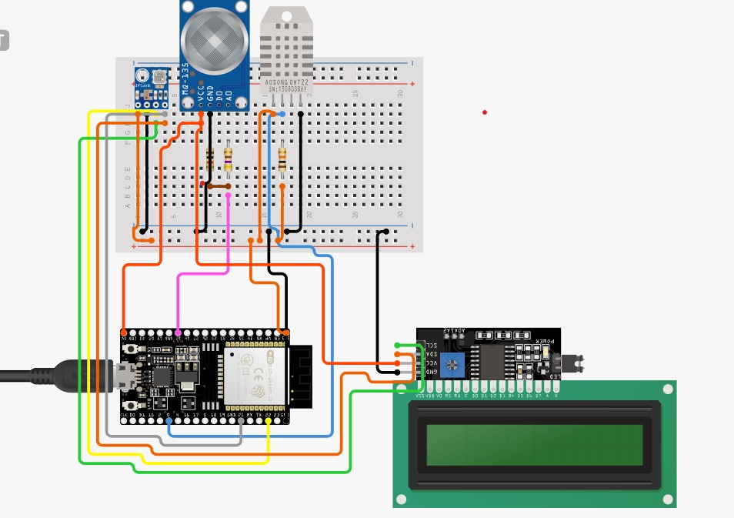
CIRCUIT DIAGRAM

Slide 9
DESCRIPTION OF COMPONENTS
ESP32:The ESP32 is a versatile, low-cost, and power-efficient microcontroller with built-in Wi-Fi and Bluetooth capabilities, widely used for IoT applications.
MQ135:The MQ135 is a gas sensor module capable of detecting a variety of air pollutants, commonly used for monitoring air quality in IoT applications.
DHT11 Sensor: The DHT11 is a basic and cost-effective digital temperature and humidity sensor widely used in various electronic projects.
BMP180:The BMP180 is a barometric pressure and temperature sensor, commonly employed for precise altitude measurement in weather and altitude-sensing applications.

Slide 10
NOVELTY
IoT Connectivity: The novelty of the above smoke detector lies in its integration of modern IoT technology, specifically the ESP32 microcontroller, for efficient smoke detection and alerting.
Real-time Data Visualization: Develop a real-time data visualization dashboard, providing users with graphical representations of air quality, temperature, and other relevant data captured by the smoke detector.
Customizable Alert System: Provide users with the ability to customize the alert system, allowing them to set different notification preferences based on the severity of the detected smoke or fire conditions.
Environmental Monitoring: Extend the functionality of the smoke detector by incorporating weather station capabilities using the ESP32 to monitor ambient environmental conditions such as temperature, humidity, and air pressure.

Slide 11
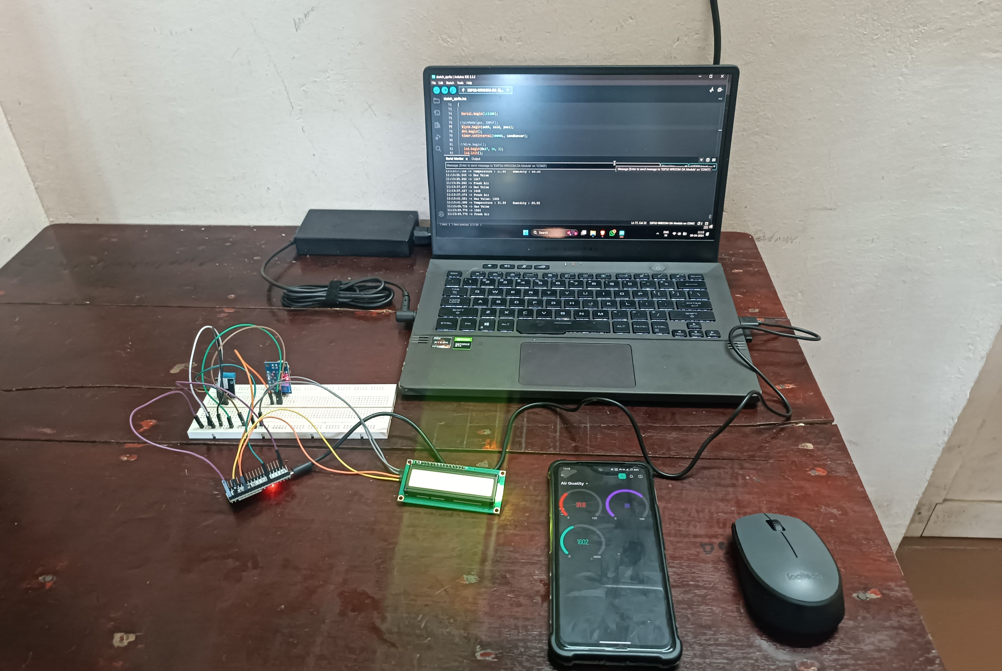
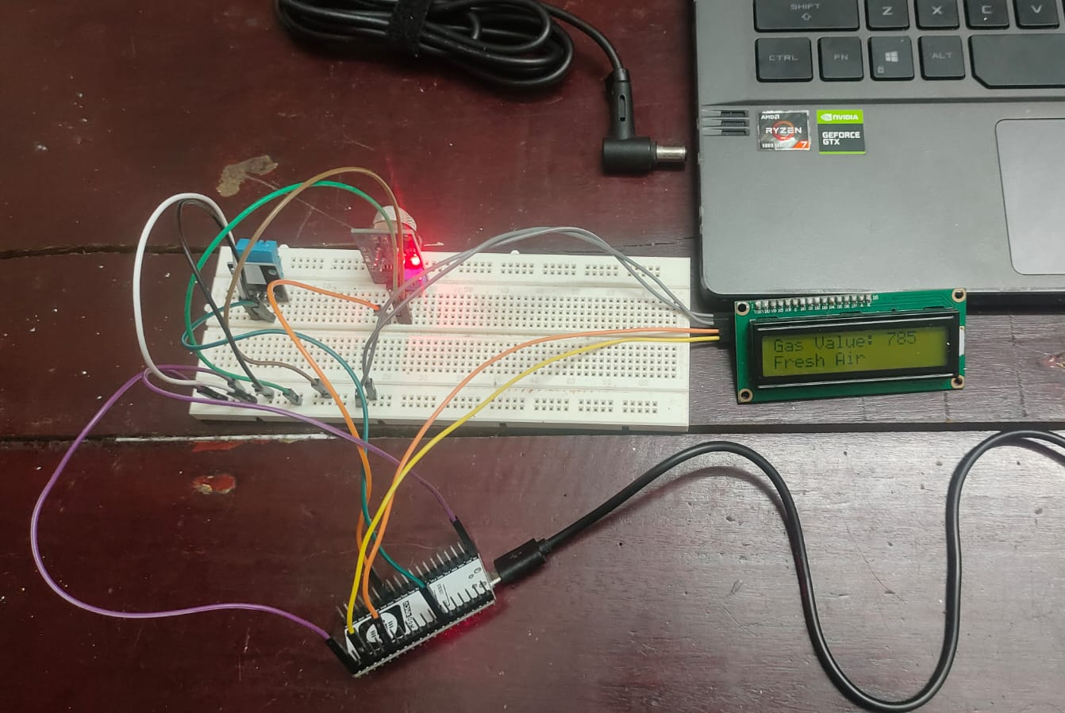
RESULT
https://youtu.be/Qz9ptWYsETY?feature=shared

Slide 12
CONCLUSION
In conclusion, the air quality monitoring system utilizing ESP32, DHT11, MQ135, and Blynk IoT Cloud offers valuable real-world applications. By providing accurate and real-time data on air quality parameters like temperature, humidity, and pollutant levels, it empowers individuals, communities, and industries to make informed decisions regarding health, environmental impact, and safety measures. This system can find applications in various settings including smart homes, offices, industrial facilities, and urban planning, contributing to better overall air quality management and public health outcomes

Slide 13
REFERENCES
Mohamad Syafiq Mohamad Adenan, et al. “Smart Smoke Detector”, https://doi.org/10.36079/lamintang.ijortas-0301.198, March 2021
In recent decades, numerous studies have focused on enhancing security systems across various domains. A critical challenge faced by security measures is the threat of fire outbreaks in diverse settings such as homes, schools, and factories. To address this concern and mitigate potential damages, the integration of Internet of Things (IoT) technology has become pivotal. This modern system utilizes sensors and switches interconnected for efficient monitoring. Employing an Arduino device alongside a temperature sensor (Flame sensor), this project aims to promptly detect and measure heat intensity in the event of a fire, serving as an early alarm system. This proactive approach is crucial given the time constraints associated with traditional fire station response times. The sensors play a pivotal role in providing timely notifications to mobile phones, enabling swift and informed action to prevent extensive damage in the event of a fire outbreak

Slide 14
Nikhil Komalapati, et al. “Smart Fire Detection and Surveillance System Using IOT”, 2021 International Conference on Artificial Intelligence and Smart Systems (ICAIS)
Fire stands as the most prevalent cause of tragic fatalities, resulting in numerous injuries and a significant surge in death tolls annually. The proposed detection system aims to safeguard individuals from fire hazards by triggering an alarm during emergencies. This involves sending warning messages to a Telegram account, identifying ESP32 movements online and notifying cellphone users. Customization is achieved through the Arduino IDE. A Telegram bot, created for ESP32, utilizes PIR sensors to issue warning messages via a Telegram account, detecting any movement. Additionally, fire sensors identify visual cues and temperature changes to activate alarms through the Telegram channel.

Slide 15
Uddesh U Naik et al. “Iot Based Air Pollution Monitoring System”, International Journal of Scientific Research & Engineering Trends Volume 9, Issue 3, May-Jun-2023
Human health can be significantly impacted by exposure to ambient air pollutants. Consequently, each country establishes health-based standards for specific air pollutants, underscoring the growing importance of detecting and measuring atmospheric contents. Meticulous planning of measurements is crucial, with monitoring station locations being a key factor influencing data representativeness. However, the complexity and substantial costs associated with planning and establishing these stations pose challenges. Air pollution, stemming from increased industrial activities, adversely affects daily life and ecosystem health, highlighting the urgent need for air quality monitoring. This project introduces an IoT-based air pollution monitoring system, classifying geographical areas into industrial, residential, and traffic zones. The system can be deployed at any location, storing measured values in a cloud database, conducting pollution analysis, and displaying pollution levels in real-time.

Slide 16
V. Hura, L. Monastyrskii, “IoT-Based Solution for Detection of Air Quality using ESP32”, ISSN 2710 – 1673 Artificial Intelligence 2023
Air pollution, a global public health crisis, presents a pressing challenge to human well-being, the environment, and the economy. Addressing its adverse effects requires advanced solutions for accurate air quality monitoring. This proposal introduces a real-time IoT-based system, utilizing ESP32 and multiple sensors for various pollutants like CO2, PM2.5, PM10, VOCs, NO2, O3, and SO2. The ESP32's seamless data transmission to cloud servers enables remote monitoring, while its modular design allows versatile deployment in residential, commercial, and industrial settings. The system is complemented by a user-friendly interface, fostering environmental awareness and informed decision-making. Regular maintenance ensures continued accuracy and reliability in real-time air quality management.

Slide 17
Umar Muhammad et al. “Environmental Condition Measurement system with a mini Weather Station using ESP32”, Vol. 21 No. 1 (2023): MEDIA ELEKTRIK
Understanding weather conditions is crucial for diverse human activities, impacting agriculture, infrastructure, hydrology, and more. This study focuses on a mini weather station designed to report wind speed, temperature, humidity, and solar radiation. Utilizing sensors like DHT11, anemometer, and pyranometer, the research reveals a 1.4% error for DHT11 indoors, rising to 9% outdoors. The pyranometer exhibits a 3.62% error in direct solar radiation measurement. However, the wind speed sensor's instability signals the necessity for future improvements in research and technology

Slide 18
SL. NO. | COMPONENTS | QUANTITY | COST OF MATERIAL
1. | ESP32 | 1 | Rs 799/-
2. | BMP180 | 1 | Rs 37/-
3. | LCD 16*2 I2C | 1 | Rs 159/-
4. | MQ135 | 1 | Rs 102/-
5. | DHT22/11 | 1 | Rs 66/-
6. | 470 Ohm Resistor | 1 | Rs 2/-
7. | 1k Ohm Resistor | 1 | Rs 2/-
8. | 10k Ohm Resistor | 1 | Rs 2/-
9. | USB Micro-B cable | 1 | Rs 99/-
 |  | TOTAL | Rs 1269/-

Slide 19
THANK YOU

