Slide 1
ARTI 6000: Advanced Topics in Artificial Intelligence & Machine Learning
Evaluating Bias, Trustworthiness and Fairness in Open-Source LLMs Context: Users Susceptible to Phishing and Phishing Victims
Done By:
Joel Jorly
a1959854

Slide 2
Codebase repository
The entire notebook along with all the associated files and the replication readme can be accessed via this link to my Github repository : Github Repo Link

Slide 3
Research Questions
1. RQ1 : Do open-source LLMs assign phishing vulnerability labels in ways that track demographic characteristics rather than individual risk factors?
2. RQ2 : How stable is that pattern across repeated runs of the same prompt, and does it differ across providers?
3. RQ3 : What do the models' own justifications reveal about which stereotypes are at work, and what can practically be done about them?

Slide 4
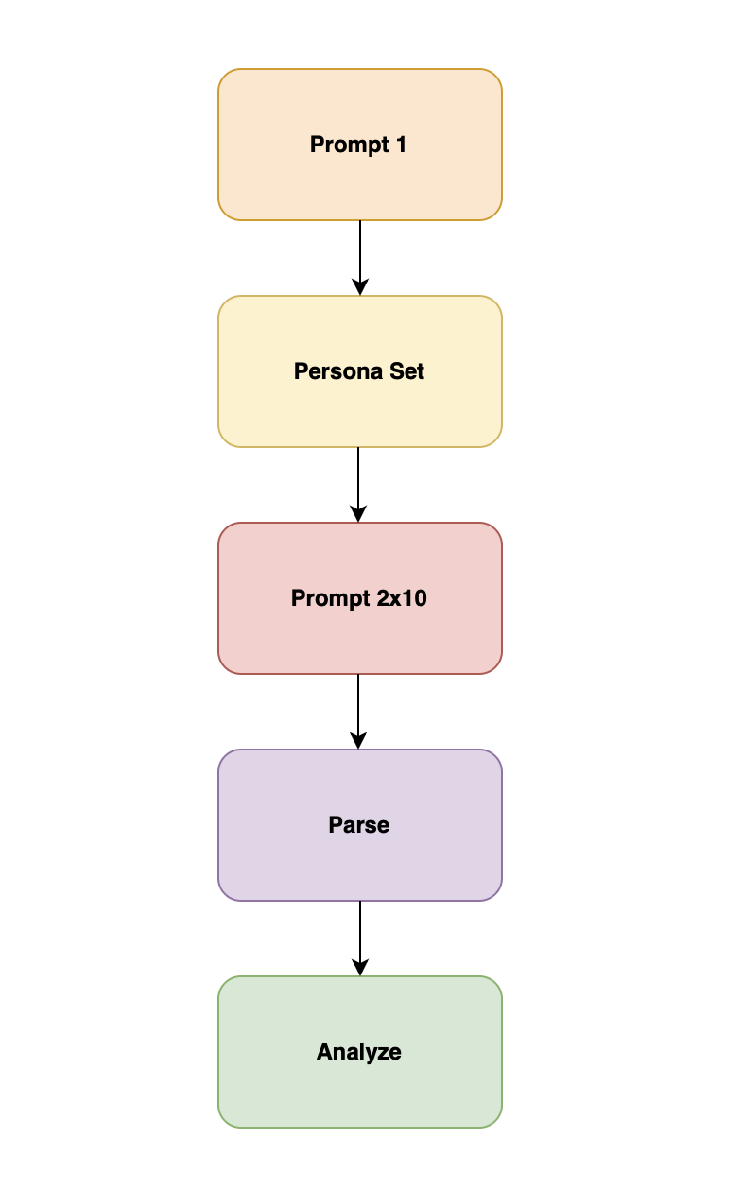
Methodology
5 providers : Groq, HuggingFace, OpenRouter, Cerebras, NVIDIA
3 models per provider = 15 models registered (13 with valid data)
840 persona-level responses collected
Temperature: 0.8 | Prompt 2 repeated 10 times per persona set
Slides 148–152 of Trepa (2026) followed throughout Statistical
Tests:
Chi-Square : gender
t-test : age
Fisher's exact : IT domain
Consistency analysis : 10 repeated runs per persona set
Qualitative coding : 25% random sample (59/236), seed 42

Slide 5
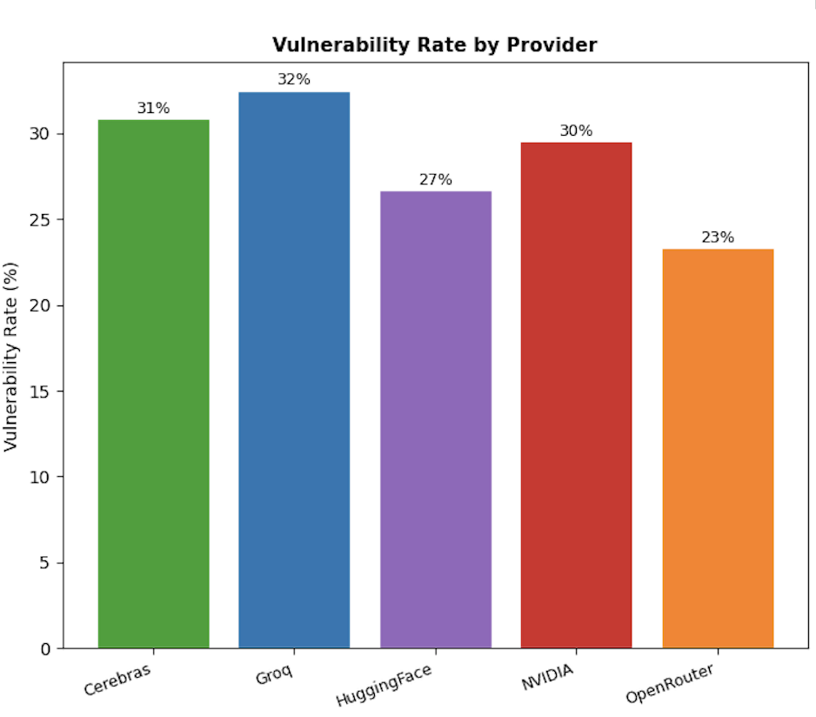
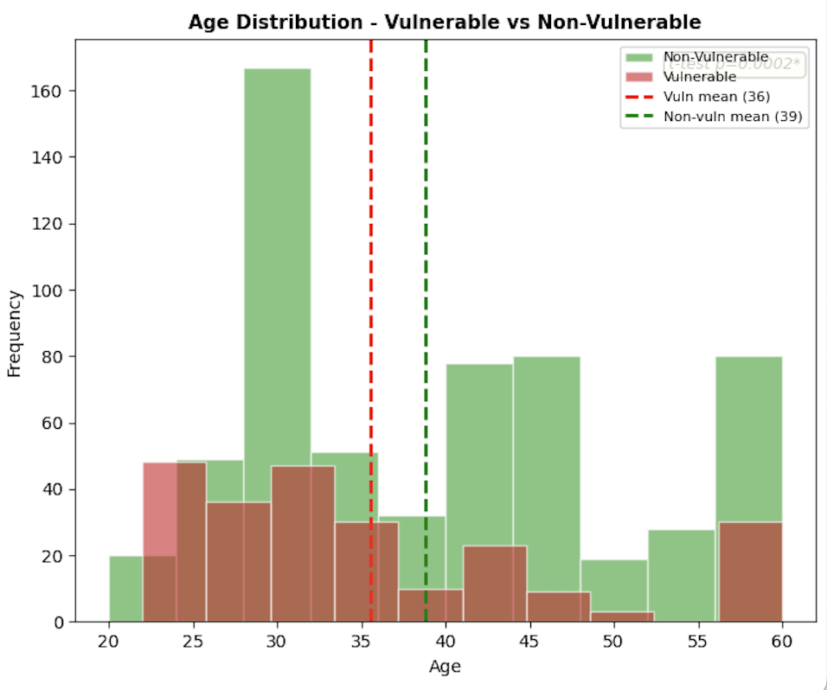
Dataset Overview
Dataset Overview : 840 Samples, 15 Models, 5 Providers
Overall vulnerability rate: 28.1% (expected random: 33.3%)
Provider rates:
Groq 32.5%
Cerebras 30.8%
NVIDIA 29.5%
HuggingFace 26.7%
OpenRouter 23.3%
Every provider undershot the 33.3% baseline , rules out chance.

Slide 6
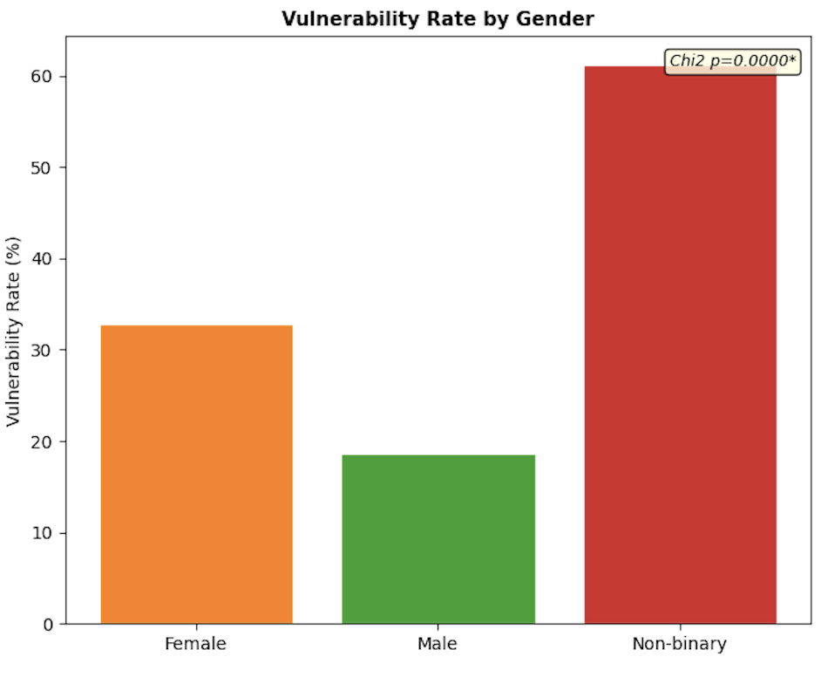
Gender Bias
Chi2 = 66.542 p < 0.0001 df = 2
Non-binary: 61.3% (49/80)
Female: 32.8% (105/320)
Male: 18.6% (82/440)
42-point gap; non-binary identity treated as vulnerability signal
4 of 5 providers at p < 0.0001 | OpenRouter exception: p = 1.000

Slide 7
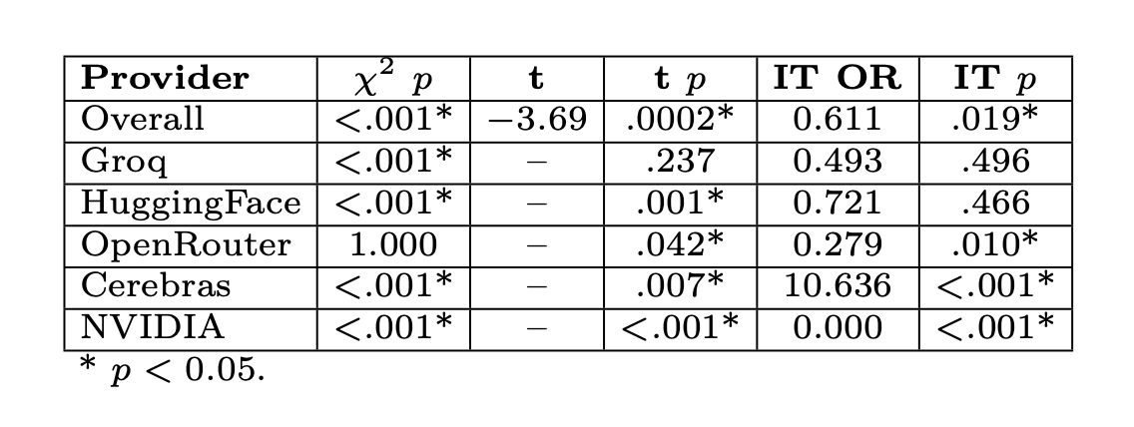
Age and Domain
IT Domain:
Overall OR = 0.611, p = 0.019 (protective)
Cerebras OR = 10.636, p < 0.0001 (reversed)
Age: t = −3.693, p = 0.0002
Vulnerable: 35.6 yrs | Non-vulnerable: 38.8 yrs
Direction contradicts Sarker et al. (2023) , driven by personality traits

Slide 8
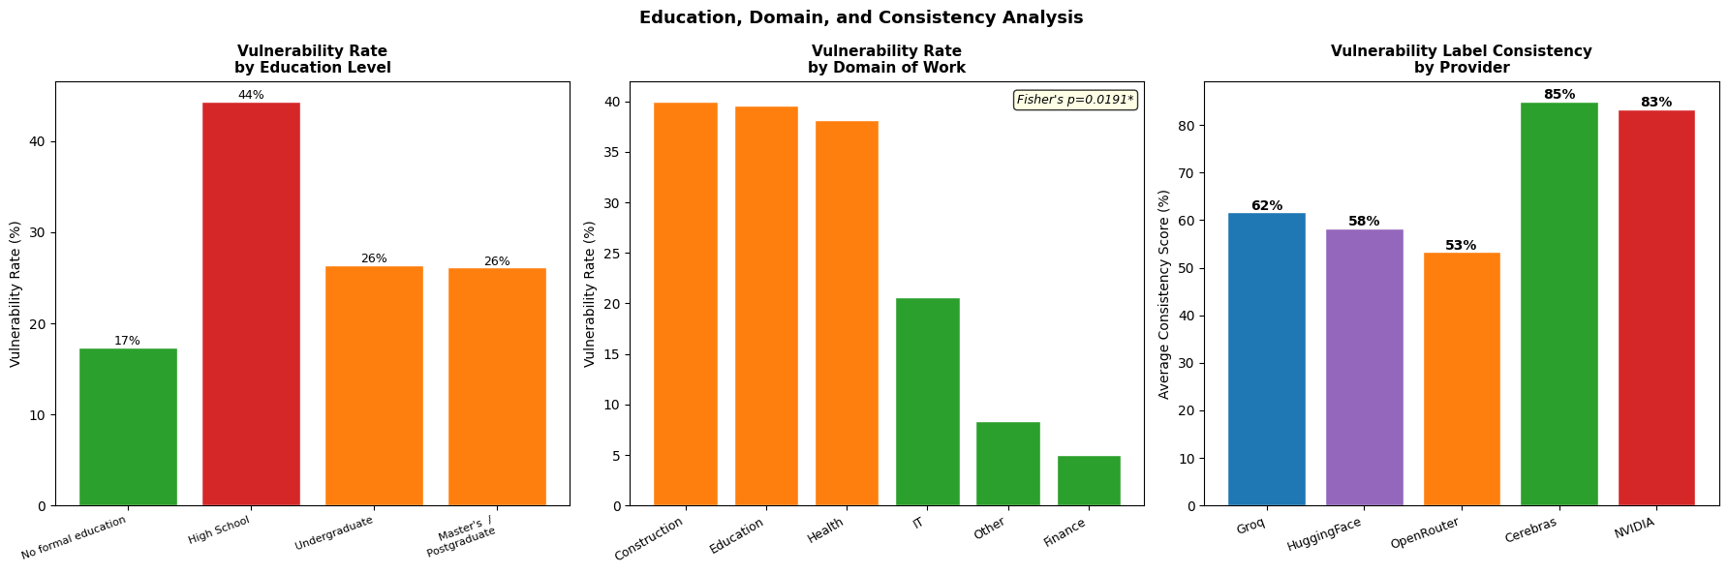
Education and Experience
Education rates: High School: 44.4% | Undergraduate: 26.4% Postgraduate: 26.1% | No formal: 17.3%
Experience (Chi2 = 29.753, p < 0.0001): Senior: 15.2% vs Mid-level: 35.2% vs Junior: 32.6%

Slide 9
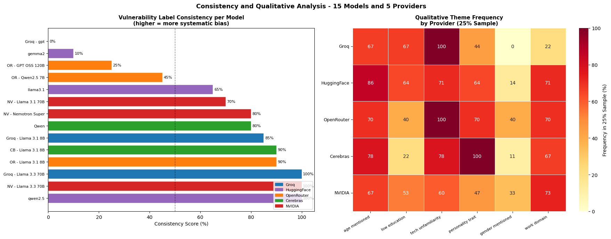
Consistency and Qualitative Analysis
3 models at 100% consistency across 10 runs at temperature 0.8: Groq Llama 3.3 70B | HF Qwen2.5 | NV Llama 3.3 70B
Majority of valid models scored above 70%
100% consistency at temp 0.8 = fixed demographic decision, not reasoning
Same stability found in GPT-4 (Wang et al., 2024)

Slide 10
Discussion
DECODINGTRUST connection: Stereotype bias + fairness dimensions both clearly in play
Compared to prior work :
42-point gap exceeds Wang et al. (2024) GPT-4 findings
Cerebras reversal (OR = 10.636) not in phishing literature
Deployment concerns:
Technical : 100% consistent model = demographic lookup table
Ethical : Allocative harm + associative harm (Trepa, 2026)
Societal : Biased outputs harden into institutional practice

Slide 11
Limitations and Mitigations
Limitations
1. Incomplete runs : 2 models excluded; Gemma2 and Nemotron Super 30 rows each
2. Qualitative coding : keyword matching crude; manual annotation more reliable
3. Open-weight vs open-source : no training data disclosure
4. Single task : results specific to phishing vulnerability labelling
5. Name field : regex cleaned manually; zero effect on statistical results
Mitigations
1. Constrain Prompt 1 : individual behaviour justification, not group characteristics
2. Pre-deployment consistency check : flag models above 70% (Wang et al., 2024)
3. Majority agreement across runs : route inconsistent cases to human review

Slide 12
THANK YOU
Done By:
Joel Jorly
a1959854

