Slide 1
EVOLUTION AND NATURAL SELECTION
EMMANUEL KAITANO

Slide 2
IN THIS TUTORIAL, YOU WILL LEARN:
The history of the theory of evolution
How natural selection provides a mechanism for evolution.
Charles Darwin’s theory of natural selection as a mechanism of evolution

Slide 3
EVOLUTION
Changes in the characteristics and diversity of life that occur throughout time.
Evolution can occur on both large and small scales.
      Microevolution
      Macroevolution

Slide 4
HISTORY OF THE THEORY OF EVOLUTION
The concept of evolution, that organisms may change over time, was not new in Darwin’s time.
However, it was not a widely accepted concept because no one understood how it could work
A mechanism was missing.

Slide 5
HISTORY OF THEORY OF EVOLUTION CONT’D
Charles Darwin’s theory relied upon the findings of other scientists:
  Casting doubt on Divine Creation
      Cuvier, Georges
      Lyell, Charles
      Darwin, Erasmus
  Contributing to the theory itself
      Lamarck, Jean-Baptiste
      Malthus, Thomas Robert
      Wallace, Alfred Russell

Slide 6
HISTORY OF THEORY OF EVOLUTION CONT’D
Georges Cuvier (1769-1832):
Leading palaeontologist of his time
Found that many species have gone extinct

Slide 7
HISTORY OF THEORY OF EVOLUTION CONT’D
Charles Lyell (1797-1875):
Geologist
Earth was way older than the 5000 years or so allowed according to Biblical chronology

Slide 8
HISTORY OF THEORY OF EVOLUTION CONT’D
Erasmus Darwin (1731-1802)
Charles Darwin’s grandfather
Proponent of the theory that species change over time

Slide 9
HISTORY OF THEORY OF EVOLUTION CONT’D
Jean-Baptiste Lamarck (1744-1829)
Believed scientists like Erasmus Darwin that life forms could change over time

Slide 10
HISTORY OF THEORY OF EVOLUTION CONT’D
Lamarckism: acquired traits can be inherited
  e.g. a giraffe with a short neck stretches to get at vegetation high up a tree and manages to make its neck longer. This giraffe passes its long neck to its offspring
  Got Darwin thinking about inheritance

Slide 11
HISTORY OF THEORY OF EVOLUTION CONT’D
Thomas Malthus (1766-1834):
Found that all species have the potential to create far more offspring than there are resources to support

Slide 12
HISTORY OF THEORY OF EVOLUTION CONT’D
Alfred Russell Wallace (1823-1913):
Came up with the theory of natural selection independently of Darwin
Spurred Darwin to publish his own work on the subject

Slide 13
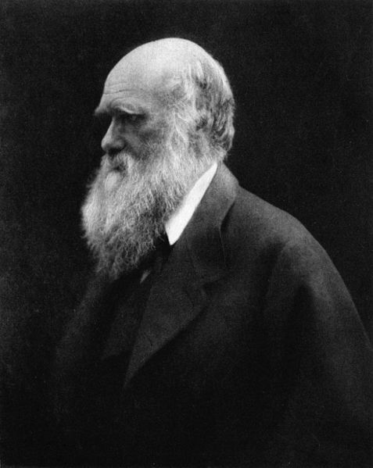
HISTORY OF THEORY OF EVOLUTION CONT’D
Charles Darwin (1802-1882)“I have called this principle, by which each slight variation, if useful, is preserved, by the term Natural Selection.”
(The Origin of Species)
Darwin provided that Natural selection is the mechanism of evolution.

Slide 14
THEORY OF NATURAL SELECTION
Natural Selection is a “Theory” in the same way that we consider gravity or Einstein’s relativity to be a theory
Three conditions for Natural Selection:
  1) Variation in traits
  2) Heritability
  3) Survivorship/Competition

Slide 15
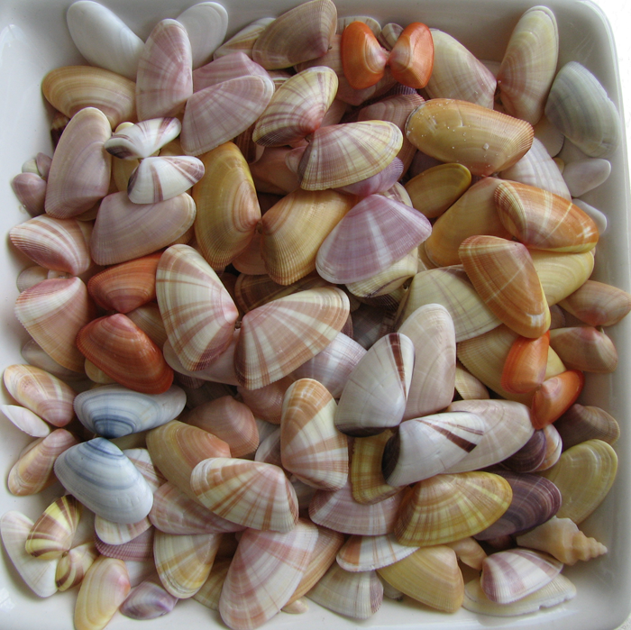
VARIATION
In any population of organisms there is natural variation.
Some of these variations will allow the organisms possessing them to survive and reproduce better than those without these particular traits.

Slide 16
VARIATION CONT’D
Observations from Lamarck and Erasmus Darwin that offspring are not exactly like parents (change can occur in a single generation)
Observed that all individuals are not alike (i.e., there are different phenotypes)

Slide 17
VARIATION CONT’D
Variation can be:
CONTINUOUS: having a multitude of variants (e.g., colour bands in the snail)
DISCRETE: limited number of types (such as blood types)

Slide 18
HERITABILITY
Offspring inherit the majority of their traits from their parents.
Natural selection requires that the gene for variation be heritable
      E.g., Working out and getting a strong heart and muscle might make you live longer and have more children but selection can not act upon it if is not a genetic trait

Slide 19
COMPETITION/SURVIVORSHIP
From Malthus: more offspring are produced than there are resources to support
Creates a “struggle for existence”
Some offspring will be better at surviving and reproducing than others (i.e., have higher fitness)

Slide 20
FITNESS
The number of offspring an individual produces that survive to reproduce themselves

Slide 21
NATURAL SELECTION AS A MECHANISM OF EVOLUTION
Evolution: change in the frequency of alleles in the population
High reproductive potential: Darwin observed that organisms have the potential for very high fertility.
  Organisms have the potential to produce, and often do produce large numbers of offspring.
  Population size would quickly become unmanageable if all of the offspring survived.

Slide 22
NATURAL SELECTION AS A MECHANISM OF EVOLUTION
Despite this high potential fertility, natural populations usually remain constant in size, except for small fluctuations.
Not all of the potential offspring survive.
Limited resources: resources that organisms need to survive are limited

Slide 23
NATURAL SELECTION AS A MECHANISM OF EVOLUTION
Competition: struggle to survive using limited resources
Survivors represent a small part of the individuals produced each generation.
Which individuals will survive is often not a matter of luck.
Populations show variation – individuals are not identical.
  They differ in many different traits.

Slide 24
NATURAL SELECTION AS A MECHANISMS OF EVOLUTION
Some of the variation between individuals in the population is heritable.
It can be passed down from one generation to the next.
Some of the traits found in the population enhance the survival and reproduction of the organisms possessing them.

Slide 25
NATURAL SELECTION AS A MECHANISM OF EVOLUTION
The favored traits will spread through the population.
  Over many generations, the species will become adapted to its environment.
  Over time, these changes can lead to the formation of a new species.

Slide 26
ADAPTATION
A species may become adapted to its environment in response to environmental pressures.
  A trait may be favored due to enhanced survival or reproduction when faced with a particular aspect of the environment.

Slide 27
ADAPTATION CONT’D
When an environment changes, or when individuals move to a new environment, natural selection may result in adaptation to the new conditions.
  Sometimes this results in a new species.

Slide 28
POPULATIONS EVOLVE
Individuals do not evolve; populations evolve.
Evolution is measured as changes in relative proportions of heritable variations in a population over several generations.

Slide 29
NATURAL SELECTION – IMPORTANT POINTS
Natural selection can only work on heritable traits.
  Acquired traits are not heritable and are not subject to natural selection.

Slide 30
NATURAL SELECTION – IMPORTANT POINTS
Natural selection is not random.
It occurs in response to environmental pressures and results in adaptation.
Environmental factors are variable.
  A trait that is beneficial in one place or time may be detrimental in another place or time.

Slide 31
NATURAL SELECTION – IMPORTANT POINTS
When natural selection is occurring, some individuals are having better reproductive success than others.
  Alleles are being passed to the next generation in frequencies that are different from the current generation.

Slide 32
UPSETTING GENETIC EQUILIBRIUM
Natural selection is not the only way that allele frequencies can change from one generation to the next.
  Genetic Drift – a random loss of alleles.
  Mutation – a new mutation can add alleles.

Slide 33
UPSETTING GENETIC EQUILIBRIUM
  Nonrandom mating – inbreeding increases the number of homozygous traits.
  Migration – shuffles alleles between populations.

Slide 34
GENETIC DRIFT
The smaller the sample, the greater the chance of deviation from expected results.
  These random deviations from expected frequencies are called genetic drift.
  Allele frequencies are more likely to deviate from the expected in small populations.

Slide 35
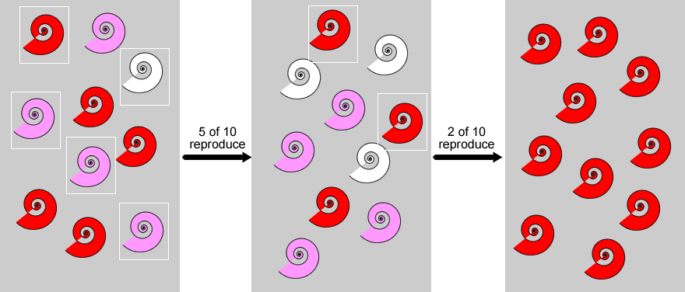
GENETIC DRIFT
Which allele gets lost is due to random chance.
Over time, drift tends to reduce genetic variation through random loss of alleles.
Frequency C^{R} = 0.7
Frequency C^{W} = 0.3
Frequency C^{R} = 0.4
Frequency C^{W} = 0.6
Frequency C^{R} = 1.0
Frequency C^{W} = 0
C^{R}C^{R} = red
C^{R}C^{W} = pink
C^{W}C^{W} = white

Slide 36
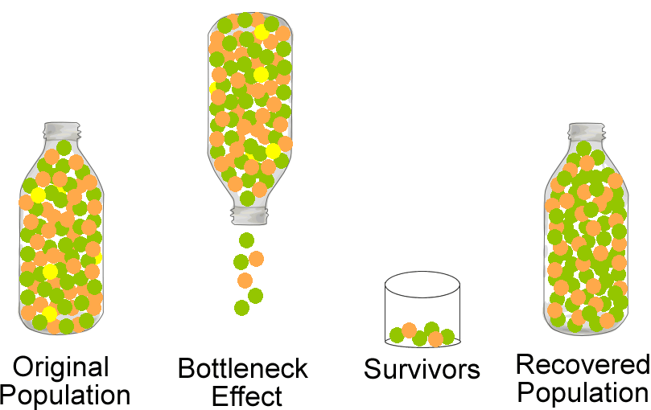
THE BOTTLENECK EFFECT
Sometimes a catastrophic event can severely reduce the size of a population.
  The random assortment of survivors may have different allele frequencies.
  This is a type of genetic drift called the bottleneck effect.

Slide 37
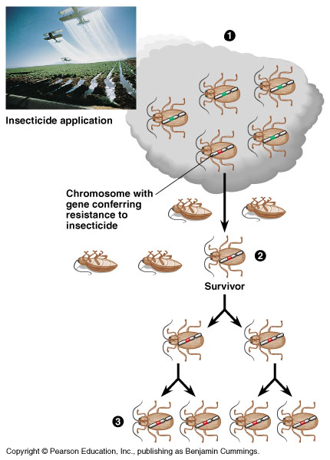
THE BOTTLENECK EFFECT
The actions of people sometimes cause bottlenecks in other species.
1)Natural pop’n with variation for insecticide resistance
2) Insecticide appl’n kills all but those with resistance
3) Surviving insects breed new generation of insecticide resistance population

Slide 38
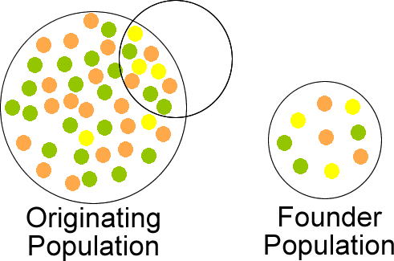
THE FOUNDER EFFECT
Founder effect:
Another type of genetic drift occurs when a small group of individuals becomes separated from the population and form a new population.
The allele frequencies in their gene pool may be different than the original population.

Slide 39
TYPES OF NATURAL SELECTION
Directional:
extreme phenotype is favored over other phenotypes and the allele frequency shift in the direction of that phenotype
Stabilizing: extreme values of a trait are selected for over intermediate value of a trait
Disruptive: population stabilizes on a particular non-extreme trait

Slide 40
EVIDENCE OF EVOLUTION
Morphological evidence: homologous and analogous organs, vestigial organs, connecting link.
Embryological evidence
Paleontological evidence
Molecular evidence

