Slide 1

Topics in LLMs 2
RAG and Fine-Tuning
Joel Kowalewski, PhD

Slide 2

To Fine-Tune (5/5) or RAG, That is the Question

Slide 3


Fine-Tuning an LLM or (generative model) refers to the use of a specialized training set to adjust the model’s parameters (weights and biases)
This involves dividing the training set into batches (small chunks) of data, then sending each batch into the model multiple times (Iterations/Epochs).
After each batch, the model adjusts its parameters to improve its predictive success.
In the case of LLMs, this success typically refers to performance on a MLM or (Masked Language Modeling) task. Here, the model “masks” or hides the next token, makes a prediction, and then compares its prediction to the actual token (this evaluation, the success, is quantified by a Loss Function

Slide 4
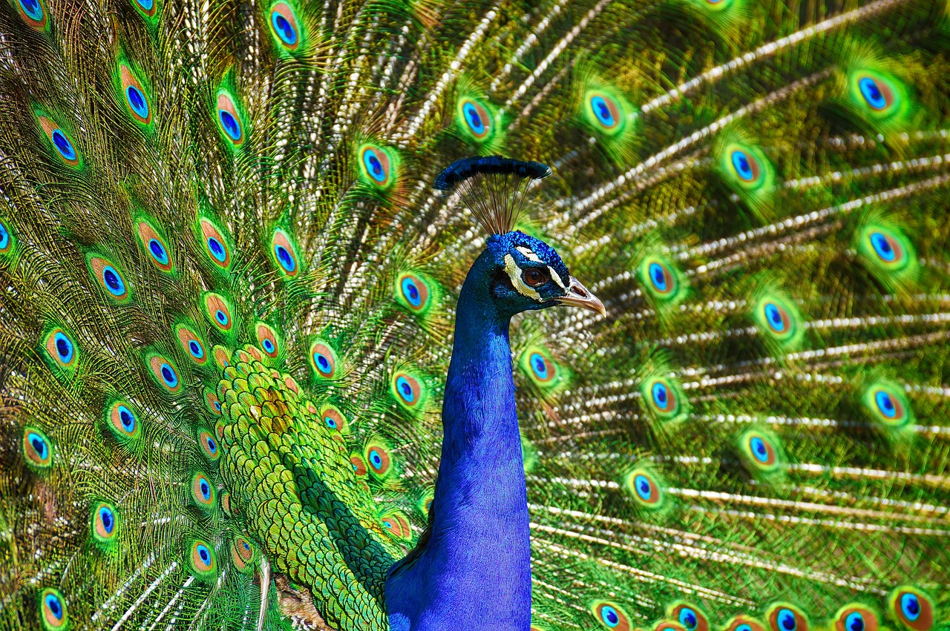
Understanding the Fine-Tuning Process
Epoch 1
Epoch 2
Epoch 3

Slide 5
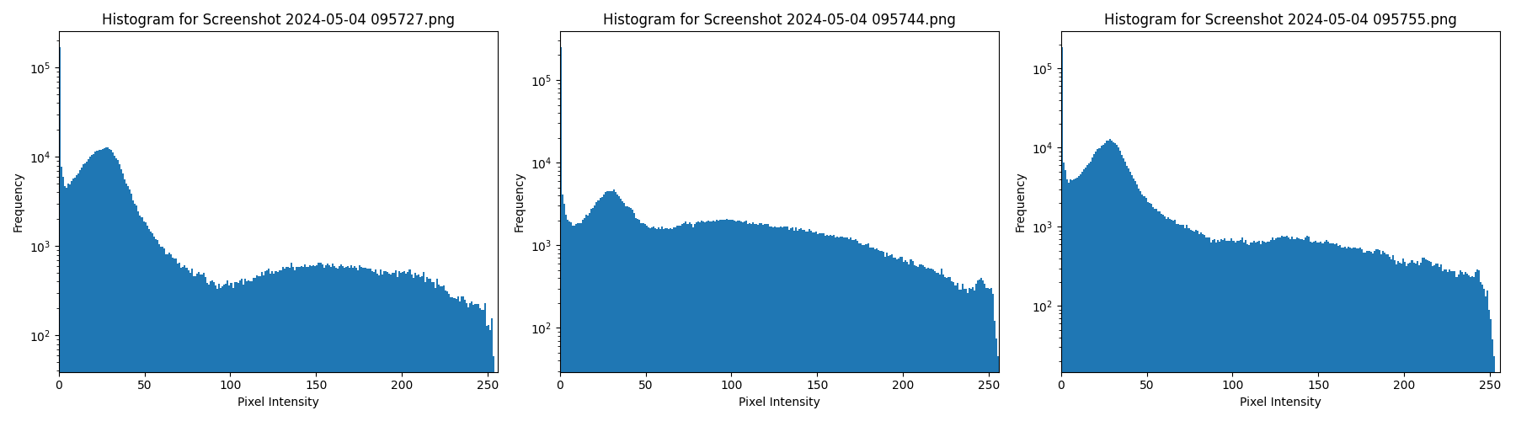
AI: Seeing the Mathematical Structure of Data

Slide 6
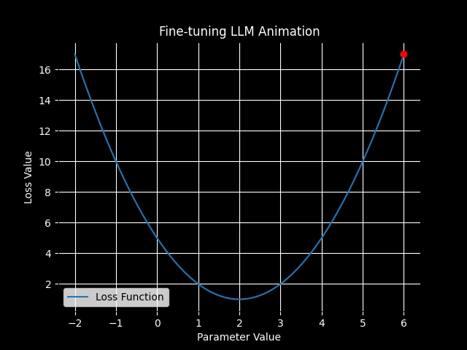
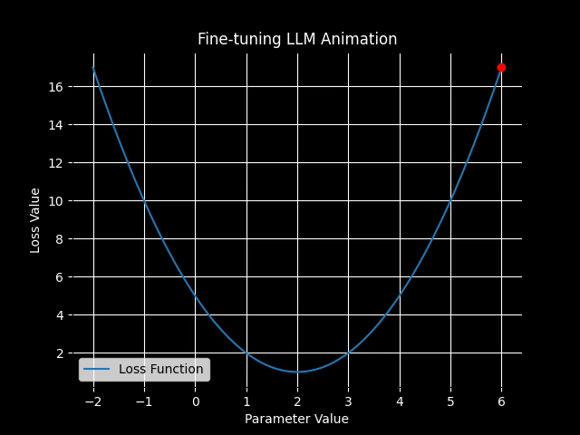
AI: Learning the Mathematical Structure of Data
Learning Rate = .1
50 Iterations/Epochs
Learning Rate = .01
50 Iterations/Epochs

Slide 7

Fine-Tuning LLMs Examples

Slide 8
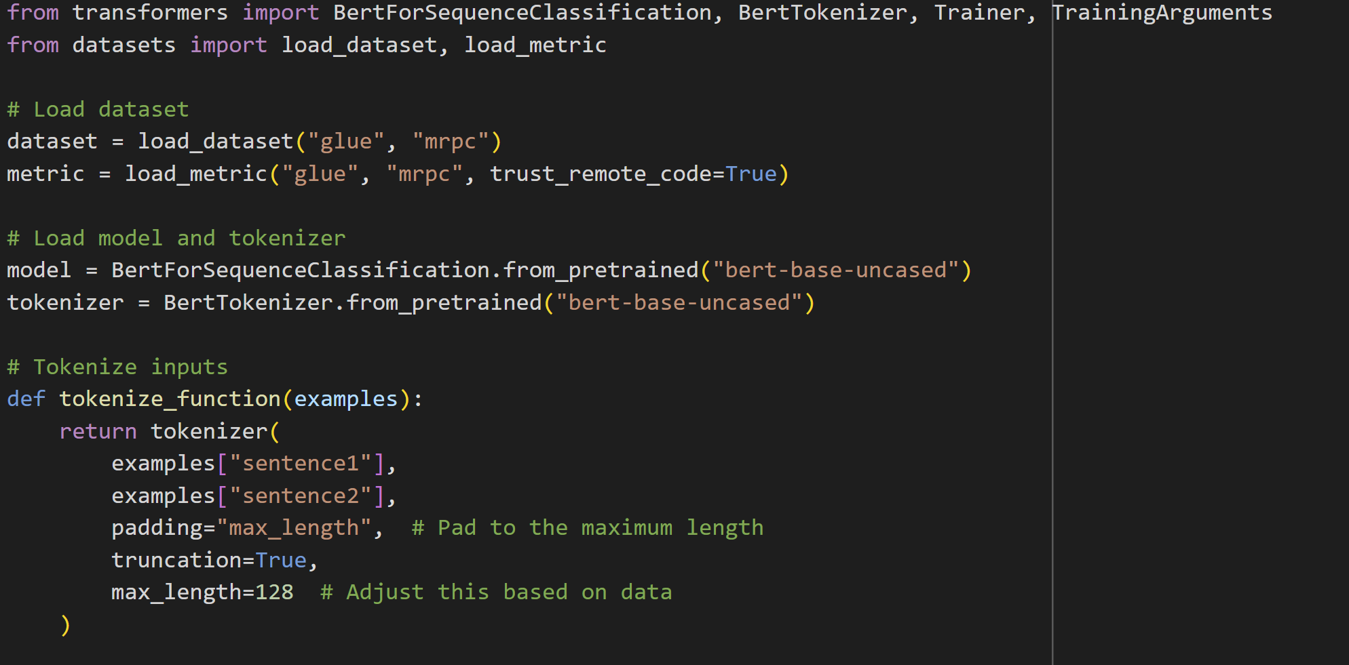
{'sentence1': 'Amrozi accused his brother , whom he called " the witness " , of deliberately distorting his evidence .', 'sentence2': 'Referring to him as only " the witness " , Amrozi accused his brother of deliberately distorting his evidence .', 'label': 1, 'idx': 0}
DATA SAMPLE,
Post-Processing

Slide 9
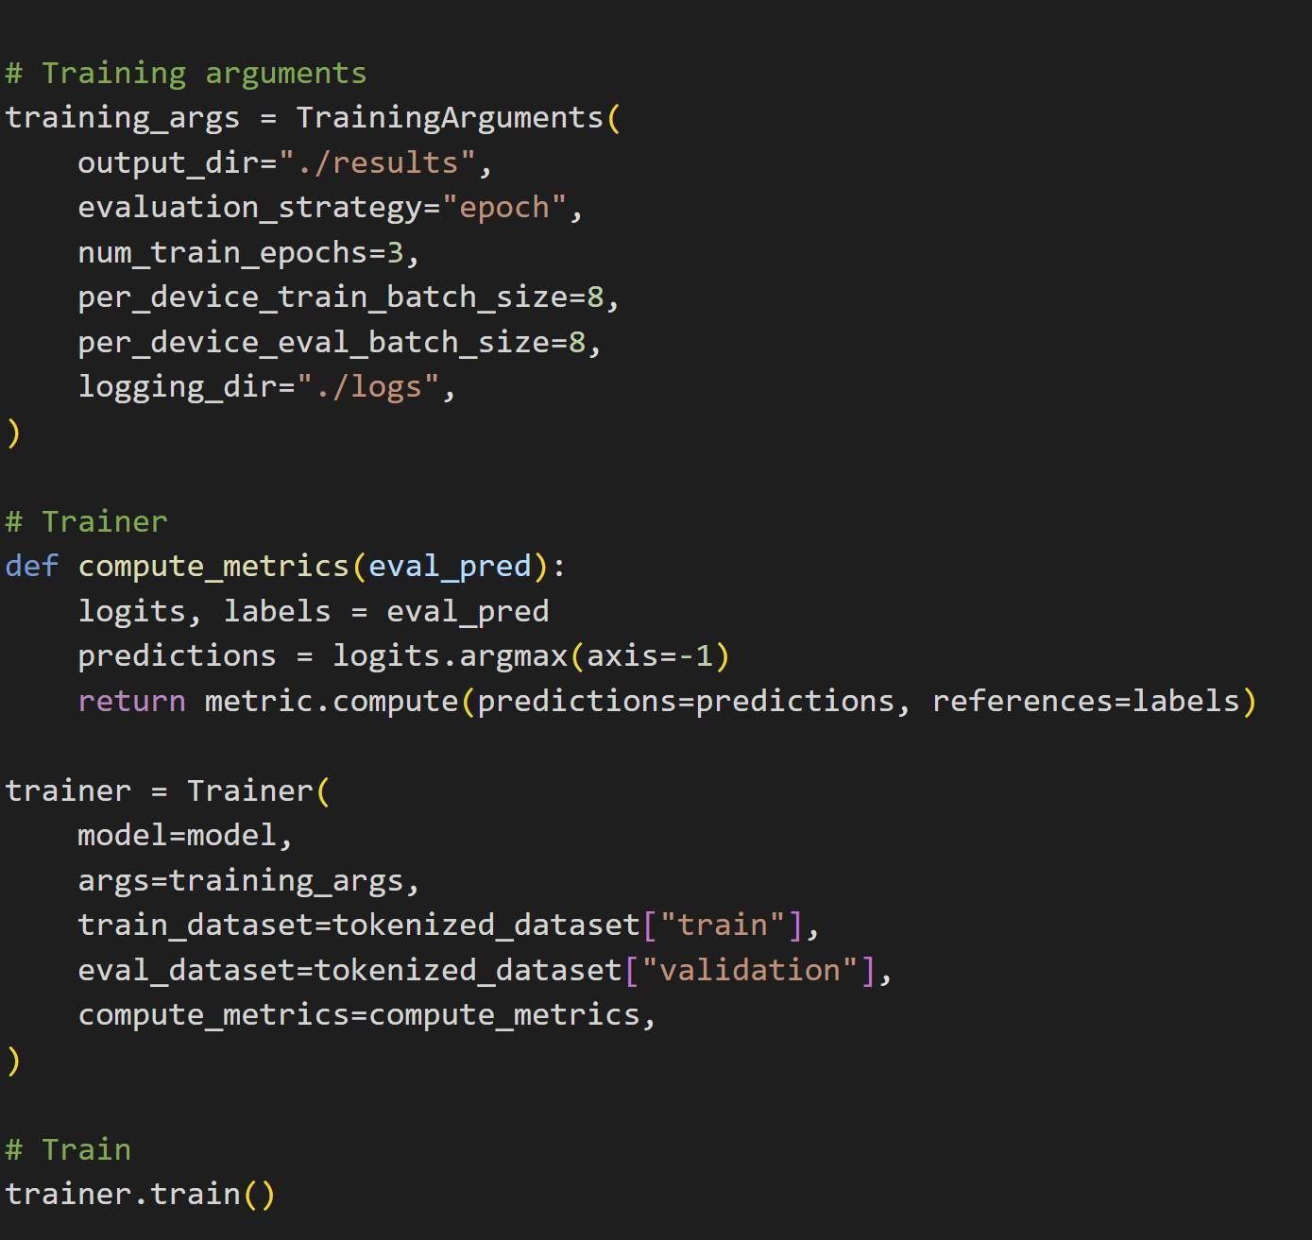
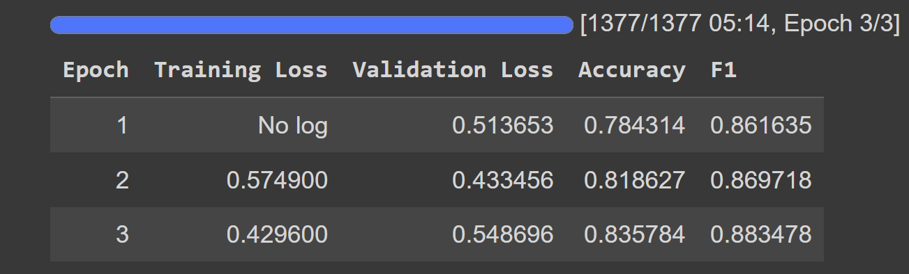

Slide 10
No Code OpenAI API

Slide 11
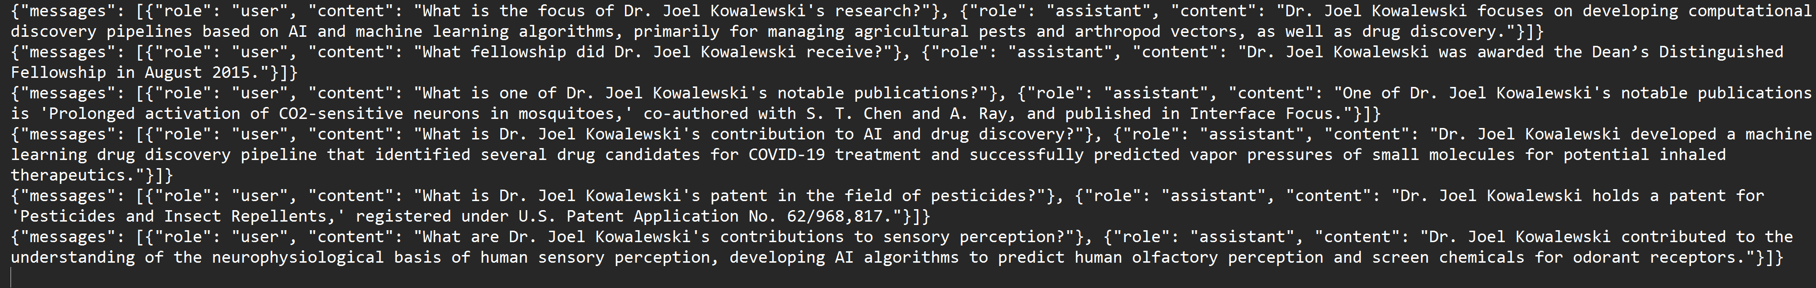
OpenAI API

Slide 12
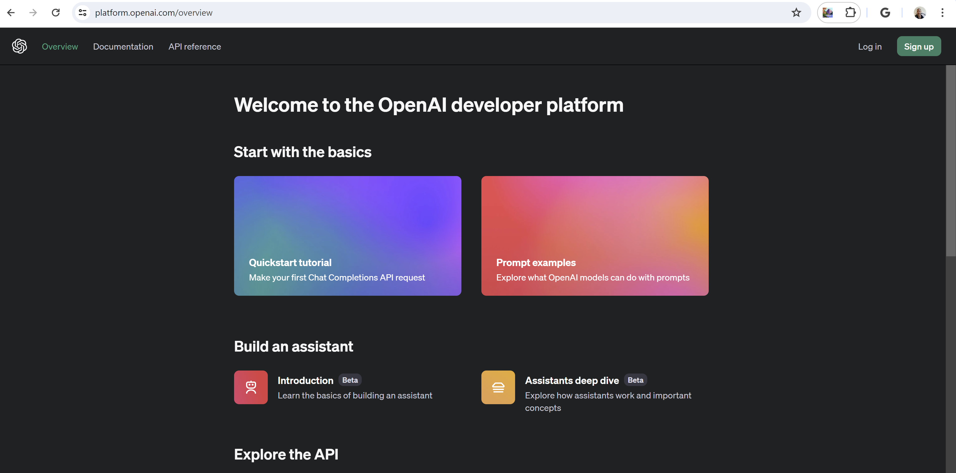

Slide 13


Slide 14
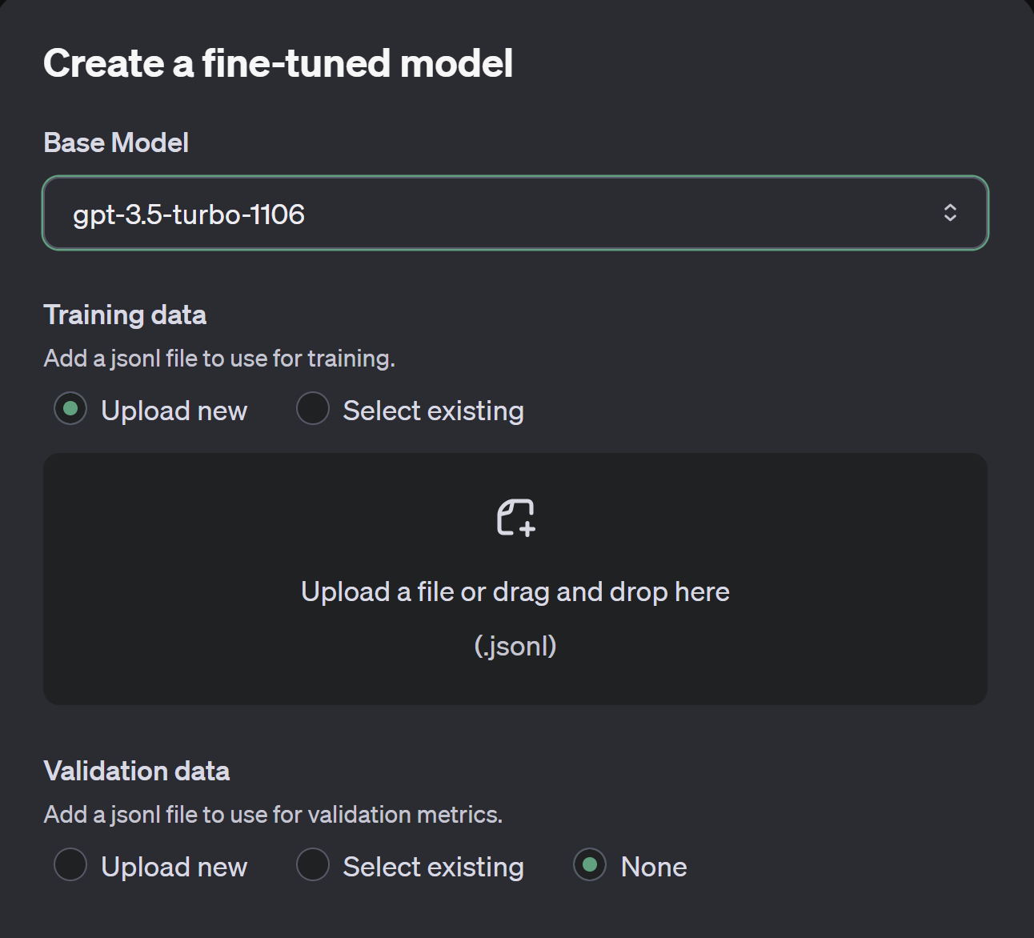
Select Model
(different rates/costs)
EXAMPLE COSTS
10,000 tokens
Training for 3 epochs = 10,000 x 3 = 30,000
Input cost: 30,000 tokens / 1,000 * $0.012 = $0.36
Output cost: 30,000 tokens / 1,000 * $0.016 = $0.48
Total cost: $0.36 + $0.48 = $0.84
DATA (jsonl)

Slide 15
Summary Table: RAG (5/1/24) versus Fine-Tuning (Next time)
Feature | Fine-tuning LLM | RAG
Customization | Pros: Highly customizable to specific tasks and datasets. Cons: Requires extensive computational resources for training. | Pros: Adapts dynamically by retrieving from a knowledge base. Cons: Retrieval errors can propagate to generation errors.
Data Dependency | Pros: Performs well with large, diverse datasets. Cons: Performance depends heavily on the quality of training data. | Pros: Less dependent on specific training datasets. Cons: Reliant on the quality and relevance of external data.
Computational Cost | Pros: High upfront computational cost for training, but lower ongoing costs. Cons: High initial investment in resources. | Pros: Lower training costs since it uses pre-trained models. Cons: Higher query-time costs due to retrieval process.
Adaptability | Pros: Highly tailored once trained. Cons: Not easy to adapt to new data quickly; retraining required. | Pros: Can adapt to new information if the knowledge source is updated. Cons: May struggle with very recent or niche topics not in the database.
Inference Time | Pros: Faster performance at inference time. Cons: Eventually, retraining is needed since new data/information is generated at a high rate. This issue leads back to the computational cost dilemma; fine-tuning may require repeated investments in hardware or cloud compute services. | Pros: Can incorporate real-time data if connected to a live database. Cons: Slower response times due to retrieval step.
Scalability | Pros: Scales well once trained, with consistent performance. Cons: Limited by the cost and feasibility of retraining. | Pros: Can scale by expanding the external data source. Cons: Affected by the efficiency of the retrieval system.

