Slide 1
AI in Healthcare
Advancing Patient Care with Autonomous Diagnostic Technologies

Slide 2
Agenda
Introduction
AI Technology Overview
System Architecture
Impact Metrics
Workflow
Conclusion

Slide 3

Introduction
Diabetic retinopathy (DR) affects millions worldwide. Early detection is critical to prevent vision loss. Autonomous AI systems enable rapid, point-of-care screening.

Slide 4
AI Technology Overview
Deep CNN ensemble for lesion detection (microaneurysms, exudates, hemorrhages).
Image Quality Module for focus, exposure, and field validation.
Cloud-based analysis with locked, FDA-authorized algorithms.

Slide 5
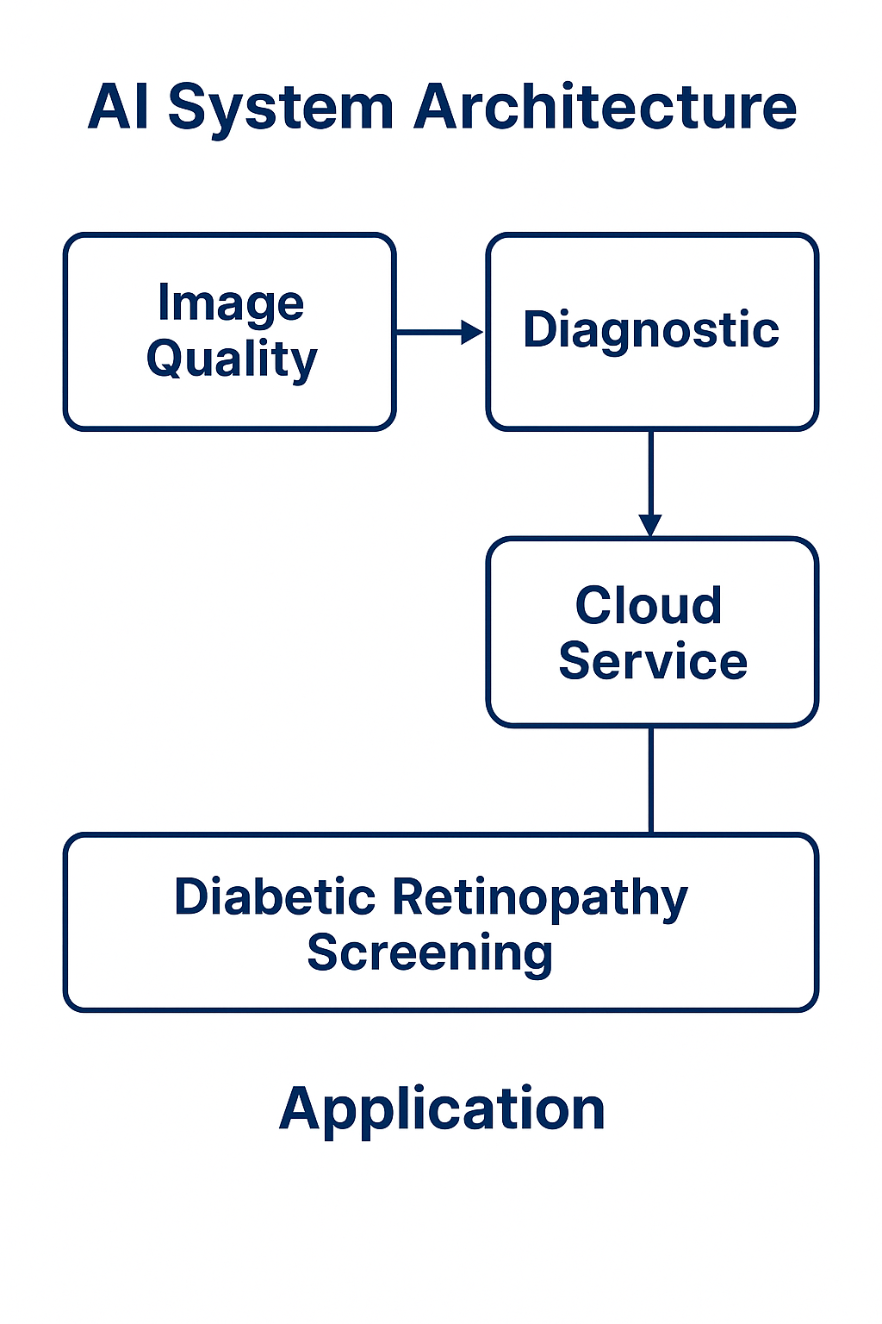
System Architecture

Slide 6
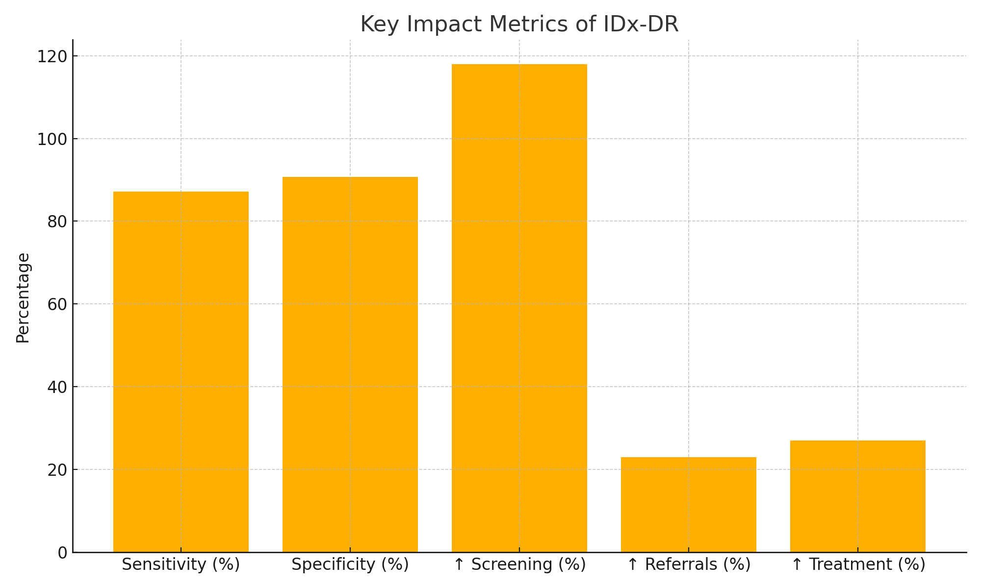
Impact Metrics
Key performance indicators demonstrating clinical and operational benefits:

Slide 7
Screening Workflow
Capture retinal images (macula & disc).
Secure upload to AI cloud service.
AI returns result in under 60 seconds.
Automated EHR referral for detected cases.

Slide 8
Conclusion
Autonomous AI in DR screening delivers high accuracy, expanded access, and operational efficiency. Continued focus on cost reduction, bias mitigation, and ethical governance will drive widespread adoption.

