Slide 1
Bootloader
Creating a bootloader on the 8-bit avr platform
https://github.com/joelluijmes/bootloader-demo
Notes:
Bootloader is first to execute before the main application
AVR supports this and names it self-programming

Slide 2
Content
Memory
RWW/NRWW Sections
Store Program Memory
Operations
Temporary Page
Intel HEX
Programming the bootloader
Code Example
Demo

Slide 3
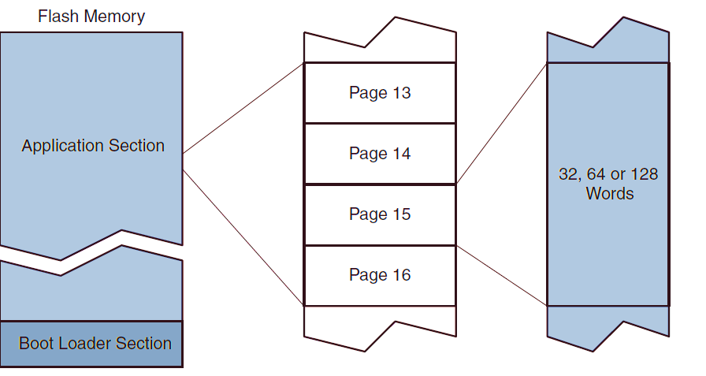
Memory
Notes:
Pages is memory organization method
Maps virtual address to physical addresses
Pages consist of words
- Word is the largest chunk that processor can process
- Byte is the smallest addressable unit for a processor
Bootloader residents in a special section

Slide 4
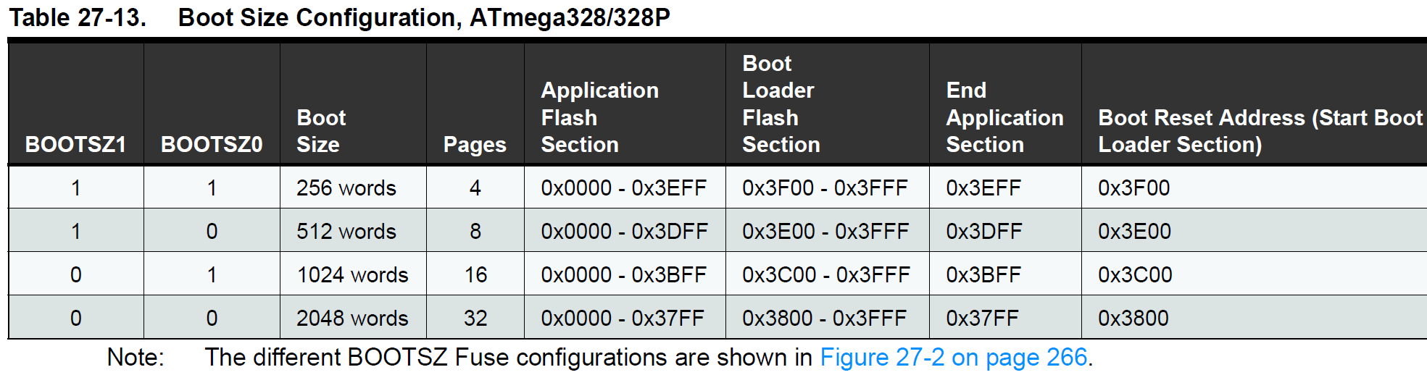
Memory Atmega328/328P
word-size is 16 bits (short)
0x3800 (word address) → 0x7000 (byte address)
2048 (words) → 4096 (bytes)
Notes:
Size of bootloader section is configurable
If BOOTRST fuse is set the cpu starts at the bootloader on reset

Slide 5
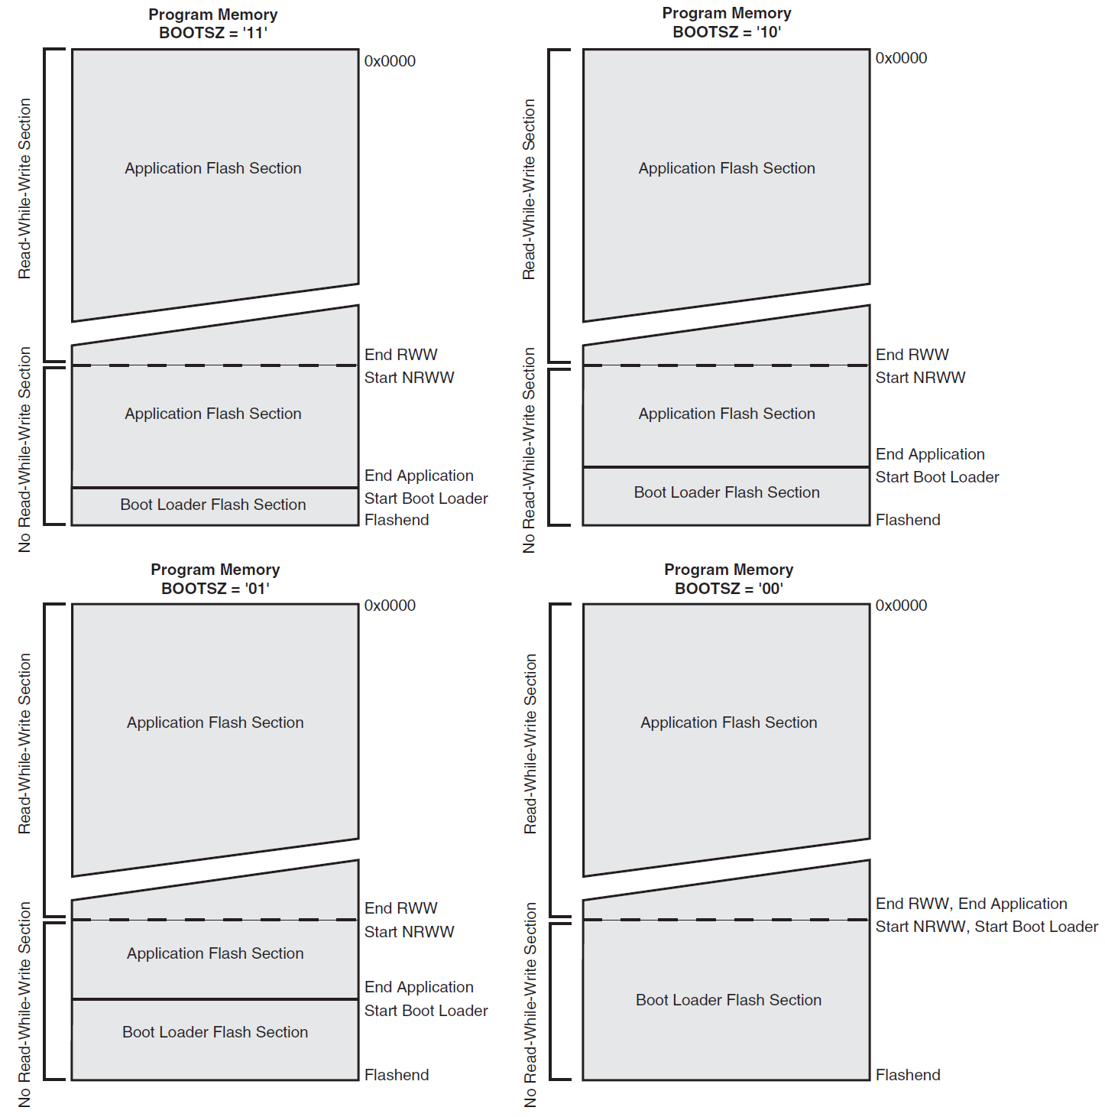
Memory Atmega328/328P

Slide 6
Read-While-Write
Flash Memory is divided in
Read-While-Write (RWW)
No-Read-While-Write (NRWW)
Bootloader resides in the NRWW section
NRWW is accessible while updating the RWW section
Bootloader can reprogram application region while it keeps running
Impossible to access RWW section while updating
Bootloader cannot easily update itself
Notes:
Self-programming is only possible in a special section called NRWW
Flash Memory is divided in NRWW/RWW
NRWW is always the largest selectable bootloader size (ATmega328 is 2048 words)
The use is that NRWW remains accessible when updating the RWW section

Slide 7
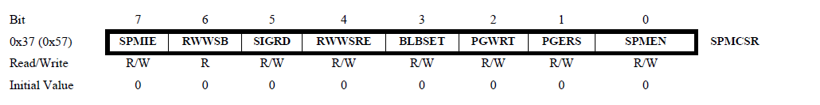
Store Program Memory SPM Instruction
Operation selected through the SPMC(S)R register
SPMEN must be set within four clock cycles when executing SPM
Notes:
All Self-programming is performed by the SPM instruction
Used to erase/write pages, fill page buffer and set boot loader bits
Operations are selected through the SPMCSR register

Slide 8
Read-While-Write Section Read Enable RWWSRE
RWW section is blocked when programming the section
Re-enable it with the RWWSRE bit
Must be enabled before starting the main program
Notes:
RWW is non-accessible after a page erase/write

Slide 9
Boot Lock Set Bit BLBSET
Write Boot Lock and Memory Lock bits
Four levels of protection for both sections:
Full read/write access
No write access
No read/write access
No read access
Can only be unprogrammed using an external programmer
Notes:
Sets boot lock and memory lock bits according to R0

Slide 10
Page Write PGWRT
Writes the temporary buffer to the flash
Address of the page is taken from high part of the Z-register
Notes:
The address is taken from the high bits of the Z register
CPU is halted during SPM when NRWW is addressed

Slide 11
Page Erase PGERS
Erases the page
Address is taken from the high part of the Z-register.
Notes:
The address is taken from the high bits of the Z register
CPU is halted during SPM when NRWW is addressed

Slide 12
Temporary Page
Flash is written page by page
The data that is written must be stored in the Page Buffer
Page Buffer is write-only buffer holding one page
Notes:
The temp page is filled by words
R1:R0 hold the word
Z register holds the address in the temp page
SPMEN can be polled to check if CPU is ready
RWWSB is set by hardware and must be cleared by software
If not the RWW reads as 0xFFFF

Slide 13
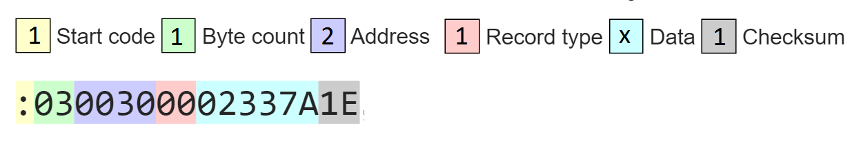
Intel HEX
avr-objcopy output files are .hex which needs to be parsed
The file format is Intel HEX
Consists of lines of ASCII tekst that are seperated by a line or carriage return
Binary data is encoded in hexadecimal characters
Each line is called a record
Notes:
Start code, one character, an ASCII colon ‘:’
Byte count, two hex digits, indicating the length of the data field.
Address, four hex digits, representing the 16-bit beginning memory address offset of the data. The physical address is computed by adding this offset to a base address.
Record type, two hex digits, defining the data.
Data, a sequence of n bytes, represented by 2n hex digits.
Checksum, two hex digits, used for validating the record.

Slide 14
Programming the bootloader
Check the fuses
BOOTRST = ‘1’ (starts bootloader on reset)
BOOTSZ = ‘00’ (bootloader at 0x7000)
Check linker option
-Ttext=0x7000 (puts .text at 0x7000)

Slide 15
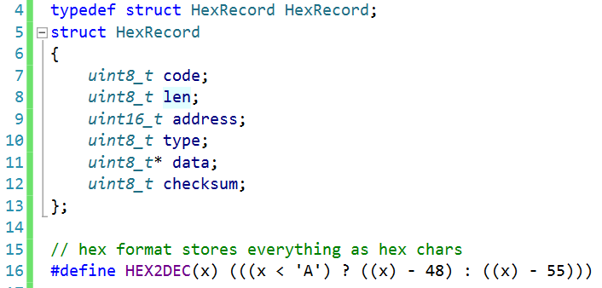
Bootloader Parsing Intel HEX

Slide 16
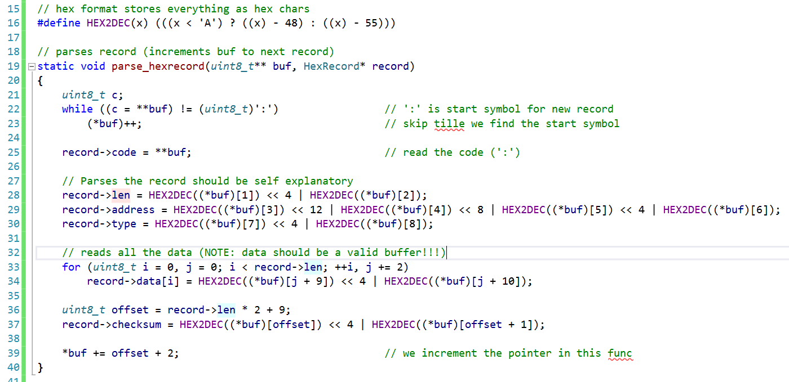
Bootloader Parsing Intel HEX

Slide 17
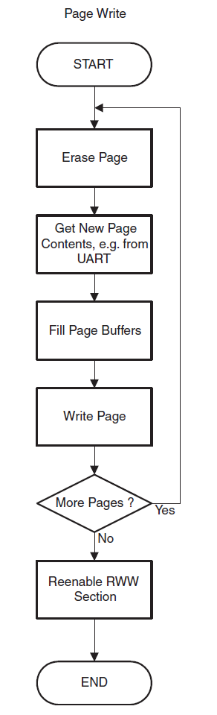
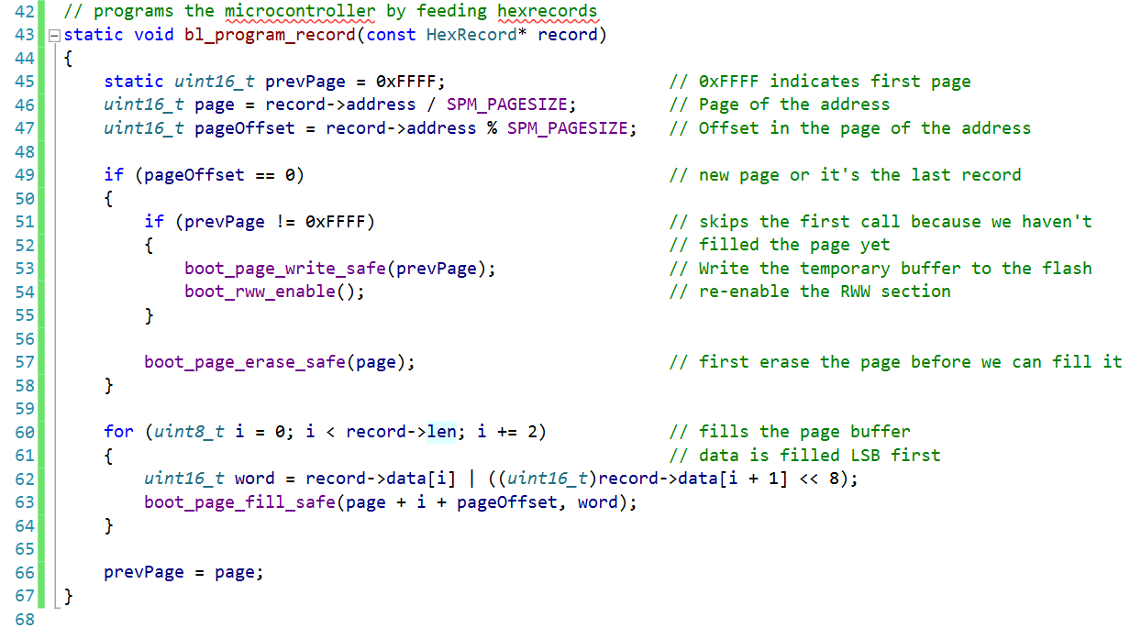
Bootloader Programming the device

Slide 18
Demo

