Slide 1
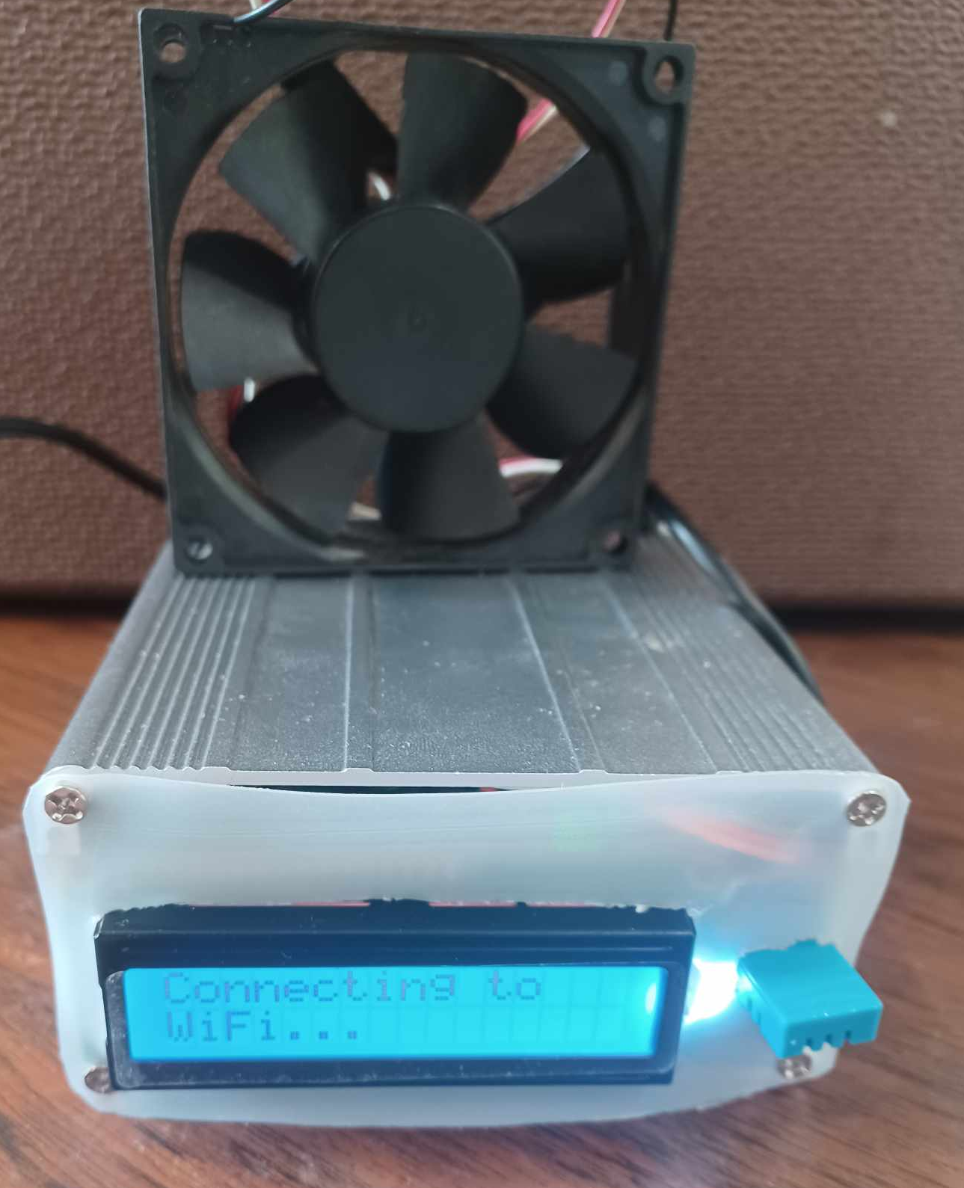
Temperature and Humidity Station: Project Overview
By: Joel Marji and Calvin Jantz

Slide 2
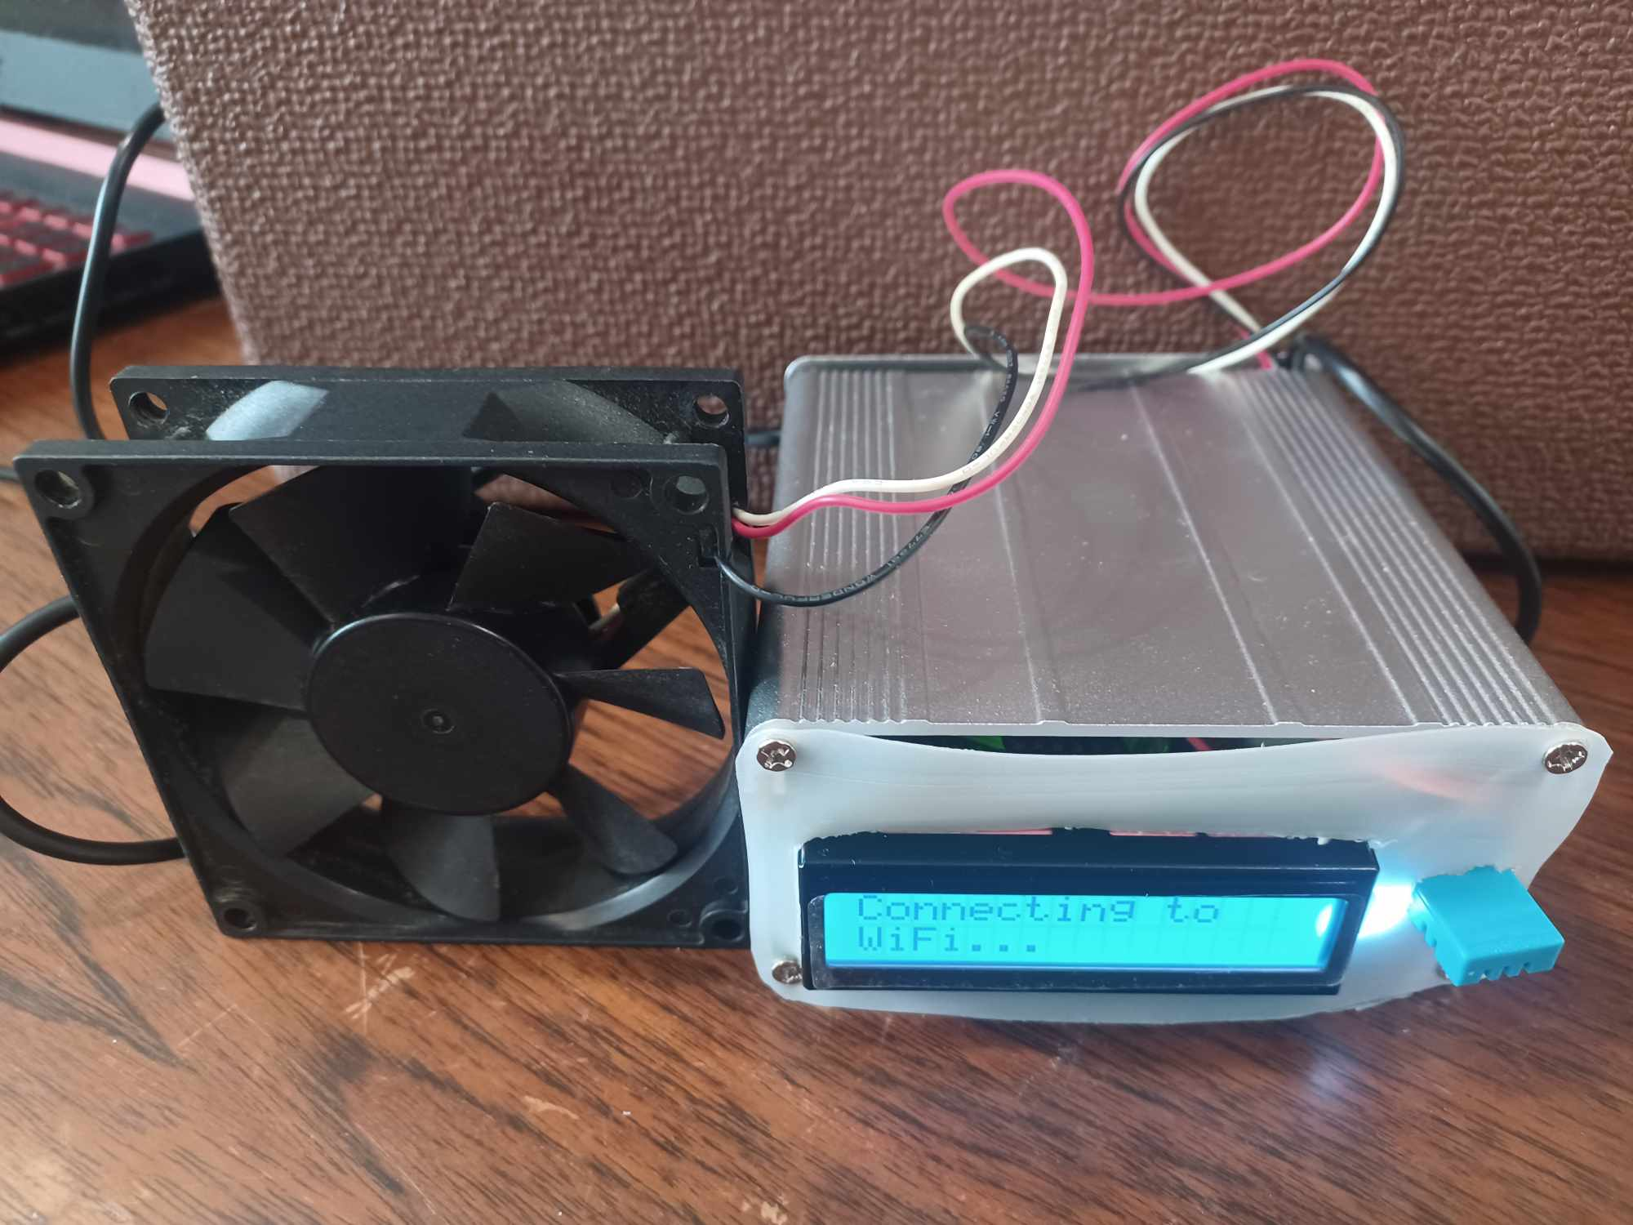
CONTENT
Project Overview
Physical Components
Electrical Design
Code Design
Results
Questions?

Slide 3
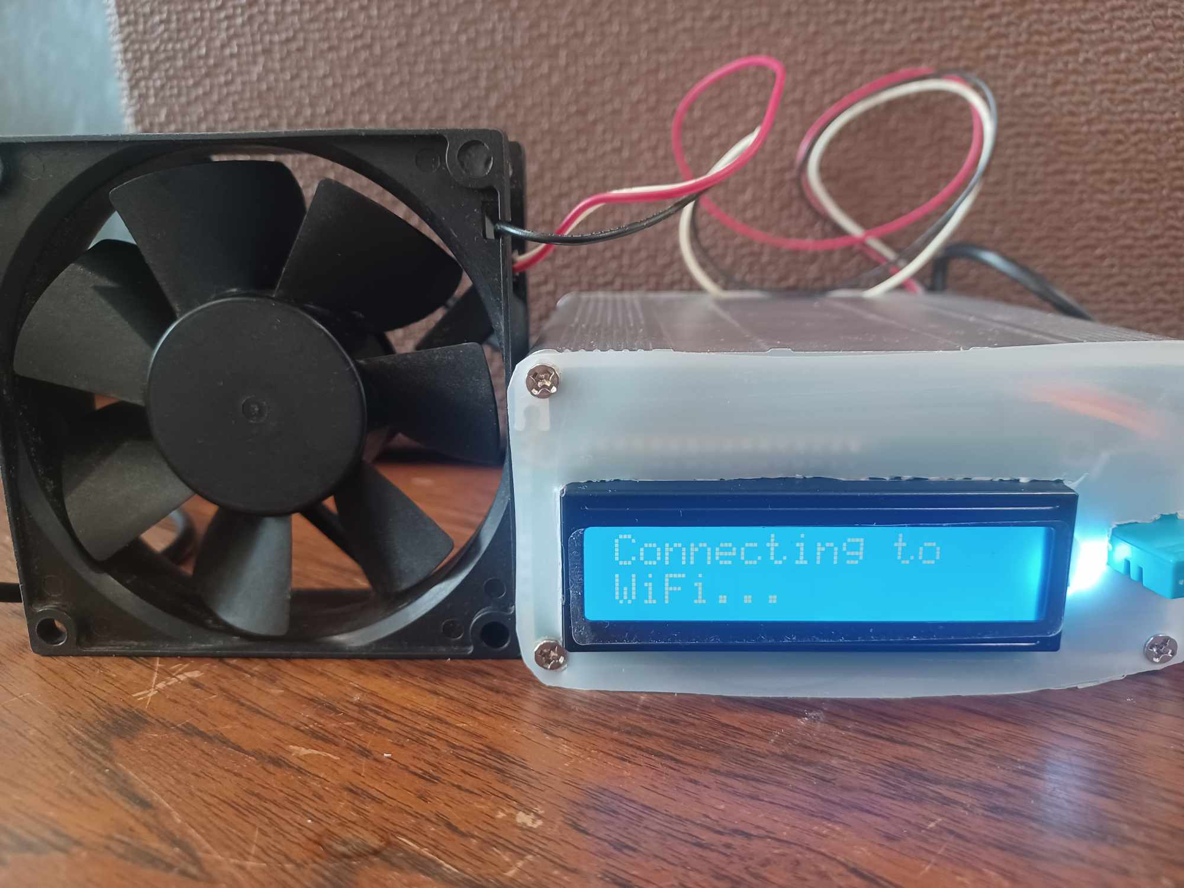
PROJECT OVERVIEW
Goal:
Create a device that displays and reads humidity and temperature.
Project areas:
Physical.
Component housing.
Electrical.
Reading parameters.
LCD and fan.
Programing.
Interpreting data.
Controlling LCD, website, and fan.

Slide 4
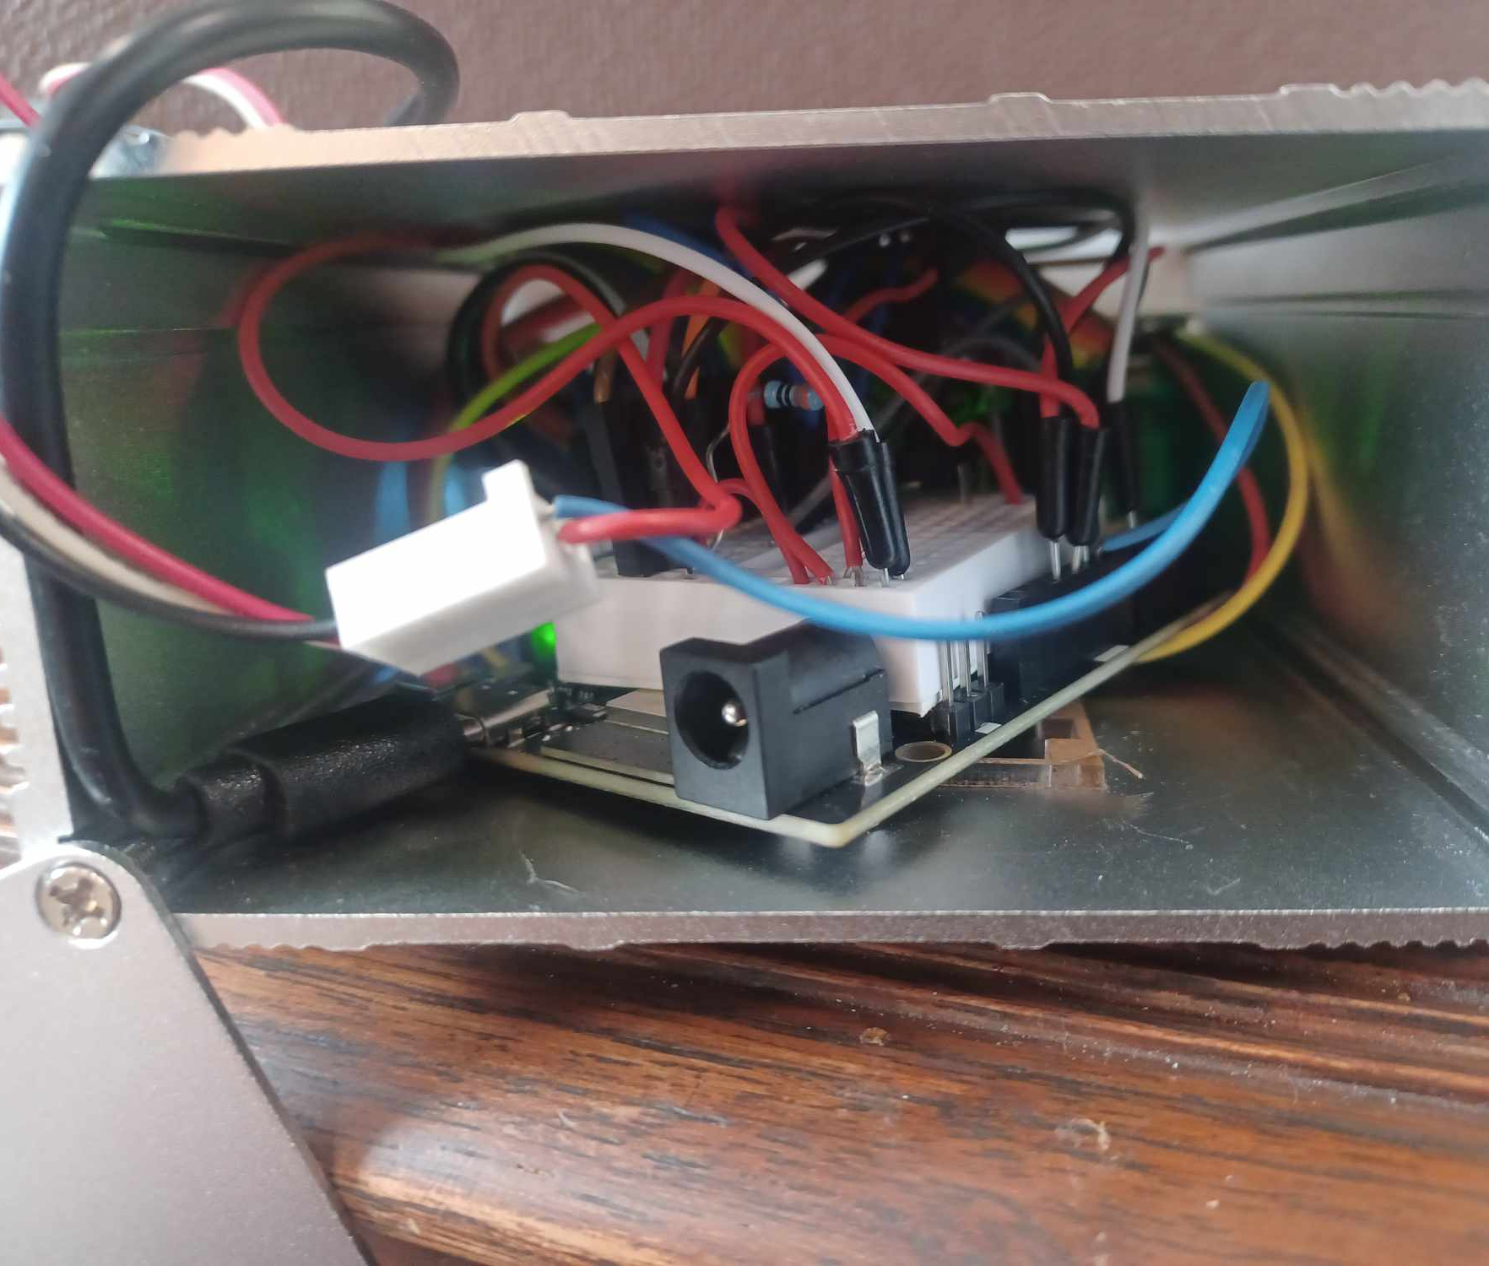
PHYSICAL DESIGN
Prefabricated aluminum case.
Recycled plastic cover.
Breadboard.

Slide 5
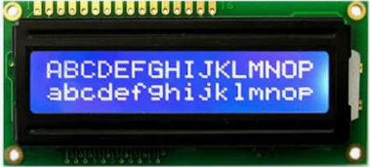
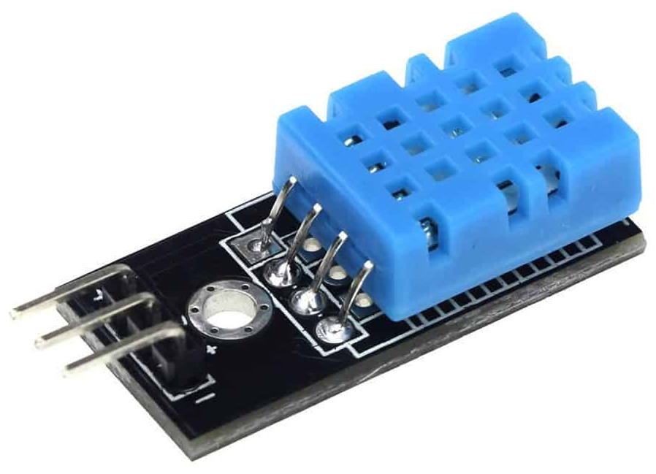
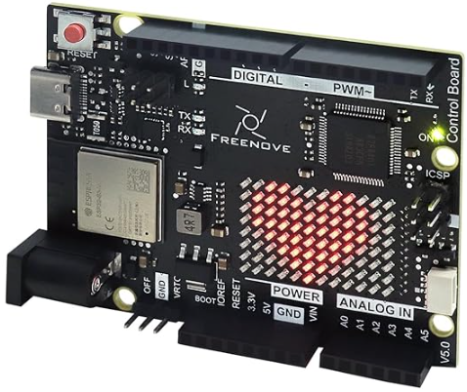
ELECTICAL DESIGN
Freenove Control Board V5 Rev4 Wifi.
DHT11 sensor.
Humidity.
Temperature.
16x2 character LCD screen.
Recycled computer fan.
Local wifi.
Putting it together.

Slide 6
CODE DESIGN
Modules:
LiquidCrystal.h
dht.h
SPI.h
WiFiS3.h
Wifi communication with locally hosted website.
Temperature >= 79 degrees turns on a fan.

Slide 7
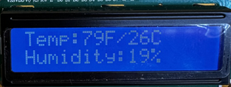
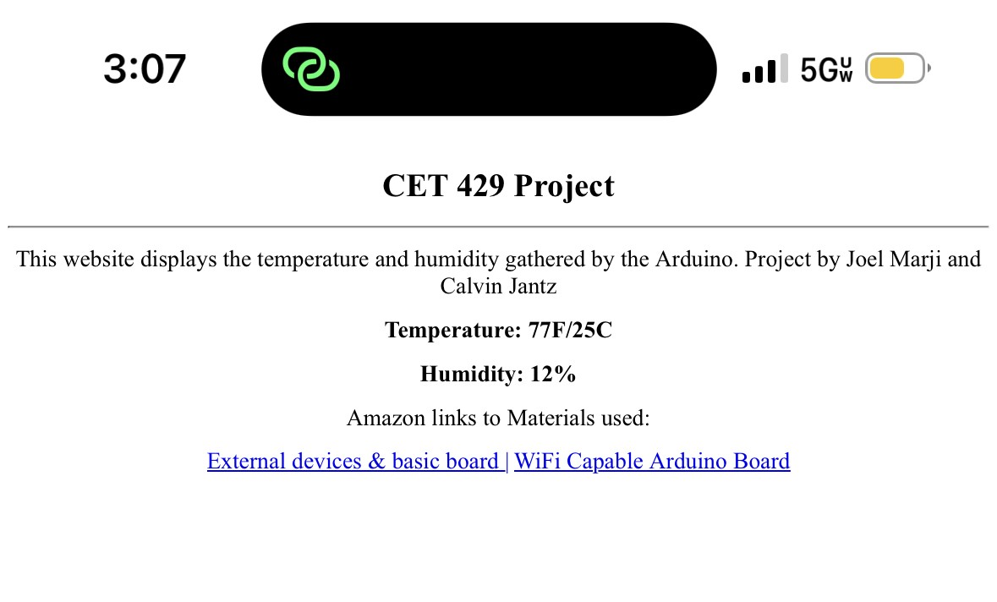
RESULTS
A success overall!
Station that monitors and displays temperature/humidity.
Temperature controlled fan.
Future work:
Upscaling.
Heat source control.
Permanent wiring.
Custom circuitry case.

Slide 8

Any Questions?

Slide 9
IMAGE SOURCES
Slide 6 Board: https://a.co/d/iTk8UqR\
Slide 6 LCD: https://encrypted-tbn0.gstatic.com/shopping?q=tbn:ANd9GcTaHySzfFzoPuOsJYxEQm2AhrMpfNbdGmCH3Uzt3fFQm1IeTJVNZqYgJliiviUzyoGXVXznR75UsMFIzpEcGKss4gkJ-UVSYgBkRWgr2US-KiQfxo-5iELc2A
Slide 6 Sensor: https://www.thegeekpub.com/wiki/sensor-wiki-ky-015-dht11-combination-temperature-and-humidity-sensor/
All other photos were taken by project participants.

