Slide 1
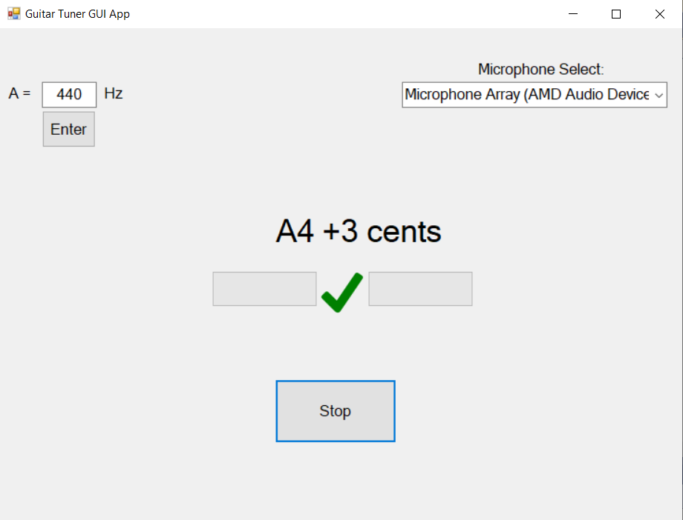
Real Time Guitar Tuner Application
A Dual-Interface (Console & Gui) C# Solution using SDL2 & MathNet
Developed by: Joel Marji

Slide 2
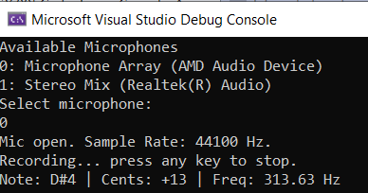
Project Overview & Objectives
Goal: Create a low-latency, accurate instrument tuner capable of running in different environments (GUI/Console App)
Key Features:
  Microphone Selection and real-time audio capture
  Frequency analysis using Fast Fourier Transform (FFT)
  Note detection with cents deviation (flat/sharp accuracy)
Tech Stack:
  C# (.NET)
  SDL2 (Hardware Abstraction)
  MathNet Numerics (FFT Function)
  Windows Forms
Notes:
-I play guitar and thought it would be cool to find out how these work

Slide 3
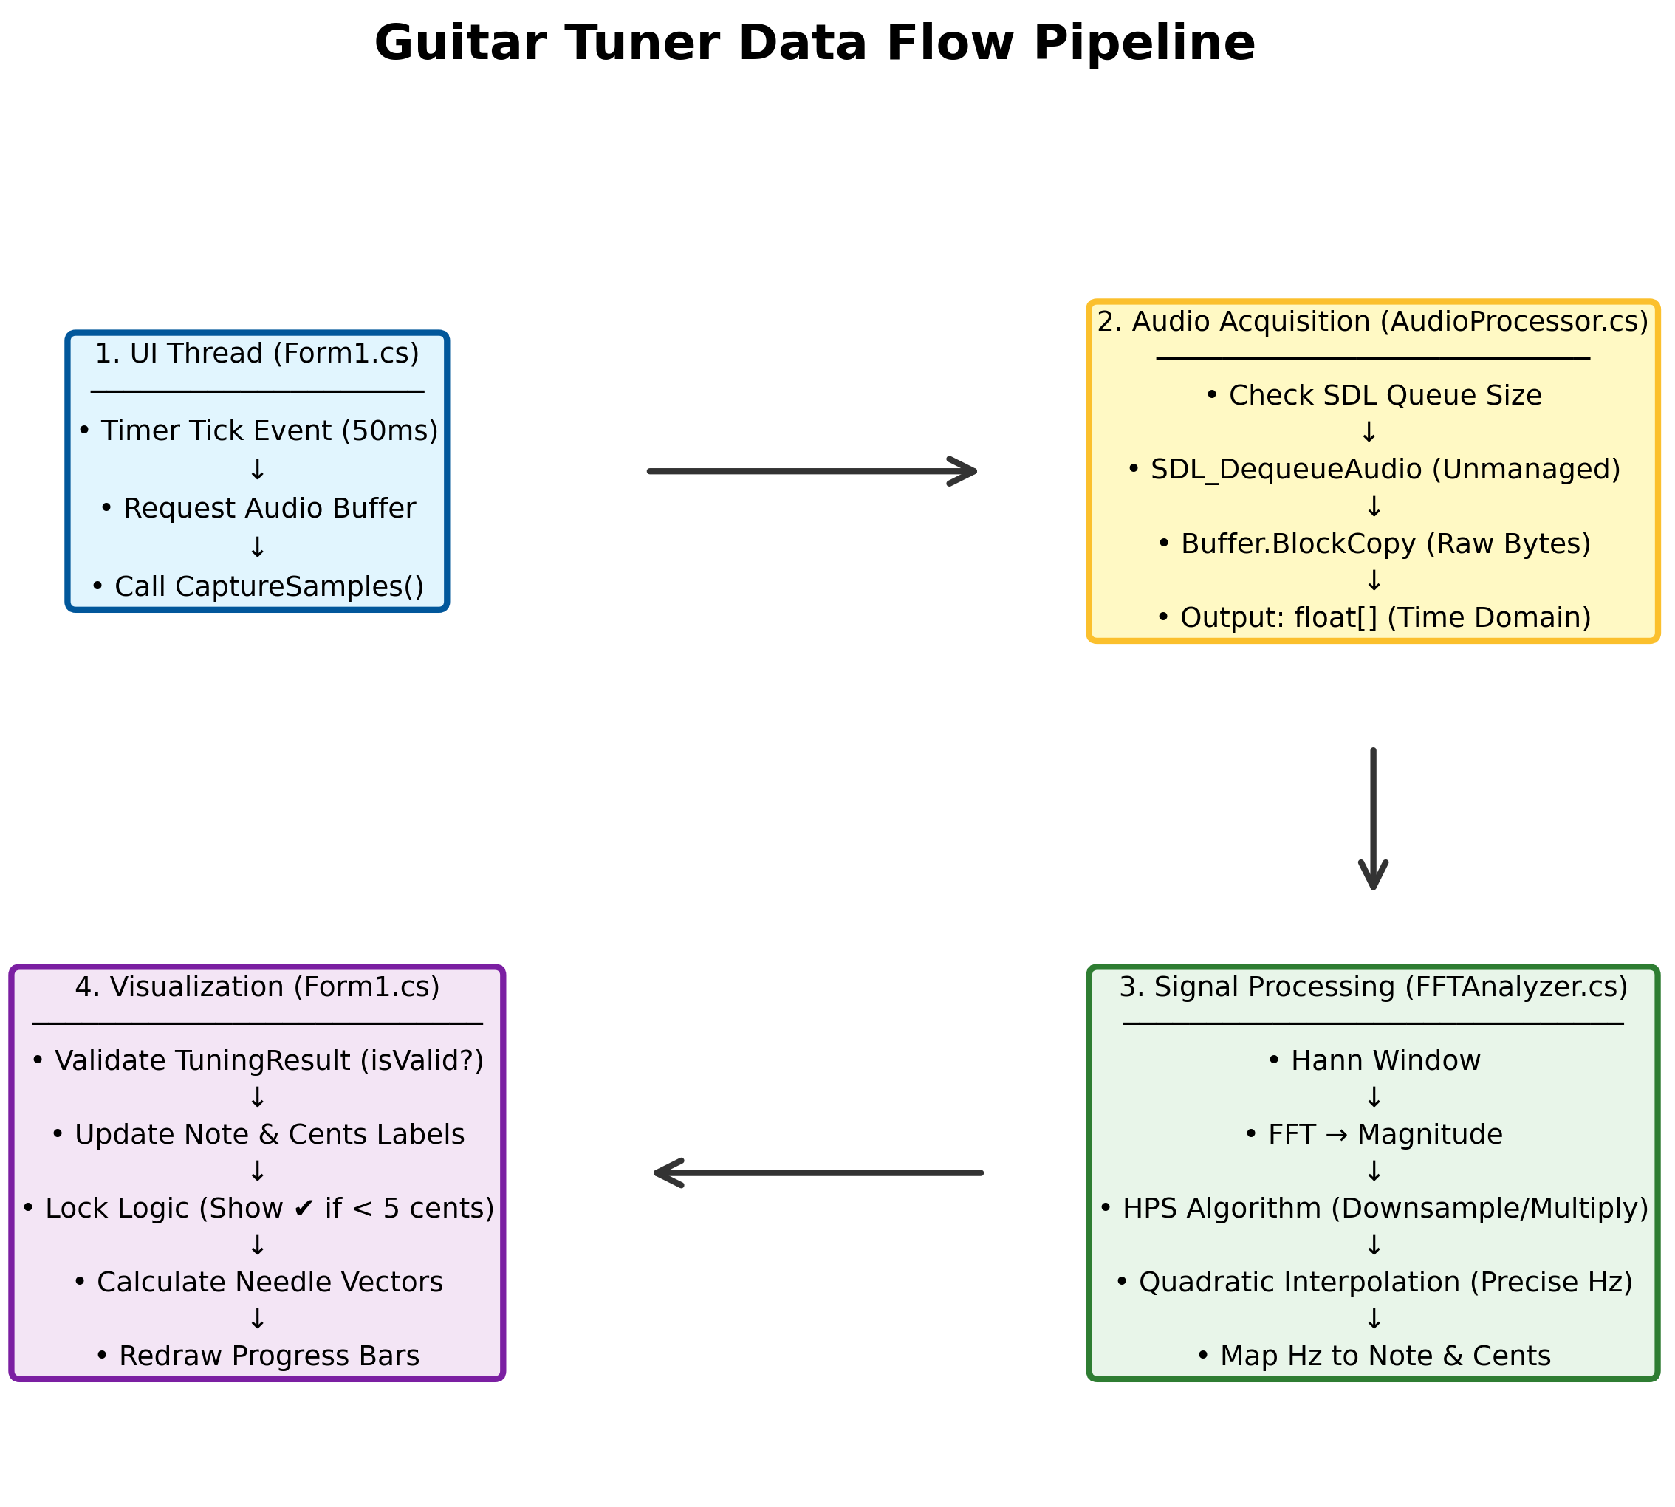
System Flowchart
Event-Driven Loop: The system operates on a synchronous 50ms timer cycle, ensuring real-time audio capture and analysis without freezing the user interface.
Managed/Unmanaged Bridge: The pipeline acts as a bridge, safely taking raw byte data from the unmanaged SDL2 C++ library into managed C# floating-point arrays for analysis.
DSP Pipeline: Raw signals undergo a multi-stage transformation—including Hann Windowing, FFT, and Harmonic Product Spectrum (HPS)—to isolate the fundamental frequency from noise and overtones. Quadratic Interpolation is used to “guess” true signal value.
Data Visualization: Transforms abstract frequency data into an intuitive "analog-style" interface, using dual progress bars to simulate needle movement and visual cues for precise pitch locking (±5 cents).

Slide 4
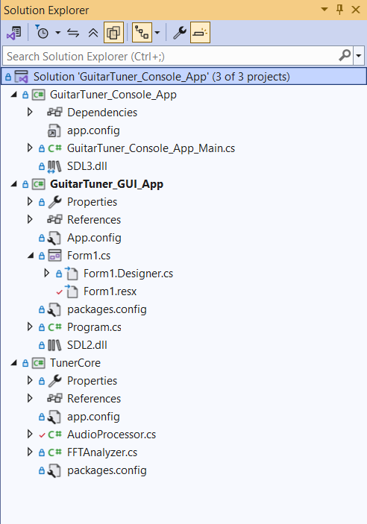
System Architecture
Concept: Separation of Concerns. Write a library (TunerCore) with public functions that can be integrated into a user-friendly interface. Reduces code complexity and improves abstraction for reuse
The Core (Back End):
  TunerCore.cs: Namespace that holds audio processing files
  AudioProcessor.cs: Handles hardware interaction through SDL2, receives audio sample as a buffer
  FFTAnalyzer.cs: Handles math and signal processing, receives buffer from AudioProcessor
The Interface (Front End):
  Console App: Lightweight app, text-based feedback
  GUI App: Visual feedback (Needle, check/X)
Notes:
-Modularity in code

Slide 5
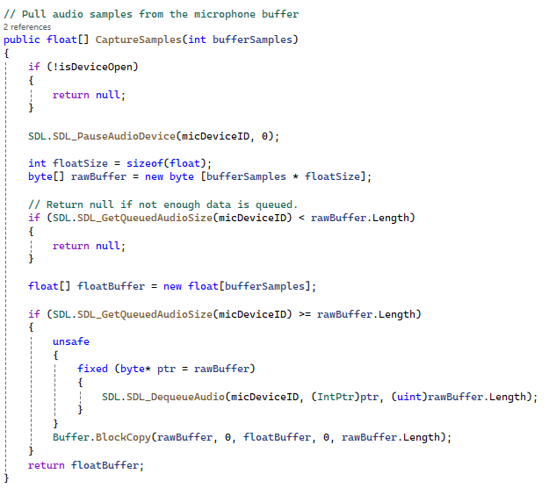
Audio Capture Using SDL2
Library: SDL2 (Simple Direct Media Layer) for Windows microphone access
Mechanism:
  Initializes audio system and returns a list of available microphones (
    GetMicrophoneList()
  Opens selected device based on desired parameters
    OpenDevice(string micName)
  Uses a Push/Pull model (SDL.SDL_DequeueAudio()) rather than callbacks for simplicity
  Captures and returns chunks of 4096 samples at 44.1kHz (approx. 93ms of audio) as a float buffer to be analyzed
The CaptureSamples Method in “AudioProcessor.cs”: Dequeuing audio buffers from the hardware for analysis
Notes:
-Push method over Pull method for simplicity
-Because SDL2 is a C++ library, data is pushed as a pointer. To use in C#, you must use unsafe to manage pointers.
-Floatbuffer returned to be analyzed

Slide 6
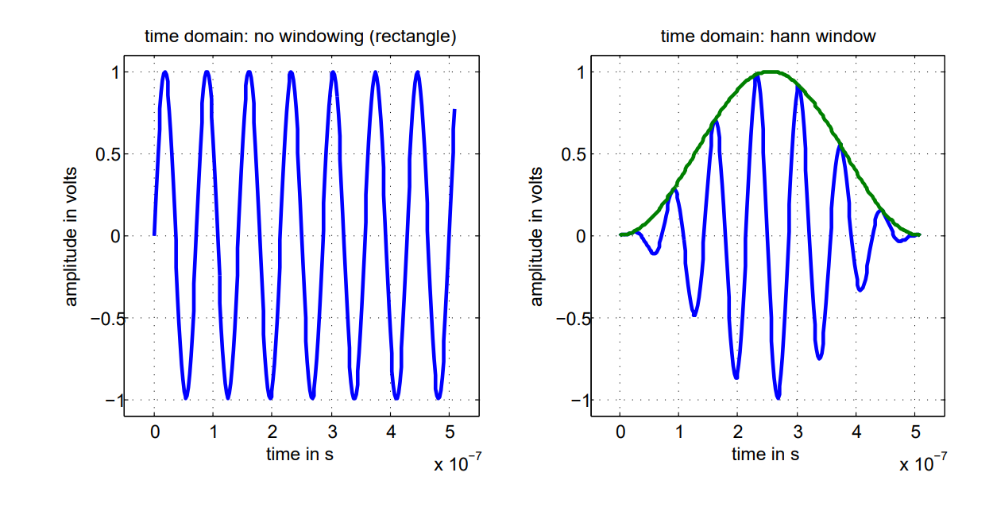
Signal Processing: Hann Window
Input (Time Domain)
  Source: SDL2 captures raw audio into a buffer (float[] samples).
Problem: Spectral Leakage
  The buffer is a random "chunk" of time (4096 samples).
  Abrupt starts and stops at the buffer edges cause "noise" in the analysis.
The Solution: Hann Windowing
  Code: windowedSamples[i] = (float)(samples[i] * multiplier);
  Applies a bell-curve math function to the buffer.
  Smooths the start and end to zero ("Fade In/Fade Out"), ensuring a clean signal for the FFT to process.
Image source: https://kluedo.ub.rptu.de/frontdoor/deliver/index/docId/4293/file/exact_fft_measurements.pdf
Notes:
Raw microphone audio is a sample, edges are cut off. Hann window smooths out edges of audio sample down to zero to ensure clean analysis

Slide 7
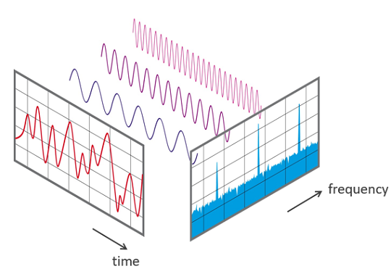
Signal Processing: Fast Fourier Transform(FFT)
Preparing for Math.NET library
  Code: fftBuffer[i] = new Complex(windowedSamples[i], 0);
  The FFT requires complex numbers (real + imaginary). Audio is mapped to the real numbers (windowedSamples[i])
Transformation (Time -> Frequency)
  Code: Fourier.Forward(fftBuffer, FourierOptions.Matlab);
  Converts data from the Time Domain (waveform) to the Frequency domain (spectrum)
Magnitude
  For loop (magnitudes[i] = fftBuffer[i].Magnitude;) finds the magnitude with the dominant frequency
  Converts complex numbers into “loudness” values for each frequency bin using Euclidean Distance
Output
  A histogram where the X-axis represents frequency and the Y-Axis represents strength
Image source: https://www.nti-audio.com/en/support/know-how/fast-fourier-transform-fft
Notes:
-Heart of the application
-Fourier.Forward(fftBuffer, FourierOptions.Matlab) line takes fft buffer (that was refined by hann window) and allows you to access signal magnitudes using fftBuffer[i].Magnitude.
-Magnitudes used for frequency calculation later, only thing this code block does is allow us to access signal magnitudes as a “histogram”

Slide 8
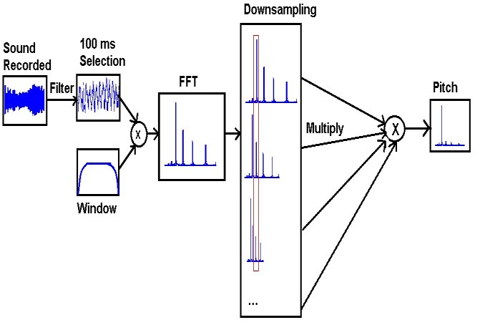
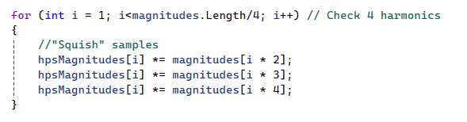
Signal Processing: Harmonic Product Spectrum (HPS)
Problem: Harmonics (Overtones)
  Instruments vibrate at multiples of the root note (f, 2f, 3f)
  Overtones can be louder than the fundamental note, which leads to inaccurate octave calculation
Solution: Harmonic Product Spectrum
  Code: hpsMagnitudes[i] = fftBuffer[i].Magnitude; in the same for loop that finds regular magnitudes
  Multiply the spectrum by compressed versions of itself, which amplifies the fundamental frequency
  The fundamental frequency peaks align and multiply, boosting the signal
  Random noise and non-aligned harmonics are naturally suppressed
Image Source: https://www.researchgate.net/figure/Pitch-detection-using-Harmonic-Product-Spectrum-HPS-method-measures-the-maximum_fig5_336946611
Notes:
-Issues with HPS: signal is often too weak to take advantage of this, fallback implemented in code to improve UI

Slide 9
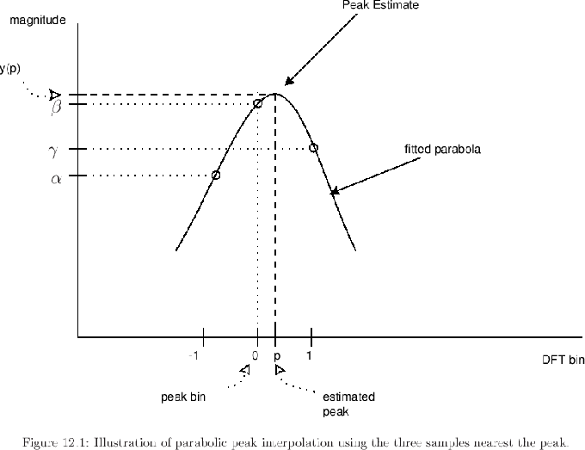

Signal Processing: Quadratic Interpolation
Problem: Bin Resolution
  The FFT sorts frequencies into bins ~10.7Hz wide. The true note often lies between bins
Solution: Quadratic Interpolation
  Quadratic interpolation calculation fits a parabola to the peak bin and its two neighbors (leftMag & rightMag)
  Mathematically solves for the exact peak of the curve to find the fractional offset
  Imporves accuracy from ~10.7Hz to ~0.1Hz
Image Sourcehttps://www.dsprelated.com/freebooks/sasp/Quadratic_Interpolation_Spectral_Peaks.html
Notes:
-Before interpolation, note A4 was always reading as 441.4Hz

Slide 10
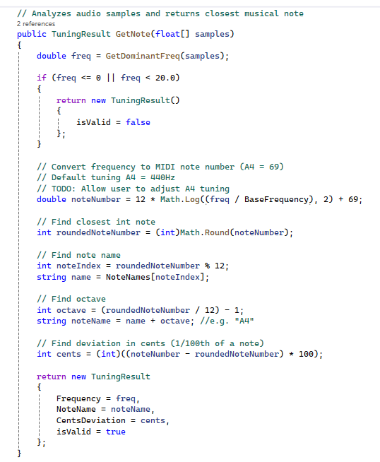

Musical Math – Frequency to Notes
Function GetDominantFreq(float[] samples) returns frequency number
The Formula: Frequency is converted to MIDI number using formula (assuming base freq of A = 440Hz):
Deviation (Cents)
  Calculates how far off the note is from the perfect integer
  E.g. A4 = 440Hz, an input of 441.2Hz would yield a result of +5 cents (sharp)
Feature: User can define BaseFrequency in GUI anywhere from A = 400Hz to A = 480Hz
Notes:
-Last 4 signal processing slides were all encapsulated in the 3rd line of this image GetNote(float[] samples)
-TuningResult is returned to wherever function was called as a struct with 4 data points

Slide 11
User Interface: Console App
UI split into 2 separate applications accessing the same logic for input/analysis using TunerCore namespace
  Console app & GUI App
Console App:
  Developed for refining TunerCore logic and debugging
  Simple top-down execution, ends when user presses a key
  Runs with a single while loop with thread sleeping to improve efficency

Slide 12
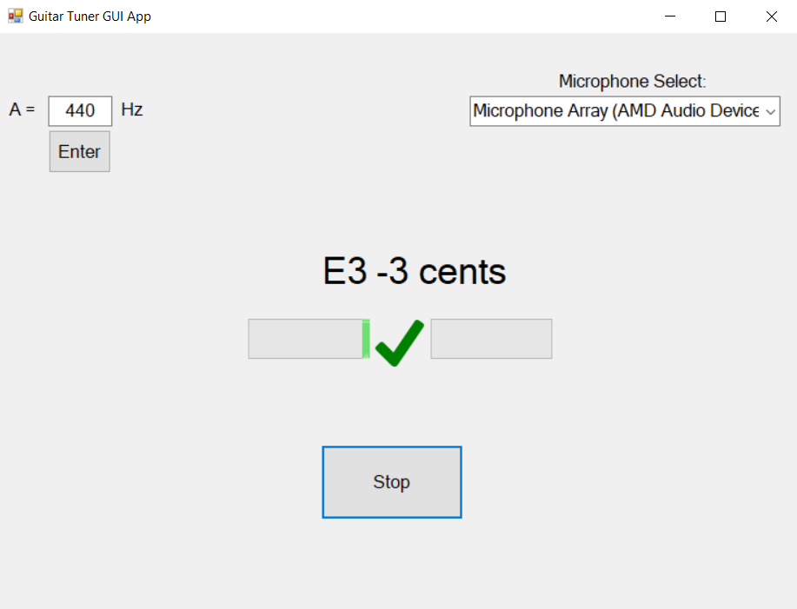
User Interface: GUI Application (Windows Forms)
The GUI application uses the same function calls from the TunerCore library, with a more polished/user friendly look
Key Logic:
  Timer-Based: Uses analysisTimer (50ms Interval) to poll audio rather than blocking UI thread, allows for smooth screen animations and functionality
  Visual Feedback:
    Dynamic “Needle” (progress bar)
    Green check/red X icons based on tuning accuracy (+- 5 cents tolerance)
  User Adjustment
    Adjustable A4 reference frequency in BaseFreq
    Drop down menu for microphone selection

Slide 13
Challenges/AI Involvement
Original idea comes from Youtube: https://www.youtube.com/watch?v=Ufx_nrxLhq0
Concept seemed relatively simple, take real time audio input and use FFT algorithm to find dominant frequency, complexity comes from refining the audio processing to produce accurate tuning result
AI Coding Assistance (ChatGPT & Google Gemini):
  While all the project code was written by me, without AI assistance this project would’ve taken way longer
  AI is best for “I have this code, what next steps could I take to improve it?”
  How I initially learned about concepts like Quadratic Interpolation, HPS, and Hann Window, gave Gemini my codebase after implementing FFT and asking how I could improve the accuracy of my result
  ALWAYS CROSS REFERENCE with external sources
  Don’t trust code that AI writes to be efficient/reliable/readable. AI is best at explaining concepts at a high level, generally, you’re better off implementing it yourself
Notes:
Emphasize that project code was not AI written

Slide 14
Future Improvements/Conclusion
Future Improvements:
  Some notes (E4) read inaccurately by <=5 cents, refinement to signal processing may be required
  GUI is still rudimentary, custom widgets/images would go a long way to improve user experience
  Feature to play notes using a synthesizer to allow tuning by ear
  Visualizer to map out frequency data
Final Thoughts:
  This project has exposed me the world of Digital Signal Processing, a field I was previously unfamiliar with
  Allowed me to learn about and apply concepts in a practical application that I previously only knew about in theory
  Improved my organizational/system architecture skills
    Storing data
    Processing and returning results from that data
    Improving code modularity (TunerCore)
    Ensuring application doesn’t crash, managing pointers (unsafe),
Questions?
Notes:
-Never taken a DSP course and didn’t have much interest in it before this project
-I struggled in calc 1 and 2 but this project has allowed me to revisit some concepts in practical application, and thus I have a better understanding of them

Slide 15
References
FFT:
https://www.nti-audio.com/en/support/know-how/fast-fourier-transform-fft
Hann Window:
https://www.gaussianwaves.com/2020/09/window-function-figure-of-merits/
Quadratic Interpolation: https://www.dsprelated.com/freebooks/sasp/Quadratic_Interpolation_Spectral_Peaks.html
Harmonic Product Spectrum:
https://acadpubl.eu/jsi/2017-115-6-7/articles/6/55.pdf
https://kluedo.ub.rptu.de/frontdoor/deliver/index/docId/4293/file/exact_fft_measurements.pdf
MIDI Note to Frequency conversion:
https://inspiredacoustics.com/en/MIDI_note_numbers_and_center_frequencies

