Slide 1
Turtle Games
Assignment – Predicting Future Outcomes
Joel Hawkins

Slide 2
Who are Turtle Games?
Turtle Games manufacturer books, board games, video games and toys
They sell these products alongside products sourced from other manufacturers and companies
Turtle Games has a Global Customer base. This analysis focuses on the sales from Europe and North America
Turtle Games are looking to improve overall sales performance by utilising customer trends
To do this, they want to understand;
The quality and reliability of the data sourced
The impact each product has on sales
The relationship between North American, European & Global sales
How customers accumulate loyalty points
How grouping/clustering the client base can be used by marketing
How customer reviews can be used to inform marketing campaigns

Slide 3
Exploratory Analysis
The platform, genre and publishers with the highest number of products sold can be seen below.
Rank | Platform | Genre | Publisher
1 | X360 | Shooter | Nintendo
2 | PS3 | Action | Electronic Arts
3 | PC | Sport | Activision

Slide 4
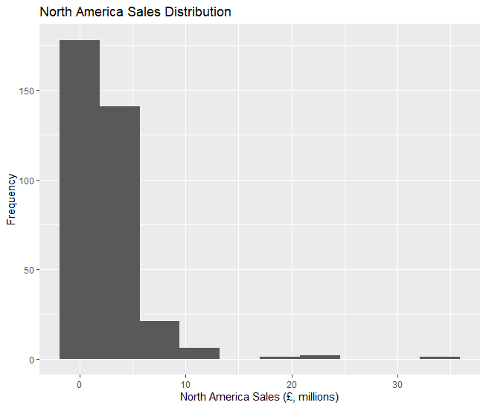
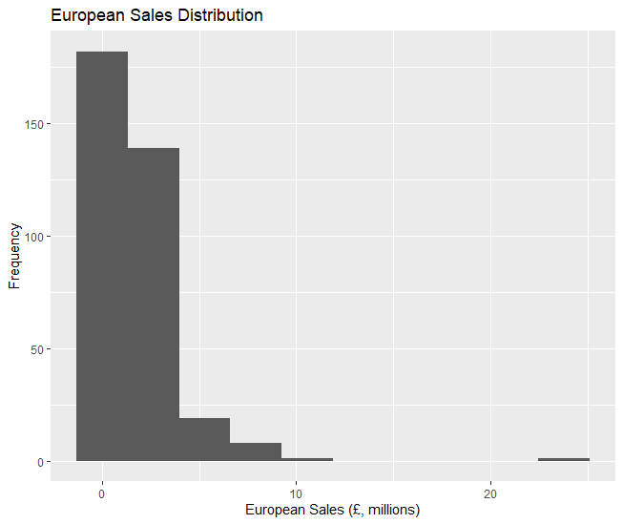
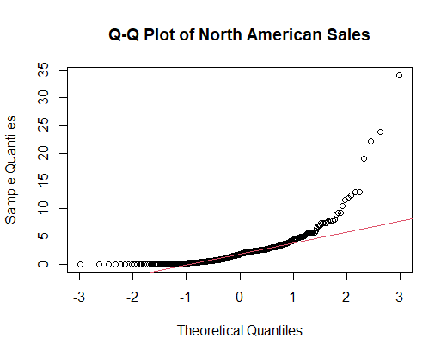
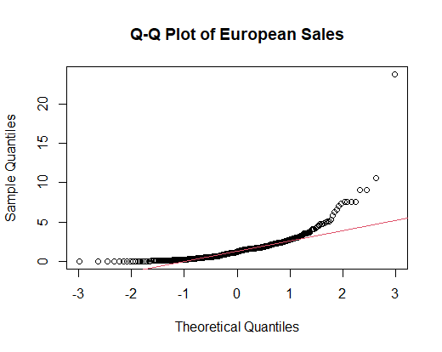
Sales Distribution by Region
North American Sales Distribution
European Sales Distribution

Slide 5
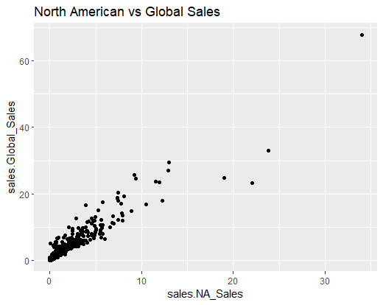
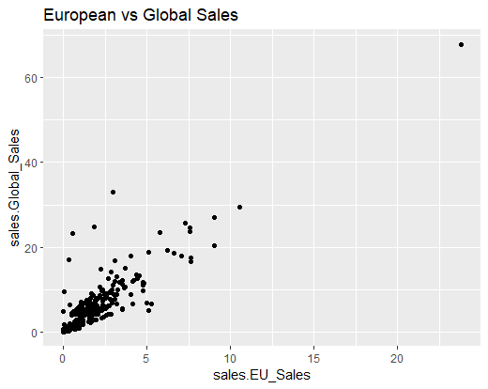
Effect of Regional Sales on Global Sales
North American vs Global Sales
European vs Global Sales

Slide 6
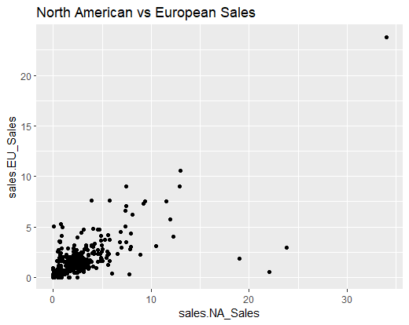
North American and European Sales

Slide 7
Global Sales Predictions
North American Sales | European Sales | Predicted Global Sales
34.02 | 23.80 | 71.46
3.93 | 1.56 | 6.86
2.73 | 0.65 | 4.25
2.26 | 0.97 | 4.14
22.08 | 0.52 | 26.44

Slide 8
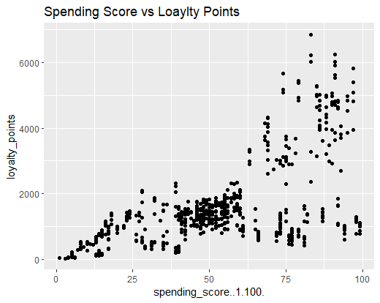
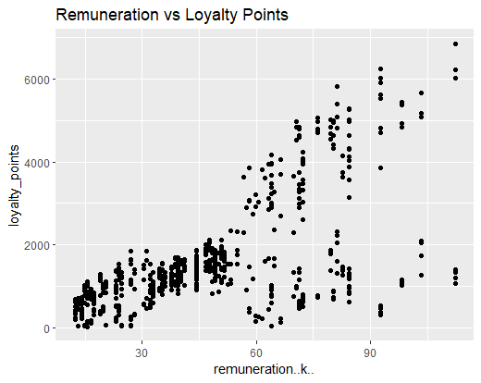
How Loyalty Points are Accrued

Slide 9
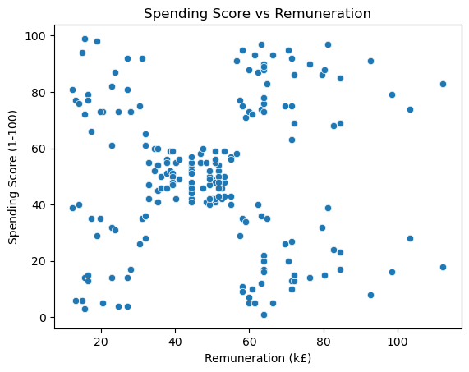
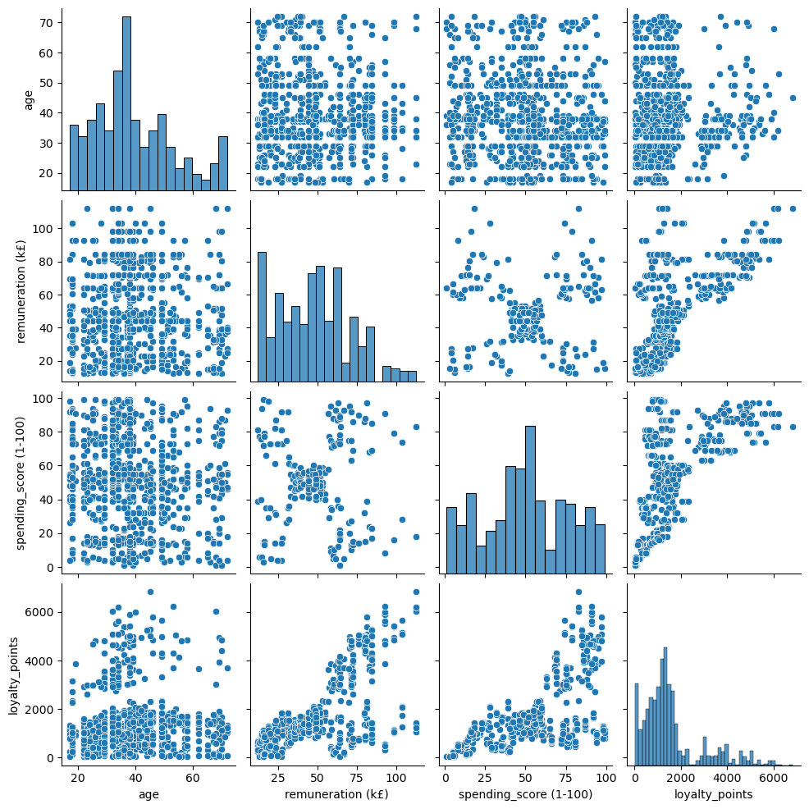
Clustering using Python

Slide 10
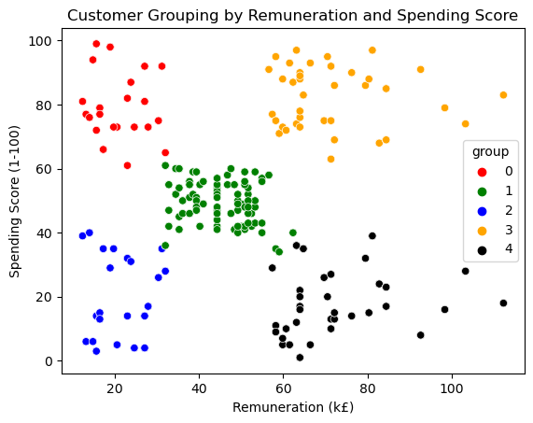
Customer Groups

Slide 11
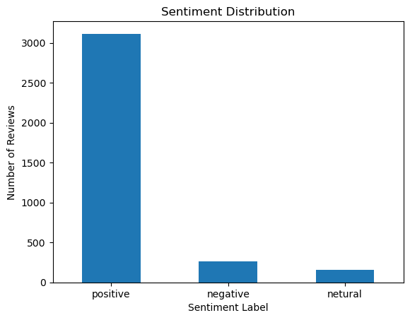
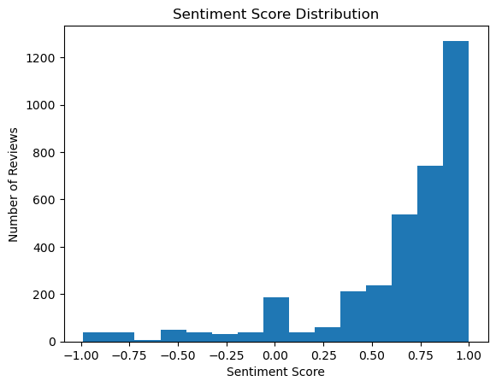
Sentiment Analysis

Slide 12
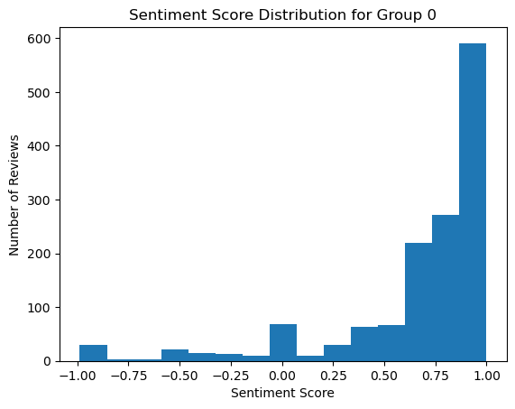
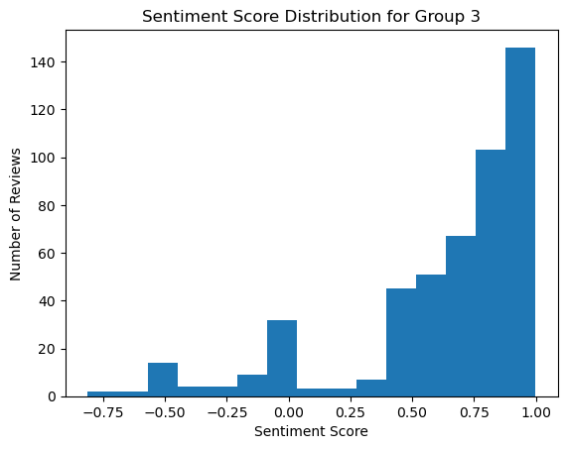
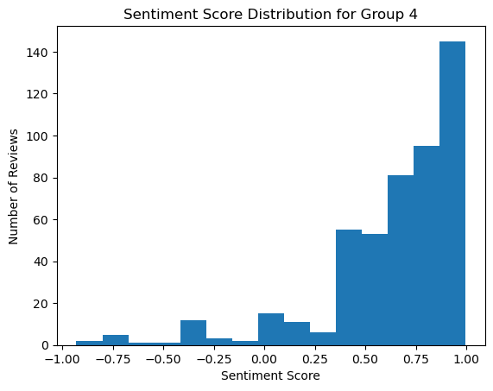
Sentiment Analysis – By Segment

Slide 13
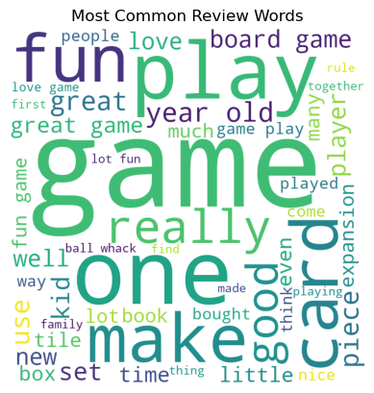
Word Cloud

