Slide 1
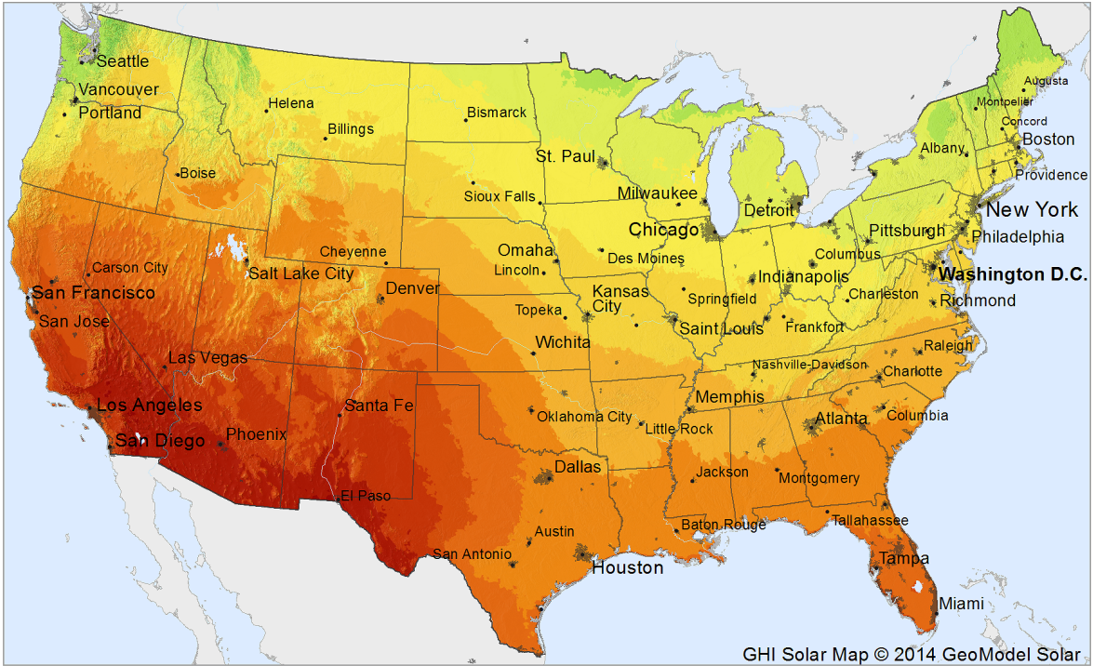
2013-2014 AMS Solar Energy Prediction Project
General Assembly Class Project
Joel Piper
January 6, 2015

Slide 2
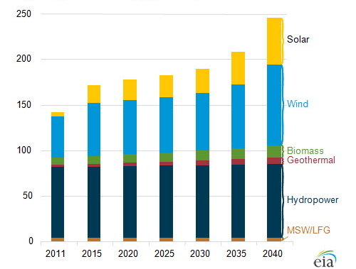
Solar power is a small but increasing source of energy in the United States
Two major hurdles in becoming significant energy source:
Price/Watt
Reliability
Reliability
Storage improvements
Predictive technologies
Renewable Energy Generating Capacity in the United States (Gigawatts)
Notes:
Currently, solar power makes up around .7% of the total energy consumption in the U.S., but this has grown from virtually zero a decade ago. The price of installing and using solar energy has dropped significantly of late. The other issue in operating a grid that has an increasing fraction of renewable energy is the variability in the power produced by these technologies. Two avenues can be useful in minimizing the effects of this variability, increased ability to store capacity and add it to the grid when demand is the highest, and the ability to understand and anticipate the amount of energy that will be generated from renewable sources such that other energy sources can be brought to bear when production is low.

Slide 3
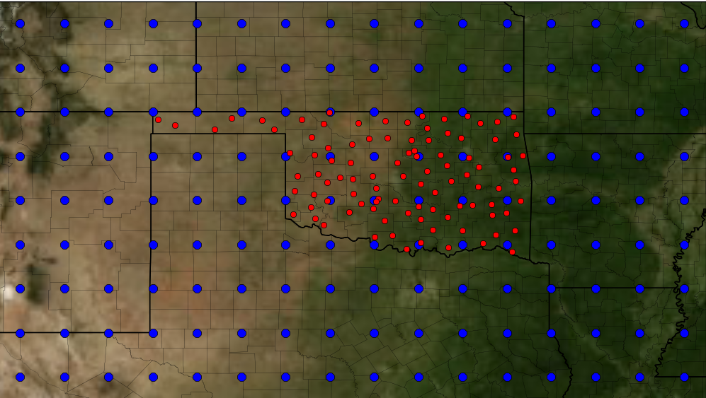
Project Goal: Develop Competitive Learning Technique for 2013 Kaggle AMS Solar Energy Challenge
Predictive Question: Predict the daily solar energy deposition at 98 sites across Oklahoma over two years using weather data (including short wavelength and long wavelength radiative flux) from a 16x9 grid of collection stations across the area.
Notes:
We have information from 11 models for each of the 15 variables at the blue dots. We need to make predictions at the red dots.

Slide 4
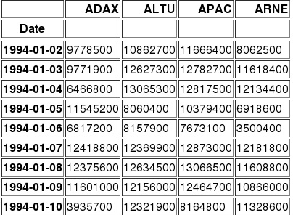
Data- 15 NetCDF input and one CSV output file
15 weather-related variables (including precipitation, cloud cover, downward/upward long-wave/short-wave solar flux, max/min/current temp, humidity, pressure)
At 144 locations, five times of the day, and eleven ensemble members (to account for measurement uncertainty of instruments)
5113 daily solar energy measurements (J/m²) from 1994-2007 at 98 Mesonet locations (~500k predictions)
<type 'netCDF4._netCDF4.Variable'>
float32 Downward_Short-Wave_Rad_Flux(time, ens, fhour, lat, lon)
_FillValue: 9999.0
units: W m-2
long_name: Downward_Short-Wave_Rad_Flux_Average (Average for Mixed Intervals) @ surface
cell_methods: time: mean
GRIB_param_discipline: Meteorological_products
GRIB_param_category: Short-wave_Radiation
GRIB_param_name: Downward_short_wave_rad_flux
GRIB_generating_process_type: Forecast
GRIB_param_id: [ 2 0 4 192]
GRIB_product_definition_template: 8
GRIB_product_definition_template_desc: Average, accumulation, extreme values or other statistically processed value at a horizontal level in a time interval
GRIB_level_type: 1
GRIB_level_type_name: surface
GRIB_interval_stat_type: Average
GRIB_VectorComponentFlag: easterlyNortherlyRelative
unlimited dimensions:
current shape = (5113, 11, 5, 9, 16)
filling on
Notes:
Not a natural alignment of input to output. Days work, but we have nearby lat/long, all hours of the day are relevant, all model inputs. So realy the 7920 variables naively. We can reduce by just focusing on the grid around a given point, and train each of the 98 separately? When getting it into a form for prediction, basically we want to have 5113 lines of input for the 5113 of output. That is useful for making the prediction and alignment, but we have a lot of measurement parameters as our columns, and it is difficult to select and reduce it, so we want to tidy it to help with visualization.

Slide 5
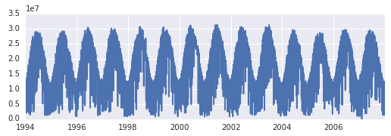
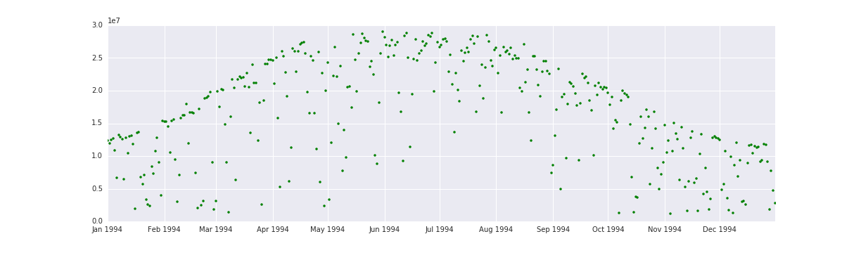
Total Solar Energy (J/m²)

Slide 6
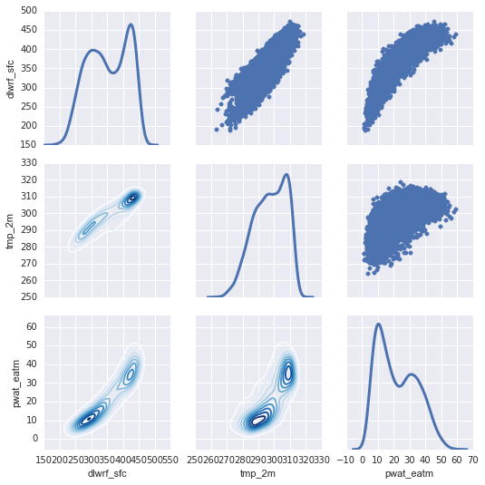
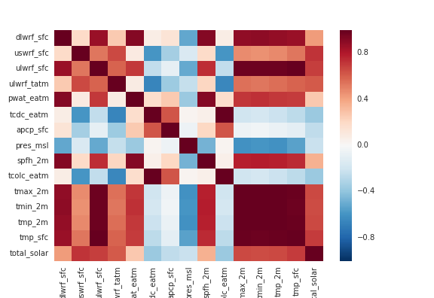
Exploration and Cleaning
Began with a single sample and the surrounding grid of Mesonet points to examine variable correlations.
Notes:
Correlation among solar flux, temperature, and pressure

Slide 7
Next Steps
Tidy the data for easier visualization
Any basic insights from simple visualizations
Start by making predictions at one station
Limit the input data points to a surrounding grid
Add summary stats across all points or cross-sections (e.g., averages, medians, extremes at all points, similar latitudes, longitudes, elevations)
Expand to all stations
Use Apache Spark and MLib to make use of parallel processing algorithms

