Slide 1
Development of
a Smart System
for Monitoring
Driver’ Behaviour
Joel Vaz

Slide 2
Current Situation (31/10)
Android Application for data collection (75%)
Already tested in Android device;
Data fidelity tested against other GPS applications;
Implemented Data Base for storage;
TODO: Integration with data processing && further testing;
Data gathering (20%)
Bus trips at different times with different drivers;
Personal vehicles;
Data Validation && Data Parsing (10%)
Conceptual idea of data validation; (Remove wrong GPS and speed data)
Data Processing (5%)
Conceptual Idea to propose;
Need to define architecture and choose technologies to implement;
Write and prepare presentation (0%)

Slide 3
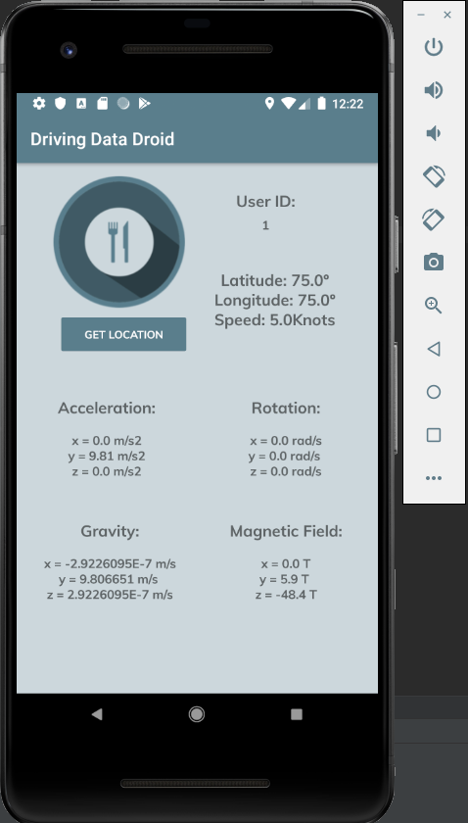
Android Application I
Location from device’ internal GPS;
Acceleration, Rotation, Magnetic filed and Gravity (if all sensors present on device);
User Id to associate data with driver.
Data aquisition starts when “GET LOCATION” is pressed, it ends when apllication is closed.
Development environment print screen.

Slide 4
Android Application II
Data is obtained at a 10Hz sampling rate (GPS data acquisition maximum sampling rate);
Data is sent to a data base (firebase) and transfered to processing computer as a JSON file;
Data is associated with a Driver’ and Trip’ ID;

Slide 5
Data Validation
Possible data validation is comparing data obtained at instant t Data[t] with Data[t-1] and Data[t+1];
If deviation is too high, data can be considered invalid;
Another possible approach is to use redundancy, for example another data collection application from a different device;

Slide 6
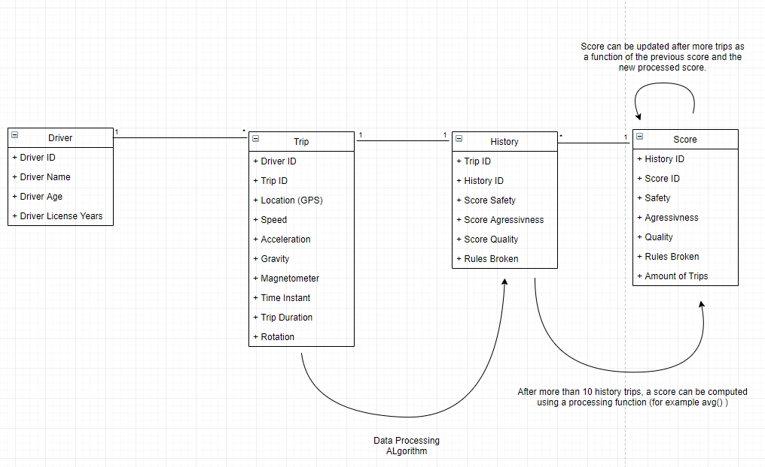
Data Base Model
Raw data from application goes here
sendToDB()
FunctionAvg()
Validation()
Processing()
sendToDB()

Slide 7
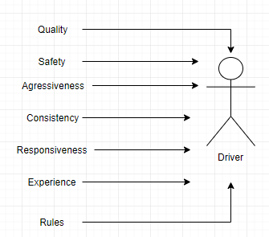
Driver Characteristics

Slide 8
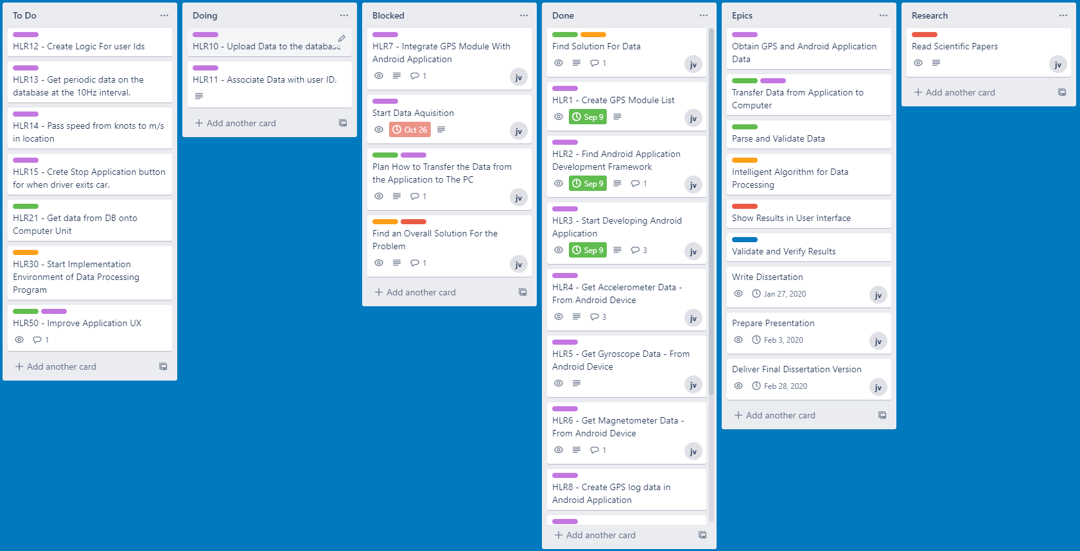
Agile Board

Slide 9
Doubts && Questions
Document and presentation dates?
Data processing Algorithm? (Fuzzy?)
Driver score output should be a single value or a multitude of characteristics with associated values?
Data Presentation? Create apllication for driver’ results?
Set skype weekly ~30 minute meetings for progress reports?
On final presentation/document should I mention Agile?
Next Steps?

