Slide 1

By Joseph Lord and David Castaneda

Slide 2
What is Teemip
Teemip is an easy to use web-based application that provides IP management.
TeemIP is a sub-product of iTop, and while iTop has more features than TeemIP,
iTop only has a limited free version.

Slide 3
Teemip Features
IPv4 and IPv6 Subnet & Range Management
Capacity Planning
User friendly interface
History on all data
Helpdesk and User Portal

Slide 4
Why we need Teemip
One of the essential duties of a system administrator is to keep track
of all the devices under the control of IT
If this is not done properly, it could lead to devices being lost or stolen without the
sysadmin ever knowing, which would be a huge problem.
TeemIp is a simple powerful tool to manage IPv4 IPv6 plans, subnet space and IPs

Slide 5
What TeemIP Does
Manage multiple customers or organizations: TeemIp supports overlapping IP spaces
Define IP plans through hierarchical network blocks
Delegate IP blocks from parent to child organizations
Manage subnets within predefined network blocks
Attach IP ranges to subnets
Register IPs and get a clear view on the IP space consumption
Proactively notify administrators on key events

Slide 6
Important Notes
TeemIP requires a php version of 5.6 or higher
TeemIP is web based, so nothing needs to be installed on the client machine
TeemIP does include ticket management and helpdesk utilities, however we opted out of those.

Slide 7
Using TeemIP
Once TeemIP is installed it is very easy to use.
We will show you an example of how to add IP’s for the lin workstation we made in our labs.

Slide 8
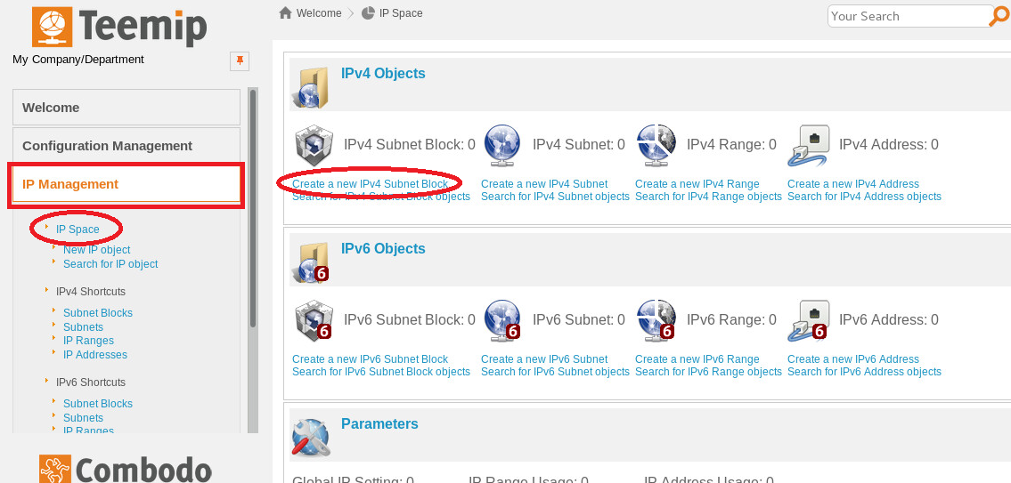
Using TeemIP
First we create a new subnet block. On the left side, click IP Management -> IP Space -> Create a new IPv4 Subnet Block.

Slide 9
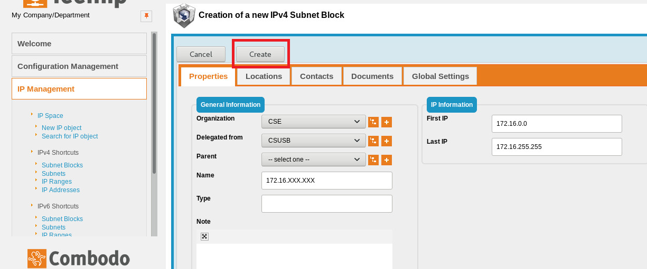
Using TeemIP
Next, create a subnet for our subnet block. Our Hadrian’s subnet is 172.16.1.0. The Gateway IP and Broadcast IP are
automatically filled out once
this subnet is filled out.

Slide 10
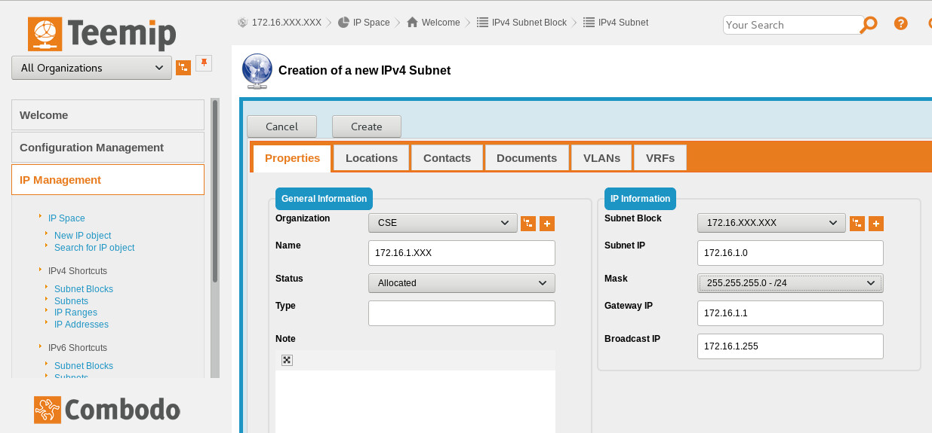
Using TeemIP
Next, we create an IP range for our subnet block. Our IP ranges for workstations are between 172.16.101 to 172.16.254. Make sure
DHCP Range is set to yes.

Slide 11
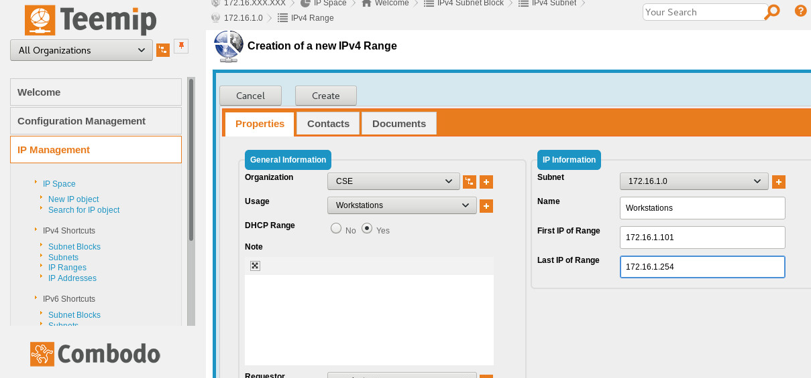
Using TeemIP
Next, Create a subnet for the workstations.

Slide 12
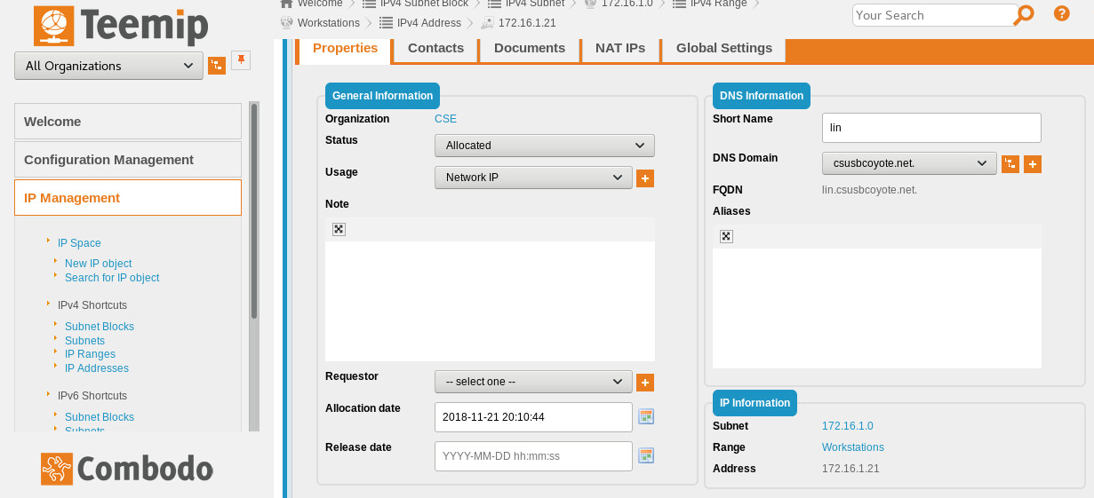
Using TeemIP
Lastly, we add our currently leased IPs to our subnet block. Make sure the DNS has the right domain

Slide 13
Done!
As you can see, TeemIP is very easy to use.
Once you have all your IP’s input into the system, you can easily search for specific IP’s or
hostnames through a search bar at the top of the webpage.

