Slide 1

By Joseph Lord

Slide 2
About Bacula
A set of programs that allow you to manage backup and recover of computer data across a network
The most popular open source backup service, available on most platforms
Fairly easy to install. Things must be installed and configured on both server and client.

Slide 3
Installation and Configuration-Server
The server has more configuration than the client does, however it is still easy.

Slide 4
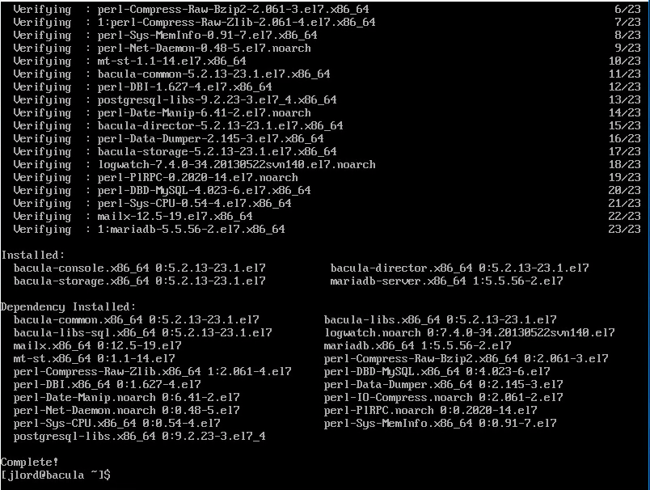
Install bacula-director bacula-storage bacula-console mariadb-server
sudo yum -y install bacula-director bacula-storage bacula-console mariadb-server

Slide 5

Start and enable mariadb
sudo systemctl start mariadb
sudo systemctl enable mariadb

Slide 6
Edit my.cnf and add the following:
sudo vim /etc/my.cnf character-set-server=utf8

Slide 7
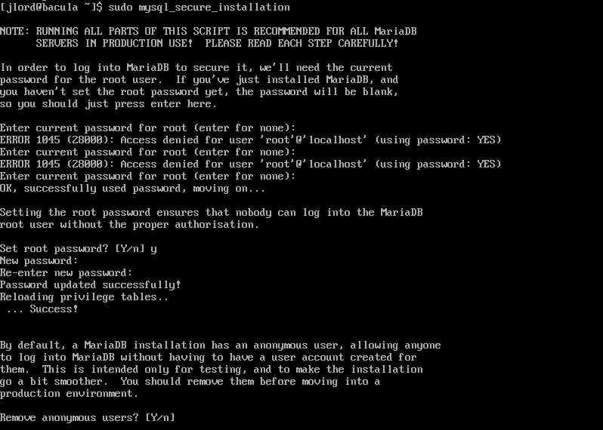
Do the mysql installation
sudo mysql_secure_installation

Slide 8
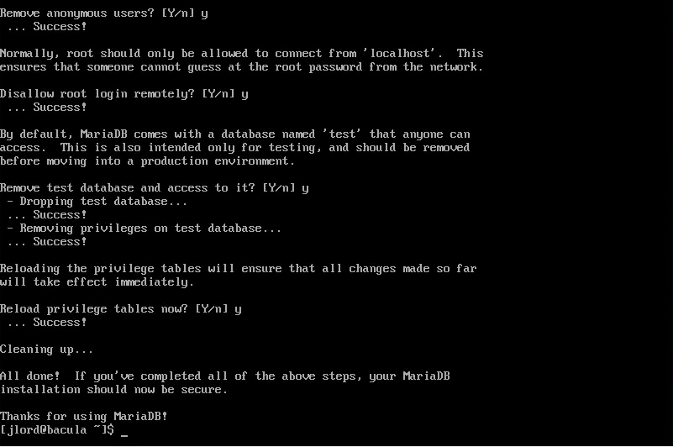

Slide 9
Add mysql and ports 9101,9102,9103 to the firewall
sudo firewall-cmd –permanent –add-service=mysql
sudo firewall-cmd --permanent --add-port={9101,9102,9103}/tcp
sudo firewall-cmd –reload

Slide 10
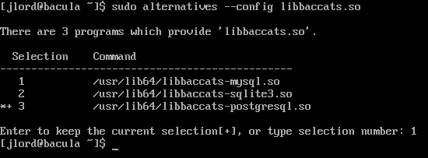
Change the selection for libaccats to mysql
sudo alternatives –config libbaccats.so
type 1

Slide 11
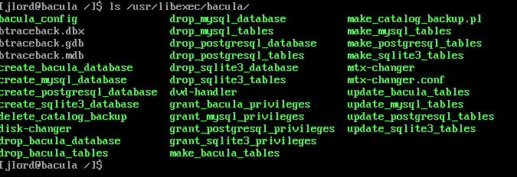
Go to root and look at the bacula directory
ls /usr/libexec/bacula/

Slide 12
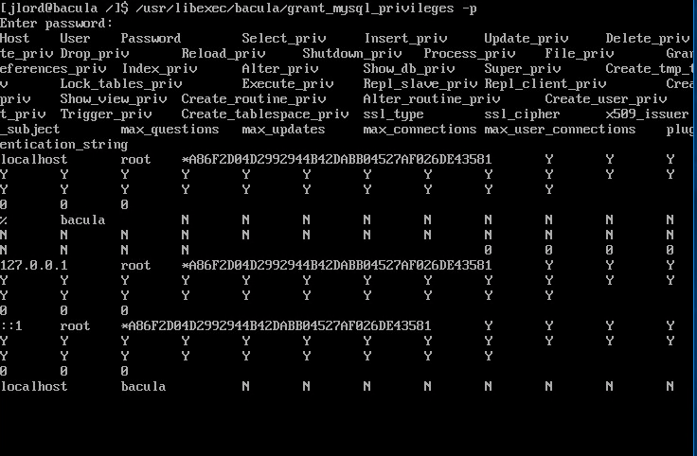
Run grant mysql privileges and create a database with tables for bacula
/usr/libexec/bacula/grant_mysql_privileges -p
Enter root password
/usr/libexec/bacula/make_mysql_tables -p
Enter root password
/usr/libexec/bacula/make_mysql_tables -p

Slide 13



Slide 14
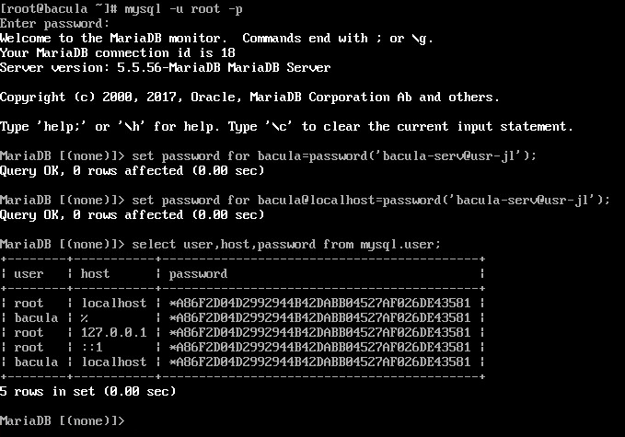
Set mysql password for bacula database and use bacula
mysql -u root -p
enter password
set password for bacula=password('password');
set password for bacula@localhost=password('password');
select user,host,password from mysql.user;

Slide 15
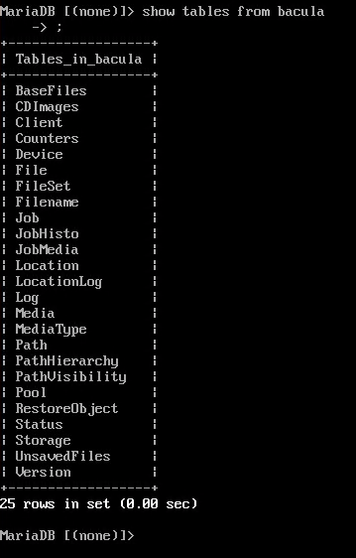
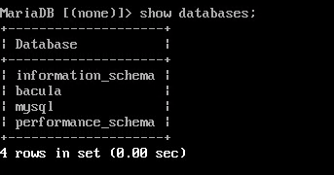
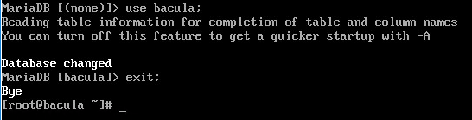
show databases;
show tables from bacula;
use bacula;
exit;

Slide 16
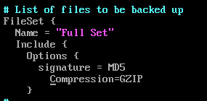
Edit bacula-dir.conf
vim /etc/bacula/bacula-dir.conf
go to line 22 and change password to your password
go to line 93 and add a new line Compression=GZIP

Slide 17
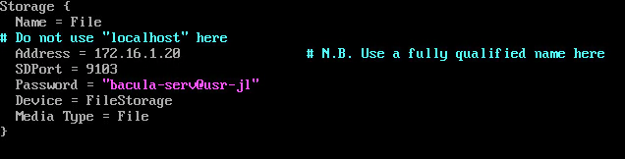
go to line 110 and change /usr/sbin to /data
go to line 158 and change localhost to IP address of the client
go to line 161 and change password to your password
go to line 187 and change address to server address
go to line 189 and change password to your password
go to line 236 and enter your dbpassword
comment out lines 310-314

Slide 18
Edit make_catalog_backup.pl
vim /usr/libexec/bacula/make_catalog_backup.pl
go to line 109 and add -u$args{db_user} -p$args{db_password}

Slide 19
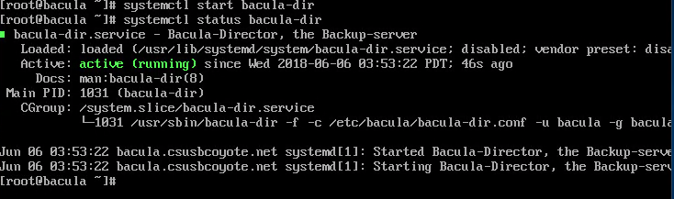
Start bacula-dir and check its status
systemctl start bacula-dir
systemctl status bacula-dir

Slide 20
Edit bacula-sd.conf
vim /etc/bacula/bacula-sd.conf
go to line 26 and change password to your password
comment out lines 33-37

Slide 21
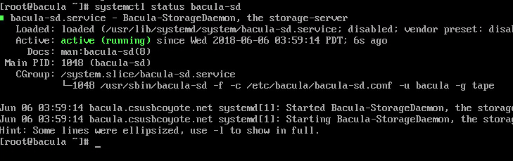
Start bacula-sd and check its status
systemctl start bacula-sd
systemctl status bacula-sd

Slide 22
ake sure server is listening to bacula-dir and bacula-sd on ports 9101 and 9103
netstat -ntpa

Slide 23
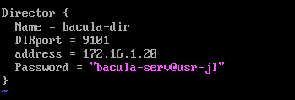
Edit bconsole.conf
change address to servers IP address and the password to your password

Slide 24
Installation and Configuration-Client
This should be fast

Slide 25
Add the ports and to the firewall and reload
firewall-cmd --permanent --add-port={9101,9102,9103}/tcp
firewall-cmd –reload

Slide 26
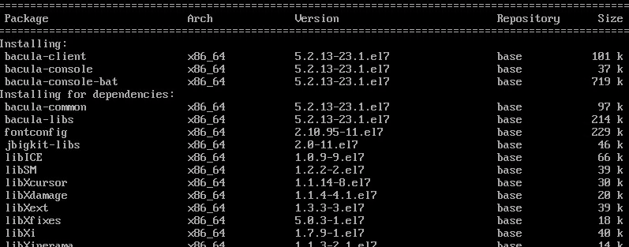
Install bacula-client bacula-console bacula-console-bat
yum -y install bacula-client bacula-console bacula-console-bat

Slide 27
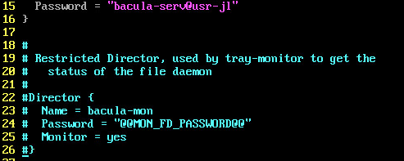
Edit bacula-fd.conf
vim /etc/bacula/bacula-fd.conf
got to line 15 and change password to your password
comment out lines 22-26

Slide 28
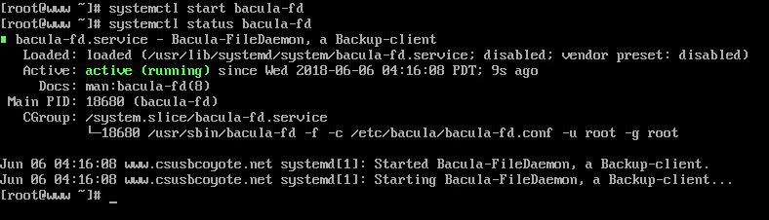
Start bacula-fd and check its status
systemctl start bacula-fd
systemctl status bacula-fd

Slide 29
Edit bat.conf and bconsole.conf
vim /etc/bacula/bconsole.conf
change address to servers IP address and the password to your password
vim /etc/bacula/bat.conf
change address to servers IP address and the password to your password

Slide 30
Make a new directory called data
cd /
mkdir data
ls

Slide 31
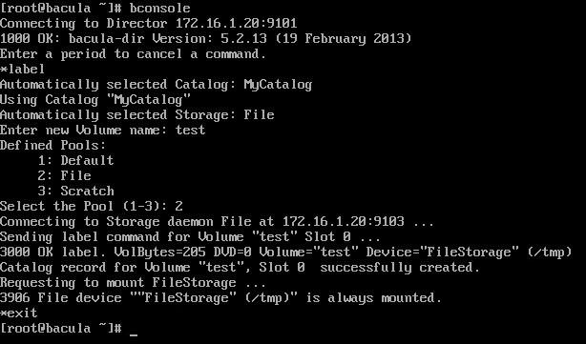
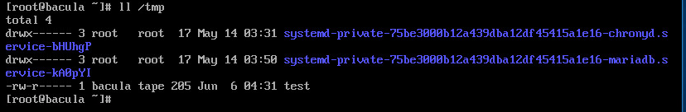
TESTINGGGGG
On Server:
bconsole
label
test
2
exit
ll /tmp

Slide 32
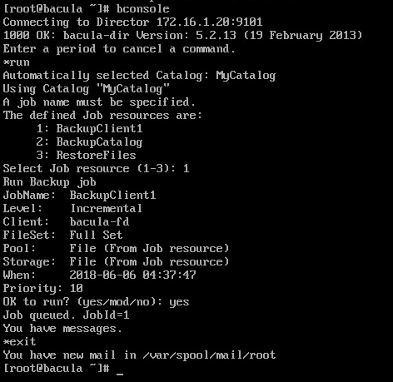
bconsole
run
1
yes
exit

Slide 33
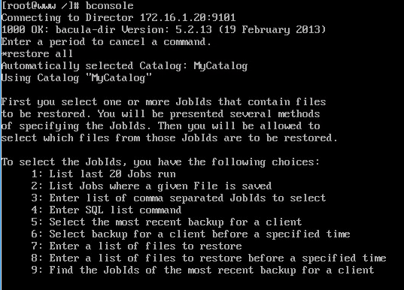
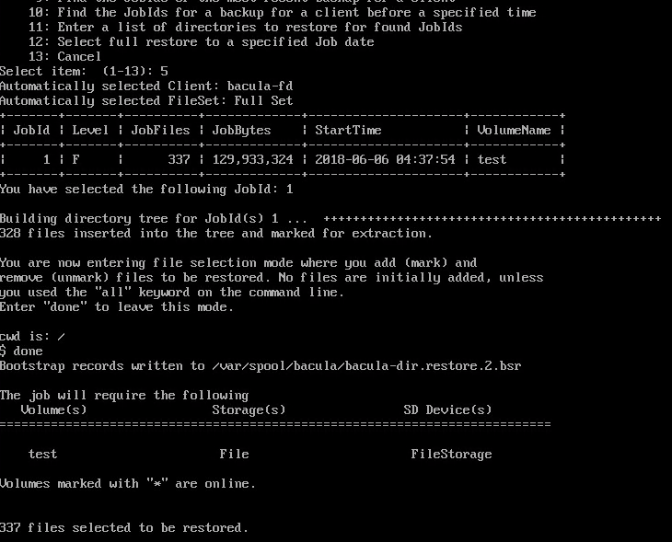
On Client:
bconsole
restore all
5
done
yes
exit

Slide 34
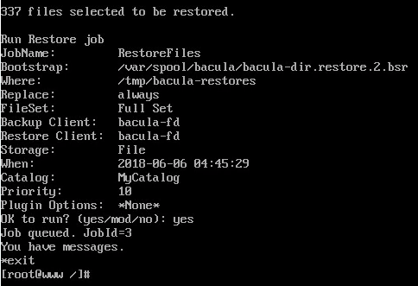

Slide 35
Lastly, check tmp/bacula-restores directory for restored files

Slide 36
DEMO

