Slide 1
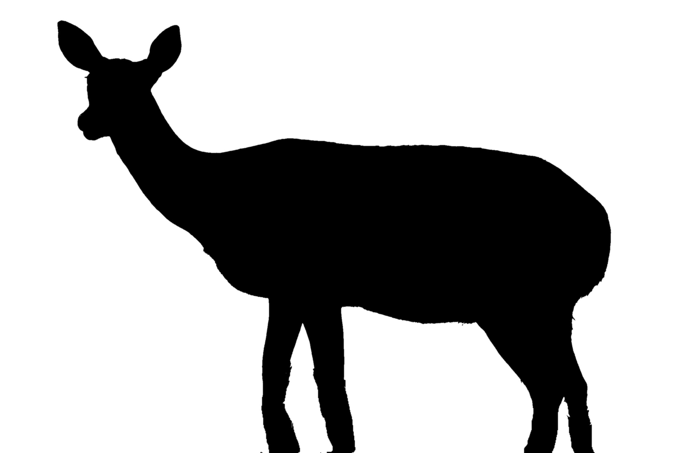
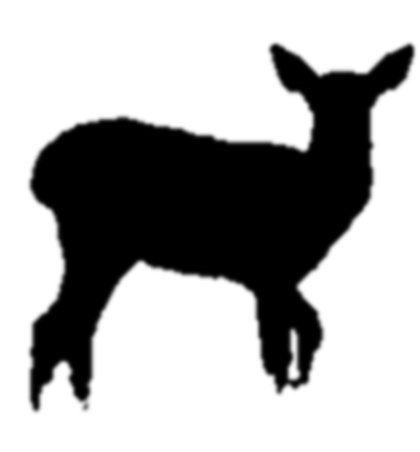

A)
Mother
Aunt
C)
Grandmother
Focal
Cousin
0.125 V_{A} + 0.5 V_{MG}
+ 0.5 C_{A,MG}
B)
Father
Father
Uncle
0.5 V_{A} +
0.25 C_{A,MG}
Focal
Focal
Cousin
0.125 V_{A}

