Slide 1
Farmy - AI
Team Lead :
Afrin
Team Members:
Joel J
DhanushKiren R

Slide 2
Contents:
Problem
Solution
Uniqueness
Future Scope
Conclusion

Slide 3
Problem Statement
Lack of investment
Damage caused due to growing the same crops repeatedly.
Reduced profit due to demand less crops
The growth of plants gets affected due to lack of particular soil fertility

Slide 4

Slide 1
Solution
Predicting the optimal crop that could be grown in a particular location based on the soil composition, rainfall, temperature

Slide 5
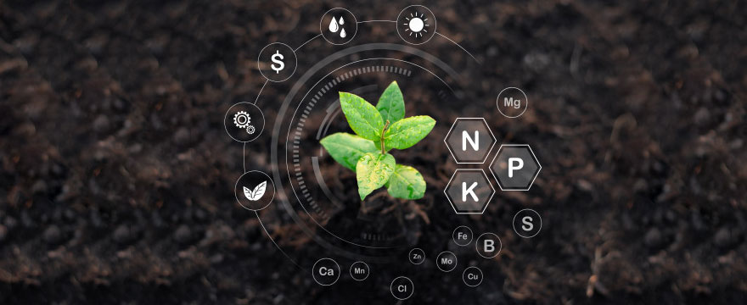
Uniqueness
ML based Website - demand, price, yield prediction (return on investment), crop recommendation and fertilizers recommendation
The user can find out the yield and the price they would get upon cultivating a certain area of crop.

Slide 6
Implementation
Technical Stack

Slide 7
Technical stack
ML models
Linear regression & decision tree classifier Technologies
html, css, bootstrap -flask
python modules sckit learn,numpy,pandas,marplotlib
User Inputs
Crop yield statistics
District Crop Planned area of cultivation(in acres)
Planned area of cultivation(in acres)
Crop Recommendation
N,P,K values Temperature(mean temp. in your area) PH Value
Rain(mean rainfall in your area) Humidity A recommended crop suitable for your soil profile is returned.
Fertilizers Recommendation
Crop N,P,K Values Temperature(mean temp. in your area) Humidity
Moisture Content A recommended fertilizer suitable for your soil profile and crop is returned.

Slide 8
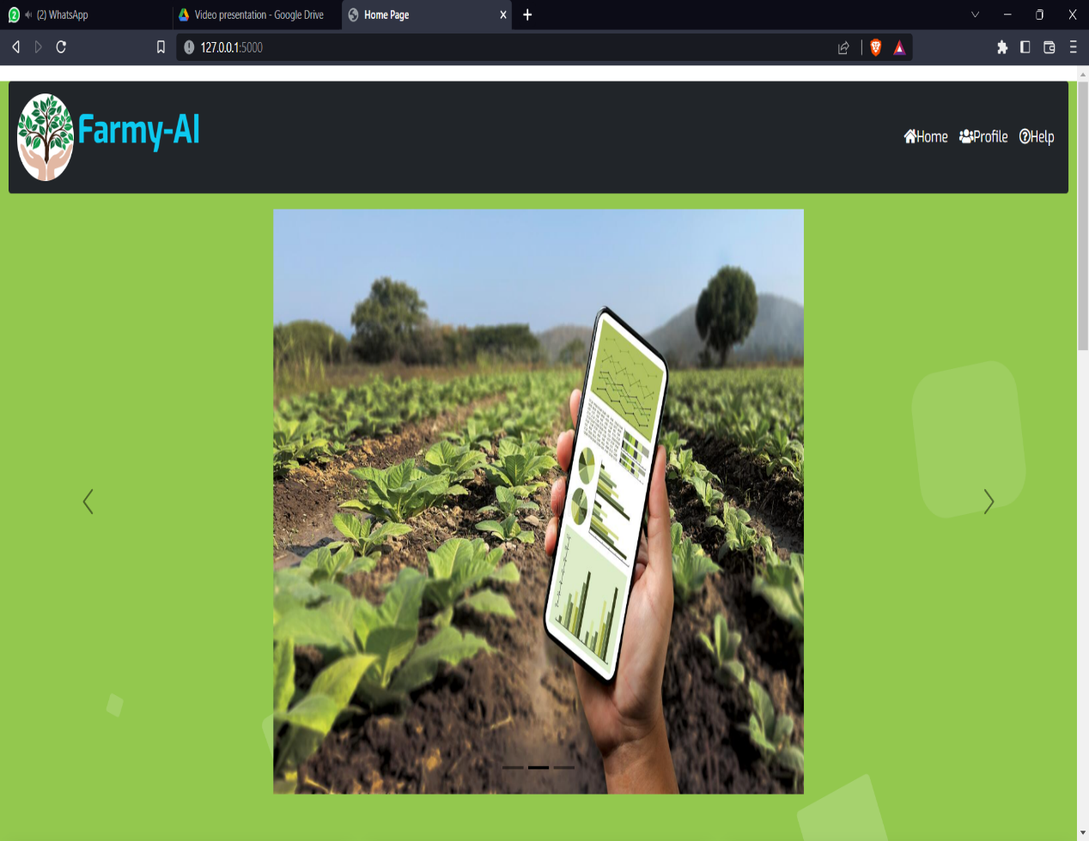
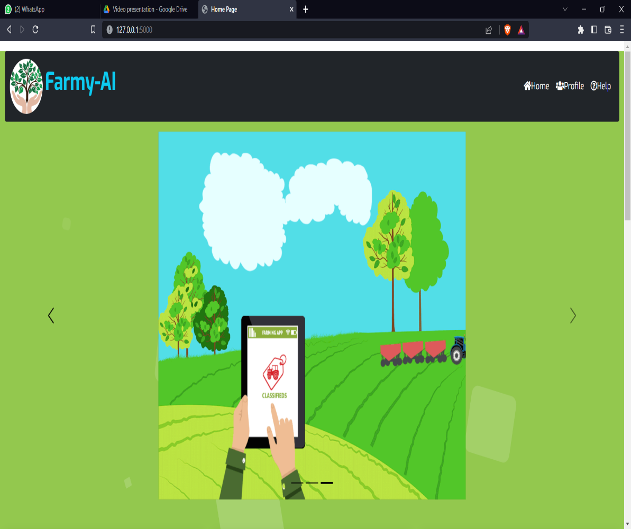
Outcome
Login Page

Slide 9
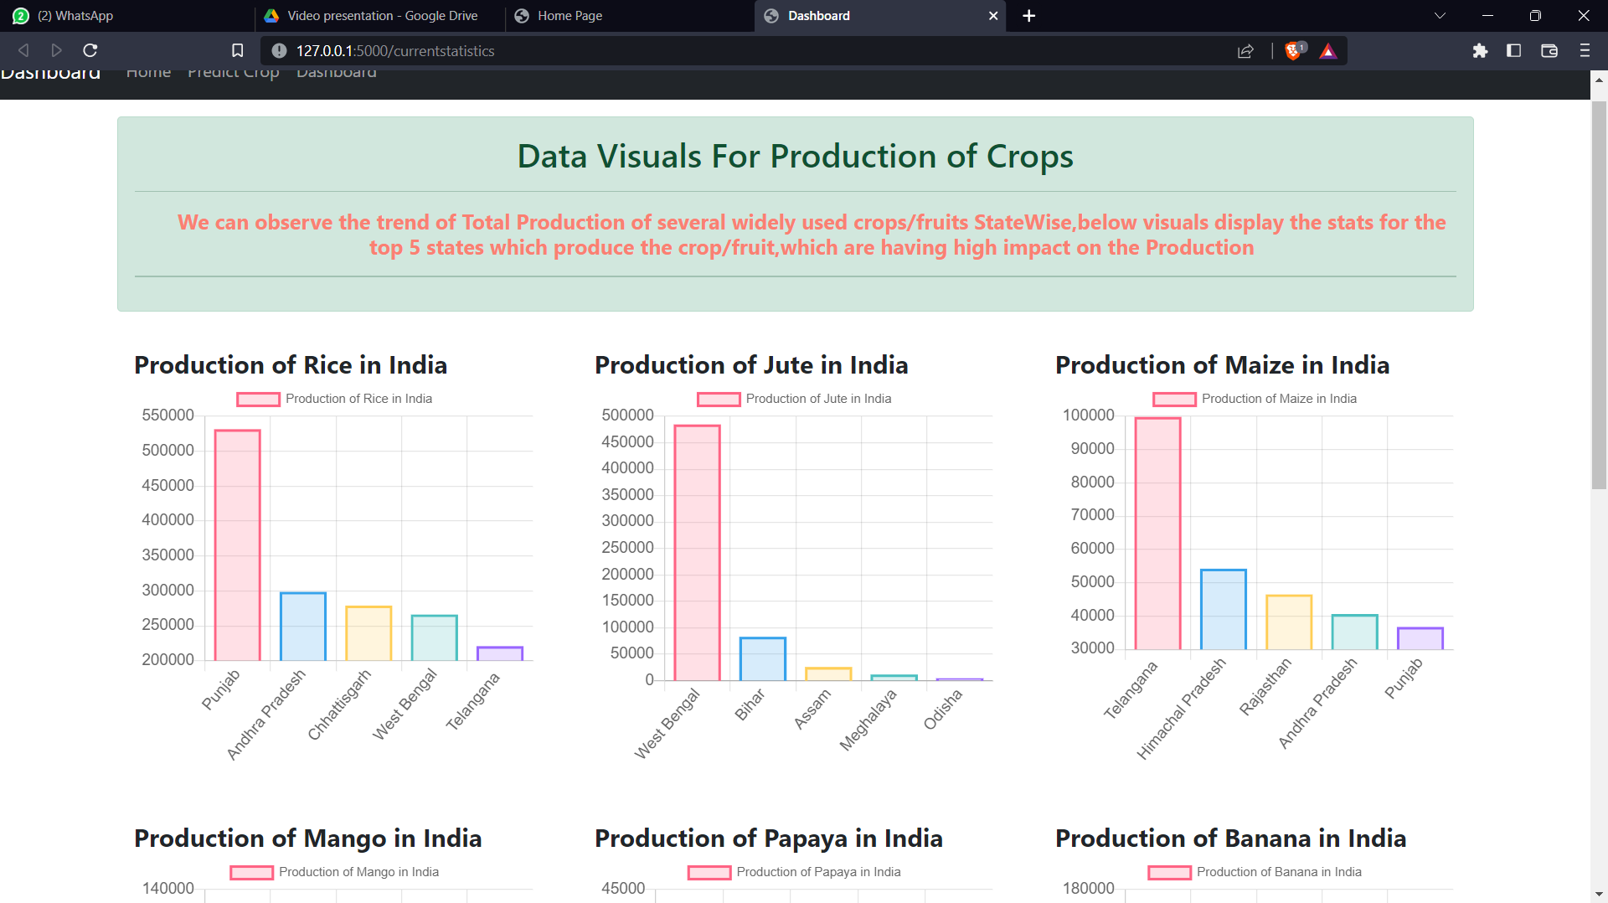
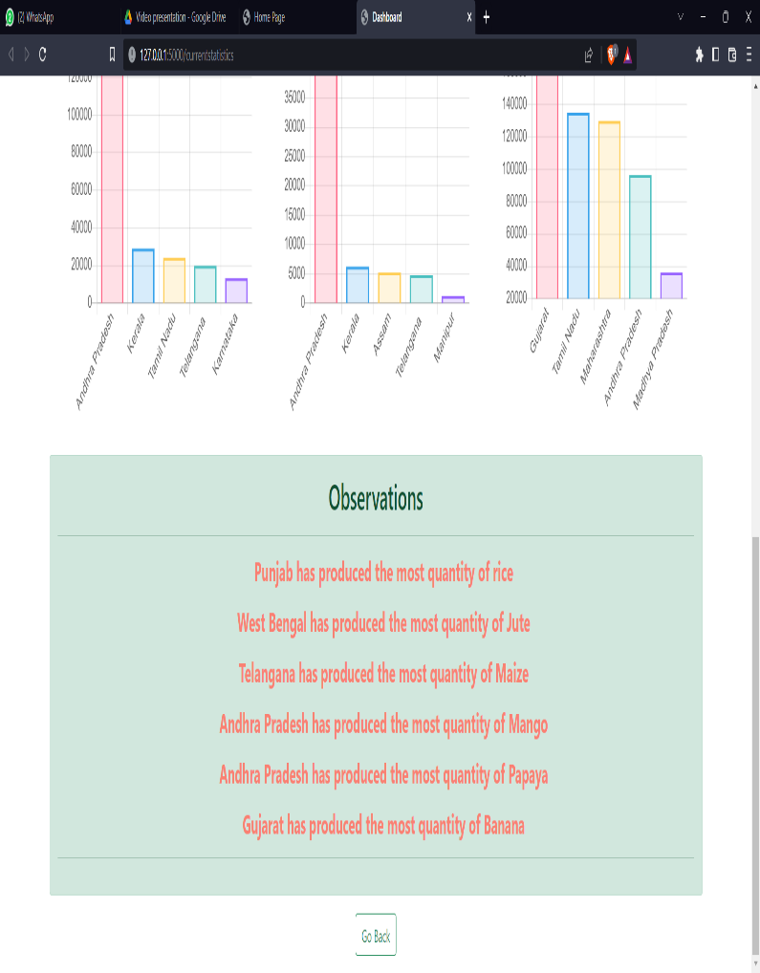
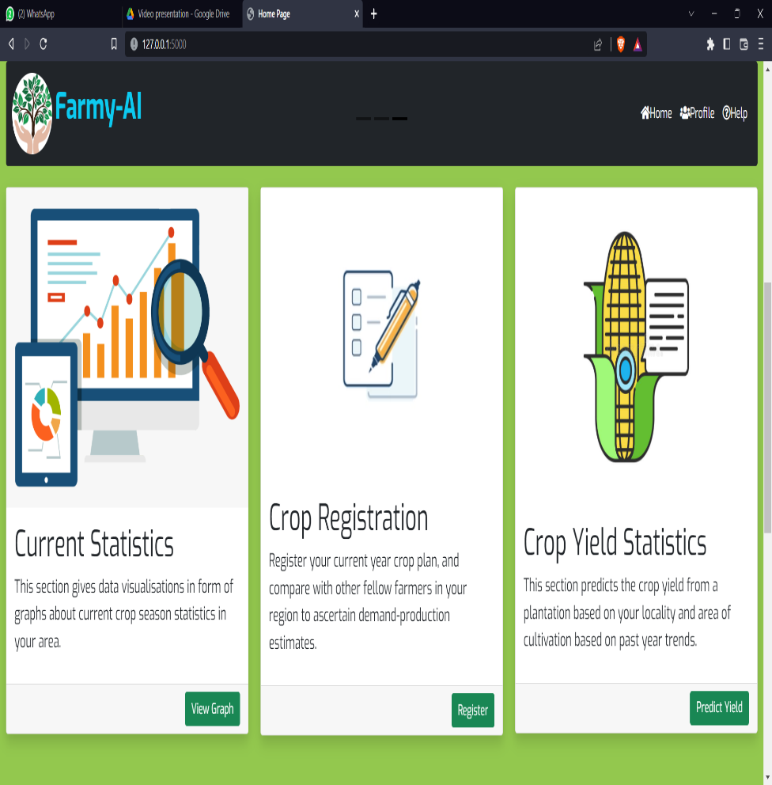
Feature access page
Data visuals

Slide 10
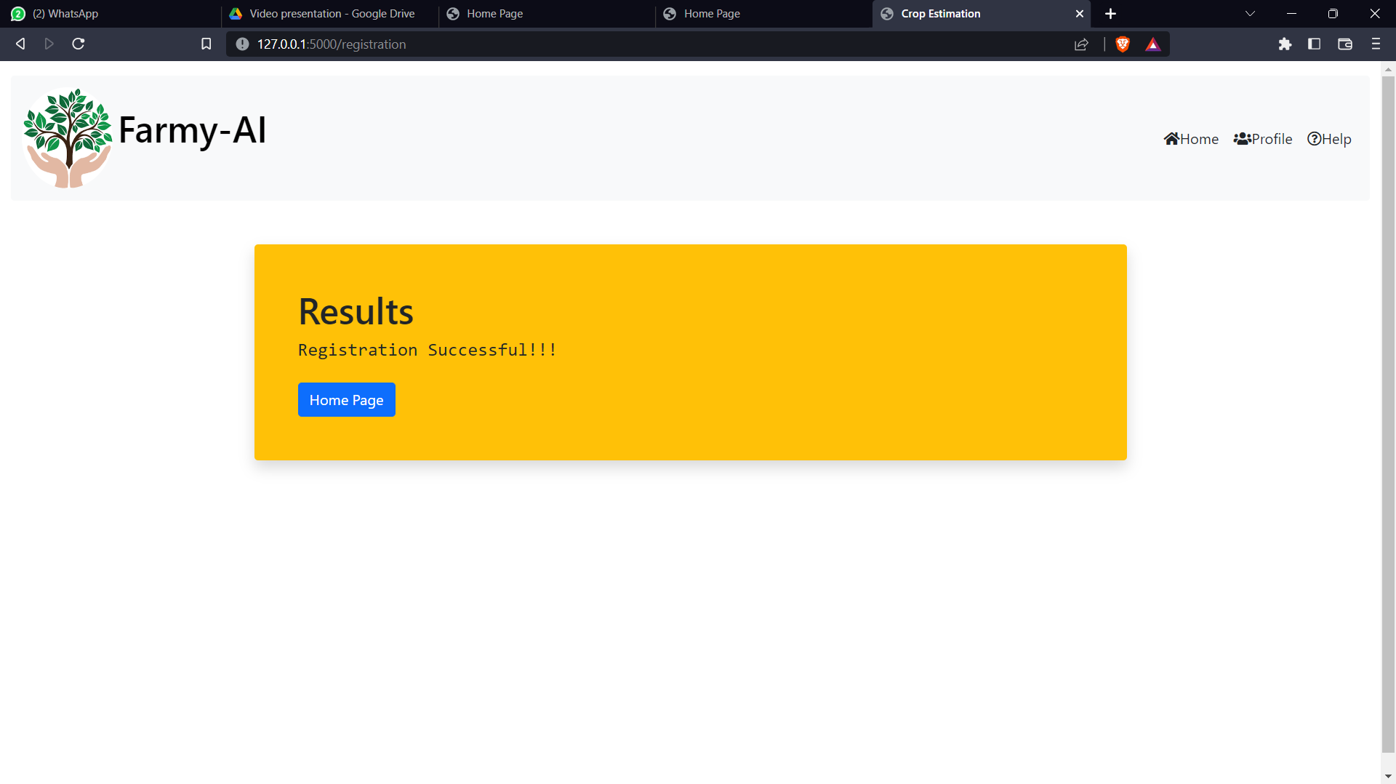
Crop Registration input page

Slide 11
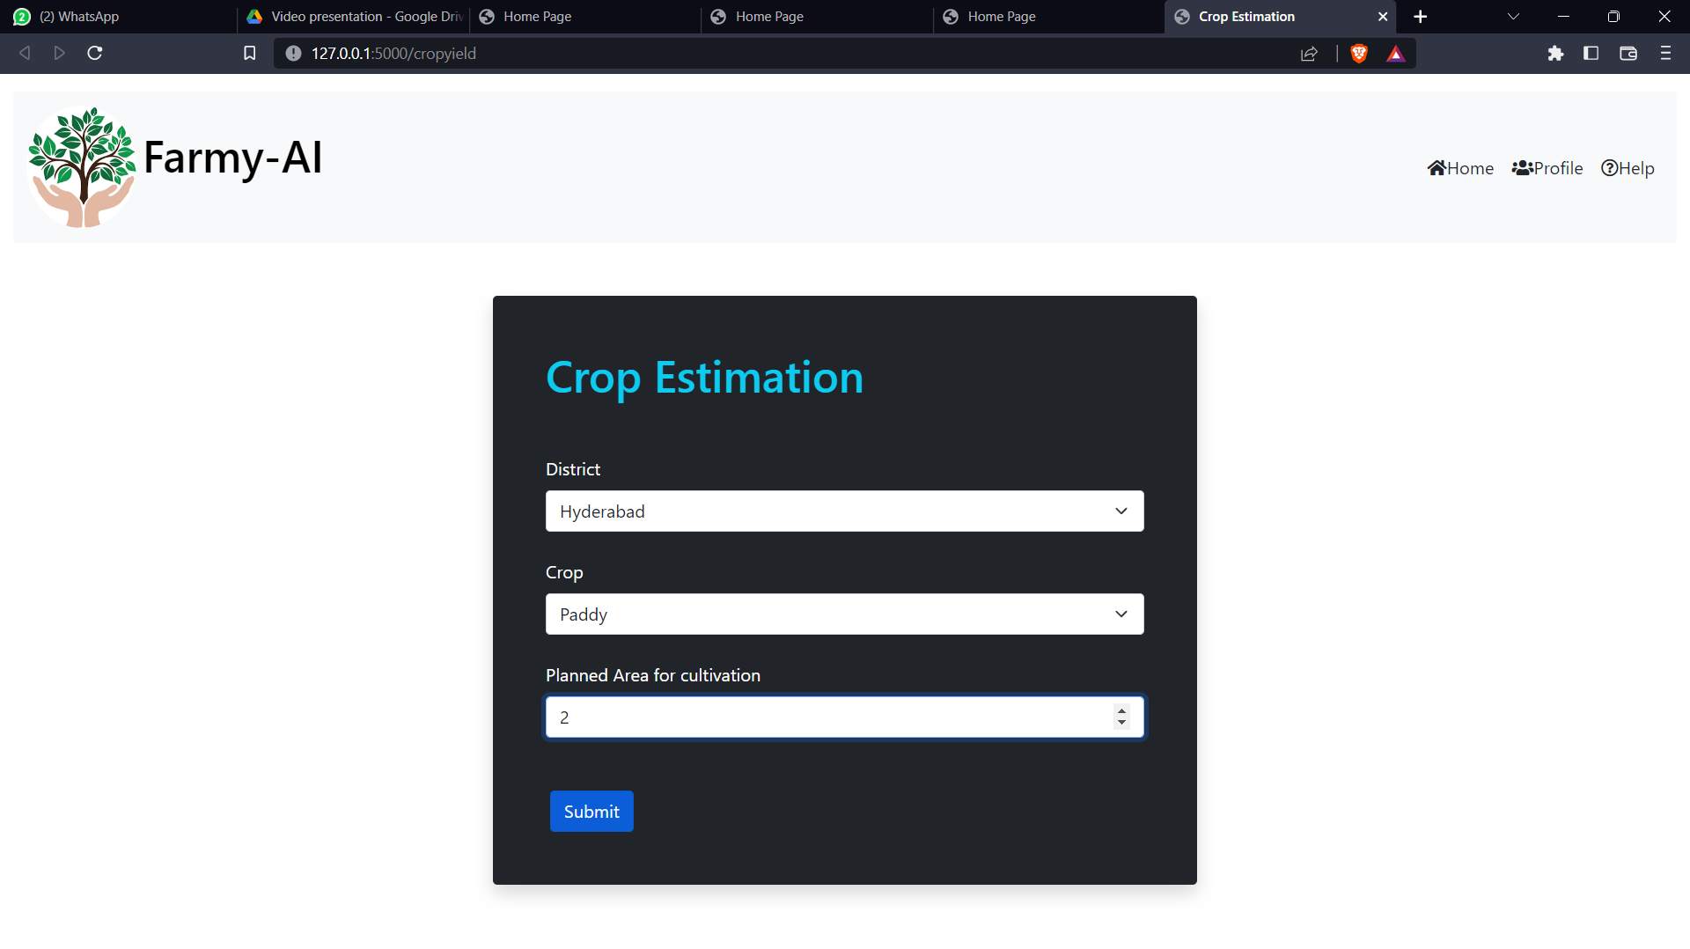
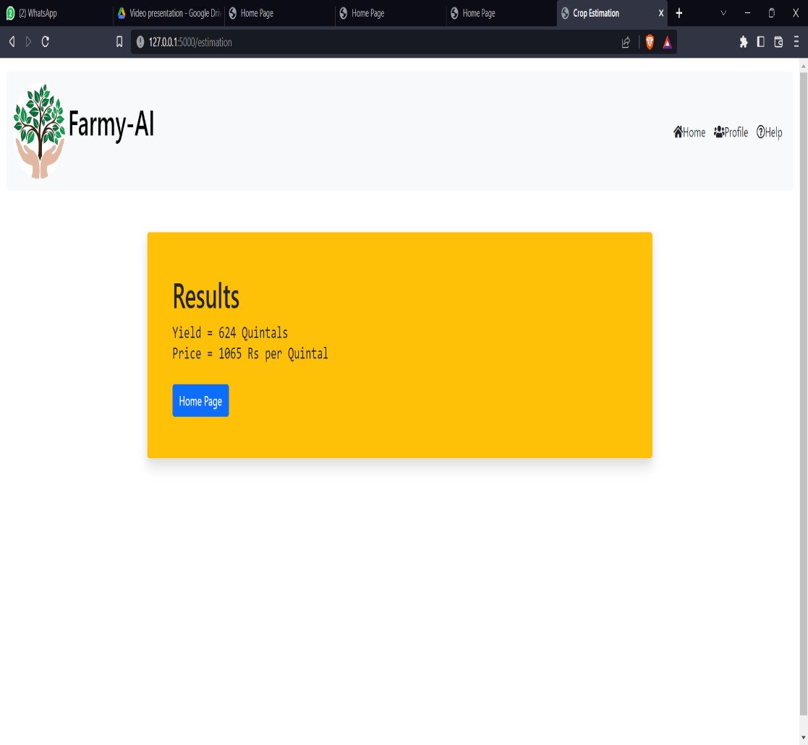
Crop Estimation

Slide 12
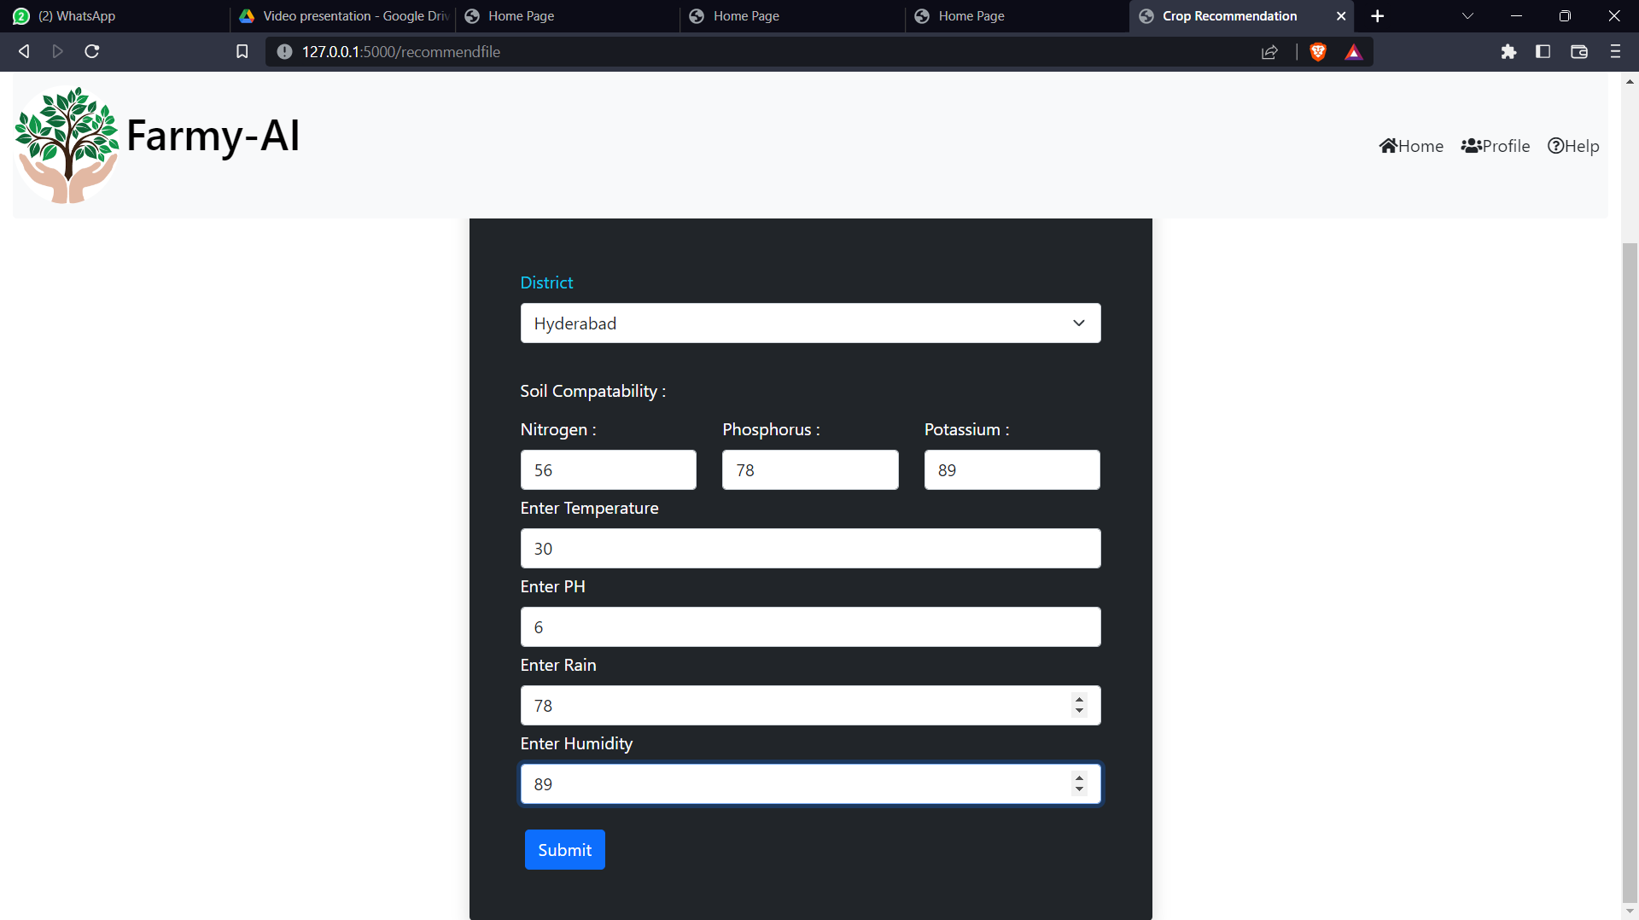
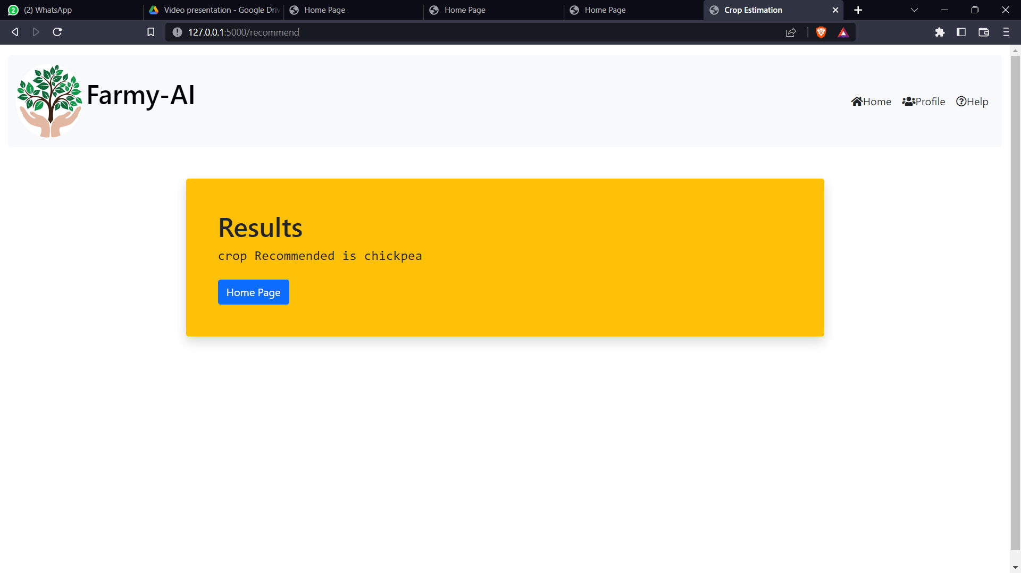
Crop Recommendation

Slide 13
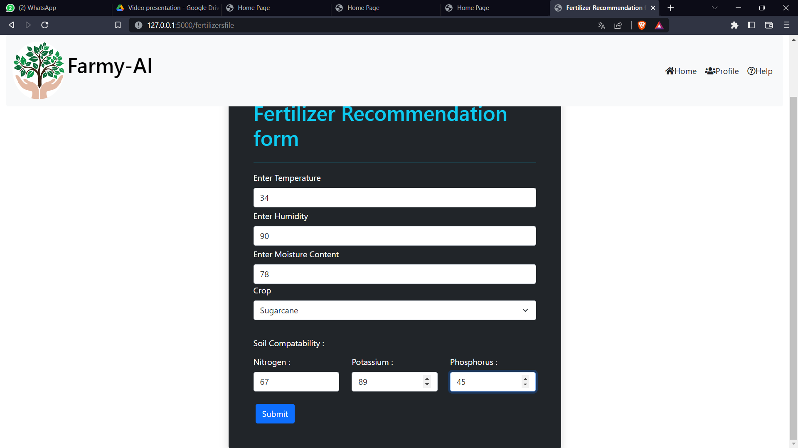
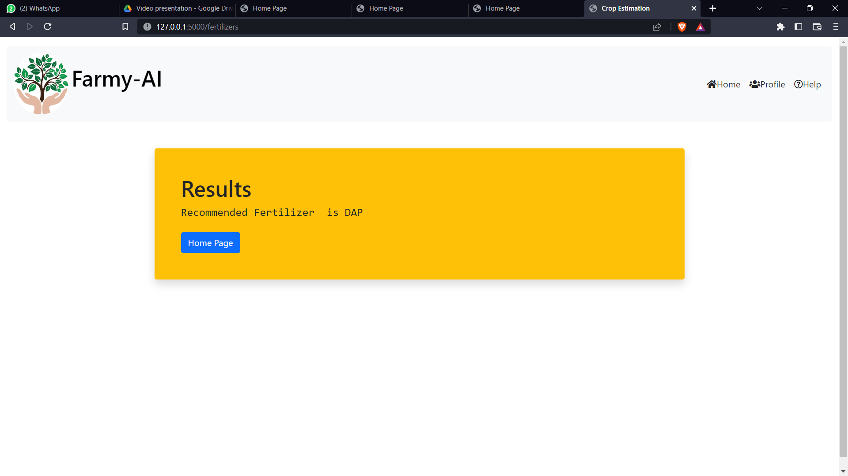
Fertilizer recommendation

Slide 14
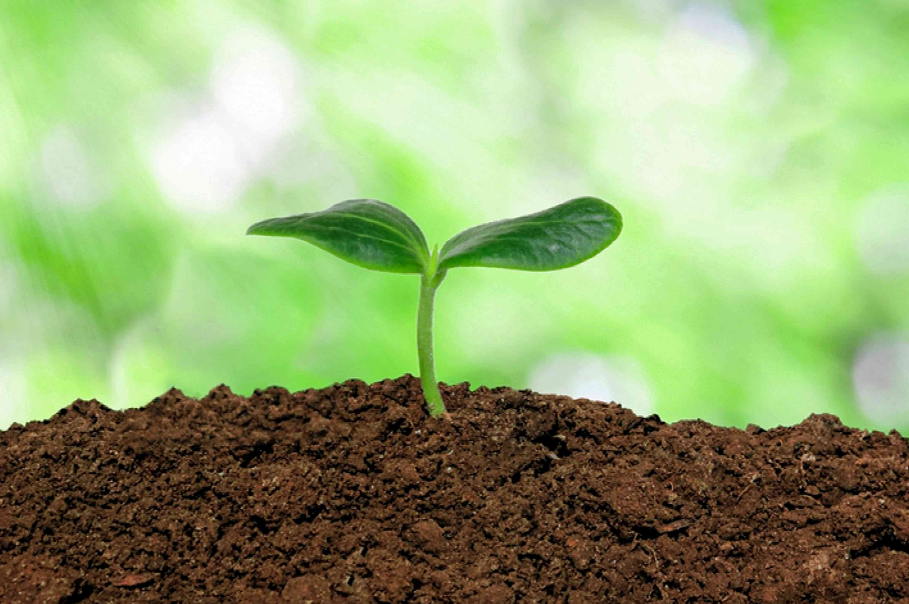
Future Scope
revenue
Other product ads
The above performed recommendation models can be integrated with IOT based Bluetooth modules which can depict the N, P, K, temperature, humidity, moisture content values from the soil itself by using sensors
Chat bot can be added to improve user experience

Slide 15
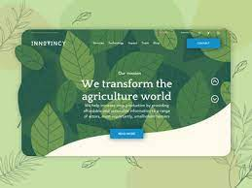
Conclusion
The Soil wealth is maintained
Plant growth is promoted
Farmer’s regular profit gets improvised

Slide 16
THANK YOU!

