Slide 1

Y
YO
YOU W
YOU
YOU WI
YOU WIN
YOU WIN!

Slide 2

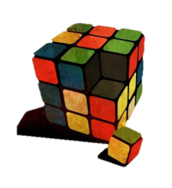
YOU WIN!
YOU WIN!

