Slide 1

Machine Learning: Vehicle Type Identification
Joel Rechin
CES540

Slide 2
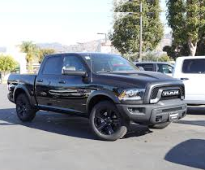
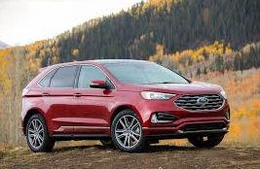
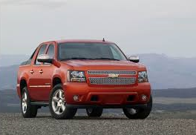
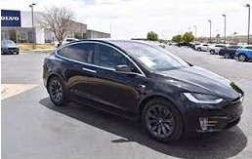
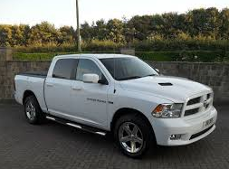
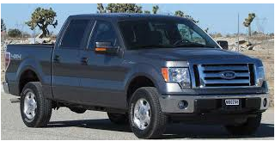
Introduction
Objective_1: Identify 3 truck makes.
Ford, Chevy, Dodge
Objective_2: Identify 3 vehicle types.
Midsize, Tesla, Truck
Used Google Image Downloader extension for image scraping.
Dodge
Midsize
Chevy
Tesla
Ford
Truck

Slide 3
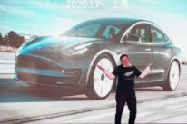
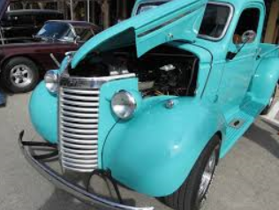
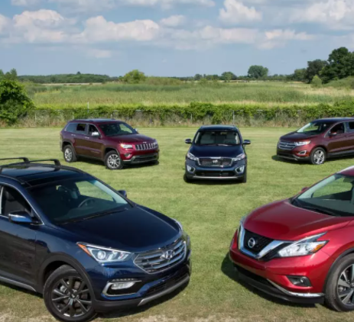
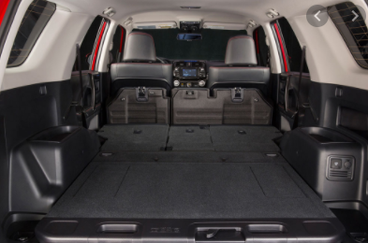
Data Collection
Scraped and filtered through ~1400 images from each make/type.
Manually cleaned up “noisy” or inaccurate images from the set.
Split images into:
500 training images
150 validation images
150 test images
Images
Train
Validation
Test
Truck/Ford
Midsize/Dodge
Tesla/Chevy

Slide 4
Data Augmentation
Image
Due to limited dataset, data augmentation was used.
Implemented the Keras preprocessing – ImageDataGenerator()
Adjustments included: shift_ranging, rescaling, zoom_range.
Implemented the data augmentation (except scaling) only to the training images.
Rescaled both training and validation images to 200x200.
Used the flow_from_directory method to pull images from the folder structure, with implied target categories.
Creates ImageGenerator objects that have been augmented and categorized to be used on the CNN model.
Augmentation
Object
Image Array
Label

Slide 5
CNN Model
Conv2D
Filters: varied
Filter Size: 3x3
Activation: ‘Relu’
2x
Pool Size: 2,2
Strides:2
Activation
Epochs: 25, 50, 100
Batch Size: 25 or 50
MaxPooling2D
Flatten
Dense
Layers: varied
Dropout: .3
Activation: ‘Relu’
2x
Activation
Dropout
Layers: 3
Activation: ‘Softmax’
Optimizer: ‘Adam’
Loss: ‘categorical_crossentropy’
Dense

Slide 6
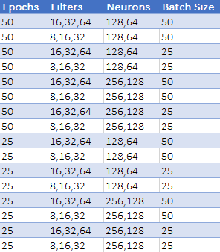
Fine Tuning
Image Generator objects are not compatible with GridSearch, so I manually ran parameter optimization.
Objective_1: Train and test accuracies never varied beyond .36 and .33 regardless of parameter tuning.
Objective_2: Manually optimized parameters.

Slide 7
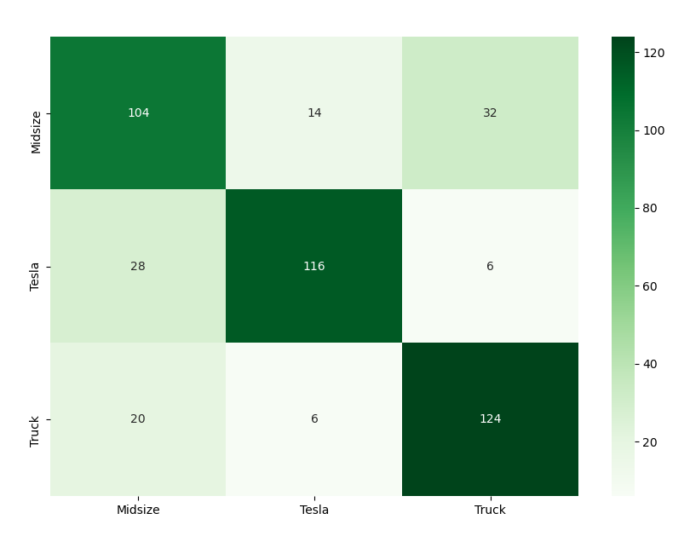
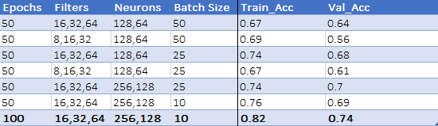
Results
Training Accuracy = 82%
Validation Accuracy = 74%
There is some overfitting.
When applied to the test set:
Midsize = 70%
Tesla = 77%
Truck = 83%
Better than guessing!
Best and used for prediction.

Slide 8

Outlook
Use larger data set.
Use cleaner data.
Less background noise
Centered
More angles
Better defined data.
Vehicles within year range
Target different features (i.e. logo for trucks)
Optimize the model using GridSearch or other methods.

Slide 9



QUESTIONS?

