Slide 1

Global Data Positions Analysis
Joel Riondato ~ 2024

Slide 2

So, what’s the point of this?
Well, you're the reason! Let me explain…
Provides data insights for personal evaluation of jobs
Challenge your expectations of global data positions
Are you considering this field or even pivoting from your current work?

Slide 3

The focus for surface level analysis:
Salary by data position type.
Proportion of work setting for each position (hybrid… etc.)
Proportion of experience level for each position (entry… etc.)
View international salary for each data position

Slide 4
Ok, what data are we going to use?
Kaggle Data Set
Published by: Murilo Zangari, DS in Brazil
Originates from ‘ai-jobs.net’.
Data positions 2020-2024 from surveys & job boards.
Usability Score: 9.41 / 10 (data manipulation still req.)
Dataset Title: “Jobs and Salaries in Data field 2024”
Stack Overflow Survey: 2023
Multiple years available, however different schemas used & thus data quality
Represents ‘realistic’ data
Potential to dive much deeper into analysis, have a look yourself

Slide 5
Beating the data into shape: an overview
Main Areas of Manipulation
Problems & Assumptions
Label for a position type based on job description. Same issue for work setting but not as severe
Calculating position salary as many currencies entered.
Mean vs Median & dealing with outliers in salary field.
Manipulate country names in joined datasets so built-in package can work for global analysis.
It’s survey data, need I say more…
Multiple entries from the same person over collection period?
Static currency conversion, it isn’t dynamic
Labeling for position type is subjective & can be flawed, e.g. Data Analyst vs BI Analyst

Slide 6
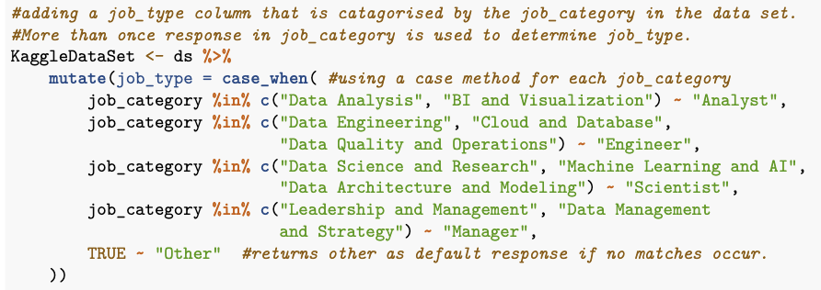
Position classification is subjective
Condensed categories for simplicity, but how does this affect our interpretation of results? Is more segmentation beneficial or degrade the insights?
Other positions: Business Intelligence Analyst, Data Architect, Marketing Scientist…
Data Positions Overlap!
DS
DE
DA

Slide 7
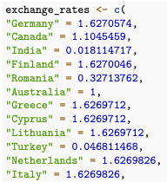
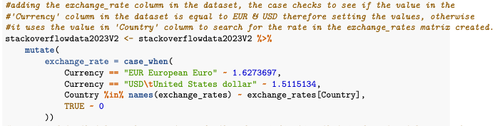
Static currency conversion method
Some inputs used USD or EUR opposed to countries currency, account for this by using the “Currency” description field and setting value in case_when function
If not EUR or USD, then search exchange_rate ‘dictionary’ like vector for currency value
Static rates and could improve by using dynamic method such as API or DB that scrapes conversions online

Slide 8
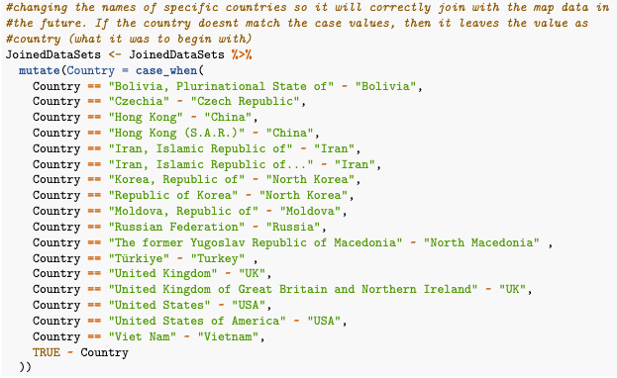
Country name manipulation
Some inputs used names of their country that are abnormal & didn’t match with definitions in R’s map_data(‘world’) data set.
Same method as before using case_when function, you know the rest…

Slide 9
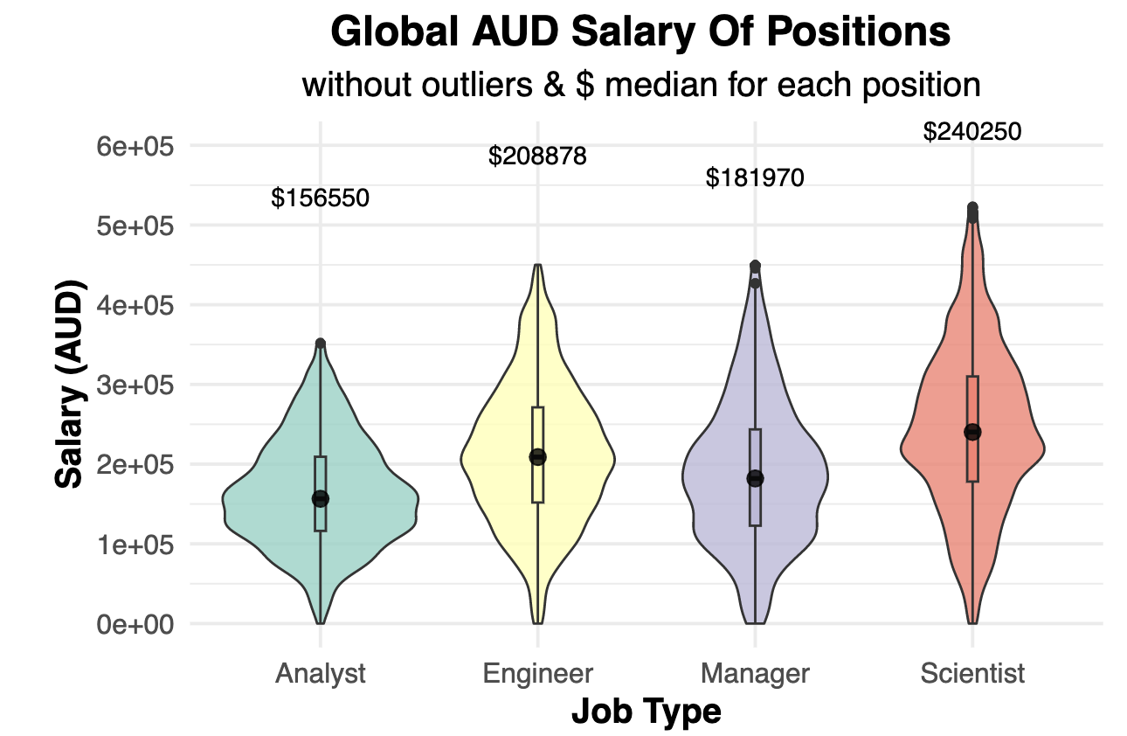

Slide 10
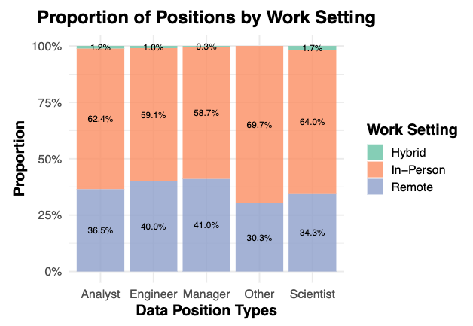

Slide 11
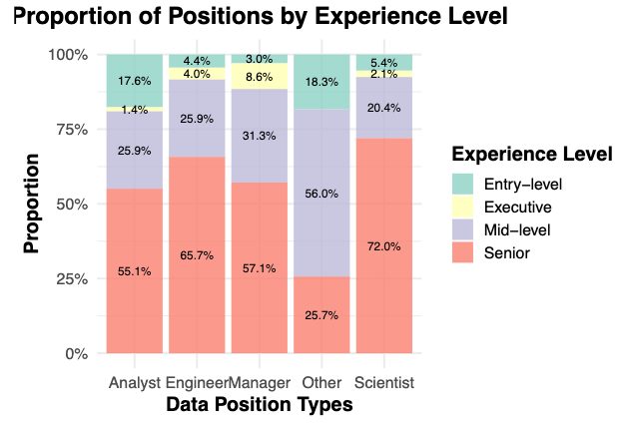

Slide 12
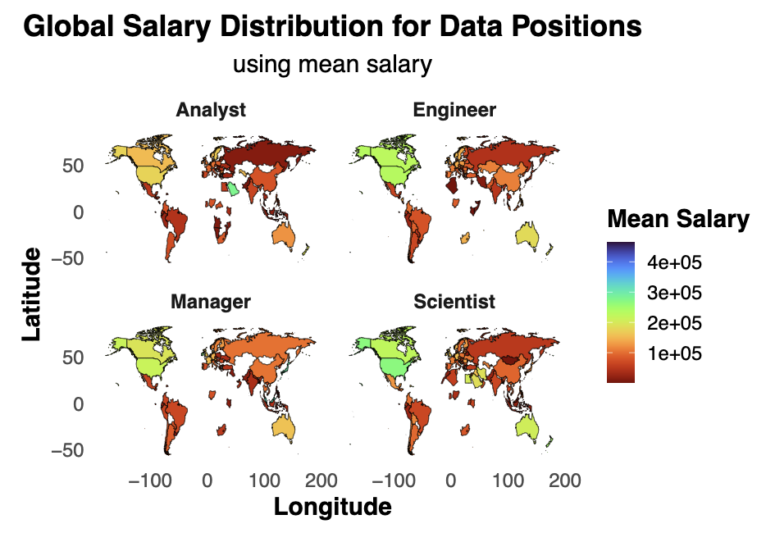

Slide 13
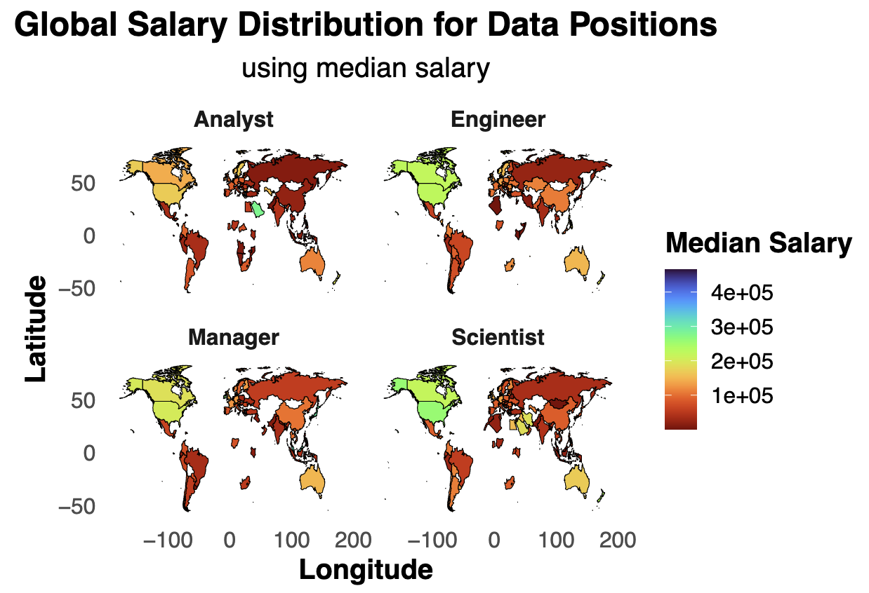

Slide 14
Thankyou for your time!
Joel Riondato – QUT MXB262

