Slide 1
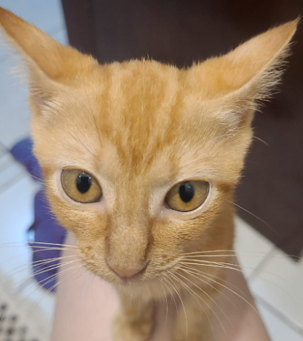
README
General instructions and comments

Slide 2
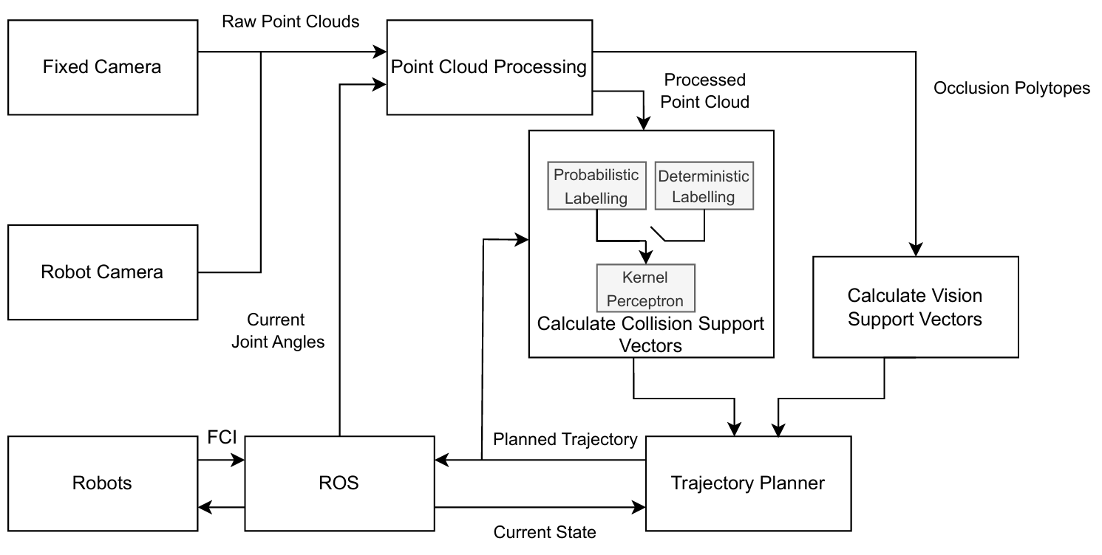

Data sent is the depth images using shared memory (interprocess Numpy arrays
Data sent is the processed point cloud using shared memory Numpy arrays (n x 3), where n is the number of points in the PC.
point_cloud_processing.ipynb
Realsense_i.py
Data sent is the vertices positions and the edge indices of each polytope via LCM
Svm_learning_*.ipynb
*
* ROS message with the current joint position of the robots is read.
Control algorithm
(the MPC, the planner helper, etc in the scenario_i.ipynb
Data sent is the current trajectory of each robot (actual joint positions and velocities at many points along the trajectory) using ROS messages.
Data sent is the support vectors and weights for each group using LCM (think ROS messages)
Data sent is the control points of the current calculated trajectories for each robot so that we can learn the obstacles more finely around the currently planned trajectory

Slide 3

Program run order:
python3 realsense_1.py & python3 realsense_2.py
talker.ipynb (sends the position reference to the control script)
camera_processing.ipynb
svm_learning_deterministic.ipynb / svm_learning_prob.ipynb
Scenario_i.ipynb:
Uncertain Placing Spot Scenario: scenario_vision.ipynb
Dynamic Movement Scenario: scenario_3.ipynb
Varying Threshold Scenario: scenario_3.ipynb
Probabilistic Algorithm Performance in Known Goal Scenario: scenario_vision.ipynb (by editing out the if/else regarding the apriltag)
A simulation can be ran by running simulation plant_simulation.ipynb and changing the simulation flag to true in the camera_processing script.

Slide 4

Control Script
In general, the control scripts work as follows:
the MPC is loaded/generated
some initial trajectories are generated, this means solving the MPC starting from multiple initial guesses (based on a combination of all the possible the inverse kinematics from the starting position) , usually first ignoring collision and then mildly desconsidering (by relaxing the col. constraint a bit) it and then fully solving the proper problem (by selecting one of the previous solves and resolving it considering the latest collision info). This can be shortcut by simply saving one of the previous solves and reloading using pickle.load. One of my previous scripts has an automated procedure of generating multiple trajectories and selecting the one that best fits the current initial/final pose reference (I changed a couple things afterwards and never updated this script, but that's the rough idea and should be fairly easy to recreate).
the previously generated trajectory is used as the first initial solve of the MPC loop.

Slide 5

Notes
Be sure to add the root folder (the one with this readme) of the master thesis to the python path, using either .bashrc or import sys; sys.path.append(path_to_root) inside the python program themselves.
The svm_learning_prob and the scenario_vision programs have instructions inside them to show what cells to run. The other programs follow the same logic.
The included Dockerfile might not include all the necessary packages used, but it should provide the commands to install the most important ones.
Each scenario might have a slightly different MPC formulation, parameters can be changed and the MPC can be rebuilt by switching the rebuild flag in the control scripts. If rebuild is false, it will simply load the previous .so files.

Slide 6
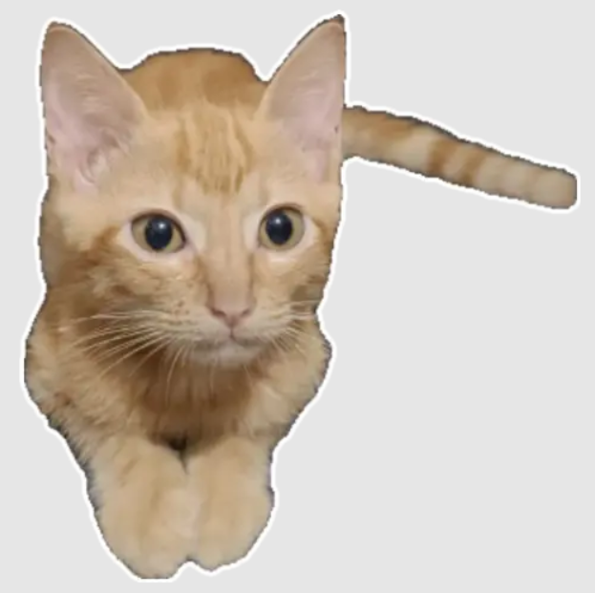
Debugging
If something seems off do:
pfkill -f "python3"
and start all the programs again
Possible reasons:
some process (learning, camera processing) died in the background
the interprocess shared memory got messed up (often happens if any of the program that uses it dies and needs to be restarted).
If everything starts running slow slow, it might be because the some of the spawned processes (such as the learning group workers) didn't die from a previous run, so run
pfkill -f "from multiprocessing"
to kill the multiprocessing processes.

Slide 7

Programs Overview
camera_processing.ipynb
This script reads the data from the cameras and the data from the robots and uses that for the processing script. The processing program is defined in diff_co_mpc/point_cloud/. The PreprocessPointCloud system gets the data from the cameras and sends to a second process, the point cloud worker that is continously working in the backgroud.
Data is sent to it, and it processes it in a non blocking manner. When it is ready, it sends a message back and the main program reads the processed PC.
The algorithm described in the thesis is implemented in the point_cloud_worker() function, in point_cloud_processing.py.

Slide 8

Programs Overview
svm_learning*.ipynb
The main parts are defined in diff_co_mpc/diff_co. The source folder contains the perceptron learning algorithm in cpp.
In learning.py the rest of the learning algorithm is defined as explained in the thesis. Each robot has a support vector worker and each of those has 4 group workers, each of those groups learns the support vector and the weights correspondent exclusively to the links as defined in the config.yaml.
Each group worker is one instance of the algorithm as described in the thesis.
All of that is running using multiprocessing, so each worker is running in parallel.

Slide 9
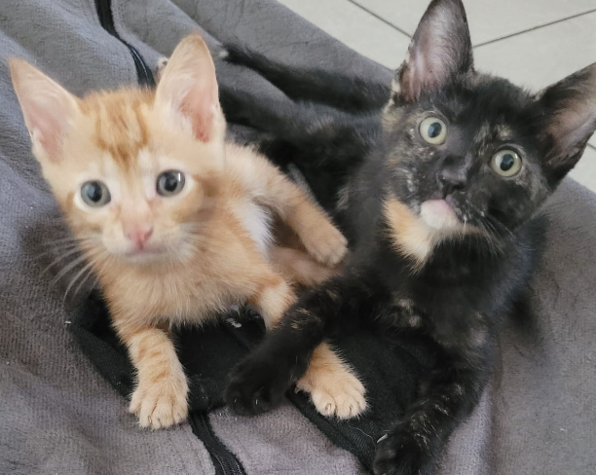
Programs Overview
control algorithm
The MPC and helper functions are defined in the mpc folder. In the optimisation.py the OptimizationInfo class contains the MPC functions and in the planner_implementation/make.py those functions are called to define the MPC itself. The optimisation variables and parameters are declared in the setup.
The OptimizationInfo class has a bunch of functions that define the constraints and costs in such a way that Casadi is decently behaved. In addition, the MPC trajectory is defined in such a way that the constraints are applied at samples of the trajectory c(s_k), where c(s_k) is a function of the control points (dec. variables).
To make Casadi behave well, it is also necessary to sort of "manually“ apply the chain rule to the constraint function and the inner function c(s_k). Those inner functions are defined in the class as well. The chain rule applied as a map to all the samples using multithreading is done using the functions in custom_casadi.py.
Finally, all the constraints and costs derivatives are put together using get_final_hessian and get_final_jacobian, that gets all those custom defined casadi functions and put them together to make the NLP work.
OptimizationData is a helper class to streamline setting the parameters, solving and getting the results.

Slide 10
