Slide 1

Prior Authorization Auto-Approval Model
Data Science Case Study
Joel Skaria

Slide 2

Executive Summary
Project Overview
Objective: Develop ML model to automate prior authorization approvals
Scope: Analysis of historical authorizations and claims data
Timeline: 48-hour analysis and development
Key Findings
Random Forest model achieved best performance
Service type is strongest predictor of approval
High model confidence across all metrics

Slide 3

Executive Summary Continued
Performance Highlights
94.6% Accuracy
0.981 ROC AUC
0.911 F1 Score
Expected Impact
↓ Processing Time
↓ Operational Costs
↑ Veterinarian Satisfaction

Slide 4
Business Problem
Problem: Manual review of veterinary prior authorizations creates delays
Current Process: Rule-based auto-approval system
Human review for complex cases
Goal: Develop ML model to increase auto-approval rate while maintaining accuracy

Slide 5
Data Overview
Two Primary Datasets:
Prior Authorization Data
Claims History Data
Key Metrics:
Current auto-approval rate
Average processing time
Decision distribution

Slide 6
Exploratory Analysis
Authorization Status Distribution
Service Type Analysis
Claims History Patterns
Key Finding: Service type strongly correlates with approval decisions

Slide 7
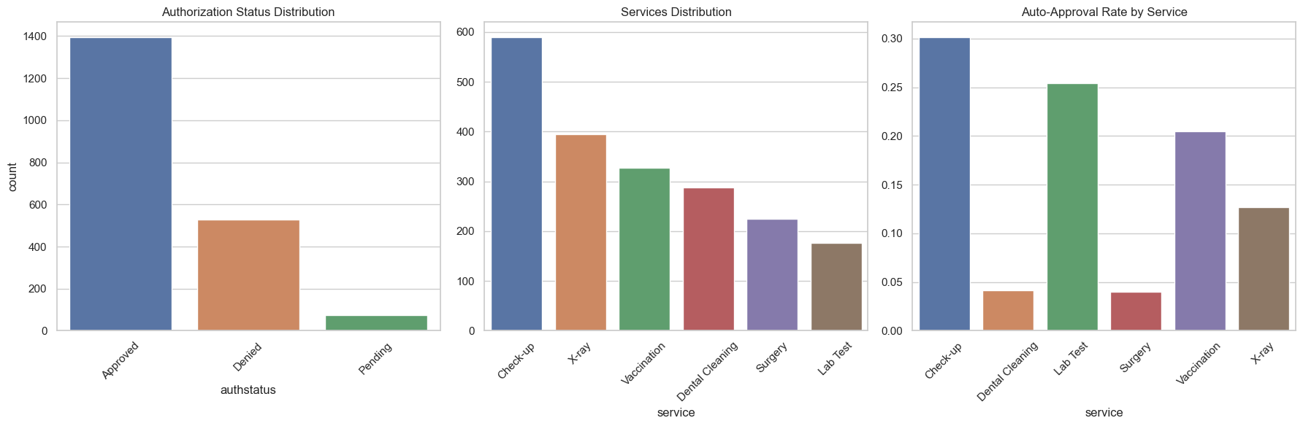

Slide 8
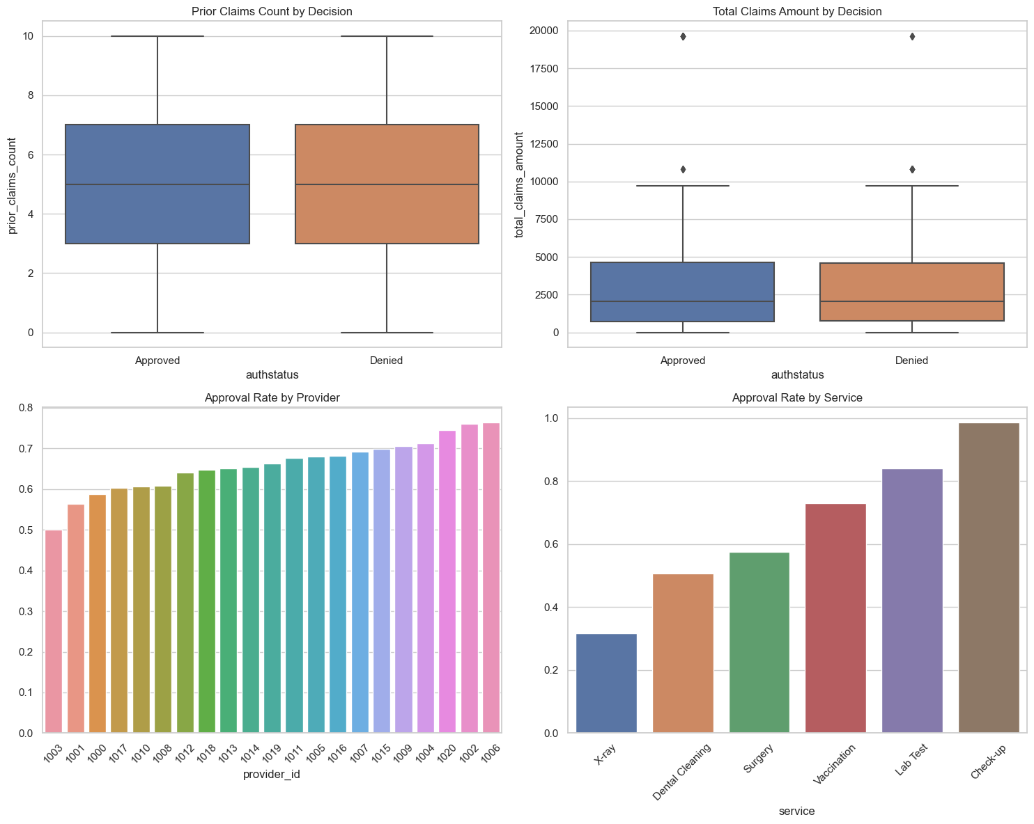

Slide 9
Feature Engineering
Created Features:
Prior claims count
Total claims amount
Service type encoding
Days since last claim
Provider history metrics

Slide 10
Models Compared
Random Forest
Logistic Regression
Decision Tree

Slide 11
Model Development
Approach:
Tested multiple algorithms
Cross-validation
Hyperparameter tuning
Best Model: Random Forest
94.6% Accuracy
0.981 ROC AUC
0.911 F1 Score

Slide 12
Feature Importance
Notes:
Top Predictors:
Service type (0.496)
Days since last claim (0.139)
Average claim amount (0.127)

Slide 13

Model Performance
Metrics:
Accuracy: 94.6%
ROC AUC: 0.981
F1 Score: 0.911
Average Precision: 0.961

Slide 14
Implementation Plan
Phased Rollout:
Start with highest-confidence services
Gradual expansion to other categories
Monitoring System:
Real-time performance tracking
Regular model retraining

Slide 15

Business Impact
Expected Benefits:
Reduced processing time
Lower operational costs
Improved veterinarian satisfaction
Maintained decision quality

Slide 16
Next Steps
Recommendations:
Begin phased implementation
Set up monitoring dashboard
Plan regular model updates
Collect feedback from stakeholders

Slide 17

Questions?
Contact: Joel Skaria, joel.skaria.js@gmail.com

