Slide 1
British Airways
Predictive Modeling Insights
(50,000 customer booking entries)

Slide 2
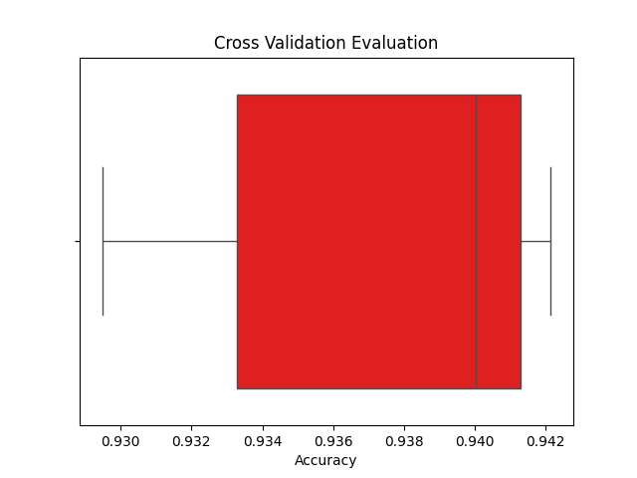
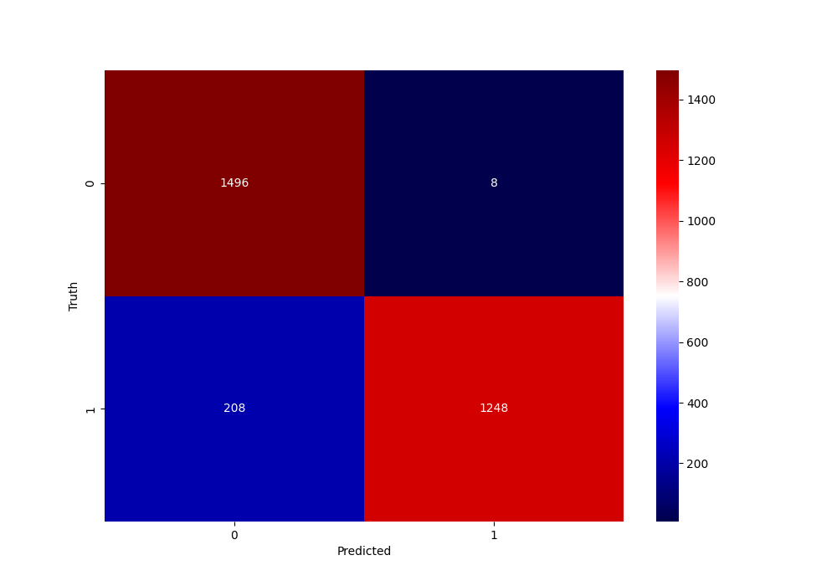
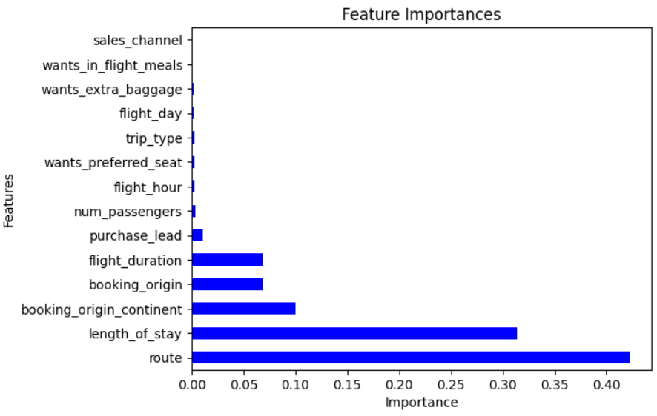
Key Insights
Cross-Validation Evaluation
Machine Learning Model: Random Forest Classifier
Accuracy Score: 93 %
Top 3 features affecting completed bookings:
Route
Length of stay
Booking Origin Continent
Prediction Confusion Matrix
Feature Importance
1496
8
0
True Value
1
208
1248
0
Predicted Value
1

