Slide 1
British Airways
Data Scraping Insights
(3,000 customer reviews)

Slide 2
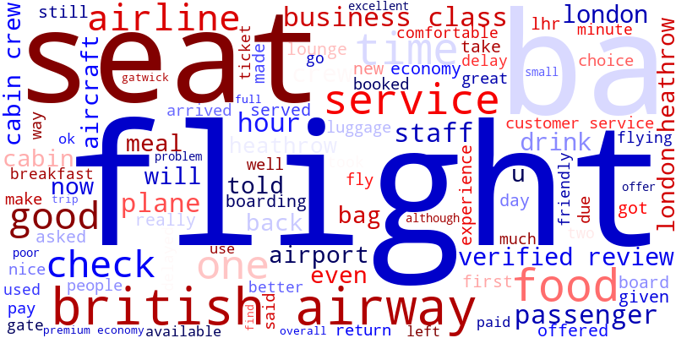
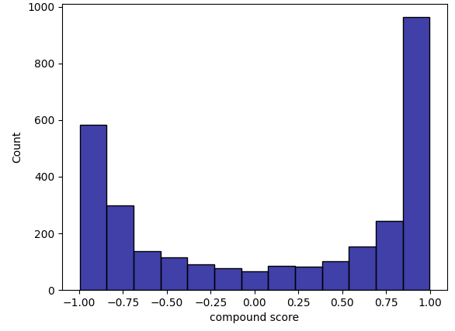
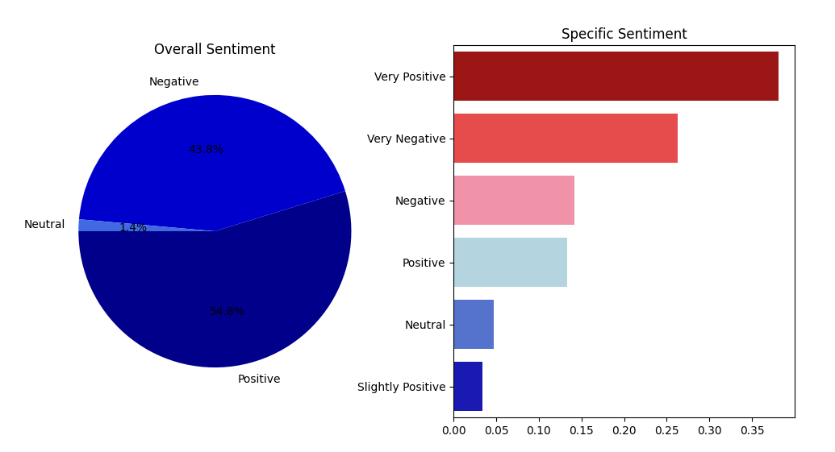
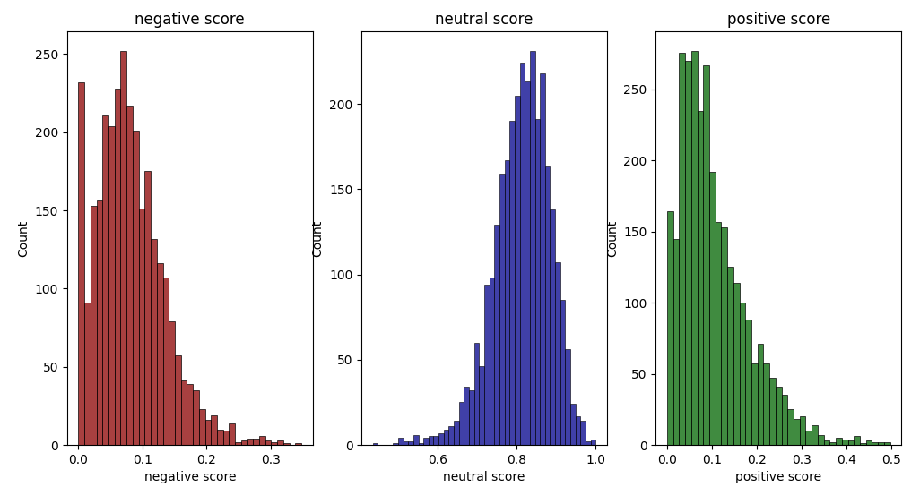
Key Insights
Word Cloud
Sentiment Compound Score
Top Review Topic: Customer In-Flight Experience
Most common review sentiment: Very Positive (> 35 %)
Positive : Neutral : Negative
39 : 1 : 31
negative
neutral
positive
Sentiment Analysis
Sentiment Scores

Slide 3
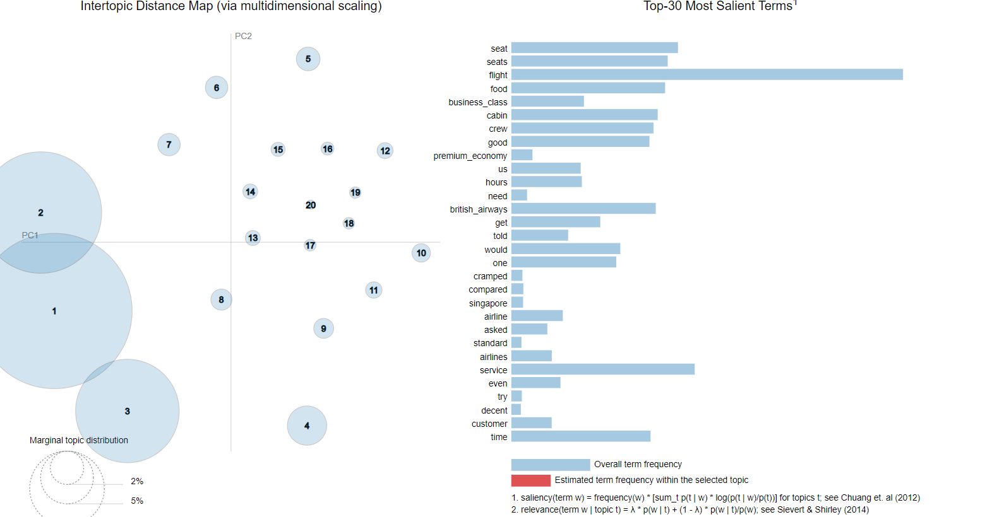
Topic Model
Click on link to access interactive topic clustering visual

