Slide 1
Cloud-Native Distributed Microservices
Patient Management System (PMS)
Author: Joel Silva (A00336679)

Slide 2
Why Distribute?
Managing a healthcare practice involves independently evolving concerns:
Appointment scheduling
Patient registration
Doctor management
Access control
Each domain has different ownership, scale needs, and deployment cadence — a monolith would couple them tightly.
Genuine cross-service dependency:
The Appointment Service must validate both doctor and patient references at write time — making distribution necessary, not arbitrary.

Slide 3
Functional Requirements (User Stories)
Patient Management
Register, retrieve, update, delete patients
Search and filter patient records
Doctor Management
CRUD operations for doctor profiles
Search by name, email, or specialty
Appointment Management
Schedule, update, cancel, and delete appointments
Filter by status, date, and doctor
Support full appointment lifecycle (Scheduled → Confirmed → Completed/Cancelled)
Authentication/ User Management
Create / disable users
JWT token

Slide 4
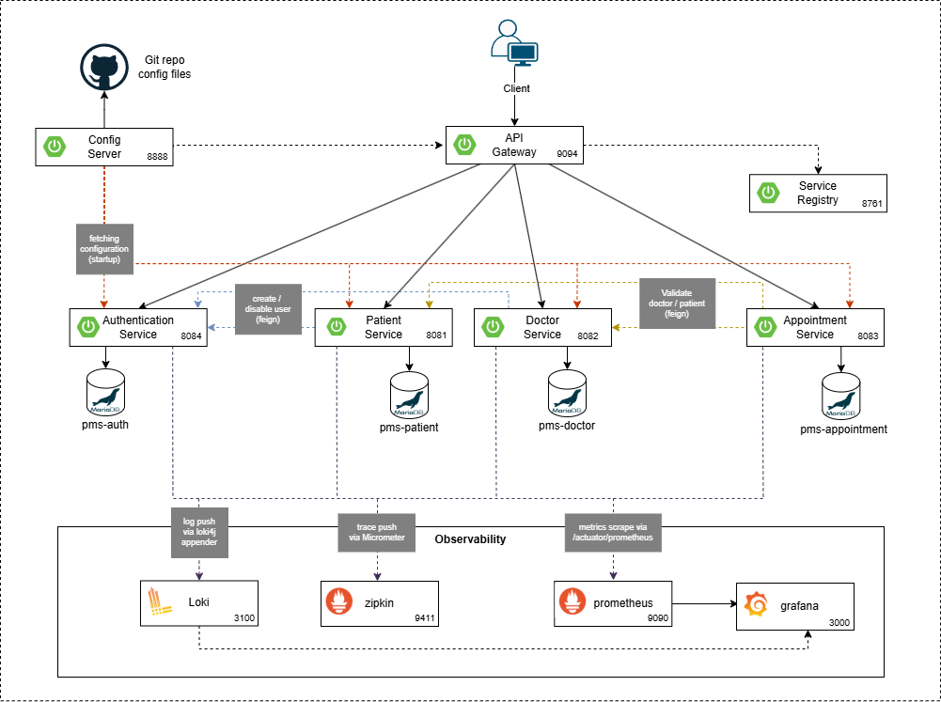
Architecture

Slide 5
Services & Responsabilities
Service/Component | Port | Responsibility
ms-auth | 8084 | Issues JWT tokens, manages users & roles
ms-doctor | 8082 | Owns Doctor entities; calls ms-auth on doctor creation
ms-patient | 8081 | Owns Patient entities; provides paginated REST
ms-appointment | 8083 | Validates doctor & patient via Feign; owns Appointment data
infra-api-gateway | 9094 | Single entry point; JWT validation; routes by service ID
infra-discovery-service | 8761 | Netflix Eureka; all services register at startup
infra-config-server | 8888 | Serves YAML config from Git; profile-based per environment
Zipkin | 9411 | Distributed tracing
Prometheus | 9090 | Metrics
Loki | 3100 | Log Aggregation
Grafana | 3000 | Dashboards

Slide 6
DEMO

Slide 7
Limitations
Synchronous service coupling → Appointment creation fails if dependencies are slow/unavailable
Shared JWT secret → Security risk if any service is compromised
Single MariaDB instance → Single point of failure and limited scalability
Tight coupling reduces resilience and fault isolation

Slide 8
Improvements
Replace shared JWT with RSA key pair + JWKS endpoint
Use isolated databases per service with backups and replicas
Implement monitoring & alerting (Grafana, error rates, circuit breakers)

Slide 9
Lesson learned
Microservices add complexity and should be justified by real needs
Fallback strategies must align with business logic (data integrity vs availability)
Externalised configuration enables fast, safe operational changes
Dependency management & version alignment are critical
Working with new frameworks requires official documentation over assumptions

