Slide 1
Oktoberfest 1985-2022
Case Study
Investigating relationships between visitors, prices, and consumption
Last updated: 9/18/23 by Joel Thielman

Slide 2
Asking Questions About the Data
How do prices affect consumption of beer and chicken?
How much beer is consumed by each visitor on average?
What events might have impacted total visitors, prices, and consumption?

Slide 3
Quick Stats
Average number of visitors per year:
6.3 million
Average amount of beer consumed per year:
6.3 million liters (interesting!)
Average number of visitors per day:
3,867
Looking at the big picture

Slide 4
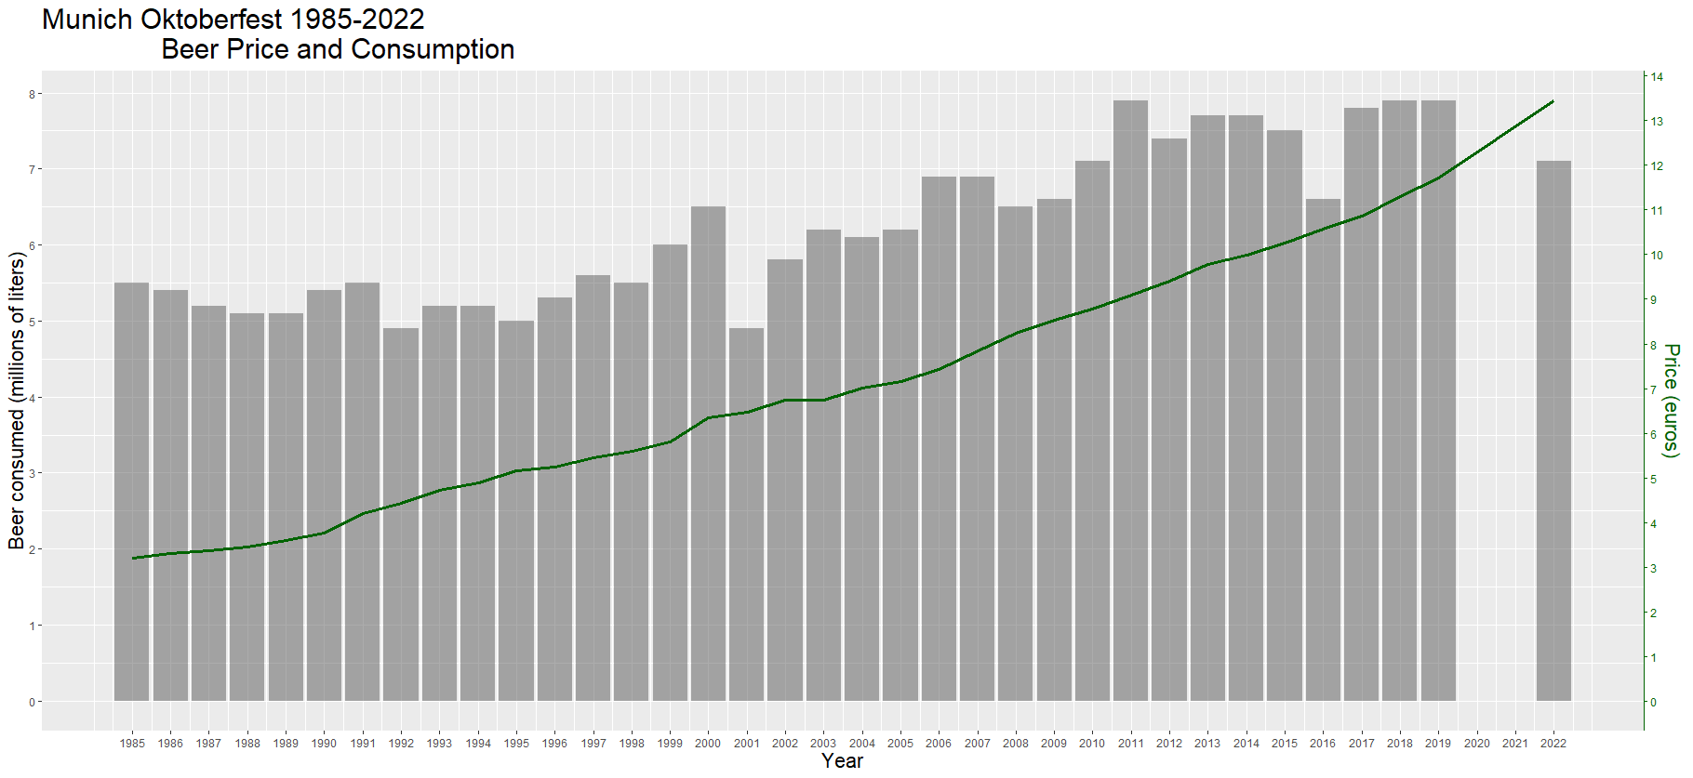
Steady incline in both price and consumption of beer
Canceled due to COVID-19

Slide 5
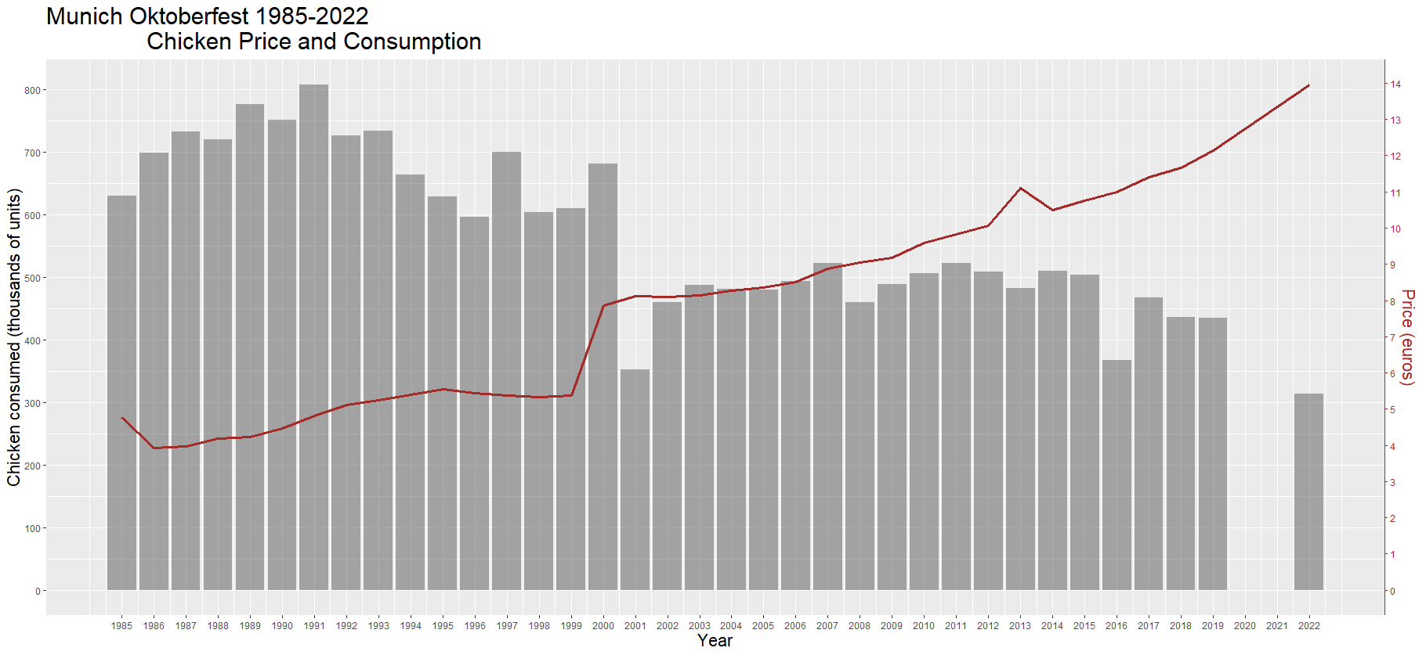
Sharp increase in price in 2000,
followed by a steep drop off in consumption
Canceled due to COVID-19

Slide 6
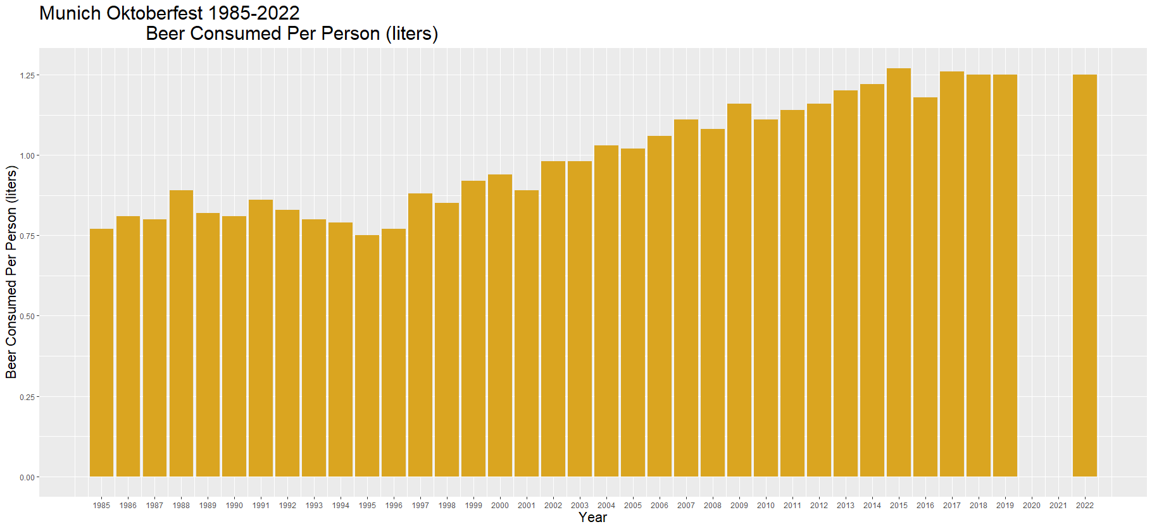
Steady increase in consumption per person
starting in the mid–’90s
Canceled due to COVID-19

Slide 7
Key Takeaways
There is a steady upward trend in beer consumption, despite rising beer prices.
Chicken consumption dropped off hard in 2001, following a sharp rise in price.
There were significantly fewer total visitors in 2001. I suspect this is due to flight restrictions following the events of 9/11.
Chicken prices rose sharply in 2000, while beer prices continued on a steady upward trend. I wonder if this had something to do with Germany's transition to the Euro.

