Slide 1
SC (Service Connector) Project
Kickoff Meeting
xx Sep 2010

Slide 2
Agenda
14:00 Introduction & Project Background (KNK)
14:10 Business and Project Plan (ORG)
14:20 SC Overview (Jan)
14:35 Itanium Overview (WMO)
14:45 Leveraged Services (FGO)
15:00 Close

Slide 3
Intro & Background (KNK)
Constraints:
HP Alpha support to be phased out mid 2012
Alpha will be replaced by Itanium architecture
USP middleware will not be ported to Itanium
Opportunities:
Develop a more flexible middleware architecture
Enables development of new functional add-ins (follows)

Slide 4
Business & Project Plan (ORG)
Project Goals
Project Status
Project Organisation (follows)
Project Approach (follows)

Slide 5
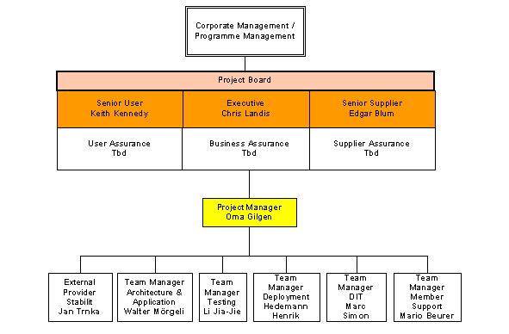
Project Organisation (ORG)

Slide 6
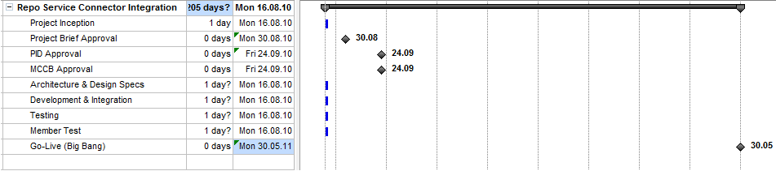
Project Plan (ORG)

Slide 7
Project Approach (ORG)
Joint Project Management under Orna & Keith
Will follow Prince2 methodology and will use some Agile Techniques:
Deliverables in planned iterations
Backlog (Task List)
Daily meetings, 15 minutes
Milestone meetings (end of iterations)

Slide 8
SC Goals (Jan)
Part of Eurex business vision
First part of new Eurex IT platform
Designed for new services (SOA)
Allow transition from old (USP)
=> More then middleware
connecting banks to Eurex Repo!

Slide 9
SC Key Features (Jan)
Simple and small => reduced to real business needs in opposite to USP
SC is Open Source (also the com. protocol)
Use of Standards => web standard protocol (http)
All java solution => multiplatform
SC cascading => performance & scalability
Fits into SIX existing infrastructure
Designed for 24x7 operation

Slide 10
SC as USP replacement (Jan)
Similar topology
Less problems with Firewalls
Better performance
Better fit with OMC
Simpler operation

Slide 11
SC tomorrow (Jan)
New services
New servers
Provider integration

Slide 12
Itanium Overview (WMO)
TBC (WMO)

Slide 13
Leveraged Services (FGO)
External Data Feeds (eg, market prices)
Webservice data (eg, SARON index data)
Added value services (eg, Managed Collateral)
Helper Applications (eg, current CFP)
Ability to incorporate externally developed & managed applications (eg, SIX-SIS hosted)

