Slide 1
Meraki Api + ELK
Document By :Joel Urtubia
2018

Slide 2
Disclaimer:
This document describe how is possible getting information from meraki api through ELK.

Slide 3
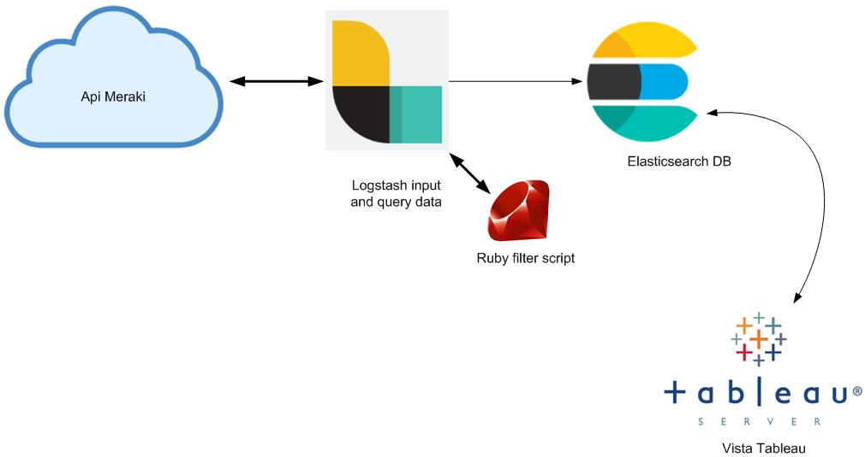
Network Topology

Slide 4
Steps
Use meraki api with postsman for check results.
Create file logtash.conf and ruby script.for use meraki api
Get this information from meraki api and store in Elasticsearch.

Slide 5
Meraki API
Meraki api store data relationship with:
Organizations: called entreprise clients, like Starbucks, mc Donald.
Devices: devices or Aps from organizations.
Clients: Users from devices.

Slide 6
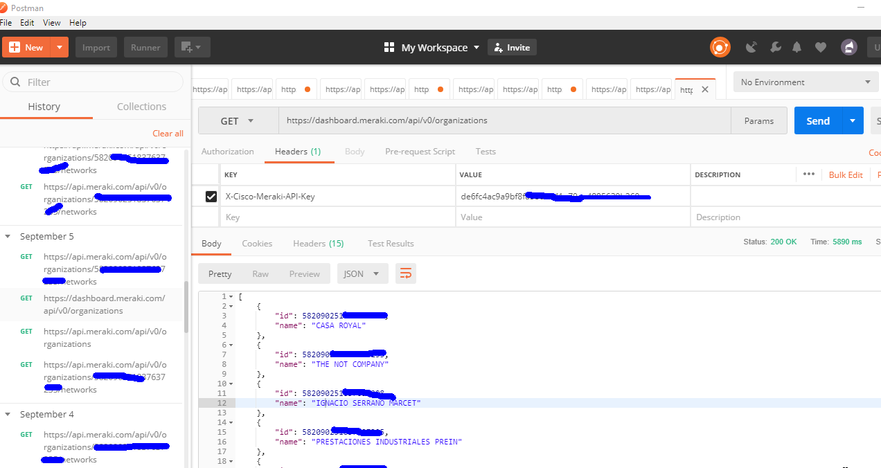
Meraki API tool postaman query

Slide 7
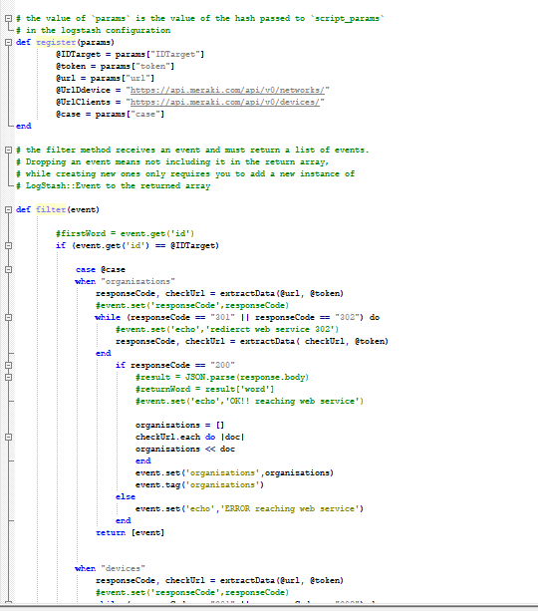
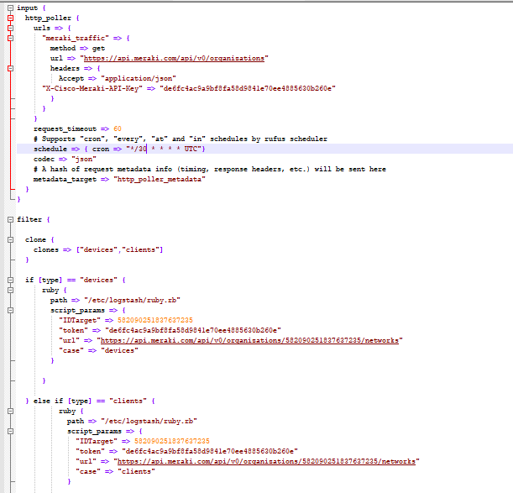
Logstash and ruby script

Slide 8
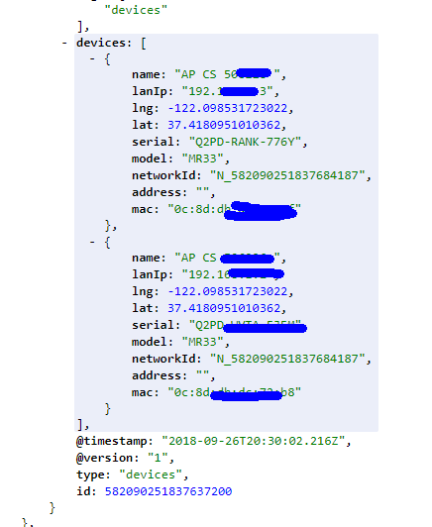
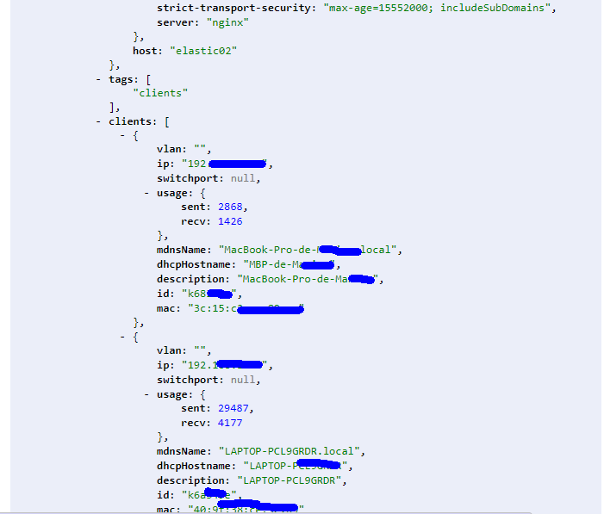
Elasticsearch DB

Slide 9
Next steps:
Use tablaeau , grafana or Kibana for view.

Slide 10
Contact:
Joel Urtubia Ugarte.
Electronic Engineer
Expert on IPTV.
Certificated on MongoDB.
Mail: joelurtubiaugarte@gmail.com

