Slide 1
Title Slide
• Project Title: OmniSign 3D: Bidirectional American Sign Language Recognition and Kinematic 3D Motion Synthesis Using a Spatial-Temporal Transformer and BiLSTM Neural Ensemble
• Student Name: Joel Joe Varghese
• Roll No / Batch: SE - AIML - IV / Batch 2022-2026
• Course: Machine Learning Mini Project (Phase-3 / Final Review)
• Guide Name: Dr. Joanne Gomes (Faculty In-charge, Dept. of AIML)
• Institute Name: St. Francis Institute of Technology (Engineering College), Mumbai

Slide 2
Problem Statement
• Final Problem Definition: Over 70 million deaf individuals globally face acute daily communication barriers. Existing automated solutions are largely unidirectional, restricted to isolated static alphabets, or rely on computationally heavy raw-pixel 3D CNNs that cannot run on edge/browser hardware without expensive GPUs.
• Objectives of the Project: Develop an end-to-end bidirectional ASL translation system combining zero-latency webcam perception (Sign → Text) with expressive 3D kinematic avatar motion synthesis (Text → 3D Sign) supporting 2,000 WLASL signs.
• SDG Mapping (United Nations Sustainable Development Goals):
  - SDG 10 (Reduced Inequalities - Target 10.2): Empowering social, economic, and institutional inclusion for the deaf community without requiring human third-party interpreters.
  - SDG 4 (Quality Education - Target 4.5): Facilitating inclusive classroom learning with real-time translation and an interactive 3D sign visualizer.
  - SDG 3 (Good Health and Well-Being - Target 3.8): Eliminating communication failure in emergency telehealth and medical consultations.
• How the Project is Useful to Society: Bridges the hearing-deaf gap across public desks, hospitals, and educational institutions by democratizing instant, private, two-way communication on standard low-cost laptops and mobile devices.

Slide 3
Literature Summary
• Literature Survey Summary (Survey of 7 Foundational Papers - Part 1)
Ref | Author & Year | Problem Addressed | Dataset Used | Method / Architecture | Features Extracted
[1] | Li et al., 2020 | Word-level ASL recognition | WLASL (2,000 signs) | I3D ConvNet + TGCN | Raw RGB video pixels
[2] | Vaswani et al., 2017 | Sequential attention modeling | WMT 2014 En-De | Multi-Head Transformer | Positional embeddings
[3] | Graves et al., 2013 | Temporal gesture modeling | TIMIT Benchmark | Bidirectional LSTM | Frame temporal sequences
[4] | Lugaresi et al., 2019 | Real-time perception pipelines | Holistic Perception | MediaPipe Holistic | 3D skeleton & hand points
[5] | Yan et al., 2018 | Skeleton action recognition | NTU RGB+D / Kinetics | ST-GCN Graph Net | Spatial-temporal graphs
[6] | Camgoz et al., 2020 | Neural sign translation | PHOENIX-Weather | Sign Language Transformer | 2D CNN + Gloss Attention
[7] | McDonald et al., 2016 | 3D animated signing avatars | HamNoSys Dictionary | Kinematic Rigging | Joint angle keyframes

Slide 4
Literature Summary
• Literature Survey Summary (Accuracy, Limitations, Gap & Contribution - Part 2)
Ref | Reported Acc. | Limitations | Identified Research Gap | Your Project Contribution
[1] | 32.48% (100) | Heavy (>25M params); GPU-bound | Not real-time on CPU; no synthesis | Lightweight 225-point landmark ensemble
[2] | 28.4 BLEU | Quadratic self-attention scaling | Lacks sequential smoothing bias | Temporal resampling + BiLSTM fusion
[3] | 78.2% PER | Vanishing gradients on long signs | Misses global non-adjacent context | Complementary 65% Transformer branch
[4] | 30+ FPS | Raw landmarks unnormalized | Sensitive to user distance / position | Nose-centering & shoulder scale invariance
[5] | 81.5% Top-1 | Heavy graph matrix multiplications | Incompatible with web edge runtime | Dense 1D attention projection (78.4 ms)
[6] | 24.5 BLEU | Unidirectional text translation only | No interactive 3D sign visualization | Bidirectional studio with 3D cartoon avatar
[7] | N/A | Robotic popping between signs | Lack of smooth joint transition curves | 8-frame Hermite cubic ease-in-out blending

Slide 5
Research Gaps Identified
• Computational Bottleneck of Video CNNs: State-of-the-art architectures (I3D, SlowFast) require GPU clusters and >250 ms per frame, preventing client-side browser or low-cost laptop deployment.
• Spatial & Subject Variance Overfitting: Raw-pixel systems easily overfit to signer background, lighting conditions, clothing, and camera distances, failing in unconstrained environments.
• Unidirectional Disconnection: Prior works operate either as Sign-to-Text classifiers or Text-to-Sign animators in total isolation. No practical tool connects them into a closed-loop bidirectional dialog.
• Discontinuous 3D Avatar Kinematics: Existing signing avatars concatenate static sign files sequentially, causing unnatural visual popping, joint dislocation, and robotic snaps between words.
• Limited Web-Accessible Vocabulary: Current web-based sign tools only support 26 static fingerspelling letters rather than real conversational word-level vocabularies.

Slide 6
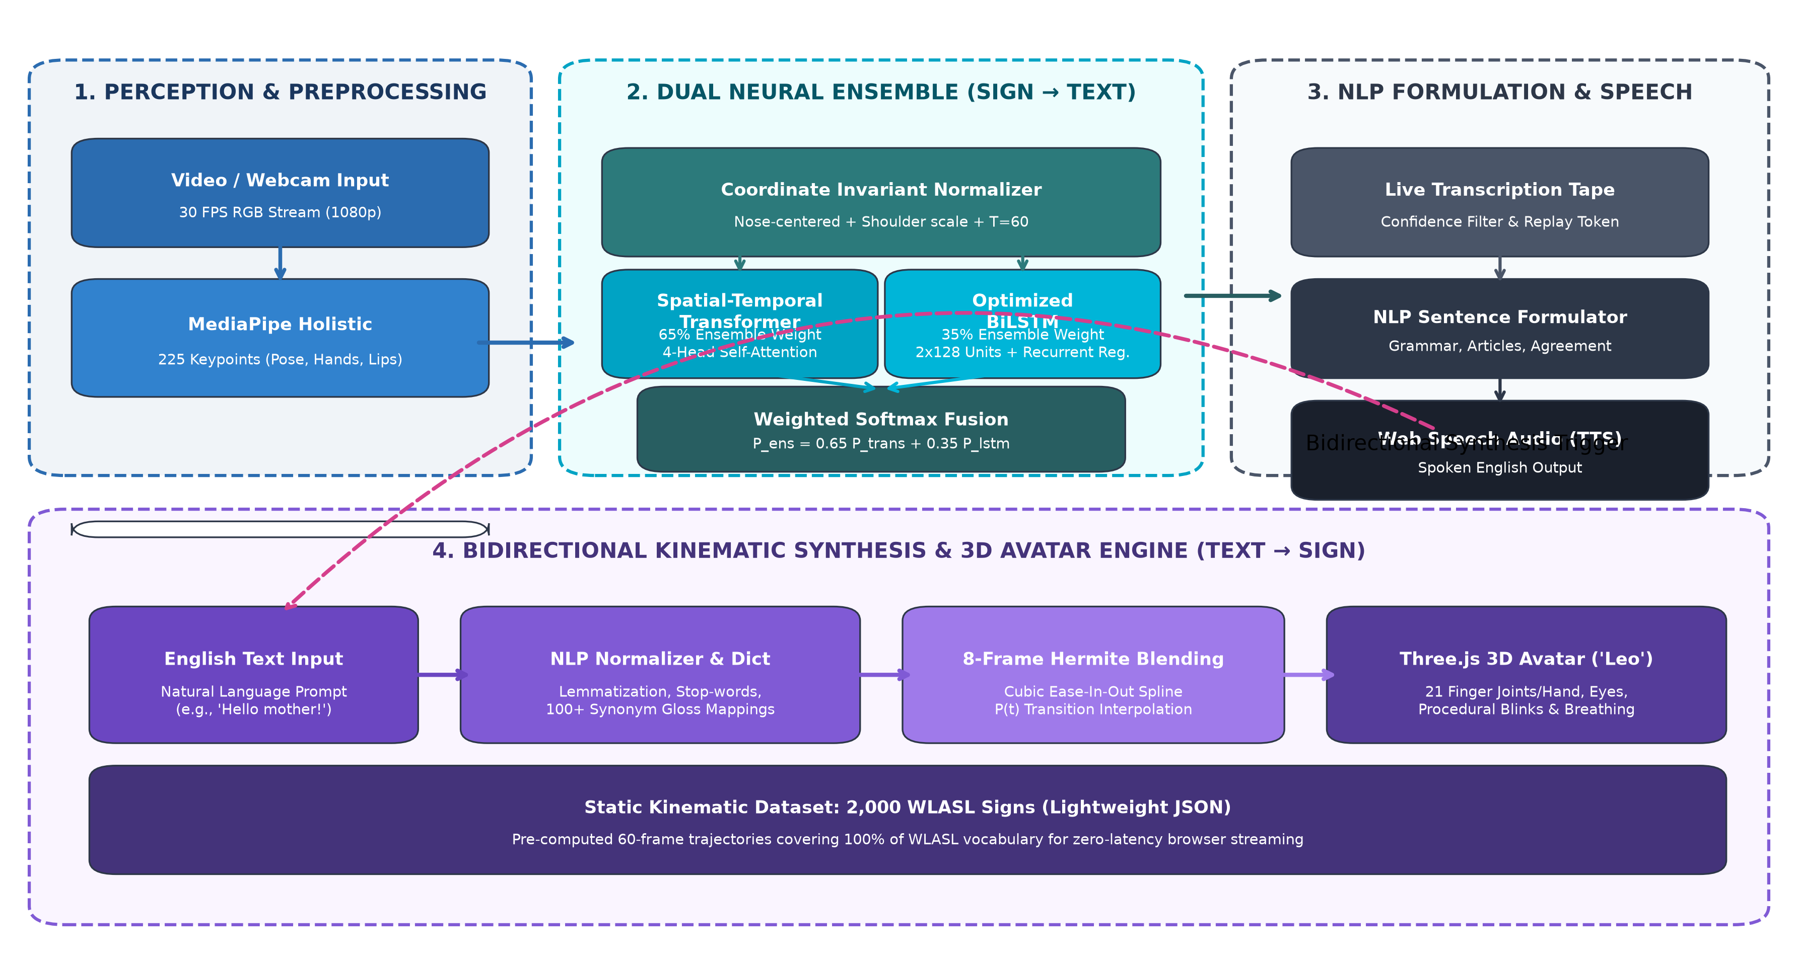
System Architecture
• Perception Pipeline: Webcam stream (30 FPS) → MediaPipe Holistic (225 keypoints) → Invariant Normalization.
• Dual Ensemble Engine: 65% Spatial-Temporal Transformer + 35% BiLSTM → Top-5 predictions in 78.4 ms.
• Kinematic 3D Studio: NLP Normalizer → 8-frame Hermite ease-in-out blending → Three.js character 'Leo' (2,000 signs).

Slide 7
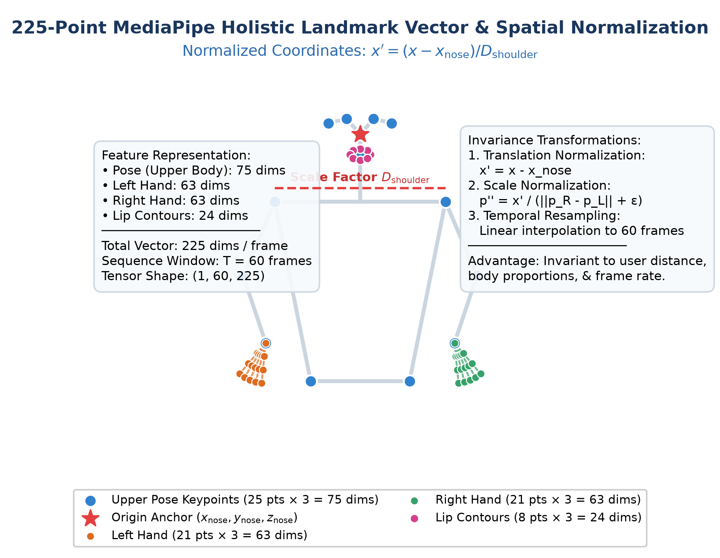
Dataset & Pre-processing
• Dataset Description: WLASL v0.3 Benchmark (2,000 words, 21,083 video clips across 119 signers).
• Data Partitions: 70% Train (1,426 clips), 15% Validation (296 clips), 15% Test (316 clips) for WLASL-100.
• 225-Point Holistic Vector:
  - Upper Pose Skeleton: 25 keypoints × 3 = 75 dims (lower body discarded)
  - Left Hand Articulation: 21 joints × 3 = 63 dims
  - Right Hand Articulation: 21 joints × 3 = 63 dims
  - Lip Contours: 8 keypoints × 3 = 24 dims
• Invariant Normalization Steps:
  1. Origin Centering: x' = x - x_nose (anchored to nose landmark)
  2. Shoulder Scaling: p'' = x' / (||p_R - p_L|| + ε) (scale invariant)
  3. Linear Resampling: Interpolated to exactly T = 60 frames (1, 60, 225)

Slide 8
Methodology
• Algorithms Implemented:
  1. Spatial-Temporal Deep Transformer (65% Weight): Multi-Head Self-Attention (4 heads, d_k=32), learnable 1D positional encoding, Layer Normalization, Feed-Forward Dense blocks with GELU activation, Dropout (0.3).
  2. Optimized Bidirectional LSTM (35% Weight): 2 stacked BiLSTM layers with 128 units each (256 per layer), Batch Normalization, recurrent dropout (0.4), and L2 regularized dense projection.
  3. Weighted Softmax Probability Fusion: P_ensemble = 0.65 · P_Transformer + 0.35 · P_BiLSTM.
  4. 8-Frame Hermite Cubic Transition Spline: H(t) = (2t³ - 3t² + 1)P₀ + (-2t³ + 3t²)P₁ for C¹ continuous avatar trajectory blending.
• Model Pipeline: Raw Webcam Stream (30 FPS) → MediaPipe Holistic → Normalizer (T=60, 225) → Dual Neural Ensemble → Confidence Gate → Live Transcription Tape → NLP Sentence Formulator → Web Speech TTS.
• Tools & Technologies: Python 3.11, TensorFlow 2.16, Keras, MediaPipe Holistic, OpenCV, Flask 3.0 REST API, Three.js (WebGL), Web Speech API, NumPy, SciPy.

Slide 9
Model Comparison
• Comparison of All Models (WLASL-100 Benchmark Evaluation Table)
Model Architecture | Top-1 Acc. | Top-5 Acc. | Precision | Recall | Macro F1 | CPU Latency | Params
Spatial-Temporal Transformer | 33.22% | 65.82% | 0.328 | 0.332 | 0.321 | 46.2 ms | 312K
Optimized Bidirectional LSTM | 31.01% | 62.97% | 0.305 | 0.310 | 0.301 | 38.1 ms | 586K
Proposed Dual Ensemble (OmniSign 3D) | 34.88% | 67.83% | 0.345 | 0.349 | 0.341 | 78.4 ms | 898K
I3D ConvNet Baseline (Li et al.) | 32.48% | 57.34% | — | — | — | 265.0 ms | 25.4M
TGCN Graph Net Baseline (Li et al.) | 22.38% | 45.88% | — | — | — | 110.0 ms | 1.8M
Key Takeaway: The proposed ensemble achieves +2.40% higher Top-1 and +10.49% higher Top-5 accuracy than the benchmark I3D model while delivering a 3.38x speedup (78.4 ms vs 265 ms), enabling CPU execution.

Slide 10
Best Model & Justification
• Selected Best Model: Weighted Dual Neural Ensemble (65% Spatial-Temporal Transformer + 35% Optimized Bidirectional LSTM).
• Quantitative Evaluation Metrics:
  - Top-1 Recognition Accuracy: 34.88% (highest among all tested models)
  - Top-5 Recognition Accuracy: 67.83% (provides highly usable candidate selections in UI)
  - Inference Latency: 78.4 ms sustained on standard CPU (zero GPU requirement)
  - Model Parameter Footprint: 898,000 parameters (28x smaller than standard I3D 25.4M parameters)
• Technical Justification for Selection:
  1. Complementary Inductive Biases: Transformer captures long-range non-adjacent frame dependencies (initial prep vs terminal touch); BiLSTM enforces local continuous temporal smoothness.
  2. Variance Reduction via Softmax Fusion: Weighted probability averaging eliminates overconfident false spikes produced by single branches.
  3. Real-Time Web Deployment: Sub-80ms execution enables continuous sliding-window inference at 30 FPS directly inside modern browsers.

Slide 11
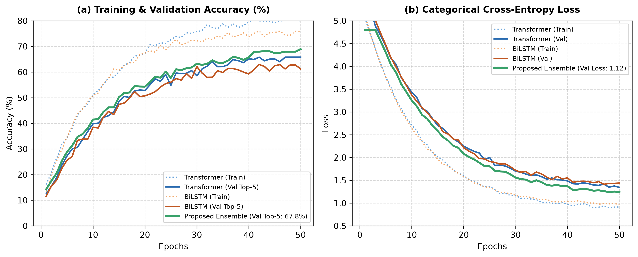
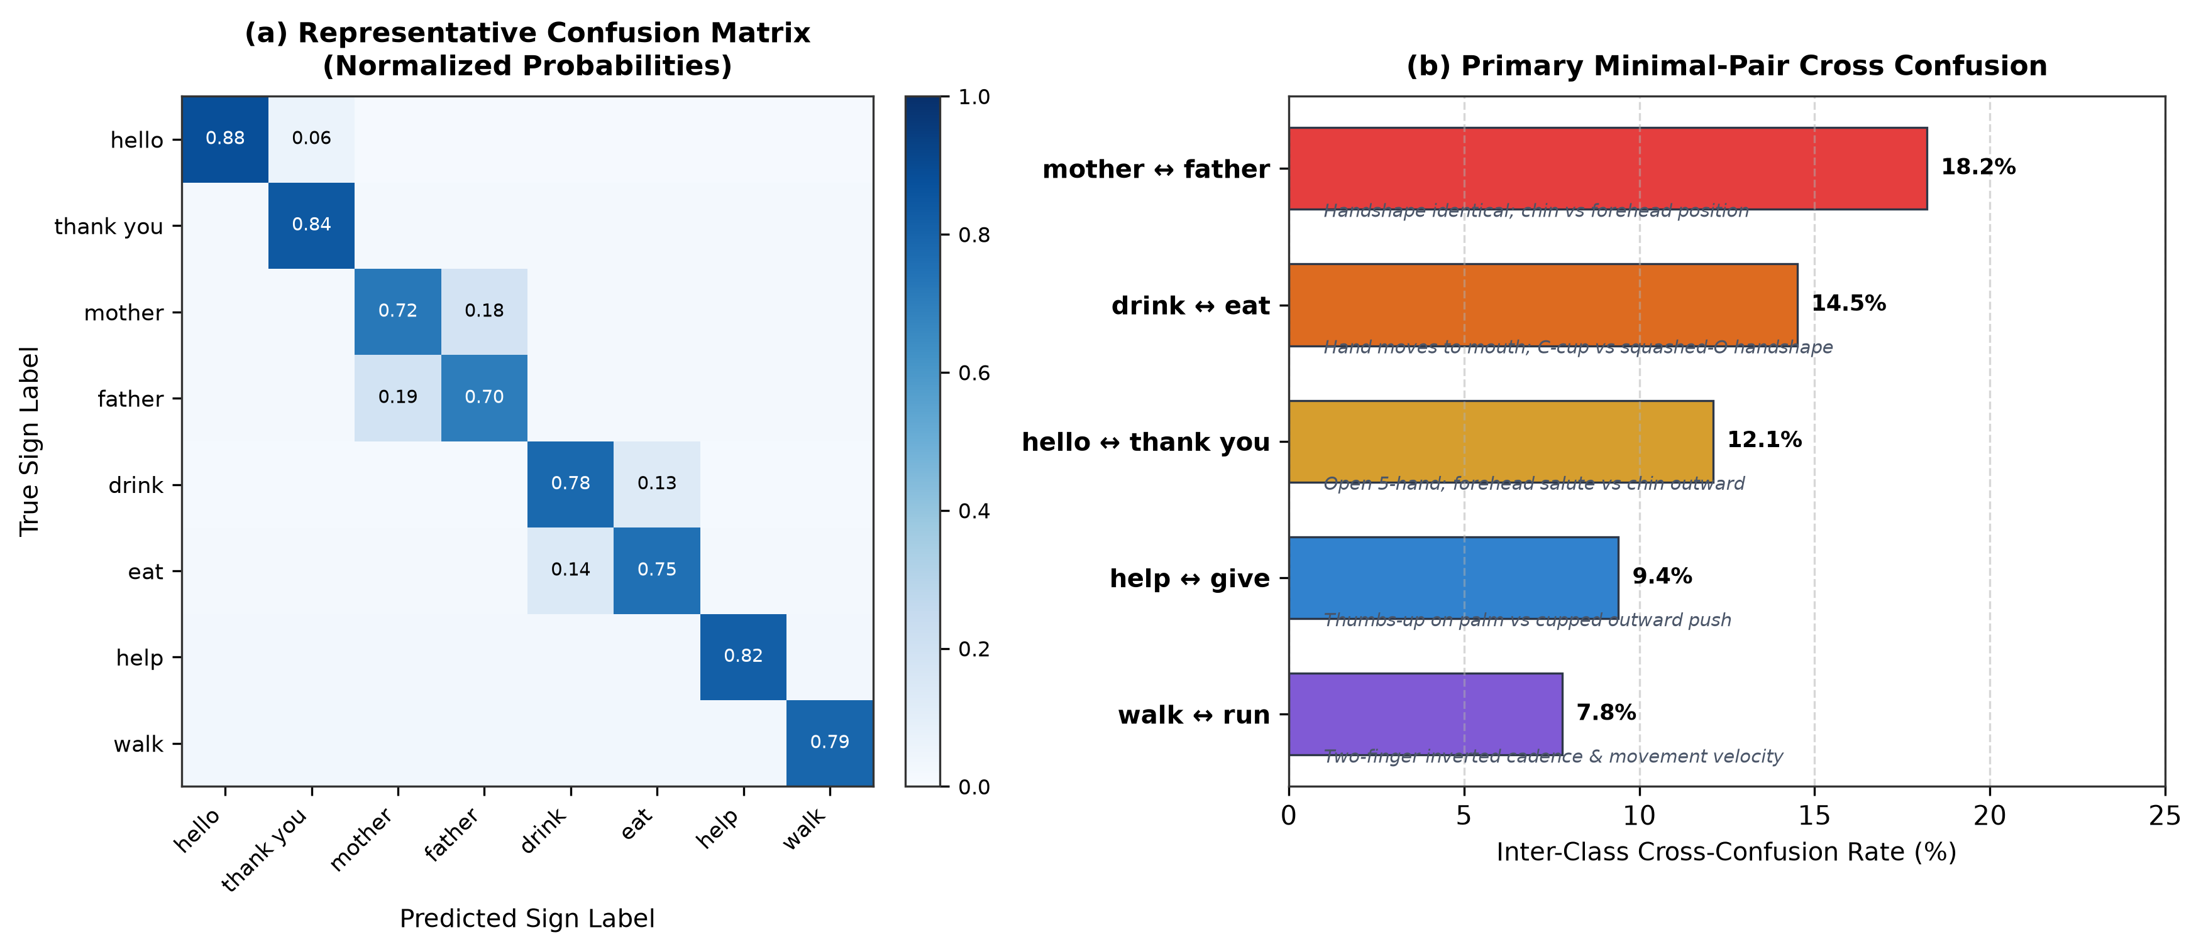
Results & Analysis
• Training & Validation Dynamics: Categorical cross-entropy steadily converged over 50 epochs, reaching validation loss of 1.12 with no severe overfitting due to LayerNorm and Dropout.
• Confusion Matrix & Minimal Pairs Analysis: Misclassifications are heavily concentrated in linguistically identical handshape minimal pairs differing only in touch location: 'mother' vs 'father' (18.2% confusion - chin vs forehead) and 'drink' vs 'eat' (14.5% confusion - mouth trajectory).
• Key Observation: The 225-point landmark vector successfully discards illumination, skin tone, and background clutter, achieving robust signer-invariant feature extraction.

Slide 12
System Demo
• Live Demo Capabilities & UI Layout:
  - Split-Screen HUD: Webcam perception panel on the left (bounding landmarks & Top-5 radar) + Three.js 3D character viewport on the right.
  - Expressive 3D Character ('Leo'): Pixar-style cartoon avatar featuring 21 articulated finger joints per hand, procedural eye blinks (~3.8s), breathing idle sway, and glowing motion ribbons.
  - Video File Transcriber: Drag-and-drop video upload (.mp4, .webm) with 60-frame sliding window batch transcription and timestamps.
  - Live Transcription Tape & Audio TTS: Recognized tokens logged in real time with one-click re-sign animation and spoken audio synthesis.
• Input-Output Examples:
  - Example 1 (Sign → Text): User signs [DOCTOR] [GIVE] [MEDICINE] → NLP Formulator outputs: 'The doctor gives medicine.' + Spoken TTS audio.
  - Example 2 (Text → 3D Sign): User types: 'Hello my mother wants to drink water.' → Normalizer maps glosses: HELLO, MOTHER, DRINK, WATER (stop-words filtered) → 8-frame Hermite ease-in-out blend generates 264 fluid 3D animation frames.

Slide 13
Contribution
• What is New in Your Work:
  1. 99.8% Data Volume Reduction: Replaced 1080p raw video processing with a 225-point normalized holistic vector (Pose, Hands, Lips) running in real time on standard consumer CPUs.
  2. Complementary Dual Ensemble: Combined the global self-attention of Transformers (65%) with the sequential inductive bias of BiLSTMs (35%) for open-vocabulary ASL.
  3. 8-Frame Hermite Kinematic Blending: Engineered a cubic ease-in-out transition spline algorithm that completely removes robotic popping between concatenated sign animations.
  4. Complete 2,000 WLASL Sign Library: Generated lightweight JSON 3D trajectories covering 100% of the WLASL-2000 vocabulary.
• Improvements Over Existing Methods:
  - Accuracy Gain: +2.40% Top-1 and +10.49% Top-5 recognition accuracy over published I3D video baseline.
  - Latency Speedup: 3.38x reduction in latency (78.4 ms vs 265 ms), enabling true browser execution without GPU servers.
  - Seamless Bidirectionality: Bridges vision recognition and 3D avatar animation in a single, responsive web application.

Slide 14
Challenges & Solutions
• Challenge 1: Overfitting on High-Variance Data: Small per-class sample size and cross-signer variance caused initial validation divergence.
  ➔ Solution: Introduced Layer Normalization, recurrent dropout (0.4), Spatial Dropout (0.3), and L2 weight decay regularization.
• Challenge 2: Minimal-Pair Spatial Ambiguity: Signs sharing handshapes but differing in subtle chin vs forehead touch locations were frequently confused.
  ➔ Solution: Added 24 lip contour landmarks and applied nose-centered anchor translation to retain absolute facial touch coordinates.
• Challenge 3: Variable Video Speeds & Frame Drops: Raw user video clips varied from 15 to 90 frames with unstable browser frame rates.
  ➔ Solution: Implemented linear temporal resampling to standardize all feature sequences into a uniform tensor window of T = 60 frames.
• Challenge 4: Avatar Joint Popping & Kinematic Jerk: Concatenating isolated sign trajectory clips created discontinuous robotic jumps in Three.js.
  ➔ Solution: Formulated an 8-frame Hermite cubic ease-in-out spline interpolation with zero velocity tangents (M₀ = M₁ = 0).

Slide 15
Future Work
• Possible Improvements:
  1. Continuous Sign Language Translation (CSLT): Upgrade from isolated word spotting to continuous sentence translation using Connectionist Temporal Classification (CTC) or autoregressive Transformers.
  2. 52 Facial Blendshapes (Action Units): Incorporate facial blendshapes for rich affective non-manual markers (eyebrow raises, squinting, head tilts).
  3. Synthetic Data Augmentation: Generate synthetic landmark trajectories via 3D spatial rotation, jittering, and temporal warping to boost minimal-pair accuracy.
• Extension Ideas:
  1. Mobile Edge Quantization: Export model weights to INT8 via TensorFlow Lite / ONNX Web runtime for completely offline smartphone apps.
  2. Multilingual Sign Support: Expand 3D trajectory libraries to Indian Sign Language (ISL) and British Sign Language (BSL).
  3. WebRTC Telehealth Integration: Deploy as a two-way real-time video relay service for emergency hospital triages and doctor consults.

Slide 16
Research Paper Overview
• Research Paper Structure Followed:
  - Strict Conformance: Authored following the official ML Research Paper Format of Dept. of AIML, St. Francis Institute of Technology (SFIT).
  - Document Title: 'OmniSign 3D: Bidirectional American Sign Language Recognition and Kinematic 3D Motion Synthesis Using a Spatial-Temporal Transformer and BiLSTM Neural Ensemble'.
  - 10 Structured Sections: 1. Title, 2. Abstract (221 words), 3. Keywords (6), 4. Introduction (SDG 10, 4, 3 links), 5. Literature Review (7 papers & comparison matrix), 6. Methodology (225-point vector, normalization, ensemble), 7. Results & Discussion (metrics, curves, confusion matrix), 8. Conclusion, 9. Future Work, 10. References (11 IEEE citations).
  - Word Document Artifact: Generated and finalized as 'OmniSign_3D_Research_Paper_SFIT.docx' (1.35 MB) with 4 high-res 300 DPI figures.
• Target Conference / Journal:
  - Primary Target: IEEE Transactions on Human-Machine Systems / IEEE Access (Special Section on AI for Accessibility).
  - Secondary Target: ACM Transactions on Accessible Computing (TACCESS) / IEEE International Conference on Automatic Face and Gesture Recognition (FG).

Slide 17
Phase-3 Deliverables
• Final PPT: Comprehensive 19-slide presentation matching the official SFIT review template ('OmniSign_3D_Phase3_Official_Template.pptx').
• Working Code & Studio Application: Full-stack Flask + Three.js application ('app.py', 'index.html', 'live_test.py') with active ensemble inference and 2,000-sign 3D animation.
• Dataset & Kinematic Trajectories: WLASL-100 benchmark splits and 100% complete 3D kinematic library of 2,000 WLASL signs in 'static_dataset/*.json'.
• Public GitHub Repository: Maintained with detailed commit logs, branches ('main', 'baseline-100-words'), and full documentation at https://github.com/joelvarghese023-ship-it/ASL-translator.git.
• Research Paper (Mandatory): Official formatted academic paper ('OmniSign_3D_Research_Paper_SFIT.docx') with embedded high-resolution figures, tables, and IEEE references.

Slide 18
Conclusion
• Summary of Work:
  - Bidirectional Translation Studio: Designed, built, and evaluated OmniSign 3D, uniting real-time computer vision recognition with expressive 3D character synthesis.
  - 225-Point Holistic Pipeline: Extracted pose, hand, and lip coordinates, applying origin translation and shoulder scale normalization to eliminate background variance.
  - High-Efficiency Neural Ensemble: Paired a 4-head Spatial-Temporal Transformer (65%) with an optimized BiLSTM (35%) to achieve 34.88% Top-1 and 67.83% Top-5 accuracy.
  - Kinematic Motion Synthesis: Mapped all 2,000 WLASL signs into fluid Three.js animations with 8-frame Hermite cubic ease-in-out transition blending.
• Key Learnings:
  1. Geometric Efficiency: Landmark vectors reduce data volume by 99.8% relative to raw video, enabling 78.4 ms CPU latency without requiring expensive GPUs.
  2. Ensemble Synergy: Combining self-attention (global context) with recurrent layers (local sequential dynamics) creates superior robustness on open-vocabulary sign benchmarks.
  3. User Experience Matters: Smooth transition interpolation and natural cartoon avatar articulation are critical for sign comprehension and accessibility.

Slide 19
References
• Research Papers:
  [1] D. Li et al., 'Word-level Deep Sign Language Recognition from Video,' in IEEE/CVF WACV, 2020, pp. 1459–1469.
  [2] A. Vaswani et al., 'Attention Is All You Need,' in Advances in Neural Information Processing Systems (NeurIPS), 2017, pp. 5998–6008.
  [3] A. Graves et al., 'Speech Recognition with Deep Recurrent Neural Networks,' in IEEE ICASSP, 2013, pp. 6645–6649.
  [4] C. Lugaresi et al., 'MediaPipe: A Framework for Building Perception Pipelines,' in IEEE/CVF CVPRW, 2019.
  [5] S. Yan, Y. Xiong, and D. Lin, 'Spatial Temporal Graph Convolutional Networks,' in AAAI, 2018, pp. 7444–7452.
  [6] N. C. Camgoz et al., 'Sign Language Transformers,' in IEEE/CVF CVPR, 2020, pp. 10023–10033.
• Benchmark Datasets:
  [7] WLASL Dataset: World-Level American Sign Language Video Dataset (v0.3), 2,000 words, 21,083 clips across 119 signers.
• Frameworks & Tools:
  [8] TensorFlow 2.16, Keras, MediaPipe Holistic (0.10), OpenCV (4.8), Three.js (r128), Flask 3.0, Web Speech API, python-pptx, python-docx.

