Slide 1
A Systematic Analysis of XSS Sanitization in Web Application Frameworks
Joel Weinberger, Prateek Saxena,
Devdatta Akhawe, Matthew Finifter,
Richard Shin, and Dawn Song
University of California, Berkeley
Notes:
Presented by Joel Weinberger at ESORICS 2011.

Slide 2
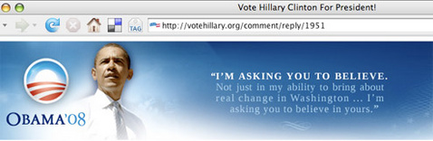
Content Injection
<div class=“comment”>
<iframe src=“http://www.voteobama.com”></iframe>
</div>
Notes:
So here we see the current US President during his 2008 campaign on his campaign website. Unfortunately, there’s one problem.
This is the website of Hilary Clinton, his rival during the primary in 2008.
This is a real example from Hilary Clinton’s website and is an example of content injection. In particular, an attacker was able to place an iframe that pointed to Obama’s site on the Clinton site that all visitors loaded. Unfortunately, the servers did not properly filter this out.
So how do we generally prevent these attacks these days?

Slide 3
Web Frameworks
Systems to aid the development of web applications
Dynamically generated pages on the server
Templates for code reuse
Untrusted data dynamically inserted into programs
User responses, SQL data, third party code, etc.
Notes:
Web frameworks are a common method of preventing these types of attacks. They provide a choke point that can help developers sanitize, or filter, untrusted data. Here we have some properties of web frameworks.
Note that we’re purposely being general here. Not all frameworks have all these properties.
Let’s take a brief look at how code might be written in a web framework.

Slide 4
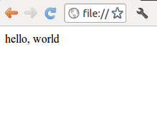
Code in Web Frameworks
<html>
<p>hello, world</p>
</html>
Notes:
In this example, we just have some simple HTML that outputs “hello, world.”

Slide 5
Code in Web Frameworks
<html>
<?php echo "<p>hello, world</p>"; ?>
</html>
Notes:
This is how you might do the same thing in PHP. PHP will execute on the server to generate an HTML page. In this case, in runs the “echo” command to output the <p> tags with “hello, world.”

Slide 6
Code in Web Frameworks
<html>
<?php echo $USERDATA ?>
</html>
What happens if
$USERDATA =
<script>doEvil()</script>
Notes:
PHP also has variables, denoted by the “$” sign. In this case, we have a PHP variable that represents untrusted user data. But what happens if that variable points to a string for a script that does something really, really bad?

Slide 7
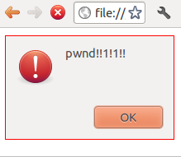
Code in Web Frameworks
<html>
<script>doEvil()</script>
</html>
Notes:
Well, PHP will happily output that string and generate an HTML page such as above and pass that to the user. So, clearly, there’s a problem with how we deal with untrusted data in web frameworks.

Slide 8
Sanitization
The encoding or elimination of dangerous
constructs in untrusted data.
Notes:
We deal with untrusted content through sanitization. Sanitization is the process of filtering out and eliminating or encoding dangerous constructs in untrusted data.

Slide 9
Contributions
Build a detailed model of the browser to explain subtleties in data sanitization
Evaluate the effectiveness of auto sanitization in popular web frameworks
Evaluate the ability of frameworks to sanitize different contexts
Evaluate the tools of frameworks in relation to what web applications actually use and need
Notes:
In this work, we make the following contributions.
You can sort of summarize our contributions as asking the question, as a developer, if you use a web framework, will you be safe from content injection attacks?

Slide 10
Sanitization Example
"<p>" + "<script> doEvil()</script> " + "</p>"
Untrusted
Notes:
Let’s take this example, where we imagine that on the server, in a web framework, we have this untrusted string (which happens to be malicious), and we are constructing output with it. How might we sanitize it?

Slide 11
Sanitization Example
"<p>" +
sanitizeHTML(
"<script>
doEvil()
</script>"
) +
"</p>"
<p>
doEvil()
</p>
Notes:
Well, we might run a special function over it to remove untrusted content. In the end, this outputs something harmless. Great! All done, right?

Slide 12
Are we done?
HTML context sanitizer
<a href='
javascript: …
'/>
"<a href='" +
sanitizeHTML(
"javascript: …"
) +
"' />"
URI Context,
not HTML
Notes:
Well, let’s look at this slightly more complex example. We construct this <a> tag, and we have the “href” attribute that contains the untrusted data. So we apply the same sanitizer as before and… uh oh. What happened? Well, our sanitizer is context specific. More specifically, there isn’t “one sanitizer to rule them all.” Depending on where the data is being output, we need to sanitize in different ways. In this case, we don’t want to apply an HTML sanitizer to a URL context.

Slide 13
Now are we done?
<div
onclick='displayComment("
SANITIZED_ATTRIBUTE
")'
>
</div>
What if SANITIZED_ATTRIBUTE =
&quot;);stealInfo(&quot;"
Notes:
So let’s add a new sanitizer for tags, URLs, attributes! Great. Then in this example, we construct our string for an attribute and…

Slide 14
Now are we done?
<div
onclick='displayComment("
SANITIZED_ATTRIBUTE
")'
>
</div>
<div
onclick='displayComment(
"");
stealInfo("")
'>
</div>
Notes:
Uh oh. In this example, we have several different contexts. There’s HTML, there’s an attribute, and there’s JavaScript. In particular, the browser looks at this HTML and entity decodes it, converting those weird looking things in the input into quotes. This changes how this data will appear in the JavaScript.
This is just the tip of the iceberg. In the paper, we discuss many other problems that the subtleties of the browser model lead to. For example, subtleties in the DOM API are not well understood by developers and often lead to real-world misunderstandings of when encodings and decodings occur.

Slide 15
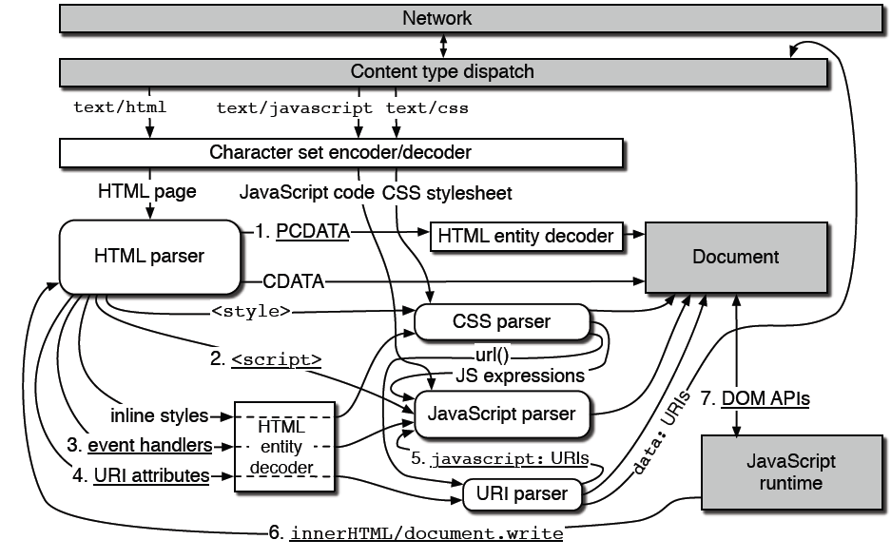
Browser Model
OMG!!!
Notes:
Browser is a collection of sub-grammars and transducers. The sub-grammars correspond to parsers for languages, such as URI schemes: CSS, HTML, JavaScript, etc. The transducers transform or change representations of text, such as HTML-entity encoding/decoding, URI encoding, JavaScript Unicode encoding, etc. The browser recognizes changes in grammar and passes them to a different sub-grammar, first passing the text through the corresponding transducer, potentially modifying the input to the sub-grammar. All this is to say, the browser is really, really complicated (for all the details on this complexity, see the paper).
Because the browser is so complicated, we need ways to automate sanitization. Trying to have every developer everywhere understand the subtleties of the browser just isn’t reasonable.

Slide 16
Framework and Application Evaluation
What support for auto sanitization do frameworks provide?
What support for context sensitivity do frameworks provide?
Does the support of frameworks match the requirements of web applications?
Notes:
We set out to measure how well web application frameworks actually do at helping developers protect their applications from content injection vulnerabilities, so we asked the following questions.
Auto sanitization is the support of browsers to automatically filter untrusted data and protect the developer from dangerous constructs.
Context sensitivity refers to the fact that we must have different sanitizers for the different places untrusted data may appear. For example, data that appears in HTML should be treated differently from data that appears in JavaScript.

Slide 17
Using Auto Sanitization
{% if header.sortable %}
<a href="{{header.url}}">
{% endif %}
Django doesn’t know how to auto sanitize this context!
Notes:
To start with, we looked at the support in web frameworks for auto sanitization and how effective it is.
Here we have a real example from a Django application. In this case Django applies auto sanitization to the URL being entered.
Unfortunately, Django only knows how to auto sanitize in the HTML context, not the URI context. Thus in sanitizes incorrectly! So even though it provides automatic sanitization of a sort, it can be used incorrectly.

Slide 18
Overriding Auto Sanitization
{% if header.sortable %}
<a href="{{header.url | escape}}">
{% endif %}
Whoops! Wrong sanitizer.
Notes:
It turns out, the developer was clever enough to override the auto sanitization in this particular case. Unfortunately, he got it wrong by applying the wrong sanitizer. That’s the importance of *effective* auto sanitization.
This is a custom sanitizer in a real Django app that was written for the attribute context. In this particular example, the coder failed to prevent XSS attack verctors such as javascript: URIs.

Slide 19
Auto Sanitization Support
No Auto Sanitization | HTML Context Only Auto sanitization | Context Aware
7 | 4 | 3
Examined 14 different frameworks
7 have no auto sanitization support at all
4 provide auto sanitization for HTML contexts only
3 automatically determine correct context and which sanitizer to apply
…although may only support a limited number of contexts
Notes:
But at least it provided some auto sanitization. Half of the frameworks we looked at don’t provide any auto sanitization support. A complete list of the applications we examined can be found in the paper.
Of the 3 frameworks that support context aware sanitization, they do this by parsing the output on the server at run time, tracking the contexts, and applying sanitizers for the appropriate context. This has high runtime overhead, but seems to be pretty effective. Unfortunately, if you have enough nested depths, it doesn’t work so well, but practically, this may net be a serious problem.

Slide 20
Sanitization Context Support
HTML Tag Context | URI Attribute (excluding scheme) | URI Attribute (including scheme) | JS String | JS Number or Boolean | Style Attribute or Tag
14 | 14 | 4 | 4 | 1 | 2
Examined 14 different frameworks
Only 1 handled all of these contexts
Numbers indicate sanitizer support for a context regardless of auto sanitization support
Notes:
Here are all the different contexts that the web frameworks provided any support for at all. Of these contexts, only 1 framework provided support for all of them. And that one framework that does all of these contexts… it’s in C++ (Ctemplate). What happened to the power of modern languages?

Slide 21
Contexts Used By Web Applications
HTML Tag Context | URI Attribute (excluding scheme) | URI Attribute (including scheme) | JS String, Number, or Boolean | Style Attribute or Tag
8/8 | 7/8 | 7/8 | 6/8 | 8/8
Web applications (all in PHP):
RoundCube, Drupal, Joomla, WordPress, MediaWiki, PHPBB3, OpenEMR, Moodle
Ranged from ~19k LOC to ~530k LOC
Notes:
Of course, that previous slide isn’t meaningful if real web applications don’t place untrusted data into those contexts, which we set out be examining 8 real applications written in PHP.
In summary, all those things that were unsupported by web frameworks… are actually in use by web applications.
In order to do this portion of the study, we used heuristics to identify sanitizers, which we then manually confirmed. We dynamically checked what inputs went through what sanitizers and what context they ended in. Note that there may be more sanitizers; these are just a minimal set.

Slide 22
Further Complexity in Sanitization Policies
wordpress/post_comment.php
User
Admin
"<img src='…'></img>"
"<img src='…'></img>"
""
"<img src='…'></img>"
Notes:
But there are further complexities. Take this real-world example from WordPress.
Different program paths might lead to different sanitizers being applied in different contexts. WordPress has “roles” for different types of users. In this case, a regular user cannot place scripts on a page. However, an administrator can place whatever content he wishes on a page. That means that different sanitizers need to be applied depending on what “role” a user has at a particular point of the code.
Of the frameworks we looked at, only 1, Yii, provides an abstraction rich enough to provide different sanitizers within the same context in different places on the page. Unfortunately, Yii only provides this flexibility for the HTML tag context.
Of note, we saw this idiom across many different applications that we examined. We believe this to be a common practice, not a one-off piece of coding.

Slide 23
Evaluation Summary
Auto sanitization alone is insufficient
Frameworks lack sufficient expressivity
Web applications already use more features than frameworks provide

Slide 24
Take Aways
Defining correct sanitization policies is hard
And it’s in the browser spec!
Frameworks can do more
More sanitizer contexts, better automation, etc.
Is sanitization the best form of policy going forward?
Notes:
We believe that purely client side policies might be a step in the right direction, a la BLUEPRINT and Content Security Policy. But we also recognize that web frameworks and sanitization are here to stay for the immediate future. There’s a lot more that web frameworks can do, and need to do.

