Slide 1
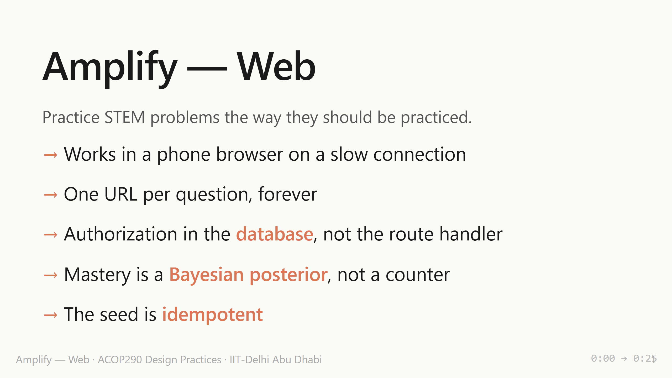
Notes:
Same product as the desktop pitch — practice STEM problems — but built for an institution, not a single user. These five commitments shape the architecture. The rest of the deck is how each one gets honored.

Slide 2
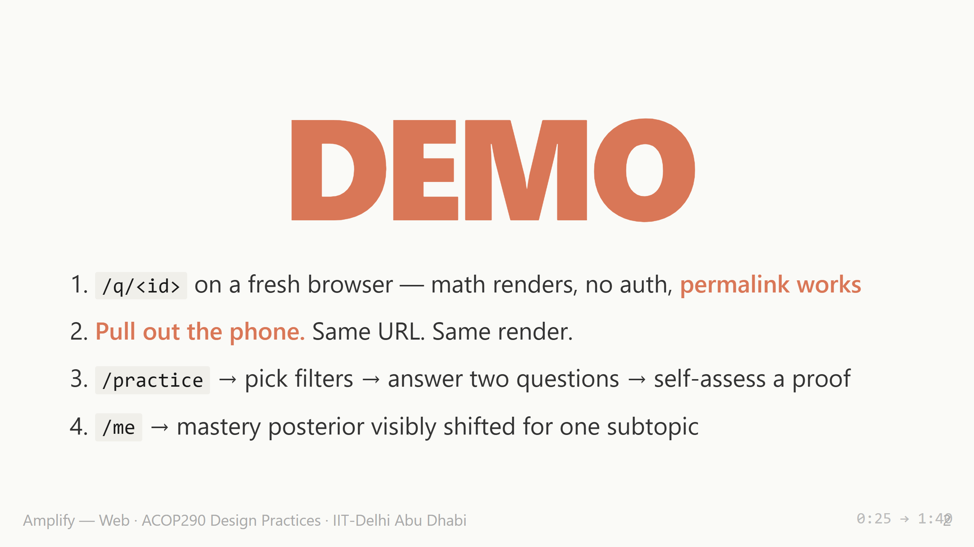
Notes:
Pre-warm the Vercel deploy 30s before going up. Phone moment is the load-bearing beat — physically pull it from your pocket. Have a 60s pre-recorded screen capture one keystroke away in case Vercel cold-starts.

Slide 3
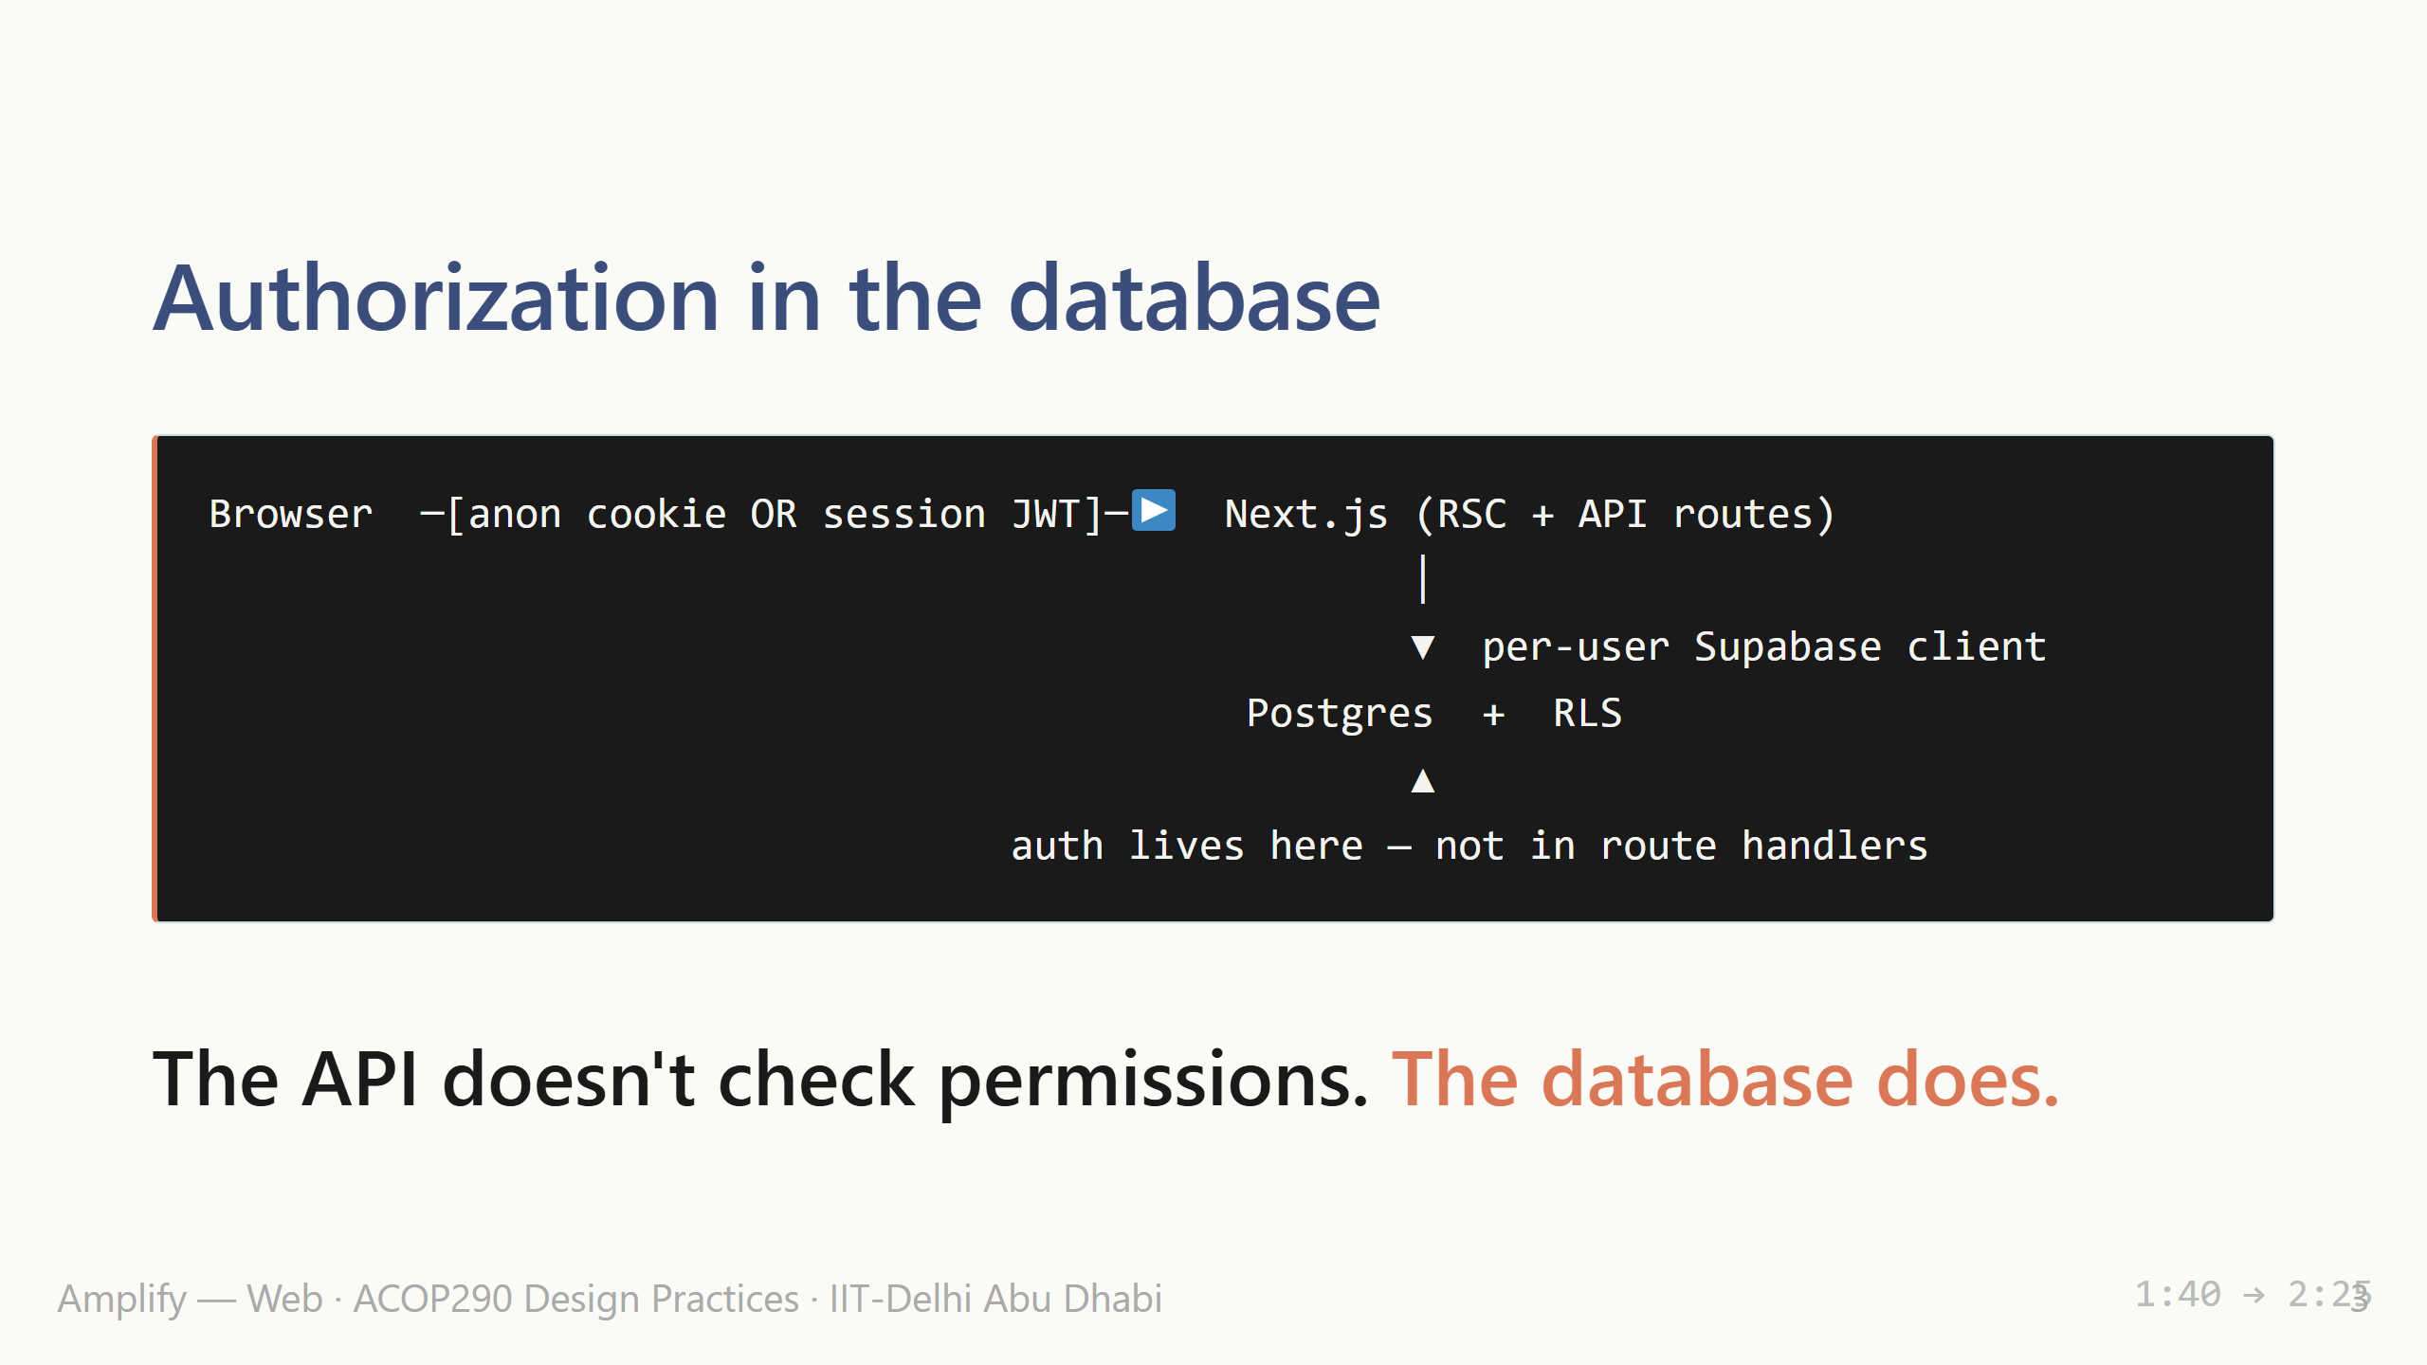
Notes:
Row-level security policies decide which rows a user can read. The route handler never has access to data the user shouldn't see — so it can't accidentally leak it. That's what makes the multi-tenant model trustworthy without writing security code in every endpoint.

Slide 4
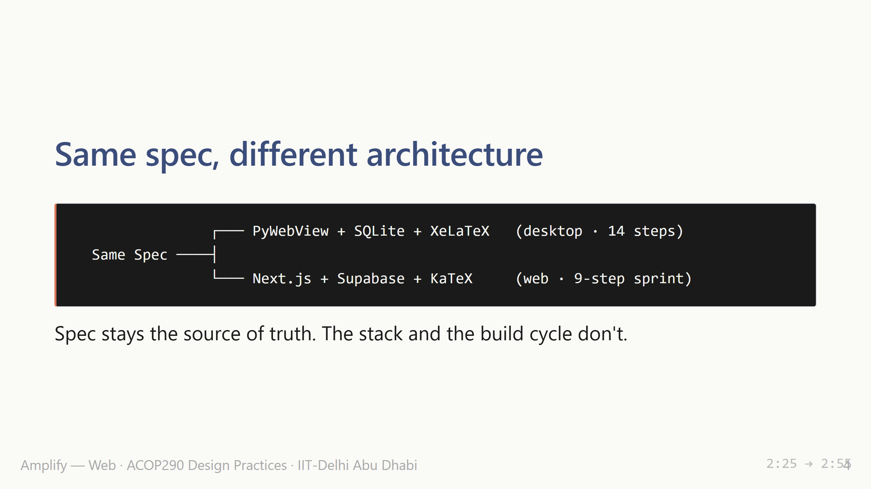
Notes:
Joel wrote the spec for an offline desktop tool. I re-targeted it for the web — same product goals, different constraints, completely different stack. The dev cycle compressed from fourteen desktop steps into a 9-step web sprint.

Slide 5
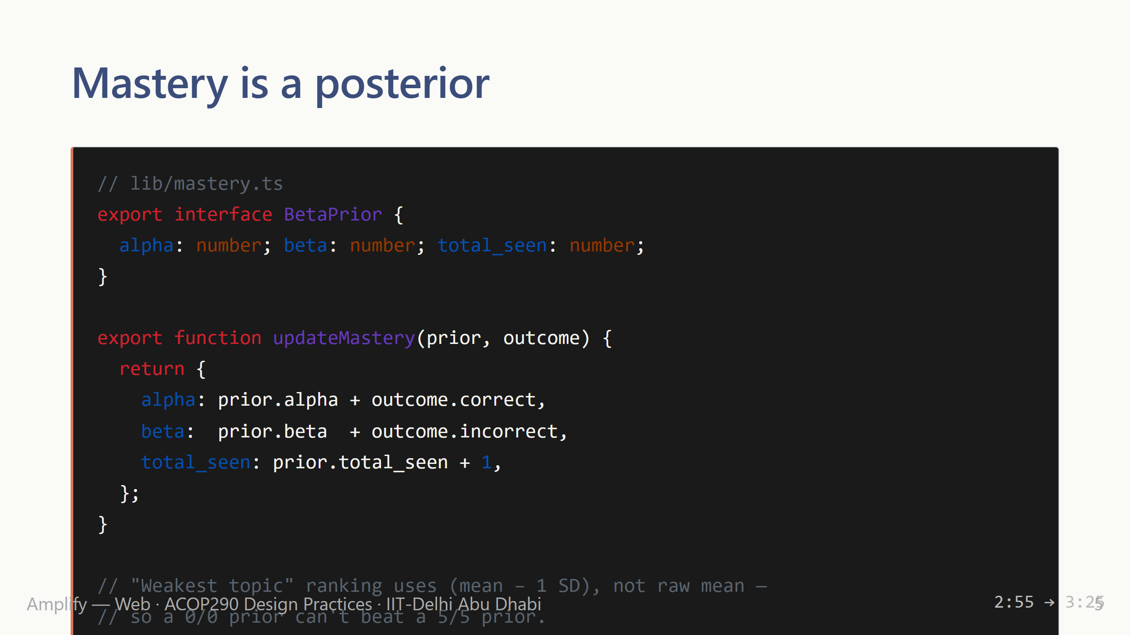
Notes:
Mastery is a Beta posterior, not a percentage. The estimate tightens as evidence accumulates. The "weakest topic" ranking uses the lower credibility bound — penalises uncertainty so a freshly-seen topic doesn't outrank a well-evidenced one. Real statistics, properly tested.

Slide 6
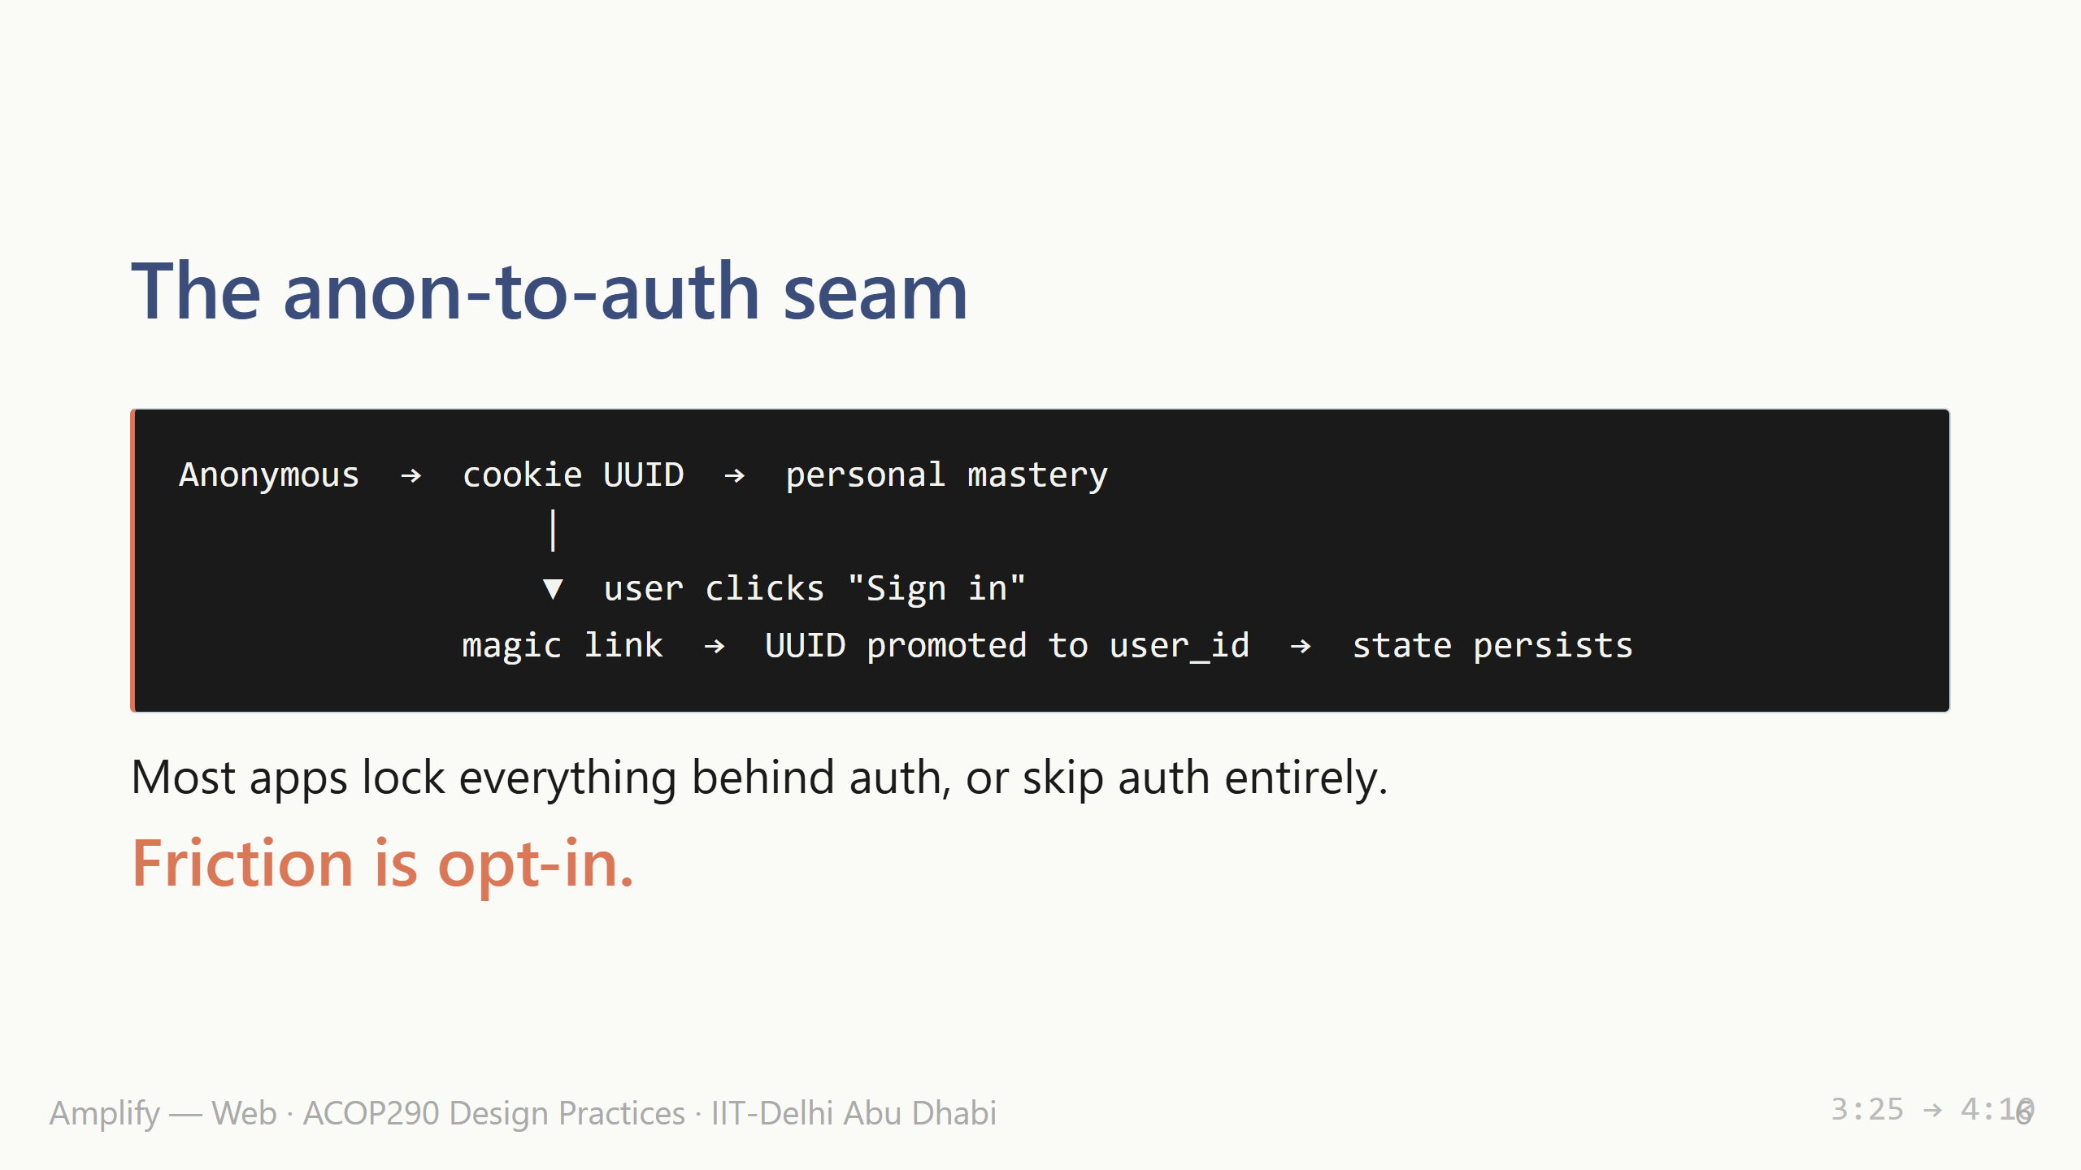
Notes:
Anonymous users get personal mastery via a cookie UUID. Signing in promotes that UUID to a real account — no data lost. That's how you earn the first session without giving up personalization on the second. This is the design-practices money slide: a deliberate seam between "trustless onboarding" and "trusted account." Most peers will not have considered this seam at all.

Slide 7
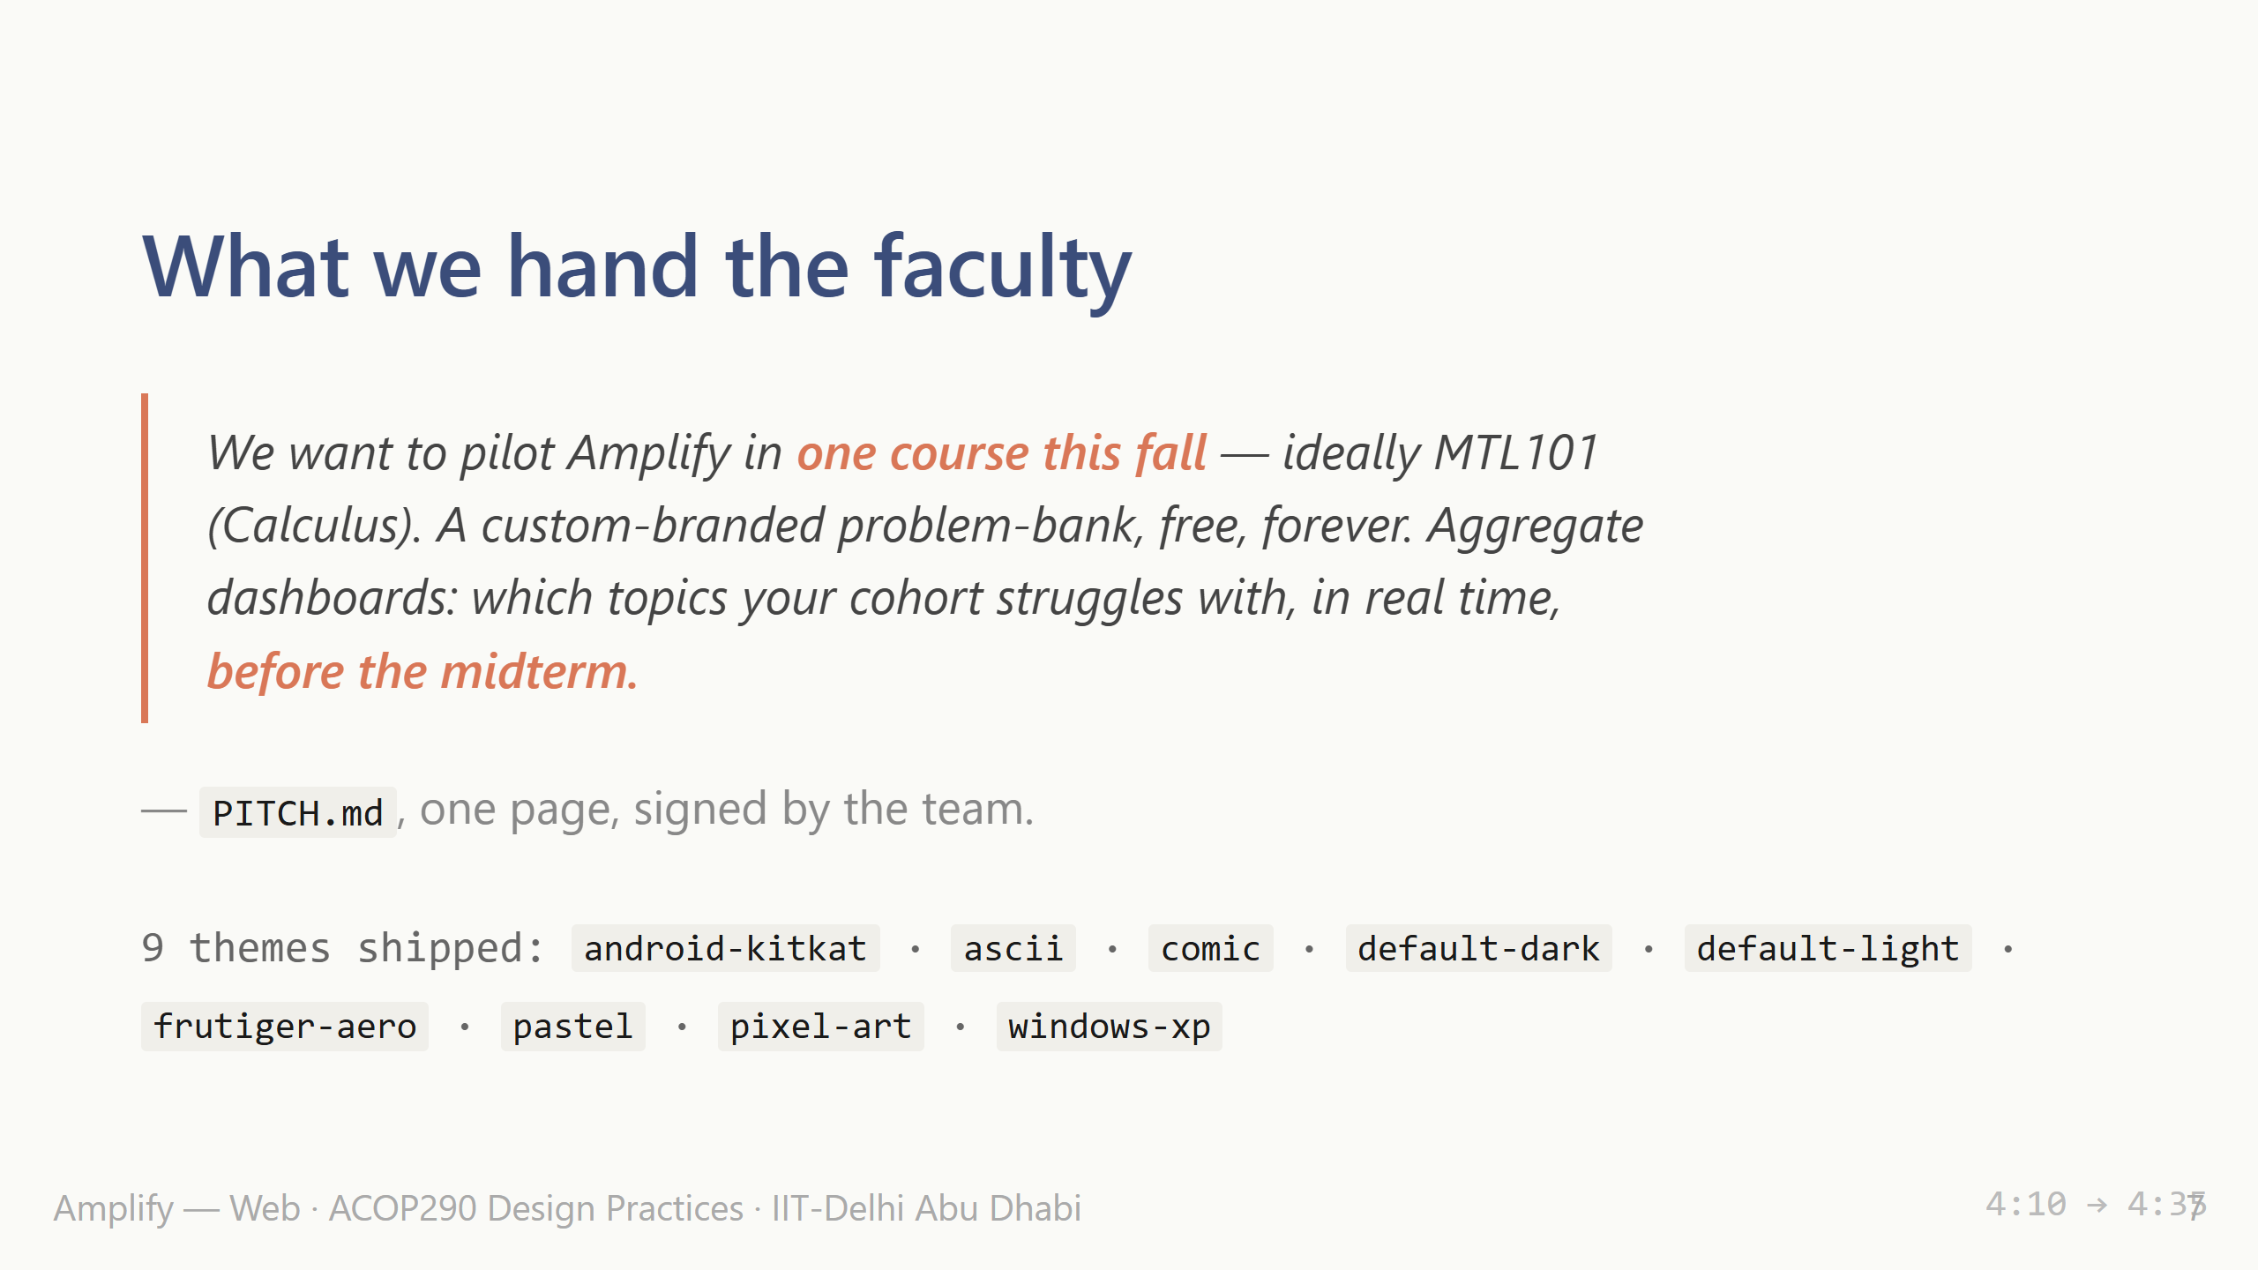
Notes:
Final artifact isn't the app — it's this one-page faculty pitch. We want a course pilot in the fall. That closes the design-practices loop: build the thing, write the pitch, hand it to the user. Also: nine themes. Flick through them on the live app as your last beat if there's time. Sit down.

