Slide 1
Team Bastion
Joely – Registration page
Reuben - Login
Vicki – Item database

Slide 2
Current progress
Working registration page with validated fields
Application hosted on Heroku

Slide 3
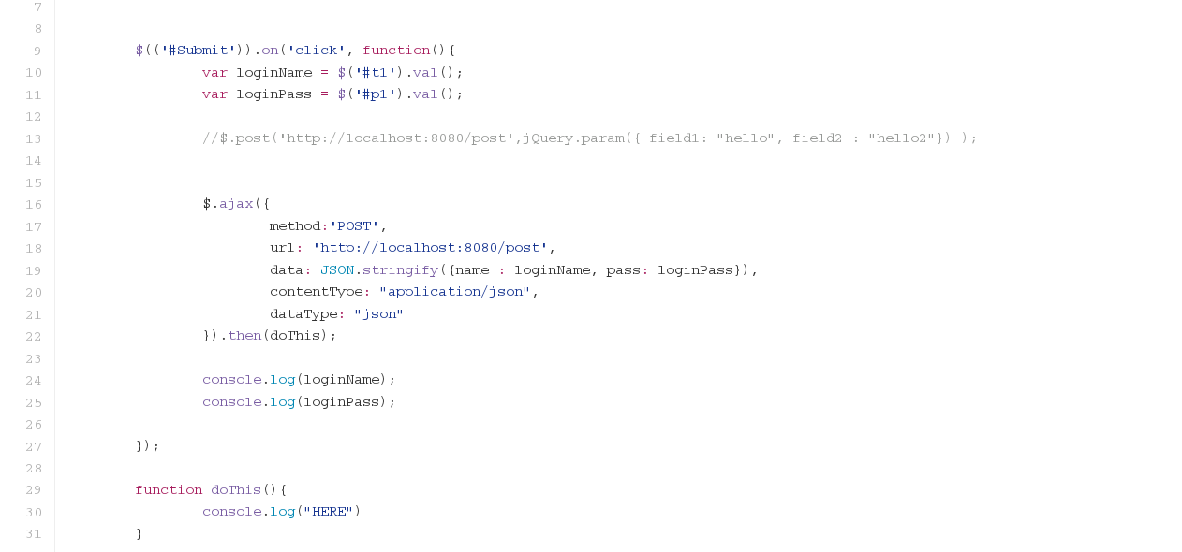

Slide 4
