Slide 1
Team Bastion
Joely – Registration page
Reuben - Login
Vicki – Item database

Slide 2
Current progress
Working registration page with validated fields
Local Node.js application linked to client HTML/jQuery
Login page

Slide 3
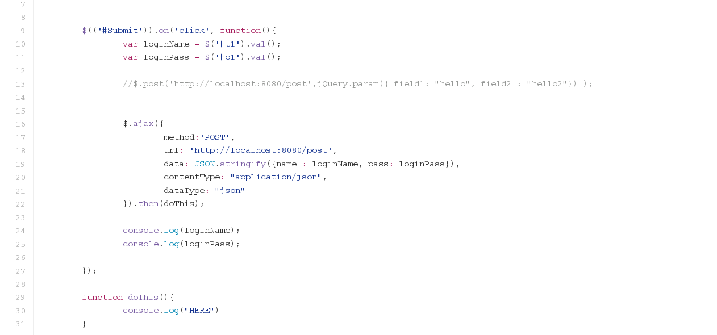
Notes:
A small sample of Reuben’s wonderful login code.

Slide 4
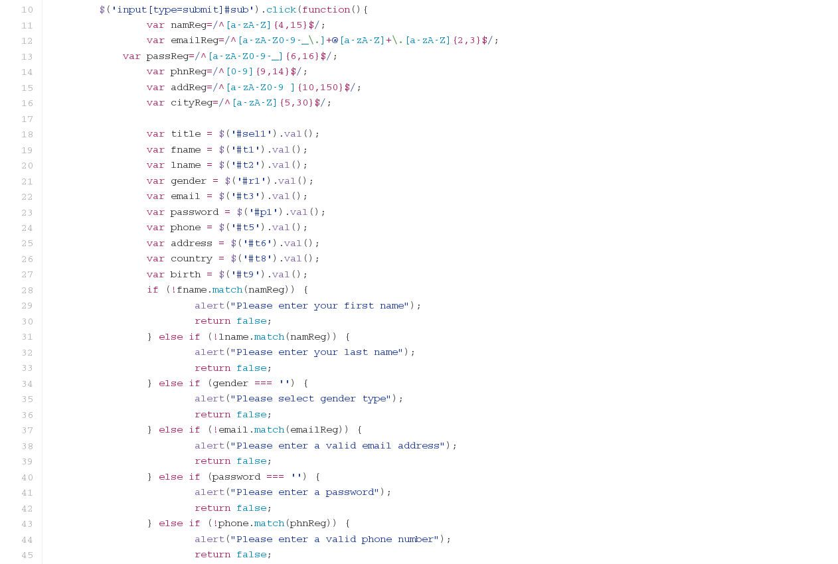
Notes:
Joely’s splendid form validation code.

Slide 5
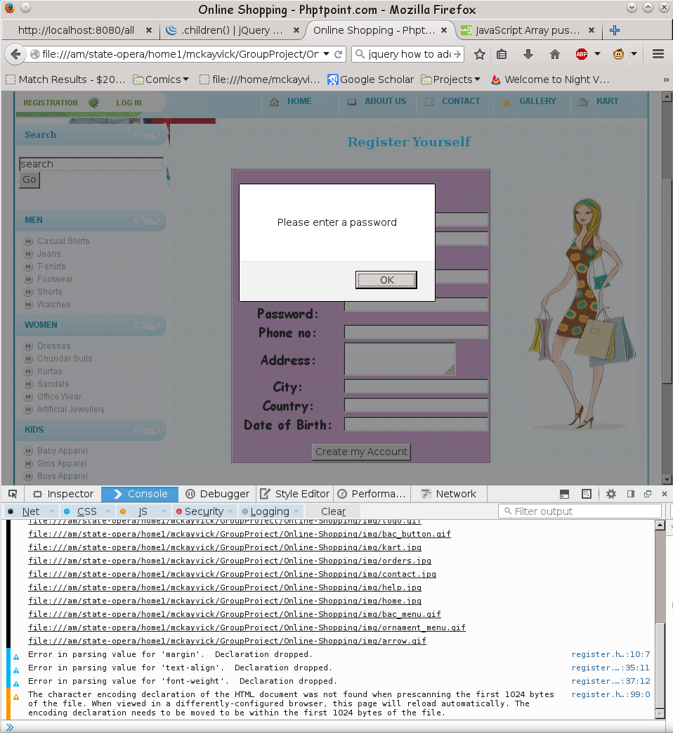
Notes:
Joely’s code in action!

Slide 6
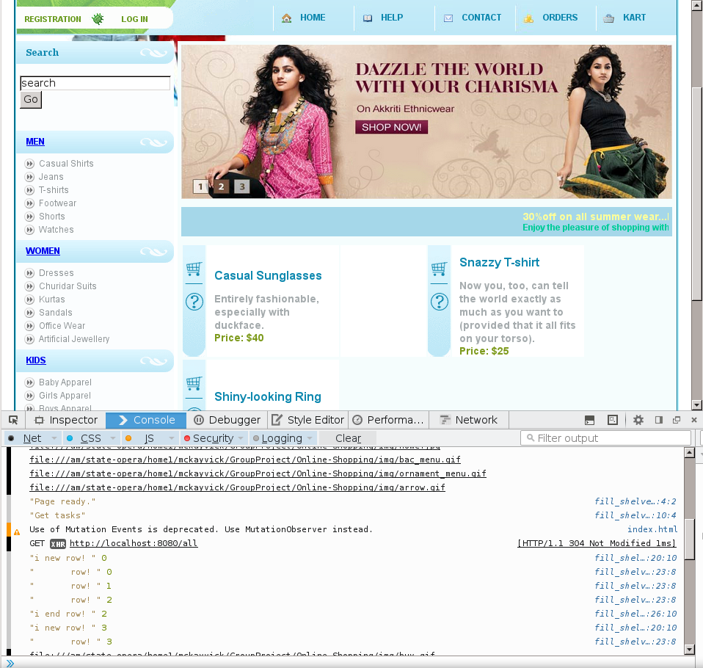
Notes:
Vicki’s database work populating a web page.

Slide 7
Next steps
Joely to build the Oauth and Heroku hosting.
Reuben to develop HTTPS support and caching.
Vicki to continue database work and shopping cart functionality.

