Slide 1
Team Bastion
Joely – Registration page
Reuben - Login
Vicki – Item database

Slide 2
Current progress
Working registration page with validated fields
Application hosted on Heroku
Working login

Slide 3
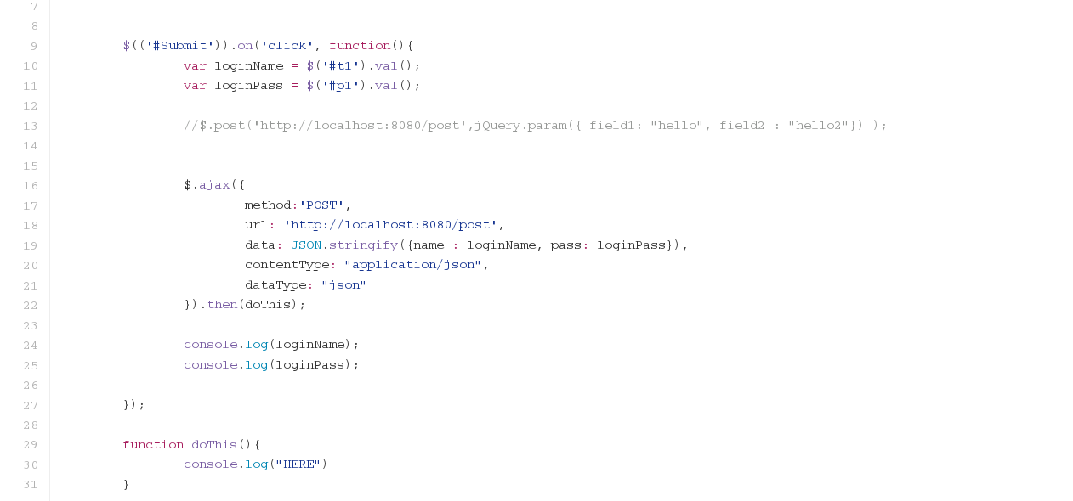

Slide 4
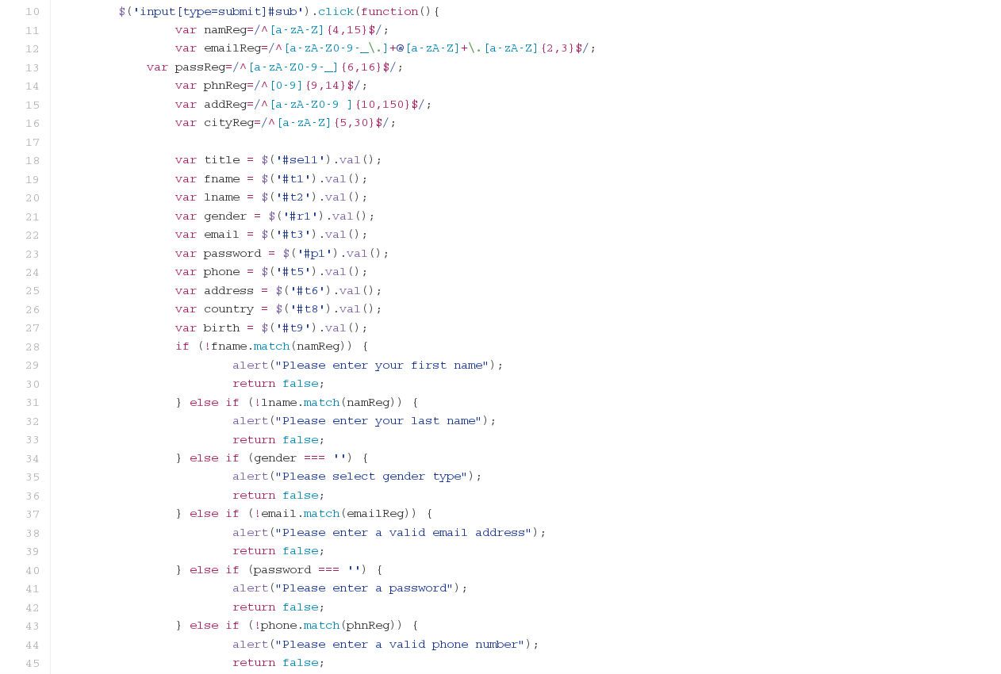

Slide 5
Future plans
Joely to build the Oauth and Heroku hosting.
Reuben to develop HTTPS support and caching.
Vicki to continue database work and shopping cart functionality.

