Slide 1


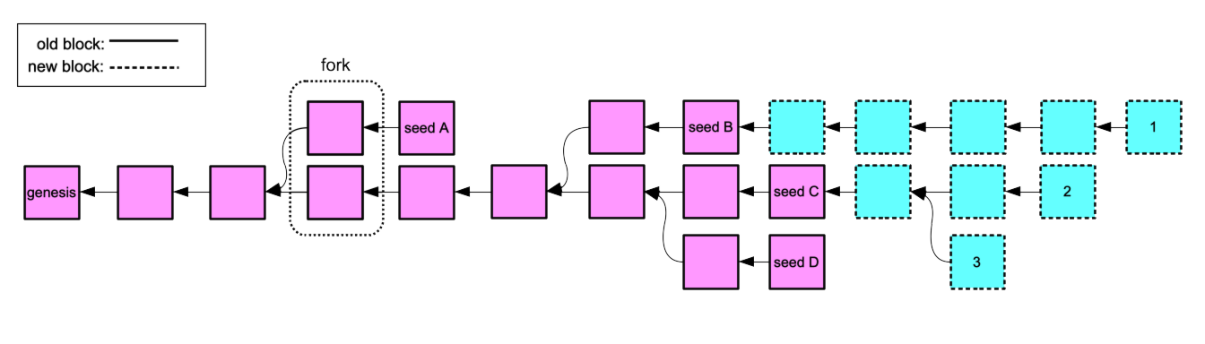
Partitionable Asynchronous Cryptocurrency Blockchain
Kendric Hood
Joseph Oglio
Mikhail Nesterenko
Gokarna Sharma
Kent, Ohio
May 3-6, 2021

Slide 2
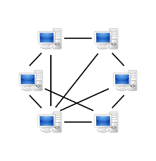
Peer-to-Peer Networks and Blockchain
peer-to-peer (overlay) network – collection of computers (peers) joined to perform a task
peer gets connection to another peer by learning its identity, message transmission is performed by underlay network: topology may change with computation
decentralized, no single point of failure, potentially scales up, peers may join and leave
multiple applications: file sharing, data storage, distributed computation
blockchain – distributed ledger of linked transactions/blocks maintained by a peer-to-peer network
able to securely record transactions without central authority
security is ensured by majority of honest peers
peers agree on which blocks to add to blockchain
cryptocurrency blockchain - ledger contains financial transactions appended block by block
Bitcoin - one of the most widely used

Slide 3
Blockchain Partitioning and Why It Matters
partition – a network split
existing blockchains do not operate under partitioning
either assumed to happen infrequently or for a short duration
or single (primary) partition only
in Bitcoin, blocks approved in partition with less computation power are discarded
still need to consider
short duration splits are common
overloaded links may present as a short split
in high frequency trading even a short split is consequential
discarding work of non-primary partitions is wasteful, decreases availability

Slide 4
Blockchain Partitioning is Difficult
CAP theorem [CAP]: cannot co-satisfy: consistency, availability, and partition tolerance in a distributed system
indeed: concurrent transactions may violate integrity
two partitions can not tell if a block was mined before or after the partition ⇒ both may confirm conflicting transactions
example:
account A has $10
transaction T₁: subtract $8 in partition P₁
transaction T₂: subtact $5 in partition P₂
result: overdraft ($3)
what to do?

Slide 5
Partition Handling Idea
to preserve the integrity of the blockchain – divide funds between partitions:
example
account A has $10 pre-split
after-split, A has $5 in P₁, and $5 in P₂
transaction T₁, subtract $8 in P₁ is rejected due to insufficient funds
transaction T₂, subtract $5 in P₂ is accepted
result: account balance is $5, integrity is preserved

Slide 6
Contribution
defined the Partitionable Blockchain Consensus Problem
studied under asynchronous system, single split, no message loss, no merging
proved impossible to solve in pure asynchronous system
defined a family detectors that enable solution
developed algorithm PART that uses detectors to solve the problem
implemented PART and detectors, simulated and analyzed performance
extended PART and detectors to handle multiple splits, message loss, merging

Slide 7
Outline
consensus
impossibility
detectors
algorithm
performance evaluation
extensions

Slide 8
Consensus
in blockchain, peers cooperate to agree on transactions to be added to blockchain
foundation: consensus – peers agree on particular transaction
Proof-of-Work (PoW)– Nakamoto-style with peers mining transactions, the longest chain of mined transactions is accepted
the asynchronous system - most general system model
messages can be delayed for an arbitrarily long time
speed difference between peers is unlimited
[FLP] in the asynchronous system, consensus is impossible even if a single peer crashes
intuition: peers may not distinguish a crashed peer from a very slow one

Slide 9
Outline
consensus
impossibility
detectors
algorithm
performance evaluation
extensions

Slide 10
Blockchain Definitions
block/link - group of transactions that includes a reference to the previous block
genesis - first block
seed - block in which accounts are split
mining - creating and linking a new block
peer adds mined block to the longest chain
tree - graph of all blocks and links
fork - two blocks that reference the same previous block
branch - a chain of blocks from the genesis block to some other block
permanent branch - a branch which grows forever under normal operation of the algorithm

Slide 11
Partitionable Blockchain Consensus Problem and Impossibility
invalid transaction creates a negative account balance
permanently valid transaction is never invalid
transactions in mergeable branches can be combined and ordered arbitrarily without creating negative account balances
Definition 1: The Partitionable Blockchain Consensus Problem:
confirmation validity: no invalid transaction is confirmed
branch compatibility: permanent branches are mergeable
progress: every permanently valid transaction is eventually confirmed
Theorem 1: It is impossible to solve the Partitionable Blockchain Consensus Problem in the pure asynchronous system.
intuition
for correct post-split operation peers across partitions need to agree on last mined block
in asynchronous system, have to rely on messages
sender is not sure if message reached receiver or lost due to split

Slide 12
Outline
consensus
impossibility
detectors
algorithm
performance evaluation
extensions

Slide 13
Detector Definition
detector – mechanism to introduce additional functionality otherwise unavailable in the system model
ex: [CT] failure detectors to circumvent FLP impossibility
detector A is strictly weaker than B, denoted A ≺ B, if A can be built from B and B can not be built from A
detector A is equivalent to B, denoted A ≡ B, if A can be built from B and v.v.

Slide 14
Partition Detectors
SPLIT– determines whether split in the system has occurred
PROP– determines whether a particular block is delivered to peers of the entire network or just for a single partition
AGE– determines whether the block was mined before (old block) or after (new block) the split
perfect AGE, never makes mistakes
◇AGE – can make finitely many mistakes
WAGE – at least one peer per partition stops making mistakes, others may not permanently settle on incorrect info
(either never choose or eventually choose correct info)
Theorem 2: The relationship between partitioning detectors is as follows:
SPLIT ≺ PROP ≡ AGE ≻ ◇AGE ≡ WAGE

Slide 15
Outline
consensus
impossibility
detectors
algorithm
performance evaluation
extensions

Slide 16
Algorithm PART Description
longest chain
Algorithm PART+AGE
AGE determines if old (mined before split) or new (afer)
longest chain
the longest chain of old blocks, tail is seed, break ties deterministically, plus
longest chain of new blocks from the seed
peer tries to mine a block on longest chain and broadcasts it to other peers
when peer receives a block, if can add to tree, checks its status with AGE:
if match with tree, adds to tree
if transitions old → new, forms a seed, splits accounts, proceeds mining

Slide 17
Algorithm PART Correctness
Theorem 3: Algorithm PART+AGE solves the Partitionable Blockchain Consensus Problem
Theorem 4: Algorithms PART+◇AGE and PART+WAGE solve the Partitioning Blockchain Consensus Problem

Slide 18
Outline
consensus
impossibility
detectors
algorithm
performance evaluation
extensions

Slide 19
Performance Evaluation Setup
abstract simulation - represented as a sequence of rounds
each round for each peer:
receive messages
preform local computation
send messages
channels are FIFO
100 peers, completely connected network
messages have random delay between 1 and max delay
submit 1 transaction per round to random peer
1000 tests per data point
vary: average message delay
measure: throughput - fraction of confirmed transactions (transactions in main chain(s))
observe: behavior of network in case of split

Slide 20
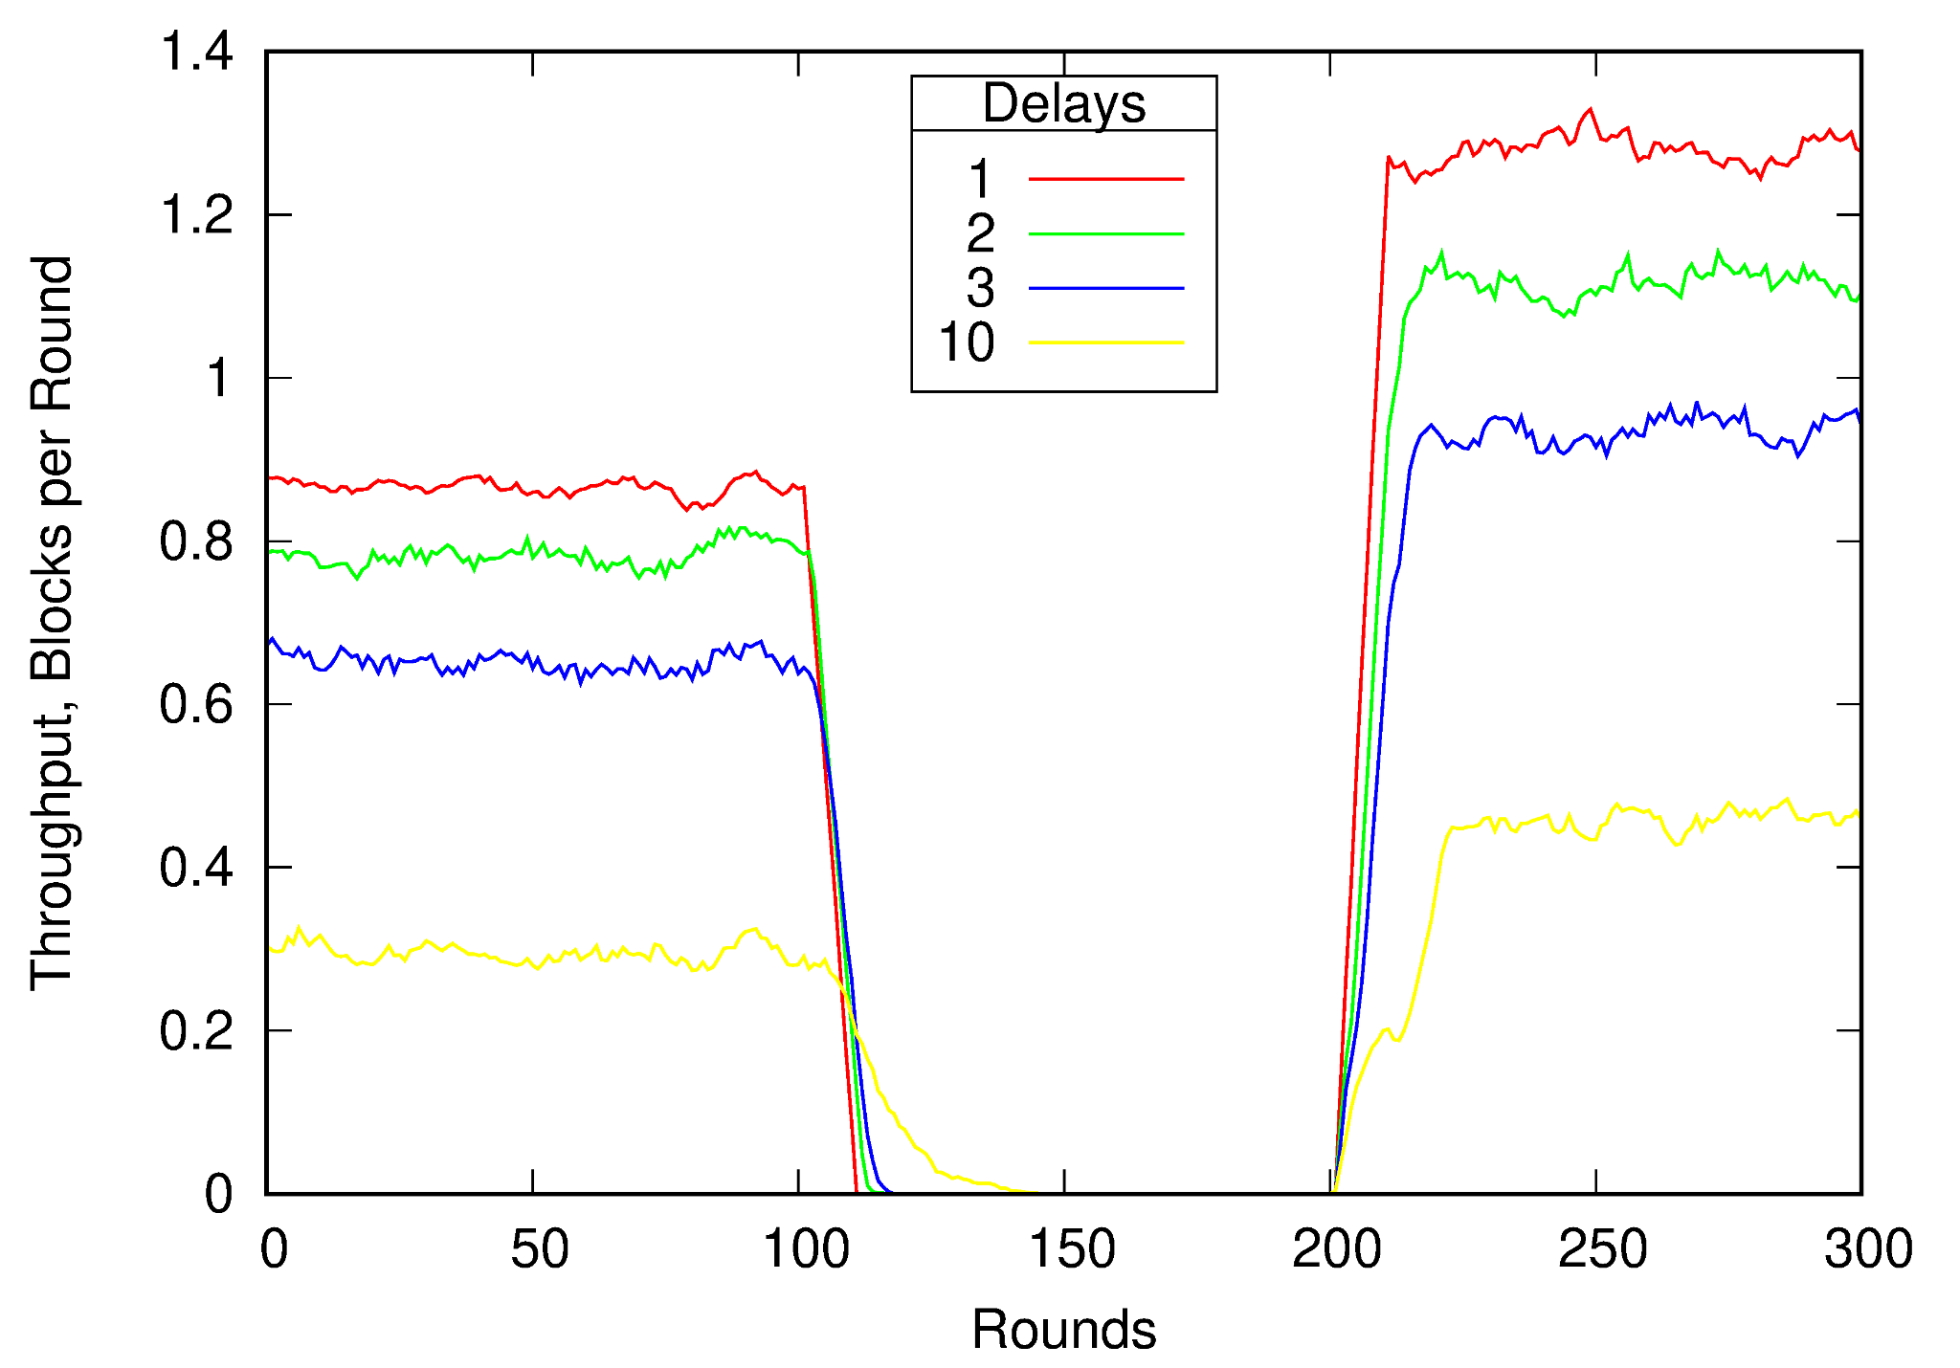
Lagging Detector Experiment
PART + ◇AGE
split at round 100, ◇AGE recognizes split for all peers and blocks only at round 200
at round 100 no new transactions are confirmed so the throughput falls
once the spilt is recognized, the throughput recovers
after split, throughput is higher since fewer competing peers and fewer forks.

Slide 21
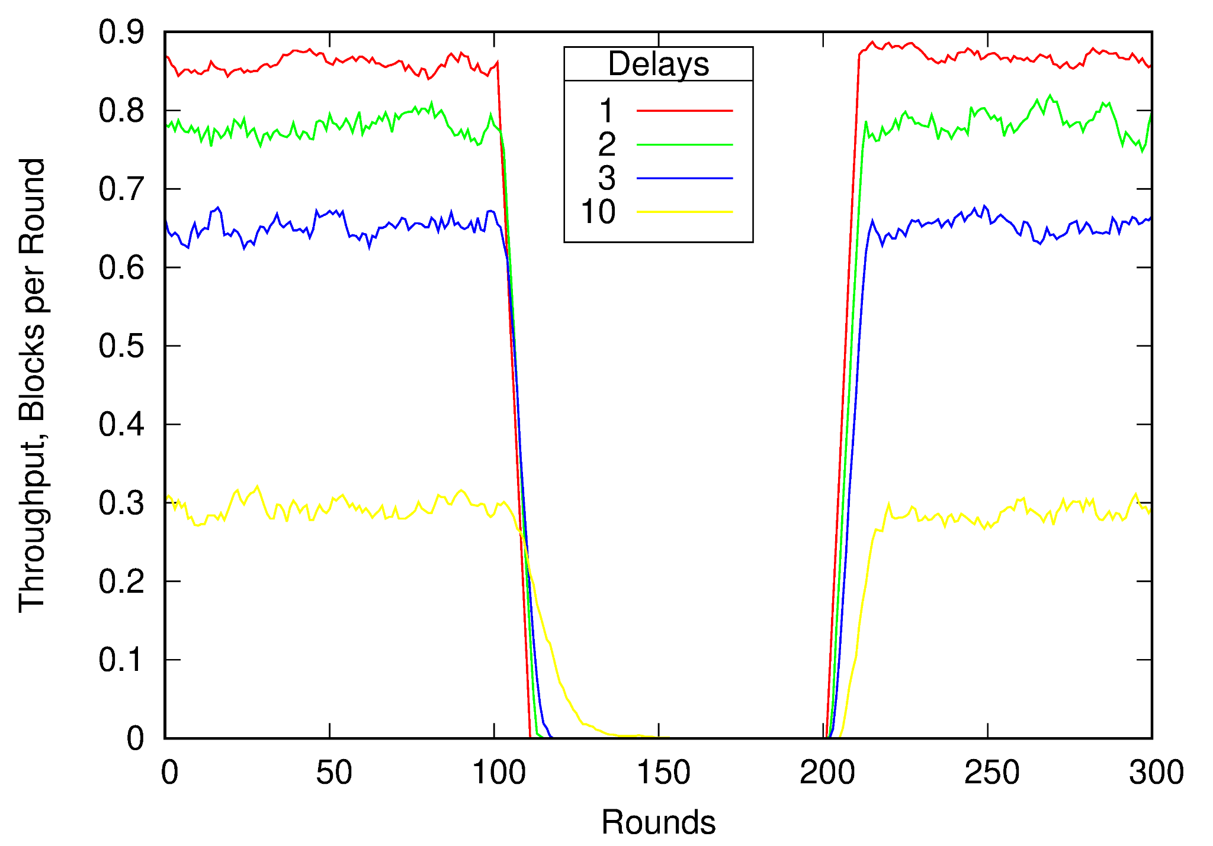
Lying Detector Experiment
PART + ◇AGE
no actual split, ◇AGE outputs split for all peers and blocks at round 100, corrects at round 200
at round 100 no new transactions until AGE corrects
after correction, throughput returns to original level

Slide 22
Outline
consensus
impossibility
detectors
algorithm
performance evaluation
extensions

Slide 23
Message Loss
assumptions
same message broadcast by same peer infinitely many times delivered infinitely many times
if block is delivered across (future) partitions, all preceding blocks are also delivered across
block catchup procedure
if peer is missing intermediate blocks - send a request message
if peer has requested message - rebroadcast
Theorem 6: Algorithms PART with block catchup procedure solves the Partitionable Blockchain Consensus Problem with message loss

Slide 24
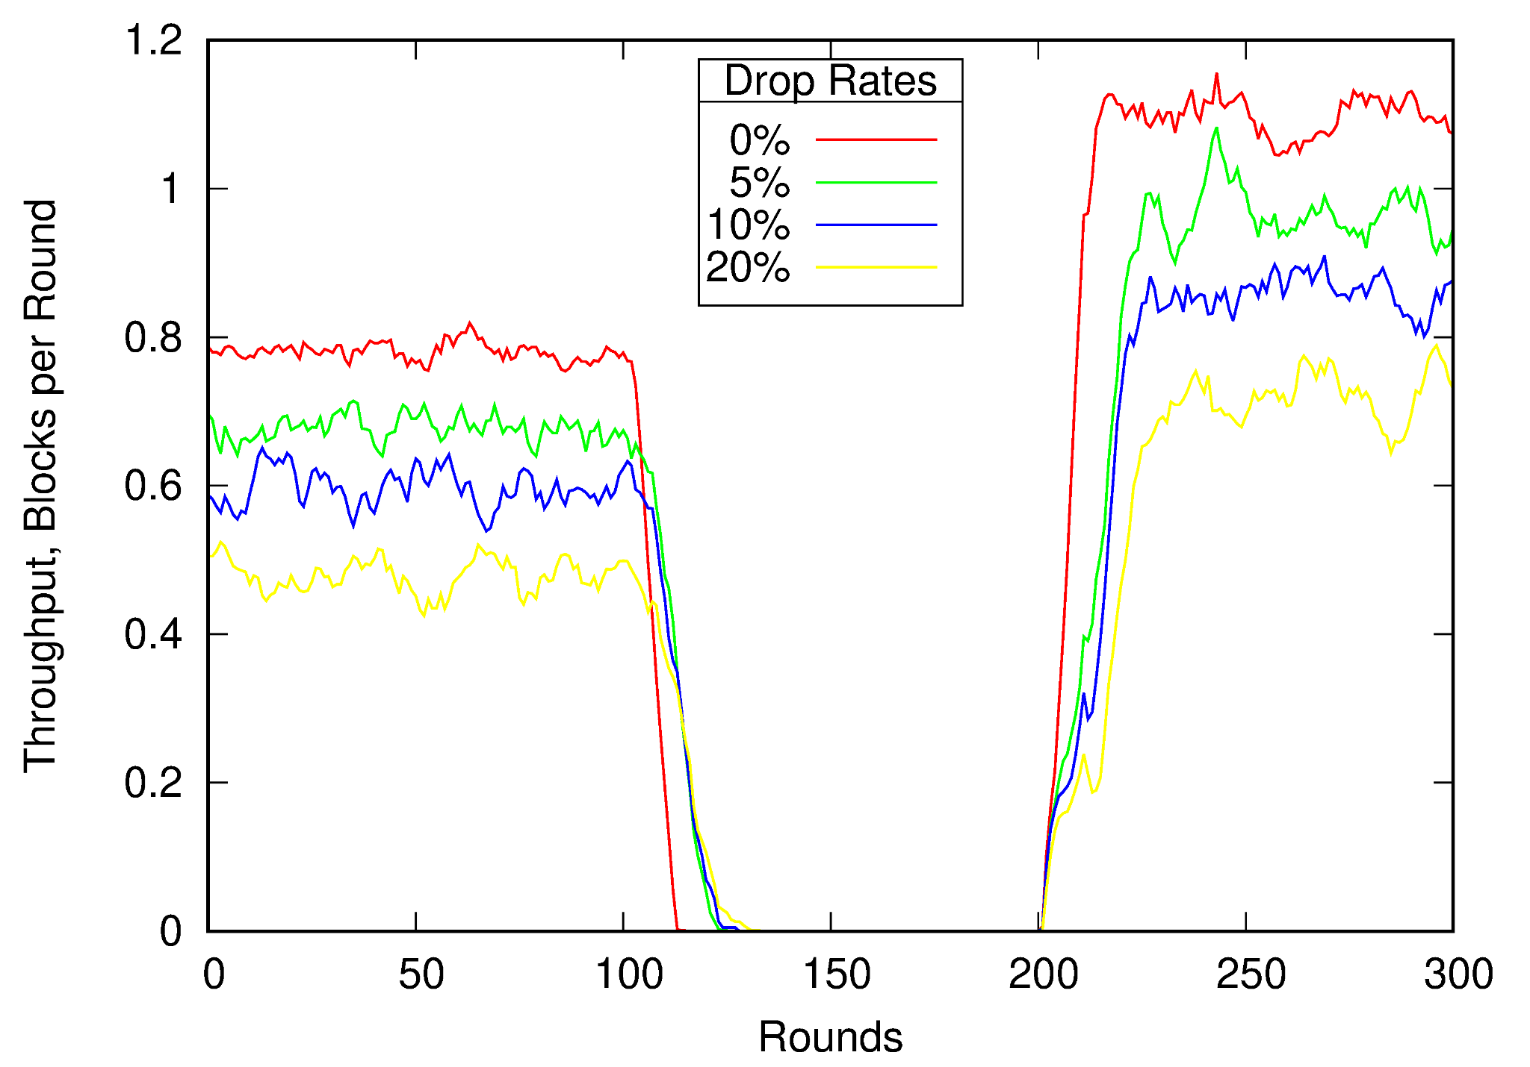
Message Loss Experiment
PART with block catchup procedure + ◇AGE,
vary loss rates, split at round 100, ◇AGE recognizes
split at round 200
message loss is similar to message delay

Slide 25
Multiple Splits, Partition Merging
multiple splits - each partition may further split into two
detectors rather than new/old output partition number: MAGE, ◇MAGE, WMAGE
PART operates as before
Theorem 5: Algorithms PART+MAGE, PART+◇MAGE, PART+WMAGE solve the Partitionable Blockchain Consensus Problem with multiple splits.
partition merging
if partitions merge - split is temporary
solutions
competitive merge (in Bitcoin) - blocks mined in one of the partitions are discarded
cooperative merge - blocks in both partitions are incorporated
implementing cooperative merge
SMAGE - determines whether block was mined during split
SMPART - modification of PART: consults SMAGE, determines if there was split, catches up, links to two branches, linked block becomes the seed of merged partition.
◇SMAGE and WSMAGE are defined similarly
may be extended to multiple splits and merges

Slide 26
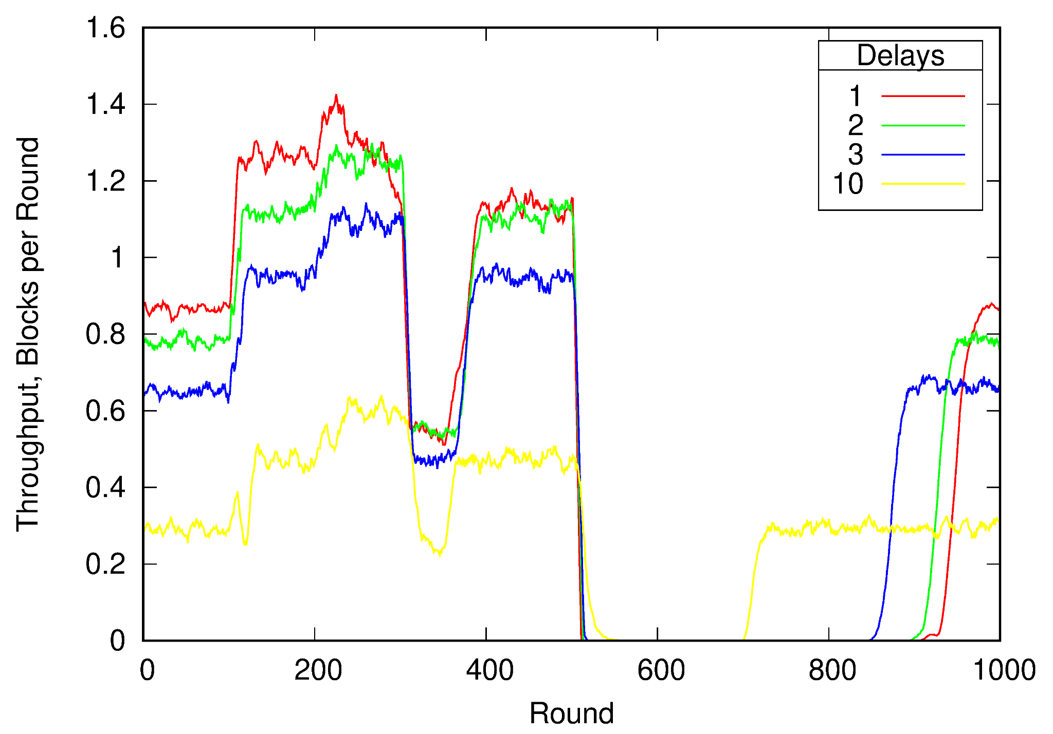
Two Splits and Merges
SMPART+SMAGE
no message loss
split at round 100, one of the partitions splits again at 200
second split merges at 300, first split merges at 500

Slide 27
Conclusion
other extensions and future work
detectors may be implemented with checkpoints or by observing mining rate
efficient post-merge block exchange procedure may accelerate merging
future work: need to explore tolerance to crash, Byzantine faults
Thank you!
Questions?

