Slide 1


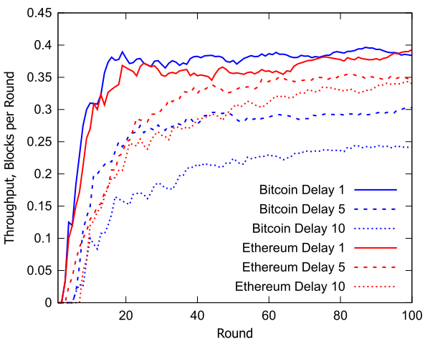
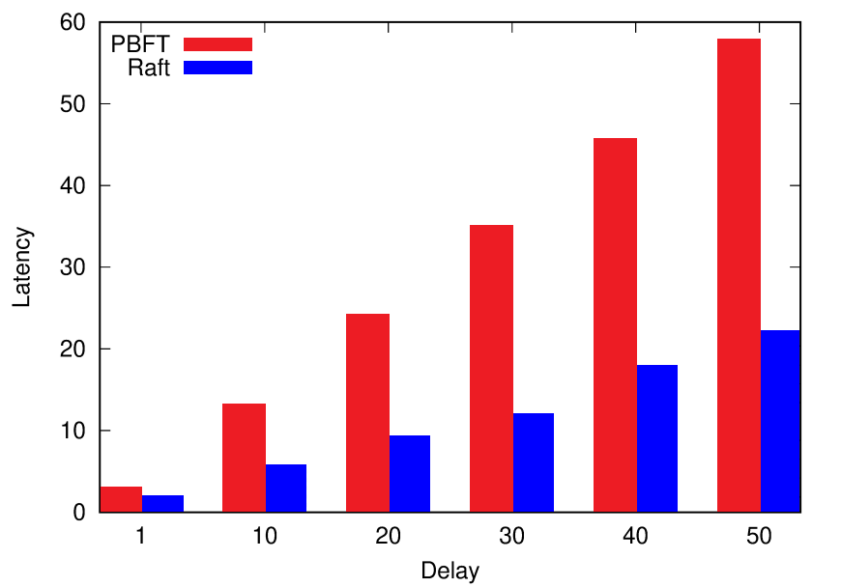
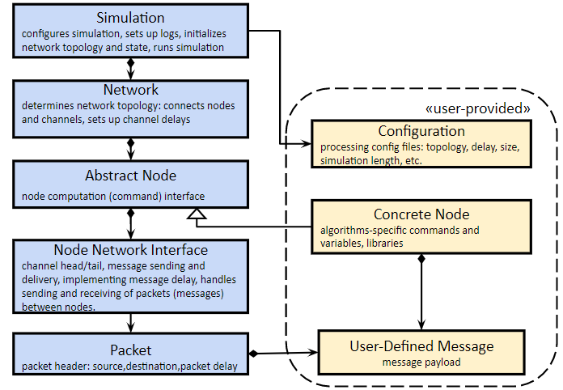
QUANTAS Quantitative User-friendly Adaptable Networked Things Abstract Simulator
ApPLIED
Joseph Oglio Kendric Hood Mikhail Nesterenko Sébastien Tixeuil
Salerno, Italy
July 25, 2022

Slide 2
Why
situation
Distributed Algorithms Community often neglects to either consider simulation or does ad hoc (one off simulation), data and code are seldom published
results are difficult to verify or compare across papers
further researchers have to start from scratch
concrete simulators (NS-2, OMNeT++) are too detailed to be useful for distributed algorithms simulation
existing abstract simulators are often too specialized, too difficult to use or focused on education and presentation rather than research
opportunity
distributed algorithms are well suited for simulation:
they are presented so that verification and correctness proof is done by hand: somewhat simple
they are abstract with a simple set of well-established primitives: message-passing/shared memory, asynchronous/synchronous,

Slide 3
What
QUANTAS: simulator for Distributed Algorithms Community
design principles
simplicity, ease-of-use - user-facing: subset of C++, core - compact codebase 4K lines of code, no external dependencies (libraries, compilers, specialized languages), set of representative examples
flexibility - configuration and output in JSON: various available interactive and automated tools to process and present data
scalability - multi-threaded implementation, minimum overhead, C++
features: easy experiment configuration through config file, standard primitives: channels with varying delay (either random uniform or Poisson), FIFO or non-FIFO channels, configurable topology

Slide 4
Architecture
Simulation
configures simulation, sets up logs, initializes network topology and state, runs simulation
components
core - responsible for running and servicing the simulation, reporting the results
user-provided - written by the researcher
Network
determines network topology: connects nodes and channels, sets up channel delays
«user-provided»
Configuration
processing config files: topology, delay, size, simulation length, etc.
Abstract Node
node computation (command) interface
Concrete Node
algorithms-specific commands and variables, libraries
Node Network Interface
channel head/tail, message sending and delivery, implementing message delay, handles sending and receiving of packets (messages) between nodes.
Packet
packet header: source,destination,packet delay
User-Defined Message
message payload

Slide 5
Code Example: Sends Greetings to all Nodes
struct HelloMessage {
std::string messageText;
};
...
void performComputation() {
HelloMessage msg;
msg.messageText = "Hello From " + std::to_string(id()); // send "hello" to all nodes
broadcast(msg);
// service all received messages
while (!inStreamEmpty()) {
Packet<HelloMessage> newMsg = popInStream();
// logger is a Singleton, "Greetings" is a tag
// getRound() returns simulated computation round
LogWriter::instance()->
data["Greetings"].push_back(newMsg.getMessage().messageText + "at round: " + getRound())
}
}

Slide 6
Example: Blockchain
algorithms: Bitcoin or Ethereum - like
20 peers, each maintains a copy of blockchain
transaction is submitted to random peer, on average 1 transaction per round
peer broadcasts submitted transaction
each peer mines received transactions, mining probability: 2.5% per round
Bitcoin - linked to longest chain
Ethereum - linked to all unliked branches
100 rounds, 10 computation per data point
throughput - number of blocks in the longest chain for each peer, shortest among peers
Ethereum appears more efficient since block is linked to all branches

Slide 7
Example: Consensus
algorithms: PBFT and Raft
sequence of values to confirm
PBFT - single leader, no view change, pre-prepare, prepare, commit messages, once the leader receives enough commits: considers confirmed, starts next consensus
Raft - leader broadcasts value, waits for majority or responses, once received, starts new consensus
latency - average number of rounds from initial message transmission by the leader until commit
20 nodes, 1000 round computations, 10 computations per data point
Raft is faster since it is not resilient to Byzantine faults

Slide 8
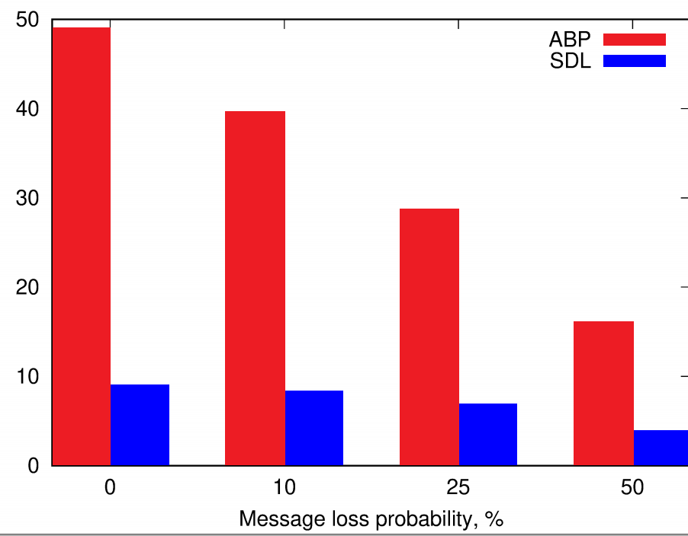
Example: Reliable Data Link
algorithms: self-stabilizing alternating bit protocol (ABP), stabilizing data link algorithm (SDL)
ABP - submit data to receiver, waits for ack, if either lost - times out and resends, requires FIFO channels
SDL - submits same message multiple times at once based on channel capacity, operates in non-FIFO channels
channel utility - ratio of messages successfully received over transmitted
2 nodes (sender and receiver), channel size of 1 (SDL sends same message 5 times), 100 round computations, 10 computations per data point
ABP is 5 times less efficient but unable to handle non-FIFO channels

Slide 9
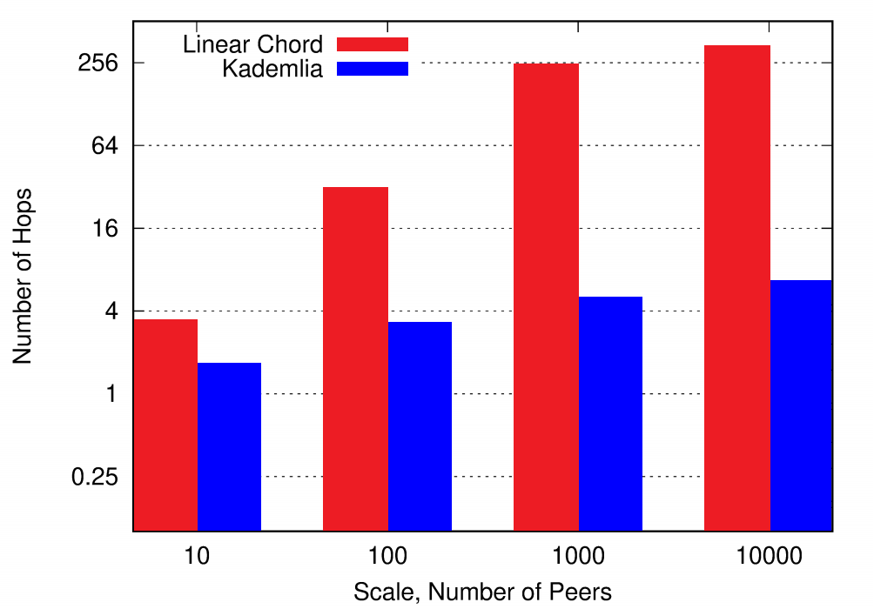
Example: DHT
algorithms: Chord and Kademlia
Chord - peers form a ring, shortcut links are not implemented
Kademlia - same ring, shortcut links implemented
query for a randomly selected peer is submitted to another random peer, number of traversed hops computed
Kademlia is more efficient due to shortcut links

Slide 10
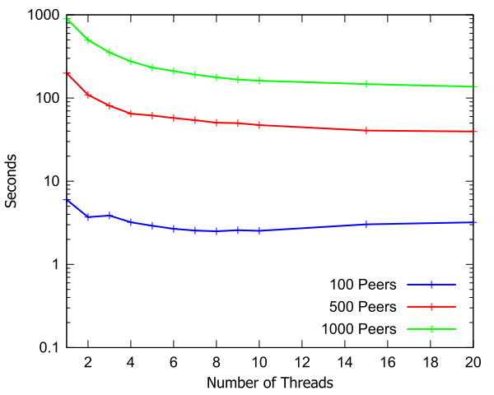
Simulation Speed
threads concurrently process rounds of separate simulation nodes concurrently
varied number of threads in thread pool
Kademlia implementation, 100 rounds, 10 simulations per data point
VM on host with 2 Intel Xeon Gold 6132 CPUs running at 2.60 GHz, 12 cores
simulation speed increases as more threads are added to the pool. This increase ends when all available host cores are used

Slide 11
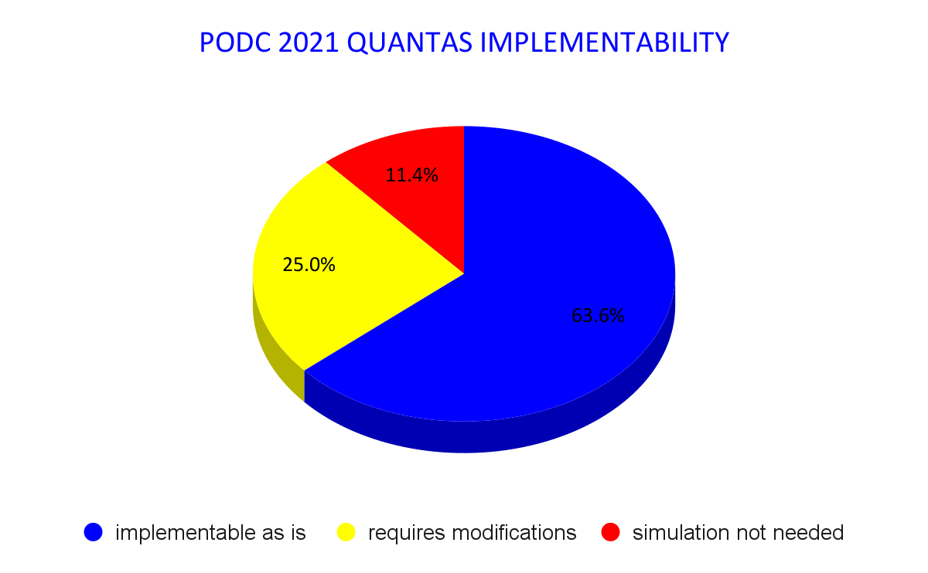
Applicability
examined algorithms in PODC 2021 papers
out 44 papers, algorithms
in 28 papers are implementable in QUANTAS with no additional modifications to simulator
in 11 papers require modifications, usually minor: shared registers, Byzantine faults, connection to visualization
in 5 papers, there are no algorithms, or no purpose for simulation
If there is a need for algorithm simulation, QUANTAS can do it!

Slide 12
Future Enhancements
more sophisticated fault models: self-stabilization, crash, Byzantine
enhanced topology manipulation: random topology generation, dynamic graphs
level separation and swapping: e.g. evaluate same consensus algorithm over different broadcast algorithms
scalability performance enhancements: more aggressive multithreading, C++ STL parallel algorithms

