Slide 1

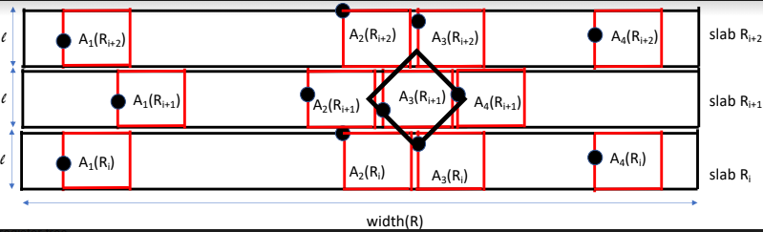
Byzantine Geoconsensus
Joseph Oglio
Kendric Hood
Gokarna Sharma
Mikhail Nesterenko
SSS 2020
November 18-21, 2020

Slide 2
Consensus
synchronous reliable communication, fully connected network
deterministic algorithm
Byzantine faults
binary consensus
each process is input {0, 1}
solution conforms to the three classic properties
agreement - no two correct processes decide differently
validity - if all the correct processes input the same value v, then every correct process decides v
termination - every correct process eventually decides
Notes:
2 Slides

Slide 3
Geoconsensus
each process has unique 2-d coordinates
if fault can affect process anywhere - classic Byzantine consensus [17]
idea - restrict fault location
fault area - finite-size convex area where all processes inside may be faulty
adversary places a fault area in the plane
may have multiple fault areas α ≥ 1
correct processes know fault area shape and size but not location
Geoconsensus - processes need to arrive at solution despite faults.
fault area
faulty processes
correct processes
Notes:
2 Slides

Slide 4
Impossibility of Geoconcensus
coverage number is the minimum number of areas required to cover each process in the network
Theorem 1 (Impossibility of Geoconsensus) Given a set of processes and a fault area, there exists no algorithm that solves the Geoconsensus Problem if the coverage number is less than 4
intuition: if coverage number is less than 4, can divide network into 3 sets, cover one fault area ⇒ reduces to classic Byzantine consensus impossibility
set A
set B
set C
processes in C cannot determine if fault area covers A or B
Notes:
Figure

Slide 5
Geoconsensus Solution
approach: separate processes into non-overlapping areas, elect leader in each, leaders run consensus, all others adopt leader's decision
SQUARE-COVER - given a set of processes, determine if a certain number of square areas cover the set
Theorem 3 SQUARE-COVER is NP-Complete
we present heuristic GSQUARE that provides a 2-approximation of optimal solution

Slide 6
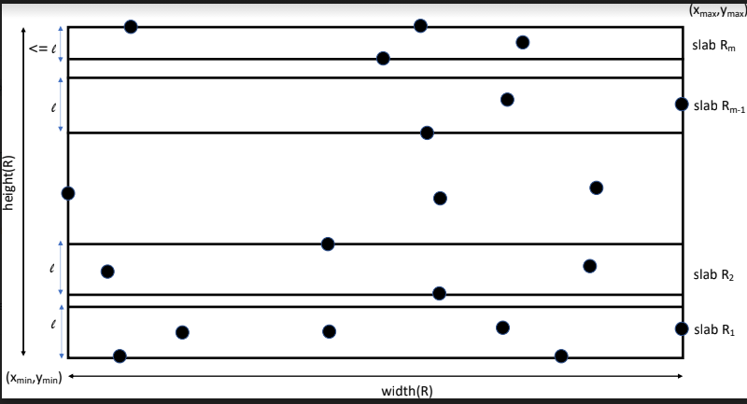
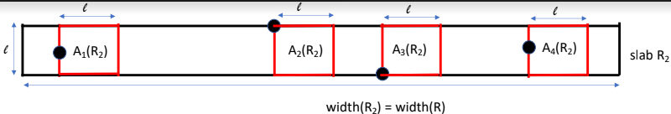
GSQUARE: Square Coverage Heuristic
enclose all processes in smallest rectangle
starting from bottom, cover by slabs of height l such that bottom of slab contains a process
for each slab, starting from left, cover all processes with squares of side l such that left side contains a process

Slide 7
GSQUARE: Approximation
Lemma 7 GSQUARE provides a 2-approximation on the number of square covers
intuition:
placement of squares in a slab is optimal
optimal algorithm can cover processes with a single square in at most two slabs
Lemma 9 a non-axis aligned square fault area may overlap at most 7 square cover areas

Slide 8
GENERIC Algorithm
GENERIC algorithm
each process computes the set of covers using GSQUARE
each process determines the leaders in the covers
the selected leaders perform consensus and the remaining processes adopt their decision
GENERIC parameters using not axis-aligned square fault areas
f ≤ N−15α faulty processes can be tolerated
cover areas ≥ 22α are required

Slide 9
Using GENERIC to Solve Geoconsensus
determine bounds for various fault areas
square multiple
non-axis aligned
circular
extend solution to multiple dimensions
Questions?

Slide 10
General Geoconsensus
Outline
coverage by squares
GENERIC algorithm
extensions
circles
higher dimensions

Slide 11
SQUARE-COVER Problem
Definition 2 Suppose processes are embedded into a 2d-plane such that the coordinates of each process are unique. The SQUARE-COVER problem is to determine if a certain number of square areas A = l × l can completely cover these processes
Theorem 3 SQUARE-COVER is NP-Complete Correctness: reduction to BOX-COVER [9]
we present a heuristic GSQUARE that provides a 2-approximation of optimal solution

Slide 12
BASIC Geoconsensus Algorithm
PSL [17] - classic byzantine consensus algorithm
BASIC
operates if there are 9α +3 processes with pairwise distance between them greater than the diameter D of the fault areas
operation:
each process elects leaders mutually removed further than D using a deterministic greedy heuristic
leaders run PSL, broadcast decision
all processes adopt leader decision
correctness intuition:
the greedy leader election heuristic finds ≥ 1/3 processes who are further than D
PSL solves classic consensus despite α faults if ≥ 3α + 1 processes

Slide 13
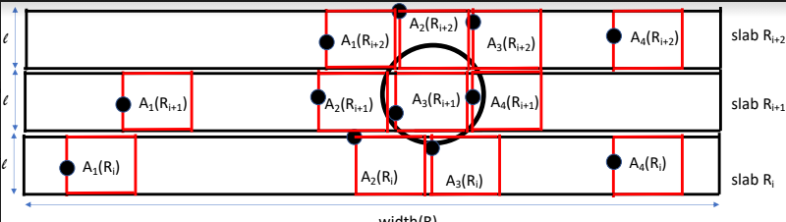
Extensions: Circles
this can be extended to fault areas in the shape of circles which provide a different tolerance level as more covers may be overlapped
If each fault area and cover area is a circle of diameter l, f ≤ N−57α faulty processes can be tolerated given that cover areas are ≥ 85α
If each fault area is a circle of diameter √2l and each cover area is a circle of diameter l, f ≤ N−65α faulty processes can be tolerated given that cover areas are ≥ 97α
If each fault area is a circle of diameter l / √2 and each cover area is a circle of diameter l, f ≤ N−33α faulty processes can be tolerated given that cover areas are ≥ 49α

Slide 14
Extensions: Higher Dimensions
Theorem 8. Given a set processes embedded in 3-dimensional space and a set of α ≥ 1 of cubic areas at unknown locations, such that any process covered may be Byzantine. Algorithm GENERIC solves the Geoconsensus Problem with the following guarantees:
if the fault area is cube of side l and not axis-aligned and the cover area is also a cube of side l, f ≤ N−55α faulty processes can be tolerated given that the cover areas ≥ 82α
if the fault area is cube of side l and axis-aligned and the cover area is also a cube of side l , f ≤ N−17α faulty processes can be tolerated given that cover areas are ≥ 25α
if the fault is a sphere of diameter l and the cover area is a sphere of diameter l, f ≤ N−217α faulty processes can be tolerated given that cover areas are ≥ 325α

