Slide 1



TRAIL: Cross-Shard
Validation for
Byzantine Shard Protection
Joseph Oglio
Mikhail Nesterenko
Gokarna Sharma
Nagoya, Japan
October 22, 2024

Slide 2
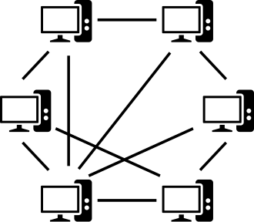
Peer-to-Peer Networks and Blockchain
peer-to-peer (overlay) network – collection of computers (peers) joined
to perform a task
peer gets connection to another peer by learning its identity,
message transmission is performed by underlay network:
topology may change with computation
decentralized, no single point of failure, peers may join and leave
multiple applications: file sharing, data storage,
distributed computation
blockchain – distributed ledger of linked transactions/blocks maintained by a peer-to-peer network
able to securely record transactions without central authority
security is ensured by majority of honest peers
peers agree on which blocks to add to blockchain
cryptocurrency blockchain - ledger contains financial transactions appended block by block

Slide 3

Shards and Faults
Sharding - improves network scalability:
separate process s into shards - consensus groups working in parallel
more shards - greater parallelism
Faults
may fail, be malicious
Byzantine fault - models arbitrary peer failure or malicious behavior
  process behaves arbitrarily,
  f - number of faulty processes
(classic) binary Byzantine tolerant consensus [Lamport82] - all
processes need to agree on a value despite f faults

Slide 4
Tolerating Faults in Shards
Sharding scalability is limited by shard fault tolerance
sharded blockchains assume no shard failures
  limites scalability: shard must be large enough to never fail
  hence fewer shards to work in parallel
Solution?
handle complete shard failure
naïve solution
  involves grouping shards into static meta-shards
  they may become performance bottleneck since have to confirm unrelated transactions
How to handle shard failures efficiently?

Slide 5
Outline
  problem
  TRAIL
  performance evaluation
  extensions

Slide 6
Currency Transmission Problem
Currency Transmission Problem:
ownership continuity – for any pair of sequential transactions t₁ and t₂, the target of t₁ is the source of t₂
request satisfaction – if the owner requests a coin movement from its wallet, this request is eventually satisfied
this problem is solvable with traditional techniques such as proof of work, Practical Byzantine Fault Tolerance (PBFT), etc.
however these schemes have limited scalability as they assume the system has enough connectivity to tolerate failures

Slide 7
PBFT
classic consensus algorithm, tolerates f
faulty peers
leader ‒ serializes transactions, starts
consensus
replicas ‒ validate transactions
normal operation
consensus phases
pre-prepare ‒ leader proposes
the transaction to the replicas
prepare ‒ replicas broadcast what they
heard to confirm transaction
commit ‒ received 2f + 1 prepares, confirm transaction
reply ‒ inform client of committed transaction
leader change - if client or peers suspect leader is faulty, replace it, transaction confirmation is not affected
client
pre-
prepare
phases:
prepare
commit
reply
p4
p3
peers:
p2
p1

Slide 8
Tolerate Shard Failures
solution: cross-shard validation
a shard may fail but if other shards are used as redundancy the failure may be overcome
we propose TRAIL an algorithm where cross-shard validation is done by forming groups of shards from the history of the coin.

Slide 9
Outline
  problem
  TRAIL
  performance evaluation
  extensions

Slide 10
TRAIL Overview
ensures validity of coin transitions between wallets
despite up to f peer and F shard faults
TRAIL - collection of shards to agree on specific coin movement
  separate for each coin
  updated as coin moves between shards
TRAIL parts:
  internal source shard consensus - source wallet peers agree on
  transaction and coin movement despite f peers
  external trail consensus - confirm the transaction, inform client
    if source shard is faulty, change leader shard and confirm transaction

Slide 11
TRAIL: Membership Update
client
transaction t1: coin c from S4 to S5
request
membership update with consequent transactions:
t1 moves a coin from a wallet in shard S4 to a wallet in S4
shard
S1
S2
S3
S4
transaction
S5
source
target
trail of coin c
t2 moves the same coin from S5 to S6
client
transaction t2: coin c from S5 to S6
request
transaction
shard
S1
S2
S3
S4
S5
S6
source
target
trail of coin c

Slide 12
TRAIL: Parts & Faults
client
internal consensus
linearizes transactions
assigns sequence number
invokes external consensus
once committed
external consensus
trail shards verify transaction
inform client and new shard
faults
if leader fails: use internal consensus to replace, transparent to TRAIL
if source shard fails: use external consensus to replace leader shard
pre-
prepare
phases:
prepare
commit
p4
p3
peers:
p2
p1

Slide 13
TRAIL: External Consensus
pre-prepare
prepare
commit
reply
client
target
S5
pre-
prepare
prepare
commit
p4
S4
p3
p2
S3
p1
S2
single message
shard-to-shard
broadcast
S1

Slide 14
TRAIL Correctness
Theorem 1. Algorithm TRAIL solves the Coin Transmission Problem with at most F Byzantine shards and at most f individual Byzantine faults in each correct shard.
intuition
internal consensus ensures ownership continuity: two transactions on same coin are linearized
external consensus broadcasts are equivalent to regular PBFT messages ⇒ it emulates PBFT and confirms transactions

Slide 15
Outline
  problem
  TRAIL
  performance evaluation
  extensions

Slide 16
Optimizing Performance & Failed Shard Recovery
internal transaction optimization:
  internal transaction: transaction between wallets in the
  same shard
  internal transactions are not recorded in the trail to reduce overhead
failed shard recovery:
  failed shard detected
  wallets are moved out of the failed shard
  internal transactions from the failed shard are rolled back to the last known external transaction
  clients re-submit rolled-back transactions

Slide 17
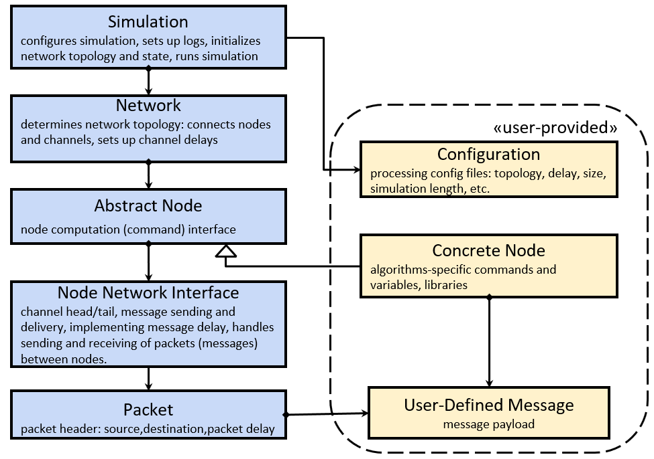
Simulation and Experiments
used abstract simulator QUANTAS [13]
  computation is represented as a sequence of rounds
  in each round, each peer:
    receives messages
    preforms local computation
    transmit messages
  channels are FIFO and reliable
1 transaction per round, 25% are cross-shard
15 tests per data point, 500 round computation
network: 50 shards, 22 peers per shard, trail length 7 shards
2 faulty shards
  behave correctly until round 100
  malicious transactions: try to move spent coin (double spend attacks), honest otherwise
  measure throughput - number confirmed transactions

Slide 18
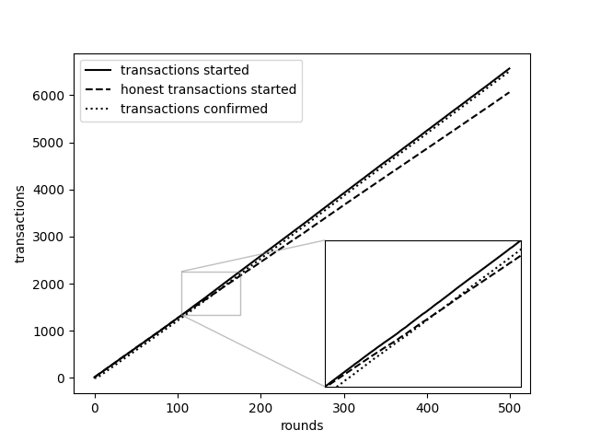
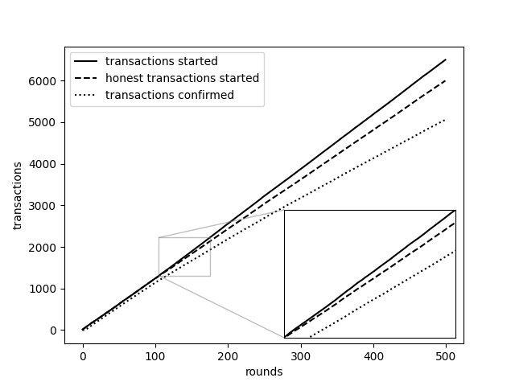
Experiments: Cross-Shard Validation
no TRAIL
TRAIL
consensus delay
consensus delay
all transactions confirmed, malicious or not
only honest transactions confirmed
TRAIL efficiently rejects malicious and confirms honest transactions

Slide 19
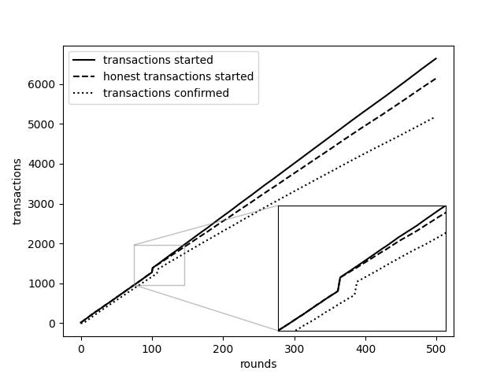
Failed Shard Recovery Procedure
assume instant detection
TRAIL initiates recovery
shard failure
TRAIL efficiently handles recovery with limited increased overhead

Slide 20
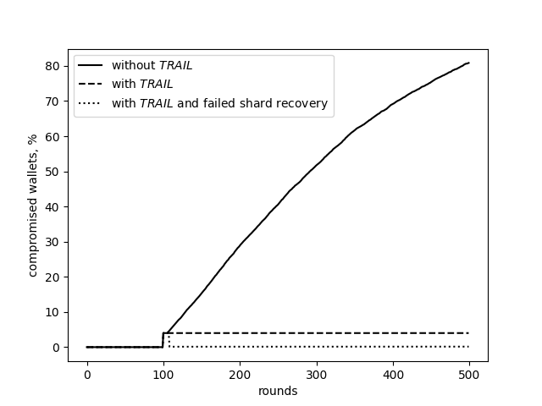
Fault Containment
compromised wallet: in a failed shard or receives a transaction from compromised wallet
without TRAIL: compromised wallets spread
with TRAIL: only the wallets in the failed shards are compromised
with TRAIL and the recovery procedure: all compromised wallets are quickly repaired

Slide 21
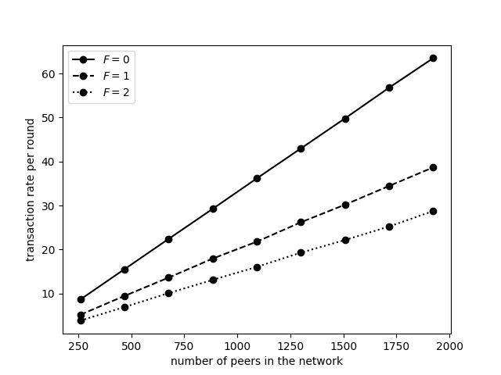
TRAIL at Scale
up to 148 shards and 13 peers per shard
5 simulations of 200 rounds per data point
plotted TRAIL’s performance for three fault tolerance levels: F = 0, 1, and 2
no cross-shard validation for F = 0
TRAIL's performance scales well as network size increases
higher fault tolerance levels (F) introduce more overhead, resulting in lower transaction rates

Slide 22
Outline
  problem
  TRAIL
  performance evaluation
  extensions

Slide 23
Making TRAIL Practical
parallel transaction handling: same source shard may run multiple
transactions on separate coins
coin processing
  splitting: mark coin as splitting, trails for coin parts diverge
  merging: mark coins as merging, process transactions jointly until
  trails converge
  minting: randomly select trail and have shards run global consensus to mint a coin
wallet optimization: wallets which transact often are moved to the same shard
shard maintenance: shards may grow and shrink as nodes join and leave the network
fault tolerance modulation: some shards/trails may be bigger to accommodate stricter Byzantine tolerance
consensus algorithm adaptability and enhancement:
  TRAIL is not depended on PBFT specifics ⇒ can be replaced by a different consensus algorithm, for internal consensus, or for different trails

Slide 24
Trail
we represented TRAIL: an algorithm that addresses Byzantine shard failure protection in cryptocurrency blockchains
future work:
can be developed into standalone system
can be used as a component to fortify existing systems
can be enhanced into more challenge conditions: partitioning, dynamic networks

Slide 25
Transactions
internal transaction:
occurs within a single shard: currency is moved between wallets in the same shard.
simpler verification: consensus is reached using the existing mechanisms within the shard.
efficient execution: no need for inter-shard communication or additional coordination.
cross-shard transaction:
a transaction which moves currency from a wallet in one shard to a different wallet in a different shard
typically handled by breaking the transaction into two, one to move the currency into the other shard and one to move the currency to a different wallet in the same shard
verifying if the first transaction is valid has been previously done using centralization, locking, or signature based methods

Slide 26
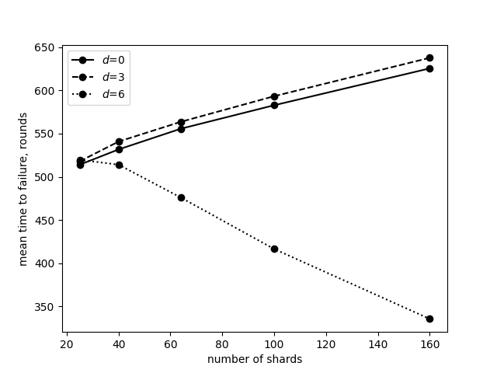
Results
Not in paper

Slide 27
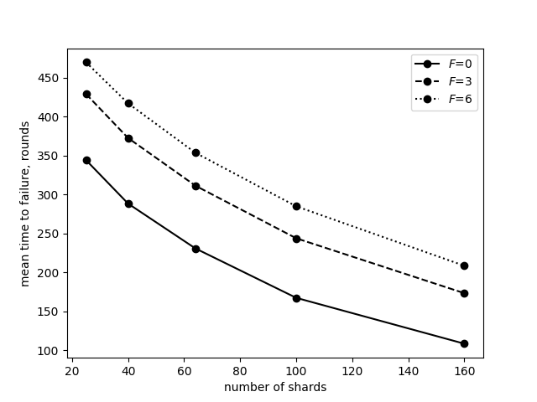
Results
Not in paper

Slide 28
