Slide 1


Consensus on an Unknown Torus with
Dense Byzantine Faults
Joseph Oglio
Kendric Hood
Gokarna Sharma
Mikhail Nesterenko
Marrakech, Morocco
May 23, 2023

Slide 2
Dense Byzantine Faults & Consensus
Byzantine fault - process behaves arbitrarily, f- number of faulty processes
(classic) binary byzantine tolerant consensus [Lamport82] - all processes need to agree on a value
interested in deterministic solutions without signatures (oral record)
consider torus with dimensions unknown to processes
fixed degree and small diameter: convenient for computing and storage tasks
known dimensions: solution is simple
incomplete topology [Dolev82] - need at least 2f+1 network connectivity: may tolerate at most 1 fault
what to do?
sparse faults - faulty processes are far enough apart to ensure Dolev’s bound [Maurer14]
want to solve for dense faults - faulty processes are arbitrarily close
HOW?

Slide 3
Outline
Impossibility
BAT - all-to-all broadcast algorithm
CBAT - consensus using BAT
extension to CONGEST model

Slide 4
No Consensus with Arbitrary Fault Location
there is no algorithm that solves consensus with f > 1 faults on a torus with connectivity 4 [Dolev82].
Intuition:
consider 2 faults (black processes), the correct (grey processes) cannot tell which neighbors are Byzantine
we restrict fault location to single column

Slide 5
No Consensus with a Faulty Column
Theorem 1. There is no algorithm that solves consensus … on a torus with a faulty column.
Intuition:
lets first consider a ring (a torus of height 1) with a single faulty process. Connectivity is 2, need 2f+1 = 3 to solve consensus [Dolev82]
this argument can be extended to a torus of arbitrary height
need at least one correct process in the faulty column
notation
black - faulty process
grey - correct in faulty column
white - correct in non-faulty column

Slide 6
Outline
Impossibility
BAT - all-to-all broadcast algorithm
CBAT - consensus using BAT
extension to CONGEST model

Slide 7
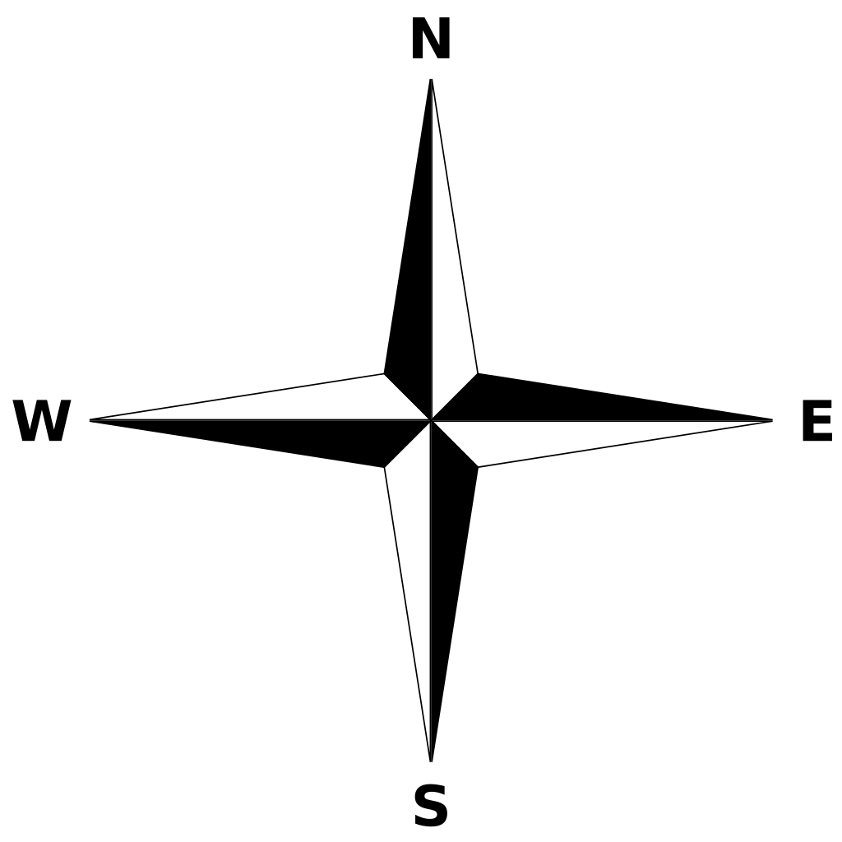
BAT: Byzantine All-to-All Broadcast on a Torus
Model: synchronous, processes share orientation, every process has unique ids, knows immediate neighbors, torus size W×H unknown to processes, arbitrary amount of data transmitted per round (LOCAL model) later relaxed to fixed size (CONGEST)
Algorithm consists of four phases:
North - collects info vertically
East-West - collects info horizontally
South - shares info vertically
Decision - terminates

Slide 8
BAT: North Phase, White Columns
white columns:
round 1: each process sends a message up containing its value
a
Round: 2 3 4
Receive: c d a
b
5
b
round k>1, k < H+1: stores message and forwards it up
round H + 1: each process will receive its own initial value, store it, and move on to the East-West Phase
remember: H, W and color are unknown to processes
c
d

Slide 9
BAT: North Phase, Black-Grey Column
black processes may send arbitrary messages to the grey process
⇒ grey process may complete its North Phase earlier than white, later or never
u
v
w
x

Slide 10
BAT: East-West Phase
process sends its entire column + left & right neighbor
East(left) and West (right), saves in rowLeft and rowRight forwards received
consider the case of the grey process starting the East-West Phase on time: together with white process
a
b
c
d
e
case (i) grey process on time, d’s perspective
rowLeft.d :
rowRight.d:
d
e
a
b
c
d
e
a
b
c

Slide 11
BAT: East-West Phase
process sends its entire column + left & right neighbor
East(left) and West (right), saves in rowLeft and rowRight forwards received
now consider the case of the grey process starting the East-West Phase out-of-sync: early
columns not shown
a
b
c
d
e
case (ii) grey process early, d’s perspective
rowLeft.d :
rowRight.d:
d
e
a
c/b
d
e
a/b
c

Slide 12
BAT: East-West Phase Right/Left Match
each white process determines completion of the phase despite single grey/black process possibly out-of-sync
two steps
checks rowLeft, rowRight individually: no duplicate ids, neighbors matching, at most one process off
replace off process column info with ⊥
compare rowLeft with rowRight: if they match, phase is complete
a
b
c
d
e
case (i) grey process on time, d’s perspective
case (ii) grey process early, d’s perspective
rowLeft.d :
rowRight.d:
d
e
a
b
c
rowLeft.d :
rowRight.d:
d
e
a
⊥
c
d
e
a
b
c
d
e
a
⊥
c

Slide 13
BAT: East-West Phase, Completion
if rowLeft matches rowRight at process d: have decision matrix: correct values of all white processes, guaranteed to happen to every white process in grey-white row
may happen in black-white row
then d outputs the matrix, starts South Phase and Decision Phase
a
b
c
d
e
case (i) grey process on time, d’s perspective
case (ii) grey process early, d’s perspective
rowLeft.d :
rowRight.d:
d
e
a
b
c
rowLeft.d :
rowRight.d:
d
e
a
⊥
c
d
e
a
b
c
d
e
a
⊥
c

Slide 14
BAT: South & Decision Phase
South Phase: share decision matrix. A white process that completed East-West Phase has decision matrix
sends it to other white processes in same column
when received, forward down, output, start Decision Phase
Decision Phase: guarantees white termination despite a black neighbor
after South Phase, a white process informs immediate left and right neighbor
terminates if decision matrix and heard from either left or right
every white process terminates
grey process does not terminate prematurely: even if gets faulty info from black up/down neighbors, does not hear from white left/right neighbors

Slide 15
BAT: All-to-All Broadcast
Theorem 2. Algorithm BAT solves the Weak Synchronous All-to-All Broadcast Problem on an unknown torus with Byzantine faults in at most one column with at least one correct row in at most 2H+2+W rounds.
Intuition:
North Phase takes H + 1 rounds to share each processes initial value with its column
East-West Phase : W rounds to propagate
South Phase: H rounds to share the decision matrix
Decision Phase: 1 round to terminate BAT

Slide 16
Outline
Impossibility
BAT - all-to-all broadcast algorithm
CBAT - consensus using BAT
extension to CONGEST model

Slide 17
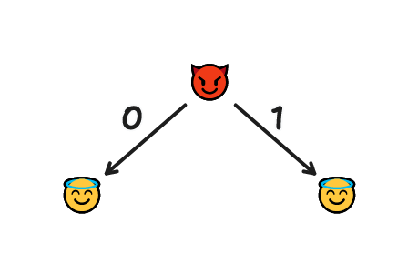
All-to-All Broadcast → Consensus
simple all-to-all broadcast is insufficient: the values of black processes may differ in the decision matrix of different white processes
black processes may send different values to different white processes and influence their decision
CBAT: use BAT twice to verify received decision matrices

Slide 18
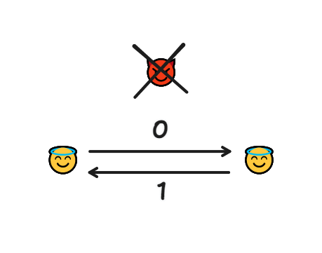
CBAT: Consensus Using BAT
Stages
Broadcast
use BAT to form initial decision matrices
Confirm
use BAT exchange initial decision matrices
Decide
select the highest id process to be leader
check if leaders decision matrix (constructed from the values heard from the other peers) is consistent (requires W > 4)
two or more columns contain:
– ⊥ (BAT detected the leader to be faulty)
– both 0s and 1s
– or whose values differ from the rest
if not consistent: all white processes detect it, all select same leader from a different column: guaranteed to be white
output the majority of the values shared by this leader

Slide 19
Consensus on a Torus
Theorem 3. CBAT solves weak consensus on an unknown torus whose width is at least 5 with Byzantine faults in at most one column and with at least one correct row.
Intuition:
use BAT to share everyone’s value
use BAT again, this time sharing what everyone heard
compute a shared set of values by finding the byzantine leader if they misbehaved
output the majority decision among the non byzantine columns

Slide 20
Outline
Impossibility
BAT - all-to-all broadcast algorithm
CBAT - consensus using BAT
extension to CONGEST model

Slide 21
Extension to Fixed Message Size: BAT
LOCAL: process may send arbitrary amount of data per round
CONGEST: process may only send Θ(1) per round
BAT LOCAL Phases:
North: message size is 1 (H rounds)
East-West: message size of H (W rounds)
South: message size of H×W (H rounds)
Decide: O(1)
in the North Phase, processes determine H, can transmit column in H fixed-size rounds, in East-West Phase determine W, can transmit matrix in H×W rounds, hence:
BAT CONGEST Phases:
North: O(H)
East-West: O(H×W)
South: O(H²×W)

Slide 22
Extension to Fixed Message Size: CBAT
similarly:
CBAT LOCAL:
Broadcast: BAT(initVal) - message size of O(H×W)
Confirm: BAT(H*W matrix) - O(H²×W²)
Decide: local computation
CBAT CONGEST:
Broadcast: BAT(initVal) - O(H²×W)
Confirm: BAT(H×W matrix) - O(H³×W²)

Slide 23
Byzantine Torus Recap
We
posed the Byzantine Torus Problems
proved it impossible if there is a complete faulty column
presented BAT: all-to-all broadcast on a torus
presented CBAT: uses BAT to solve consensus
extended results to fixed message size
Questions?

