Slide 1
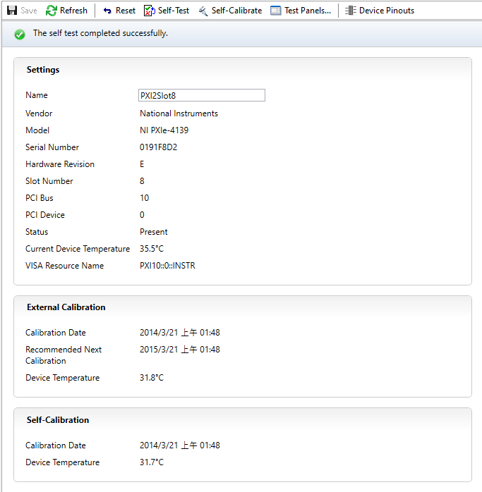
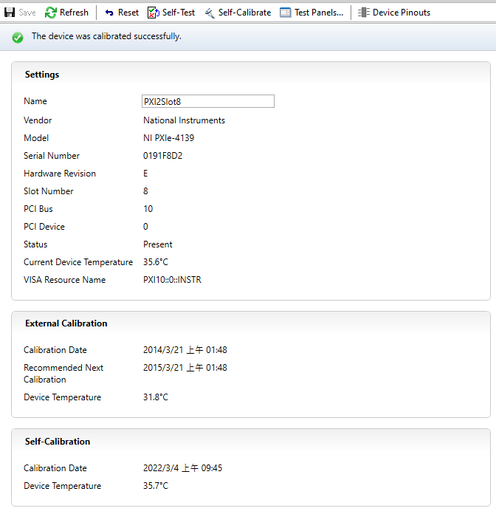

4139 Pass
Self Test
Self Calibration
Input/Output Test

Slide 2
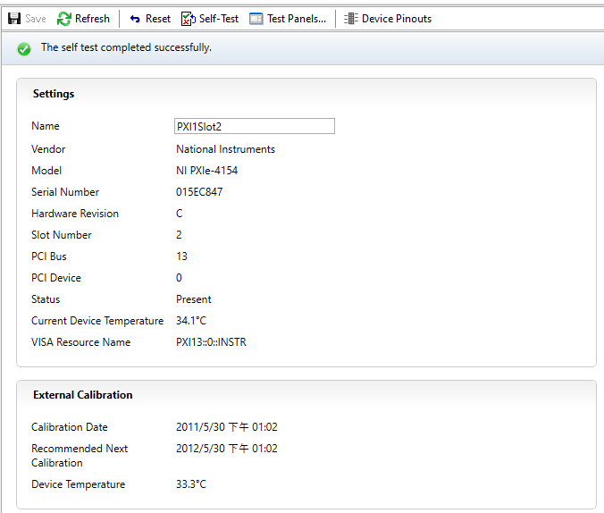

4154 Pass
Self Test
Input/Output Test

Slide 3
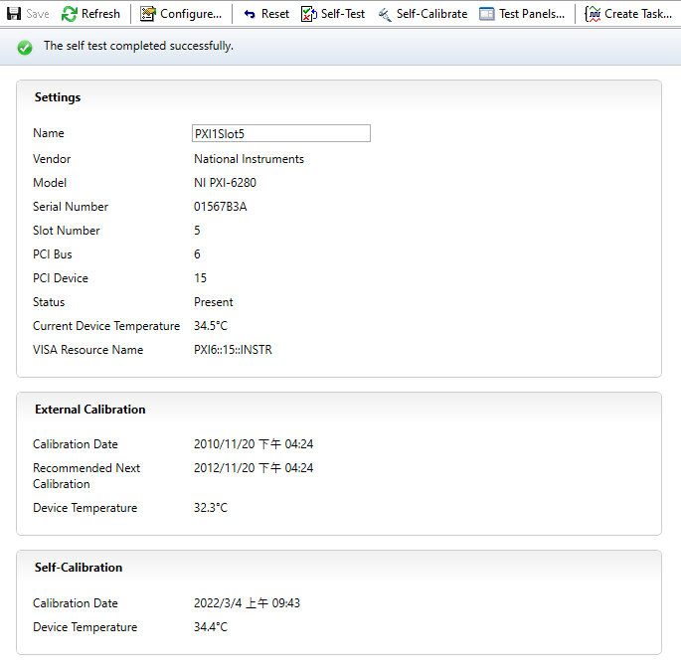
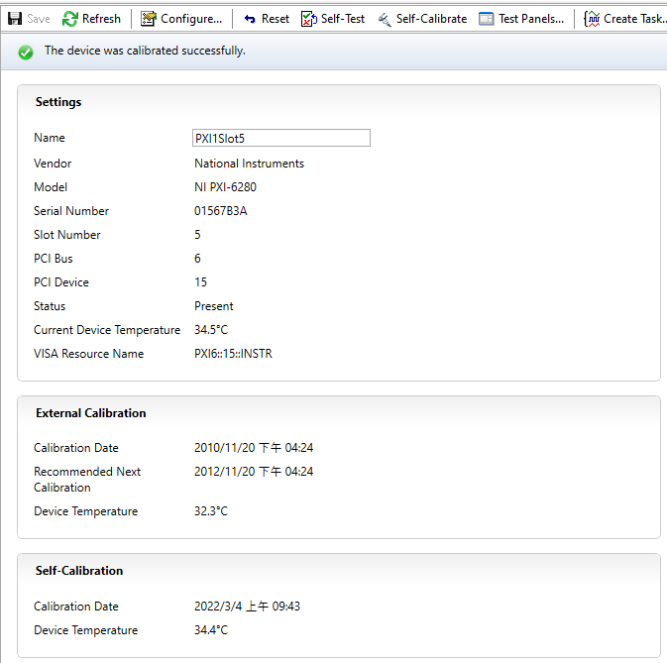
6280_1 Pass
Self Test
Self Calibration

Slide 4
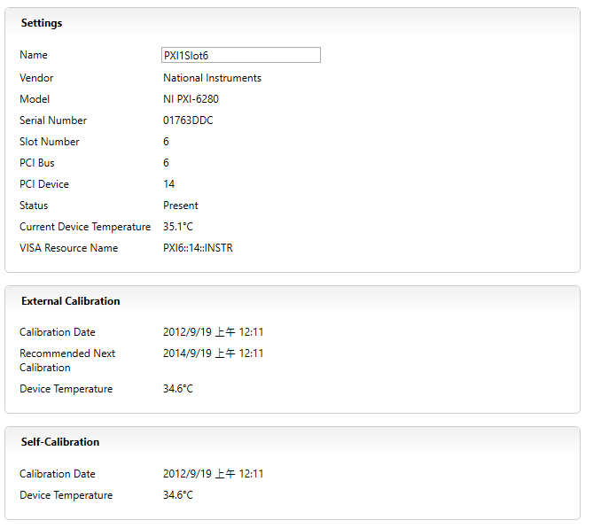
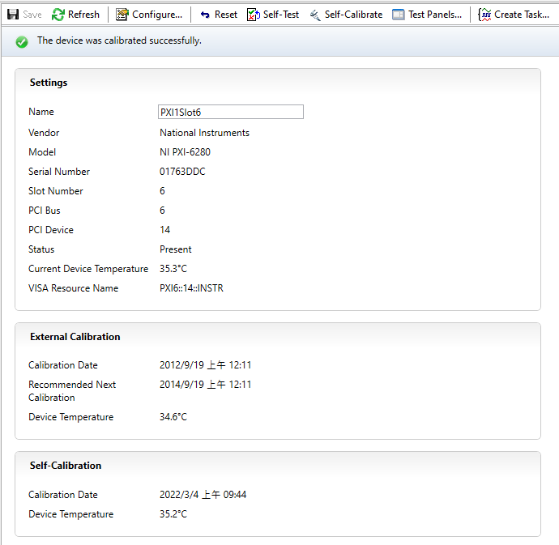
6280_2 Pass
Self Test
Self Calibration

Slide 5
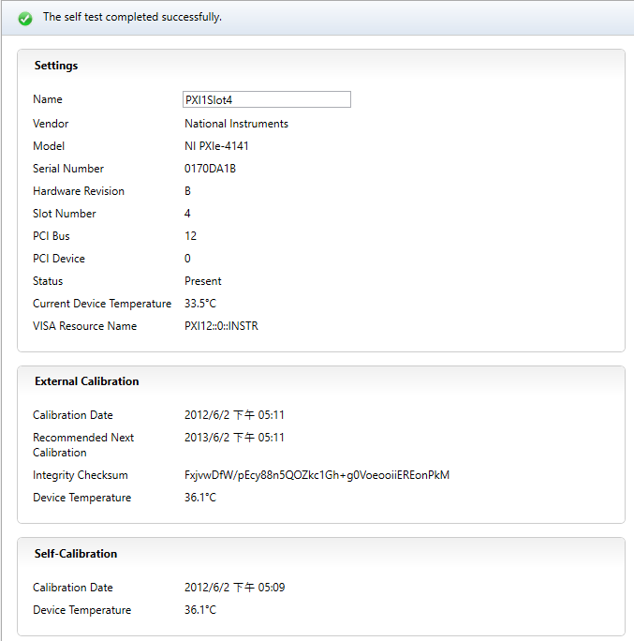
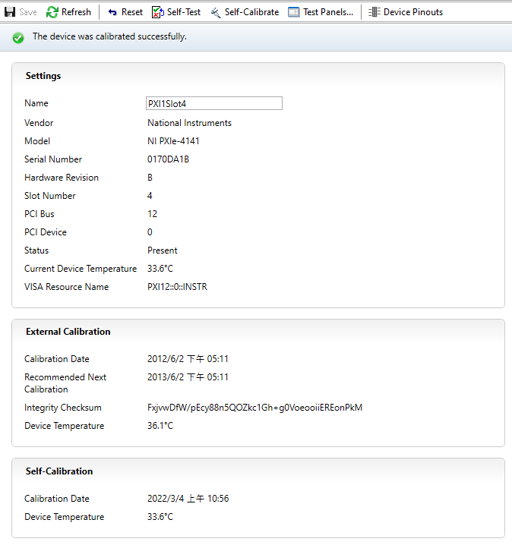

4141 Pass
Self Test
Self Calibration
Input/Output Test

Slide 6
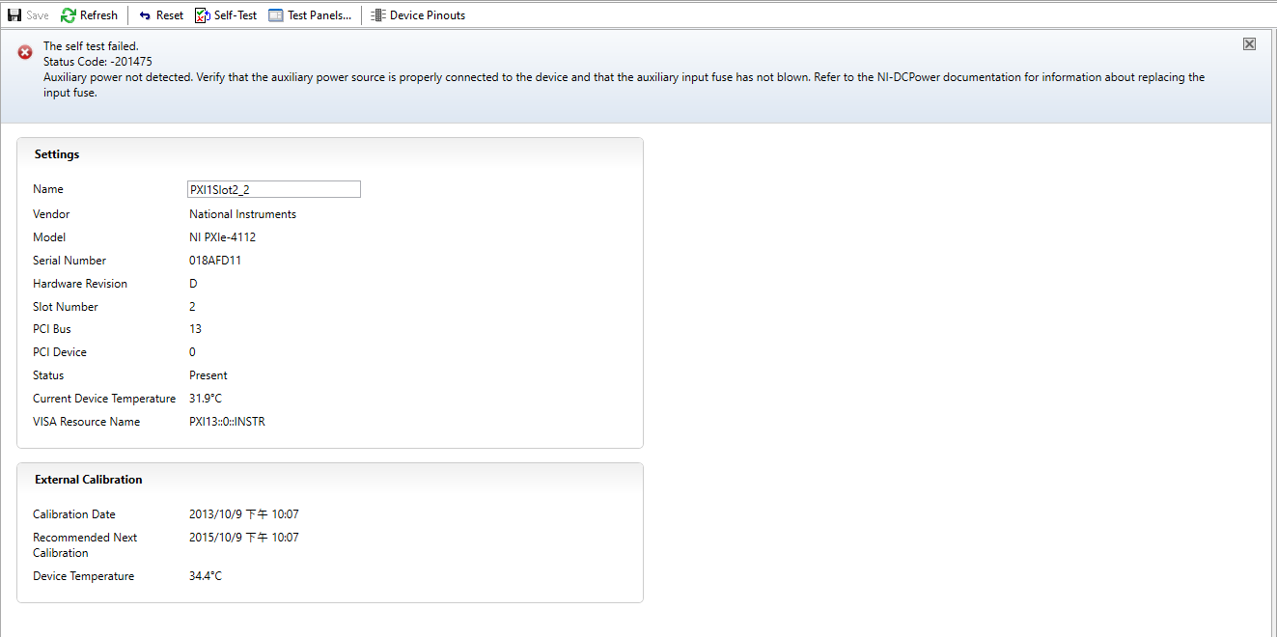
4112 Failed
Self Test

Slide 7
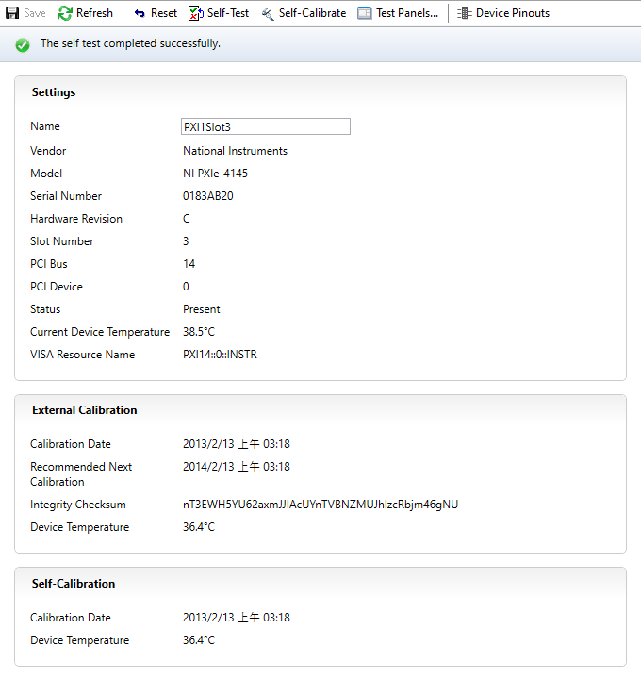
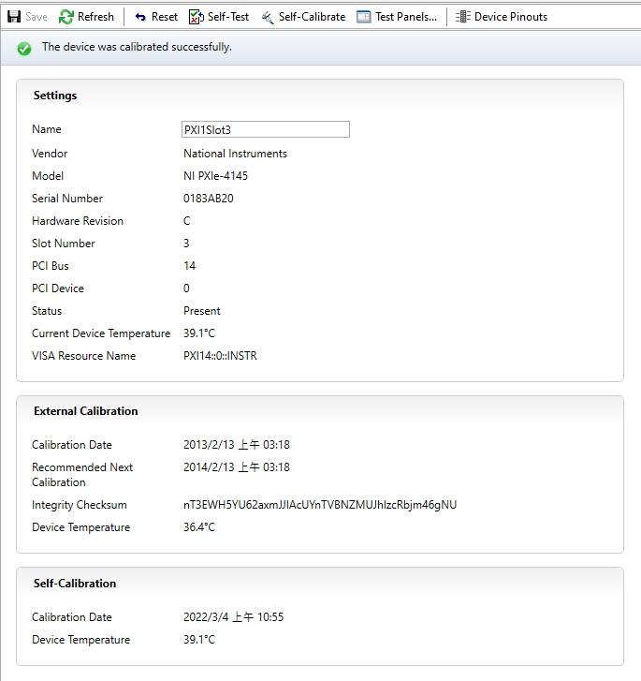

4145 Pass
Self Test
Self Calibration
Input/Output Test

Slide 8
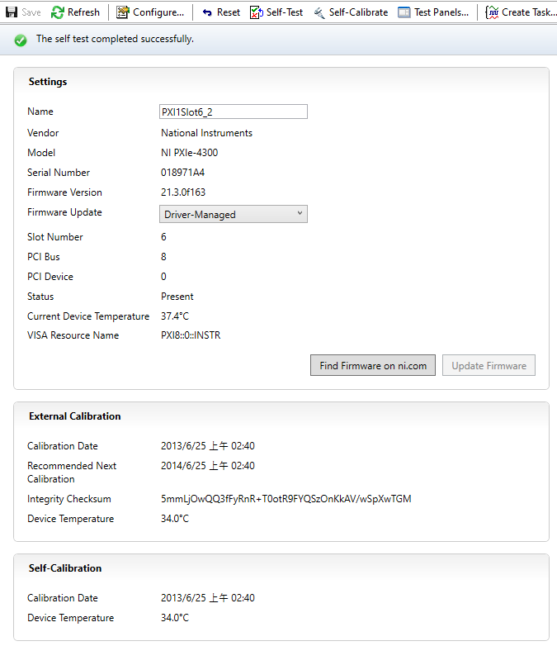
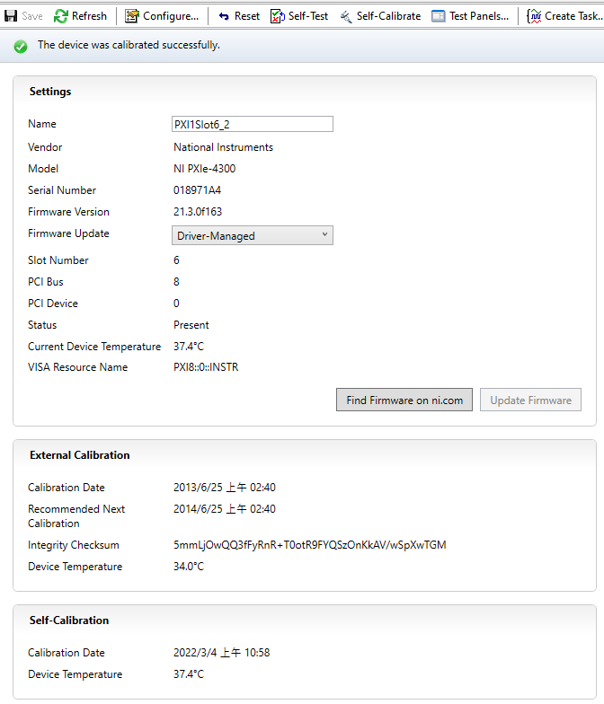
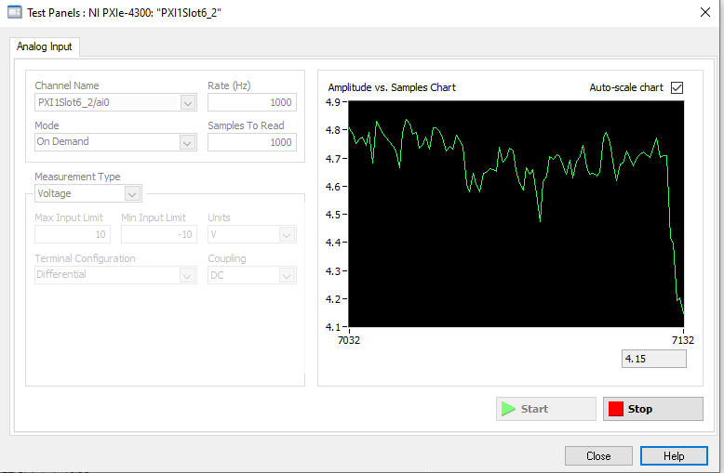
4300 Pass
Self Test
Self Calibration
Input/Output Test
Input 5 V

Slide 9
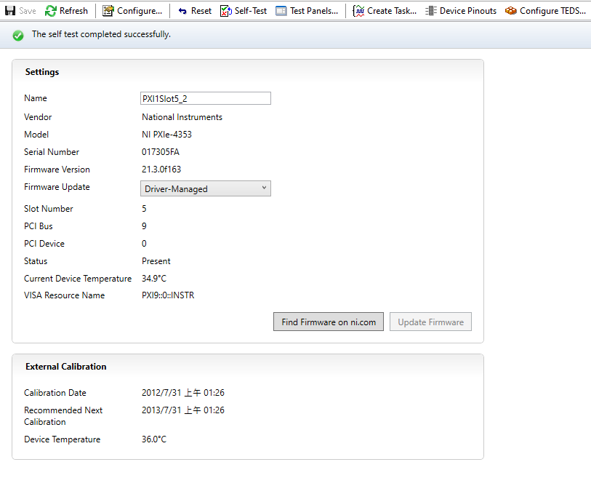
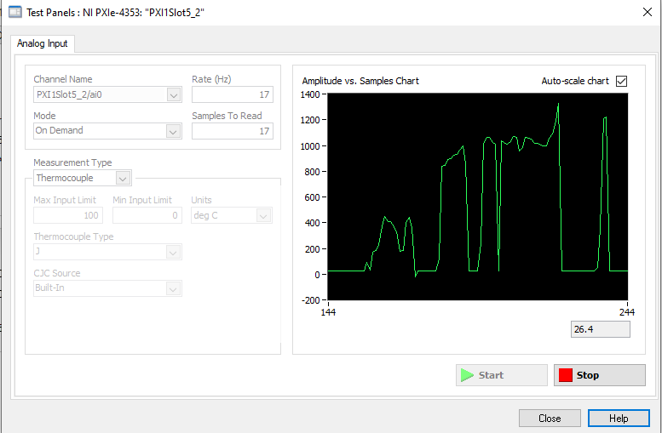
4353 Pass
Self Test
Input/Output Test
By touching the wire and the voltage will be changed.

Slide 10
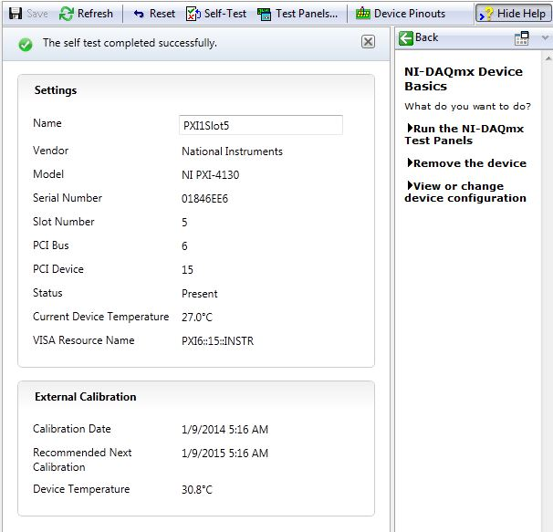
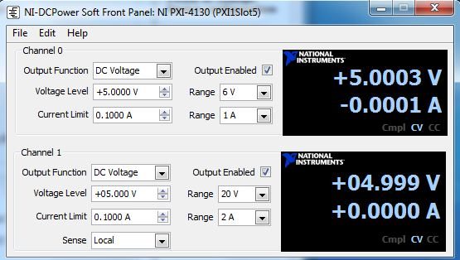
4130 Pass
Self Test
Input/Output Test

Slide 11
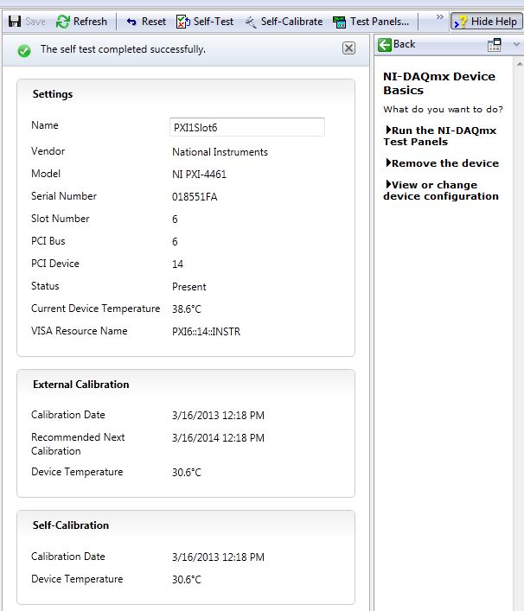
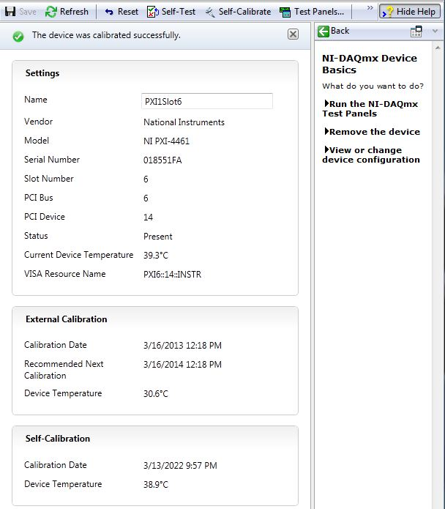
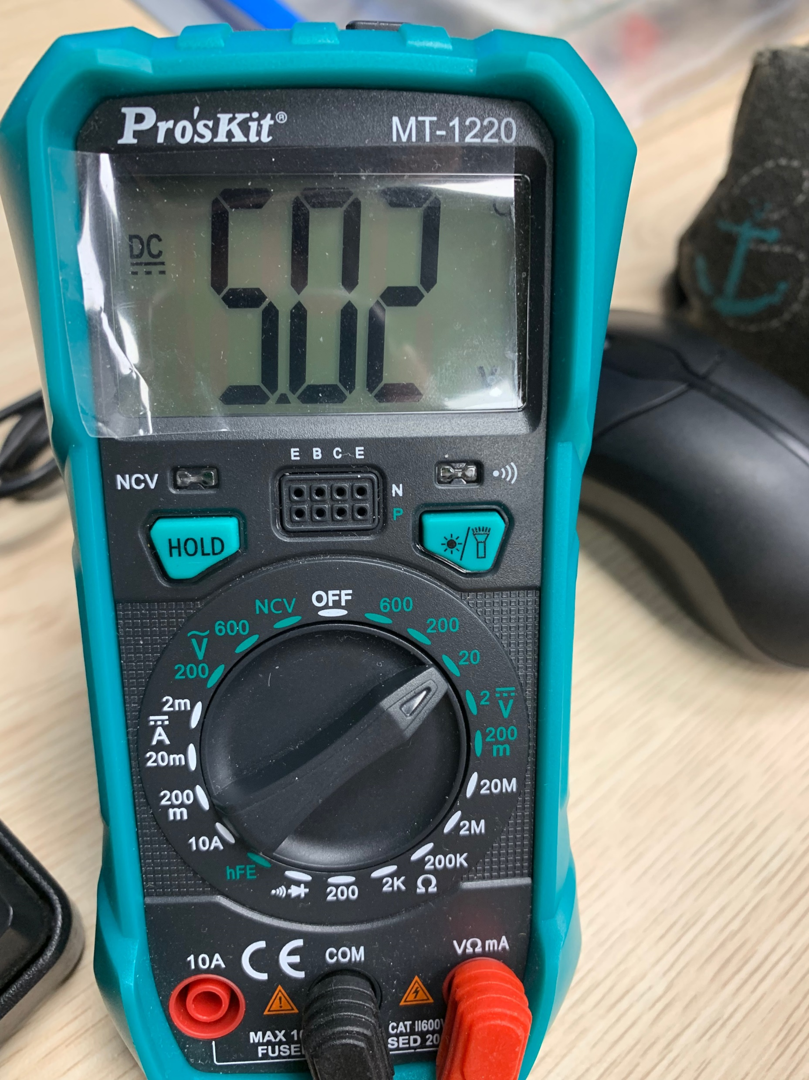
4461 Pass
Self Test
Self Calibration
Input/Output Test
Output 5 V and read by meter

Slide 12
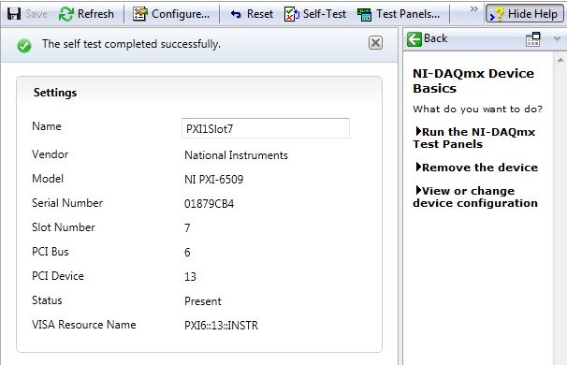
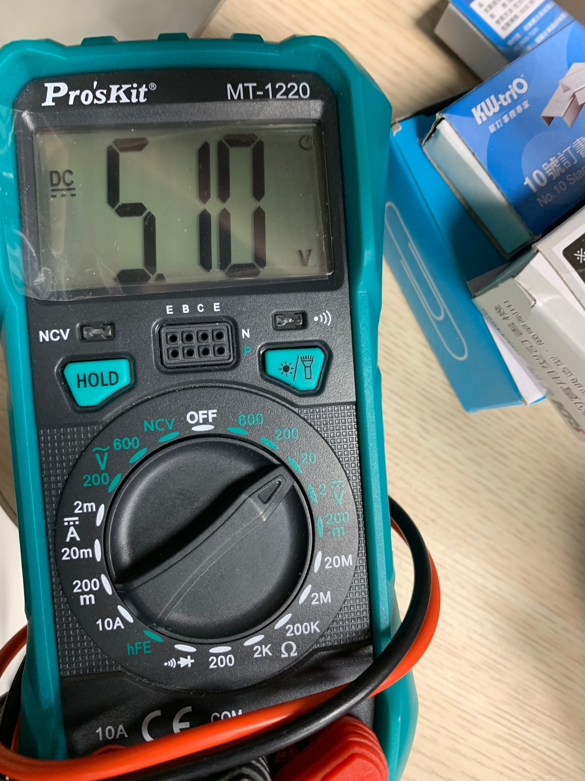
6509 Pass
Self Test
Input/Output Test
DO Test

Slide 13
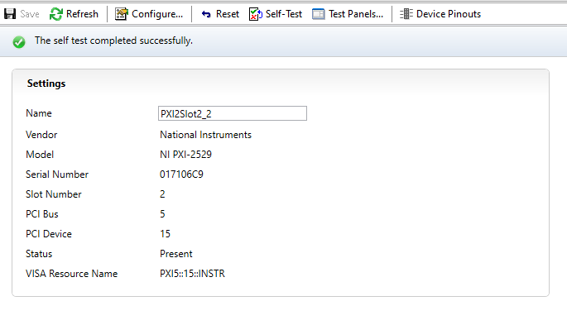
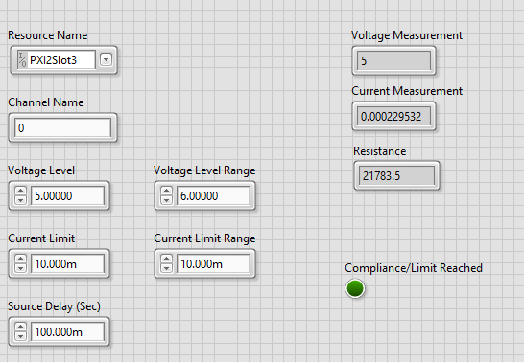
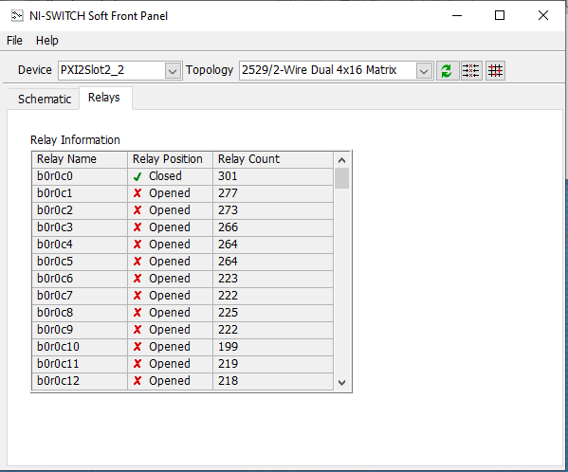
2529 Pass
Self Test
Input/Output Test

