Slide 1
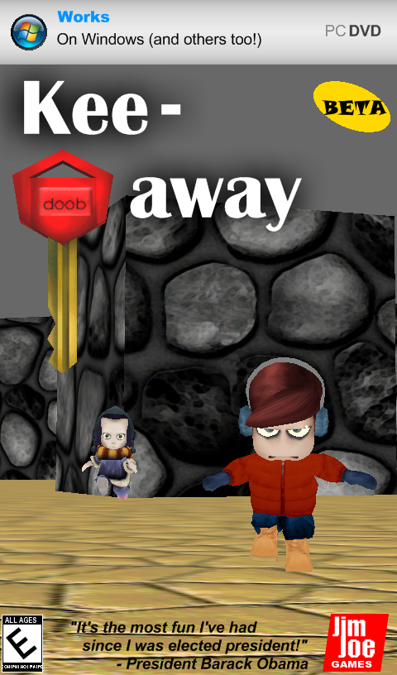
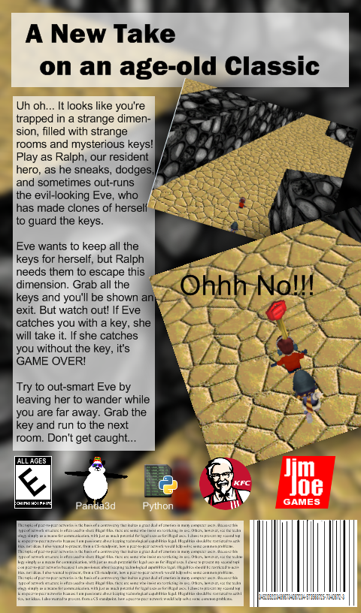

Slide 2
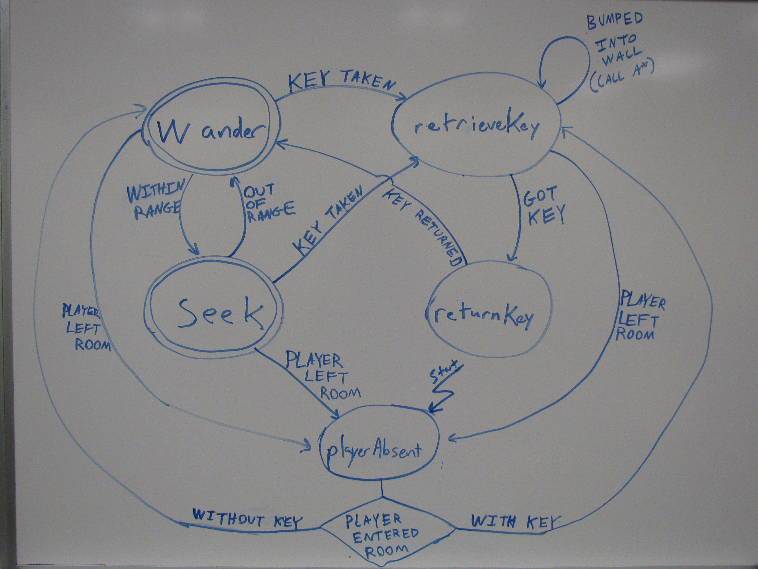
Finite State Machine Diagram

Slide 3
A* Hacks – Everything is a NodePath
Every entity in our game is a node path
  (That includes NPC's, Players, waypoints, even the walls and floors)
  This allows us to have a function that can take a node path and determine its nearest waypoint.
  Once we have those, if there is a clear path to nearest waypoint, use that as a start/endpoint for A*. (The target is always treated as a waypoint.)

Slide 4
A* Hacks – Keeping path up to date
A* is recalculated whenever
  A waypoint is reached.
  Anytime a waypoint is skipped. This can happen when:
    There is a clear path to the next waypoint
      Next waypoint isn't the one we are currently seeking
    NPC bumps into a wall during A* search
      This happens when NPC is seeking a moving target
        (Namely the case were there is a clear path to the target so it skipped waypoints, but the target moved behind a wall)

