Slide 1
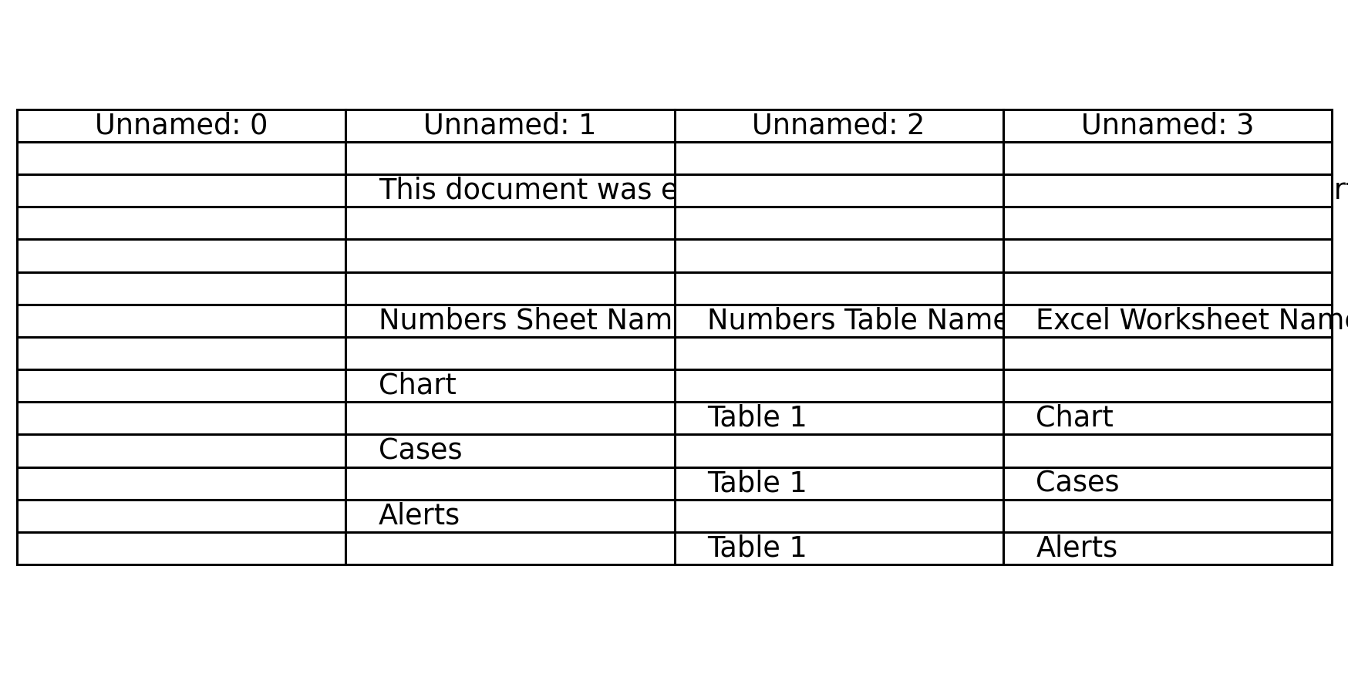
Export Summary

Slide 2

Chart

Slide 3

Cases

Slide 4
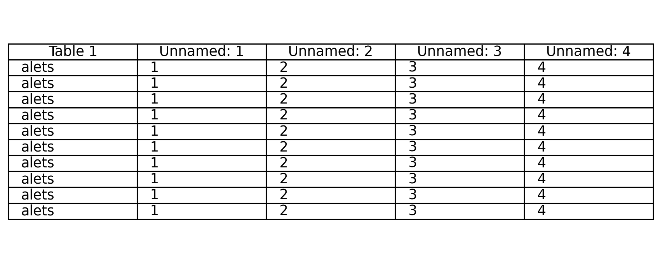
Alerts

