Slide 2
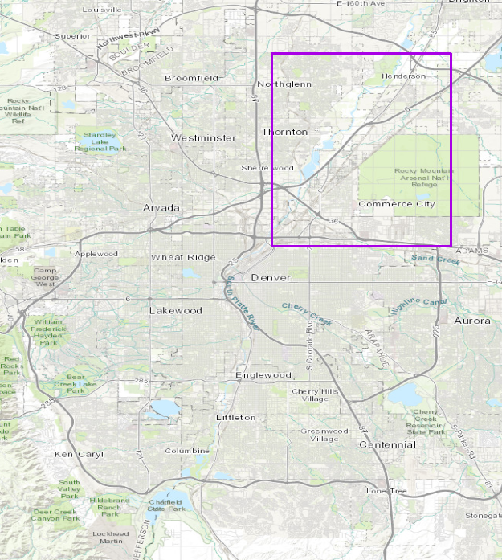
Example scenes
Leaf-on (August 2015)
GBDX products
Land Use Land Cover (LULC)
Built-up Extent
Notes:
ID SENSOR DATE
10300100612DE400 WV2 12/17/2016 (large strip)
104001000F443900 WV3 8/5/2015 (smaller tile)

Slide 3
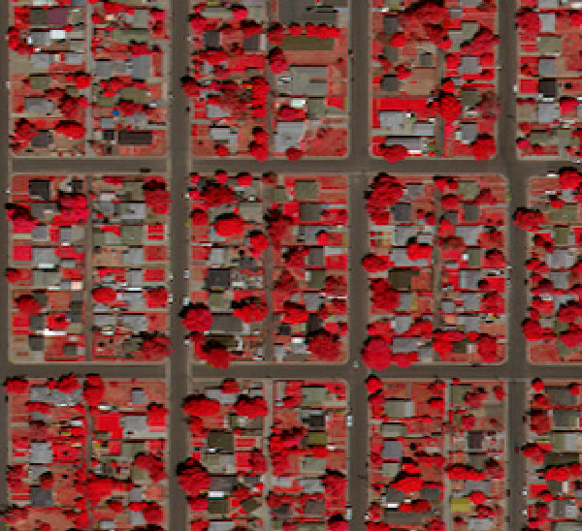
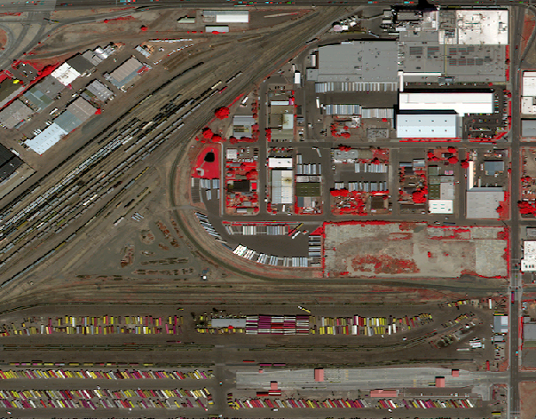
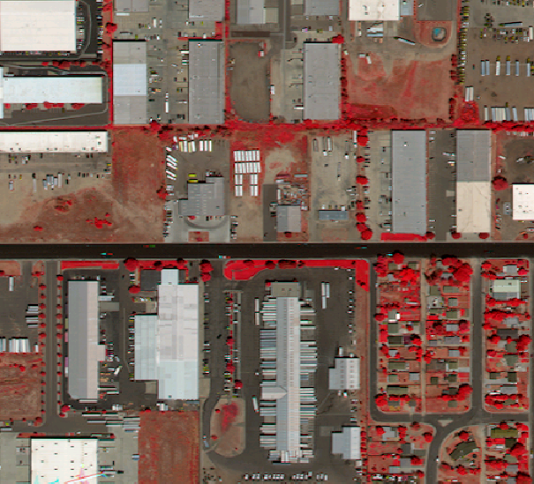
Color – Infrared view

Slide 4
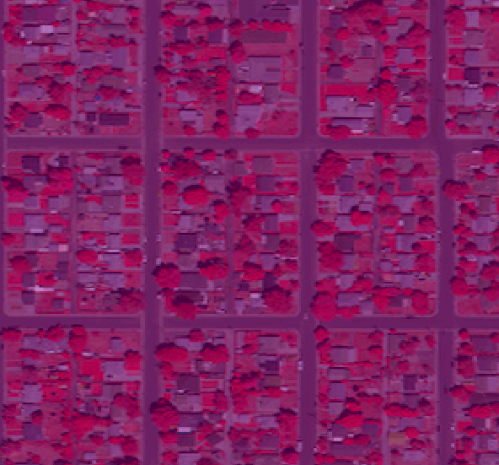
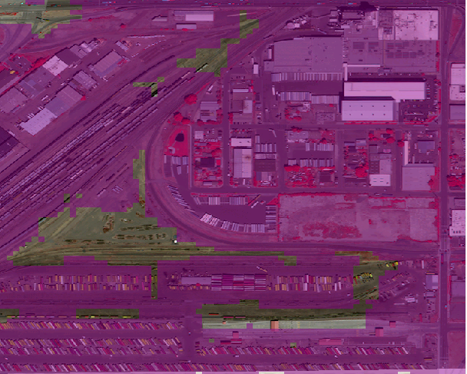
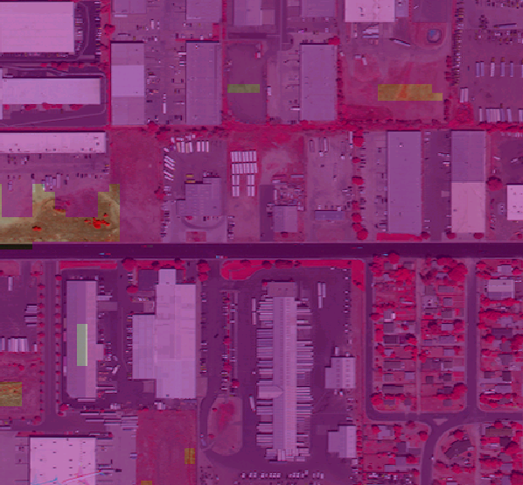
GBDX Built Up Extent (purple shading)

Slide 5
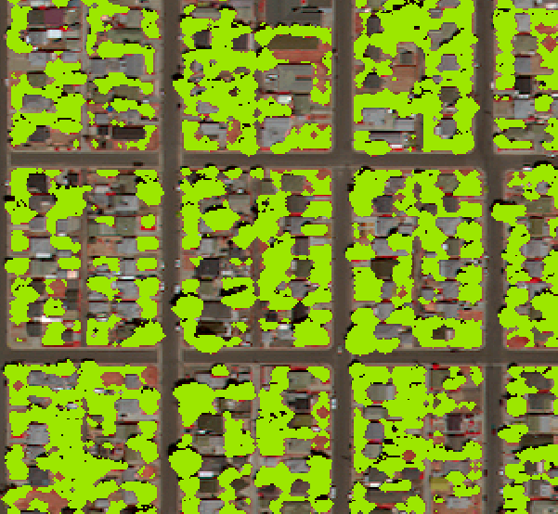
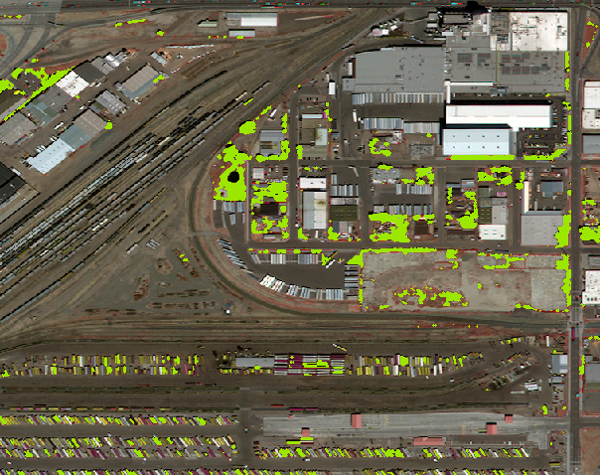
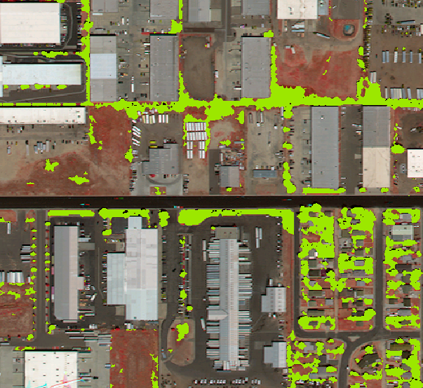
Vegetation Land Cover

Slide 6
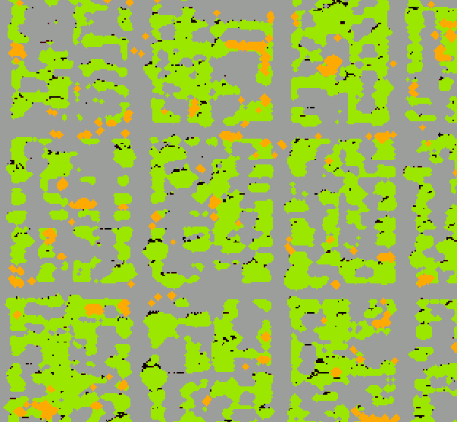
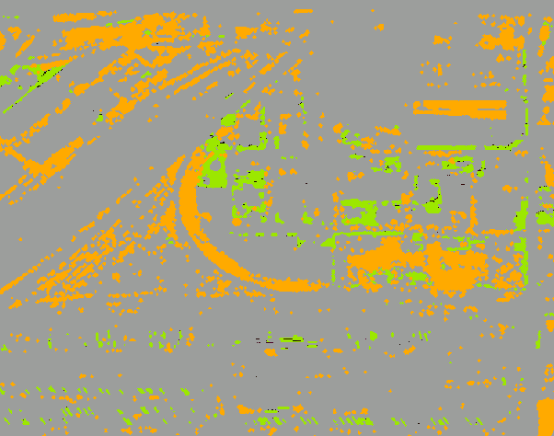
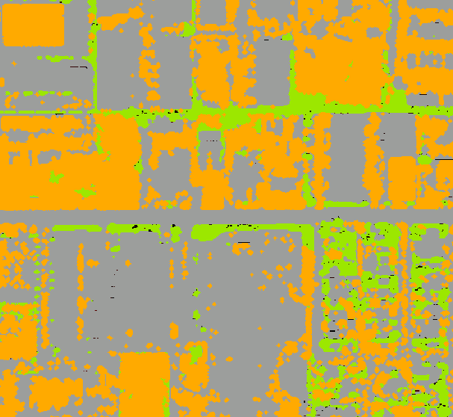
Land cover – vegetation, bare soil, unclassified

