Slide 1

Best Practices of Analytical Sales Management
Zorian Rotenberg,
VP @ InsightSquared
Wednesday, February 20

Slide 2
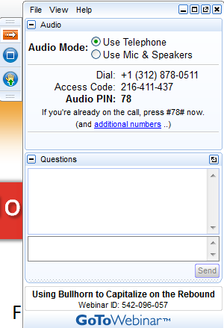
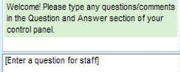
Housekeeping
How to participate:
For audio choose “Use Mic & Speakers” or “Use Telephone” in your Audio window
Submit your text question using the Questions pane
Note: A recording will be made available

Slide 3

Tweet your questions to @InsightSquared with #sales #analytics hashtags.

Slide 4

Hosted by
Zorian Rotenberg
VP @ InsightSquared
Background:
VP @ several hyper-growth startups, all 100%+ sales growth ranging from $8 Million - $100 Million; last company was acquired by Dell
CEO @ StarWind Software (i.e. CEO = “Sales VP”)
Sales @ IBM Software Sales Group
B.S. from Lehigh University, Harvard MBA
And:
Loves analytics: Finance major, minors in Applied Math and in Computer Science, started career as Investment Banking Analyst on Wall St.
Hobbies: intersection of Sales Management & Analytics, Excel (plus Skiing, Tennis & Traveling)

Slide 5
1
7 Best Practices of Analytical Sales Management
2
How To Be An Analytical Sales Manager
3
Top Sales Reports That You Must Use Now

Slide 6

1
7 Best Practices of Analytical Sales Management

Slide 7
7 Best Practices
Inspect to Get Respect
Always Coach with Metrics
Know % Conversions of Your Activities
Know Your Pipeline Historically
Know Your Sales Funnel for Each Rep
Know Each Rep’s Sales Cycle
Forecast by Pipeline Stages, Not Forecasting Stages

Slide 8
2
How To Be An Analytical Sales Manager

Slide 9
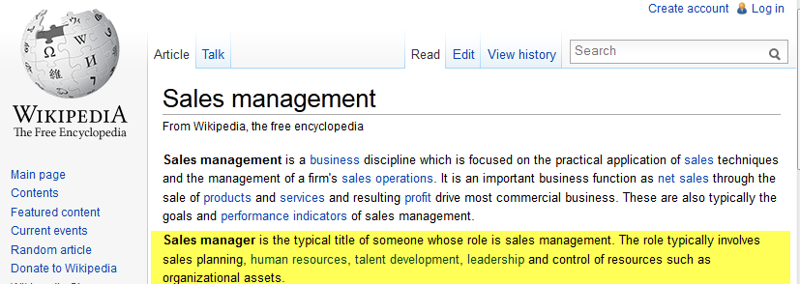
Who is a Sales Manager?

Slide 10
Defining a Sales Manager
Someone who builds a high-performance sales organization using an effective, repeatable process to drive predictable revenue goals
The objective is not to make sales but to do so through others

Slide 11
Defining a Good Sales Manager
A Good Sales Manager is a master at coaching
A Good Sales Manager has a unique approach to each individual rep while average sales managers use a “one size fits all” approach
Coaching requires knowing the individual’s key metrics

Slide 12
“If you can't measure it,
you can't manage it!”
- Peter Drucker
Notes:
Sales is a Science

Slide 13
How To Become An Analytical Sales Manager
It’s MUCH easier than you think
All basic sales data is already within your reach
Set 1 hour weekly to study your metrics
Keep it simple with only a few KPIs
Ask metrics-based questions

Slide 14
3 Super Simple Steps To Get Started
5 rows in Excel with your 5 KPIs
Ask each rep to track these and report to you monthly
Hire an Analyst who can do more advanced analyses

Slide 15
Your 5 Basic KPIs (for Each Rep)
Activities : Opportunities
Sales Cycle
Historical Pipeline : Sales
Leads : Opportunities : Deals
Lead Source that drives the most sales

Slide 16
How To Build a Data-Driven Sales Culture
Lead by example
Get buy-in from the team
Be transparent & over-communicate
3 : 1 “Praise : Reprimand”

Slide 17
4 Biggest Mistakes
Your team doesn’t trust the data
You use data as a stick, not for coaching
You have too many metrics and it’s too confusing
Metrics are not incorporated into the repeatable process

Slide 18
3
Top Sales Reports That You Must Use Now!

Slide 19
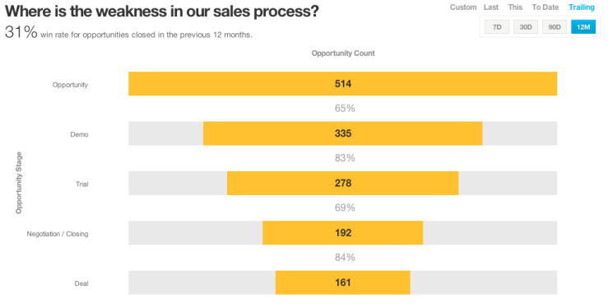
1. Sales Funnel Conversions
What is it?
Shows you the # and % conversions at each step of your sales funnel.

Slide 20
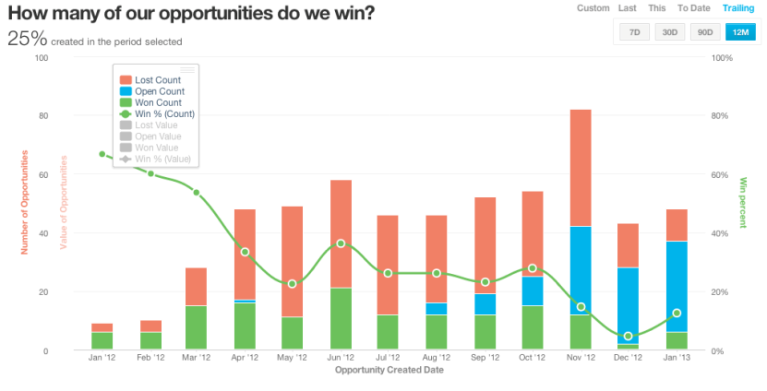
2. Win/Loss Analysis
What is it?
Shows you the count of your won vs. lost opportunities, the revenue won/lost, and the reason for lost.

Slide 21
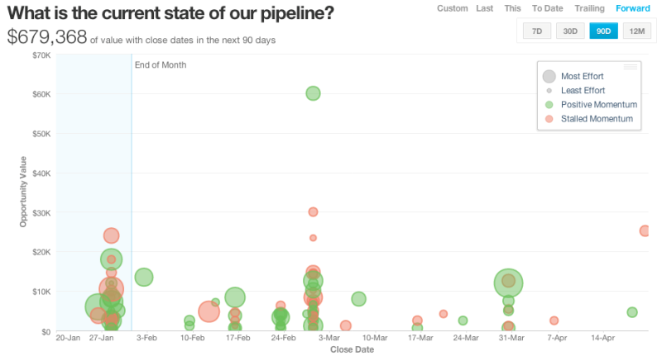
3. Pipeline Today
What is it?
This report shows you the current state of your pipeline by close date and by the most important deals that merit attention.

Slide 22
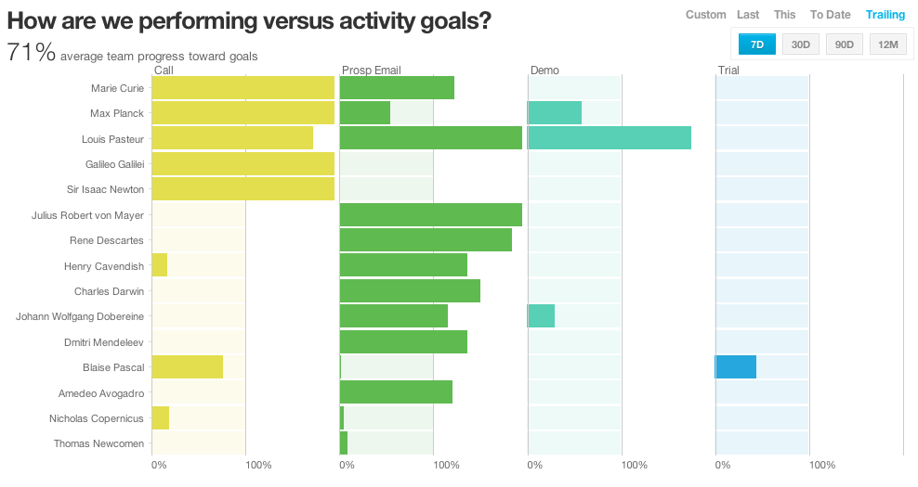
4. Activities Against Goals
What is it?
This report shows you how your employees are performing in a given period of time vs. individual goals

Slide 23
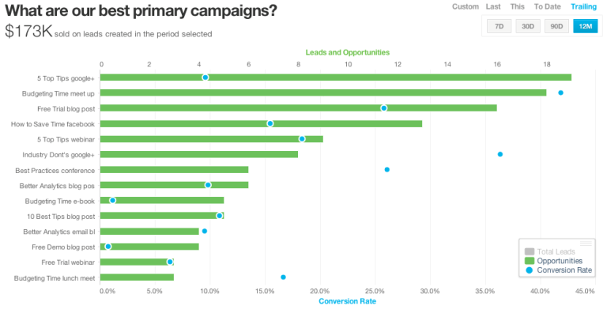
5. Campaign Analysis
What is it?
This report shows you how effective your marketing/sales campaigns have been at driving leads, opportunities & revenue

Slide 24
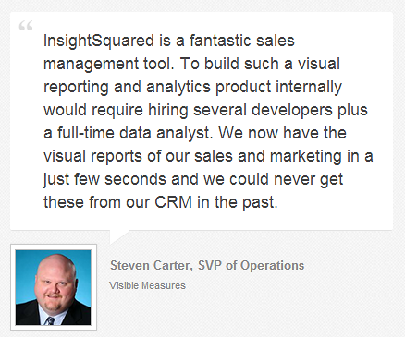
About InsightSquared
#1 in Salesforce Analytics
Get actionable & instant insights
Increase Rep Productivity
Close EVEN MORE Deals
Do: Smart Forecast TM

Slide 25
Q & A
Sign up for a FREE 2-Week Trial:
http://www.insightsquared.com/get-a-free-trial/

Slide 26
Thank you!
Contact: zorian@insightsquared.com
Phone: 617.370.8116
Twitter: @insightsquared
More info: www.insightsquared.com

