Slide 1
ATN 164 · Screen2Prevent (S2P)
Patient Experience Mockups
QR Code–Initiated Chatbot Survey on Personal Device
Texas Children's Hospital — Emergency Department
March 2026 · Confidential

Slide 2
Patient Journey Overview
9 screens walk the patient from QR scan through survey completion and mHealth enrollment
1
2
3
4
5
6
7
8
9
›
›
›
›
›
›
›
›
QR Scan
Landing
Language
Consent
Welcome
Questions
Sensitive
Complete
mHealth
Phase 3
Phase 3
Phase 3
Phase 3
Phase 4
Phase 4
Phase 4
Phase 4
Phase 6
Key Design Principles
Privacy by Design
Zero Typing Required
Conversational Tone
Non-Coercive Flow
Inline encryption reminders before every sensitive question. No data cached on device.
Tap-to-select response buttons throughout. Critical for speed in an ED setting.
Age-appropriate chatbot language for 14–24 year olds. Empathetic acknowledgments between questions.
Skip and 'Prefer not to say' options on every question. Voluntary mHealth enrollment at end.

Slide 3
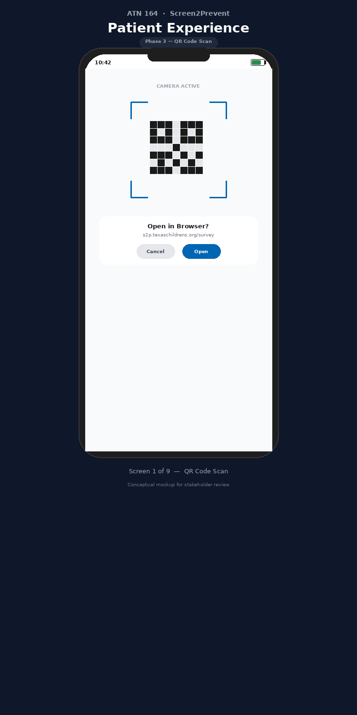
Phase 3 · Step 3.1
1/9
QR Code Scan
Patient points phone camera at QR code signage in triage or exam room
Camera auto-recognizes the code — no app download required
Branded URL (s2p.texaschildrens.org) builds trust before tapping Open
Dynamic QR codes allow URL rotation without reprinting signage
Design Note: Signage should be tamper-evident, printed in-house, and placed at eye level with adequate lighting.
Confidential — Texas Children's Hospital — ATN 164 Screen2Prevent

Slide 4
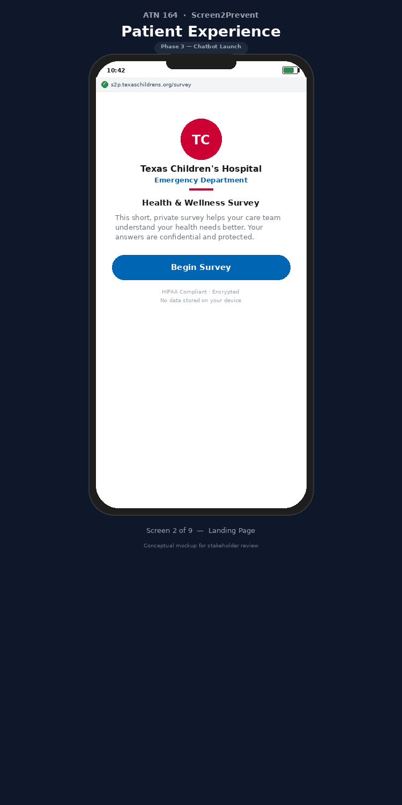
Phase 3 · Step 3.3
2/9
Landing Page
Texas Children's branding (logo, colors) confirms legitimacy
HTTPS lock icon visible in browser bar
Clear, non-clinical language: "Health & Wellness Survey"
HIPAA compliance and encryption noted at bottom of page
Design Note: The "Begin Survey" CTA is the only actionable element — no distractions.
Confidential — Texas Children's Hospital — ATN 164 Screen2Prevent

Slide 5
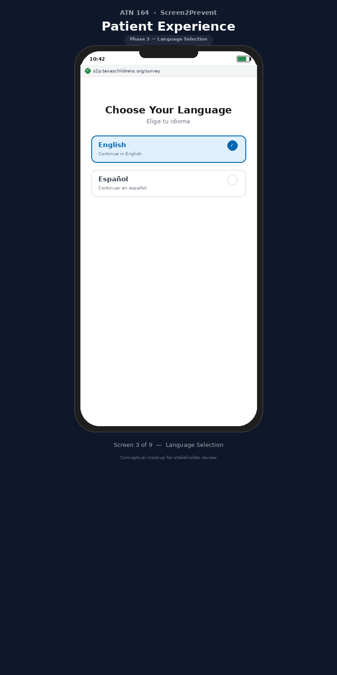
Phase 3 · Step 3.3
3/9
Language Selection
English and Spanish per ATN 164 protocol requirements
Large, easy-to-tap selection cards with visual confirmation
Bilingual header ensures comprehension before selection
Expandable to additional languages if needed
Design Note: Language preference persists through the entire chatbot session.
Confidential — Texas Children's Hospital — ATN 164 Screen2Prevent

Slide 6
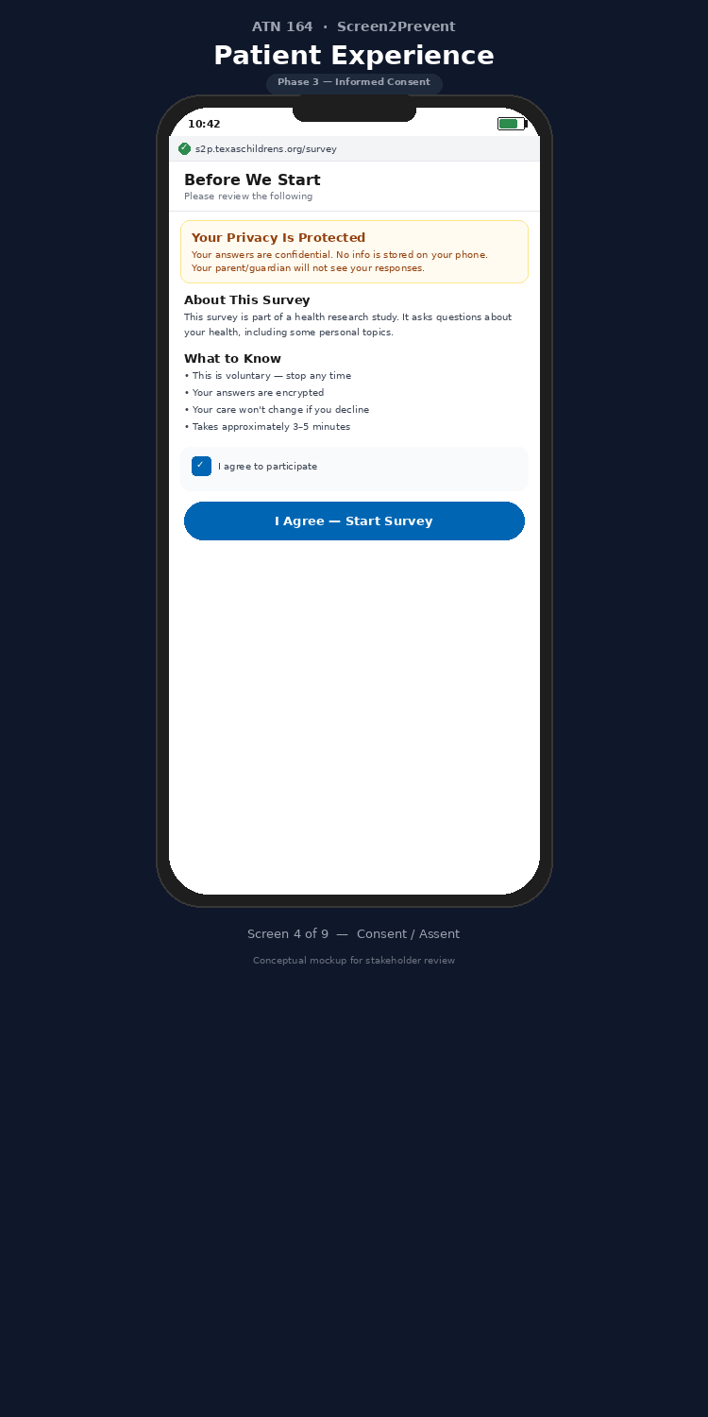
Phase 3 · Step 3.4
4/9
Informed Consent / Assent
Yellow privacy banner: "Your parent/guardian will not see your responses"
Key facts in scannable format: voluntary, encrypted, 3–5 minutes
Active checkbox acknowledgment required before proceeding
IRB-approved language adapted for age-appropriate assent (14–17) or consent (18–24)
Design Note: This screen is the single most important element for driving honest disclosure from minors.
Confidential — Texas Children's Hospital — ATN 164 Screen2Prevent

Slide 7
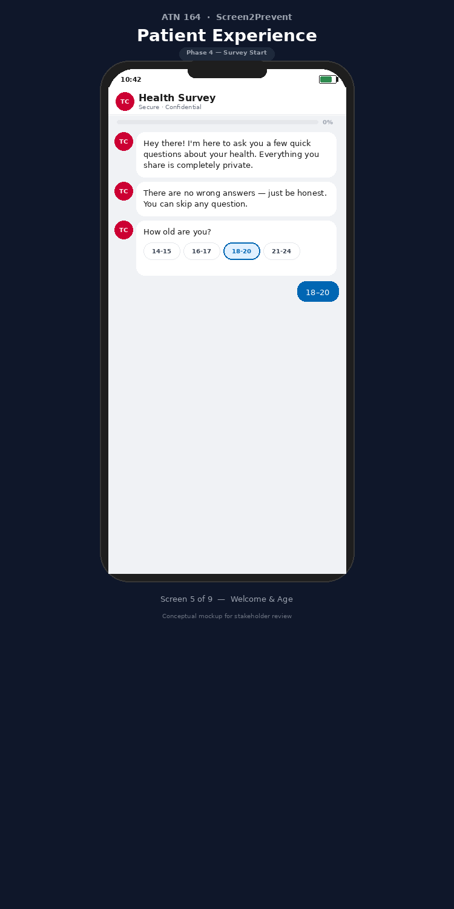
Phase 4 · Step 4.1
5/9
Welcome & Age Question
Conversational chatbot greeting — warm, non-clinical tone
First question is intentionally easy (age range) to build momentum
Tap-to-select buttons eliminate typing entirely
Bot avatar (TC) and "Secure · Confidential" subtitle reinforce trust
Design Note: Progress bar at 0% sets expectations for survey length.
Confidential — Texas Children's Hospital — ATN 164 Screen2Prevent

Slide 8
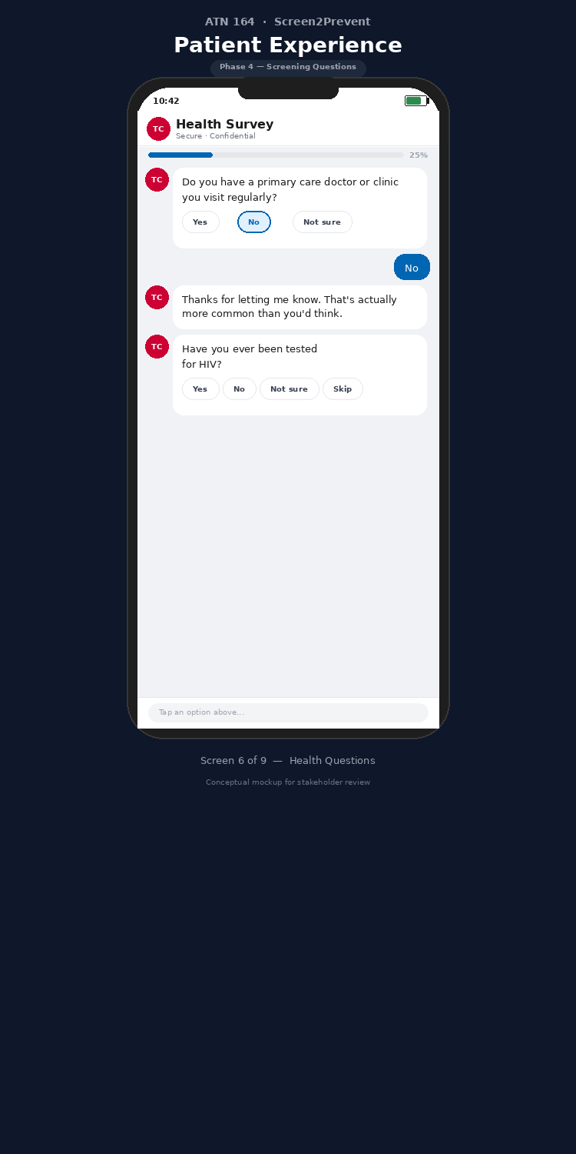
Phase 4 · Steps 4.1–4.2
6/9
Health Screening Questions
Multi-turn conversation flow with empathetic acknowledgments
"That's actually more common than you'd think" normalizes responses
Branching logic: follow-up questions adapt based on prior answers
"Prefer not to say" and skip options available on every question
Design Note: Progress bar advances (25%) giving patients a sense of completion momentum.
Confidential — Texas Children's Hospital — ATN 164 Screen2Prevent

Slide 9
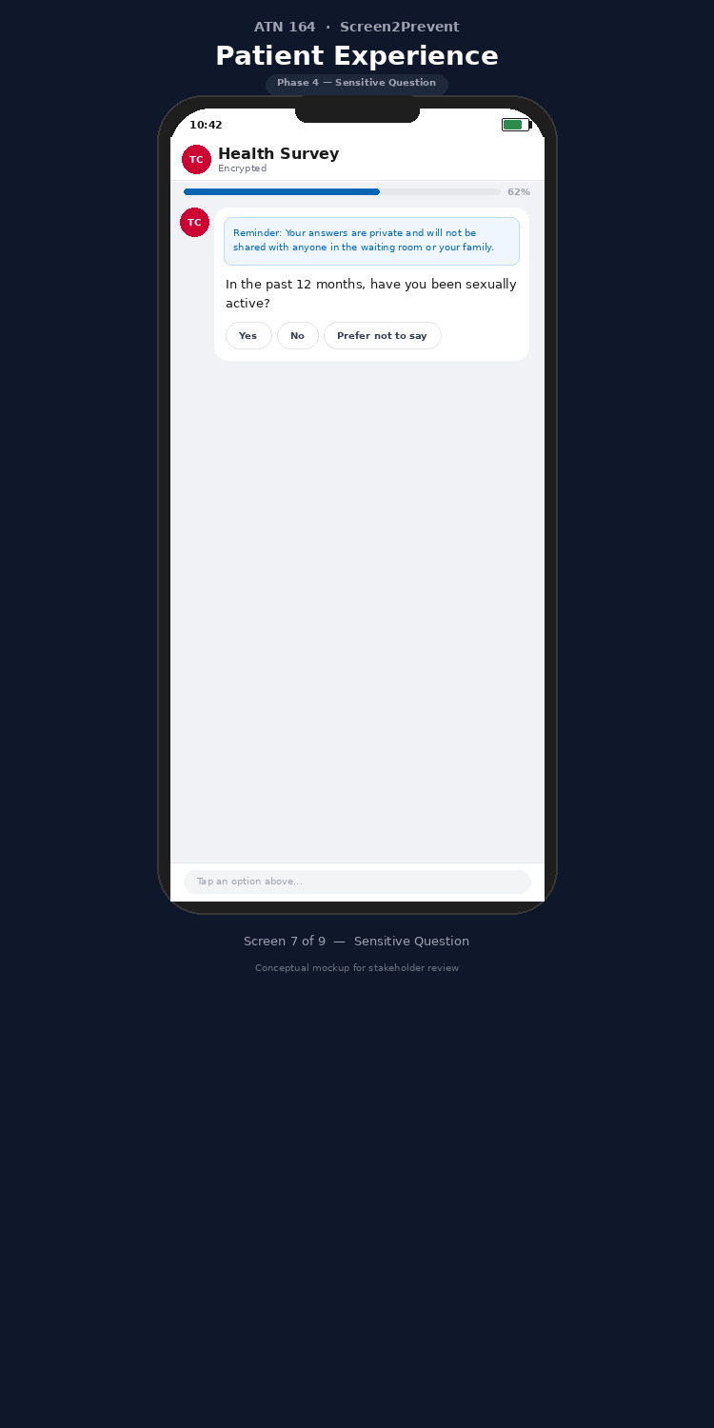
Phase 4 · Step 4.1
7/9
Sensitive Question with Privacy Reminder
Blue inline privacy banner appears before the sensitive question
Explicit reassurance: "not shared with anyone in the waiting room or your family"
Header changes to "Encrypted" to reinforce security
"Prefer not to say" option respects patient autonomy
Design Note: This contextual privacy reminder at the point of disclosure is a key differentiator from static survey forms.
Confidential — Texas Children's Hospital — ATN 164 Screen2Prevent

Slide 10
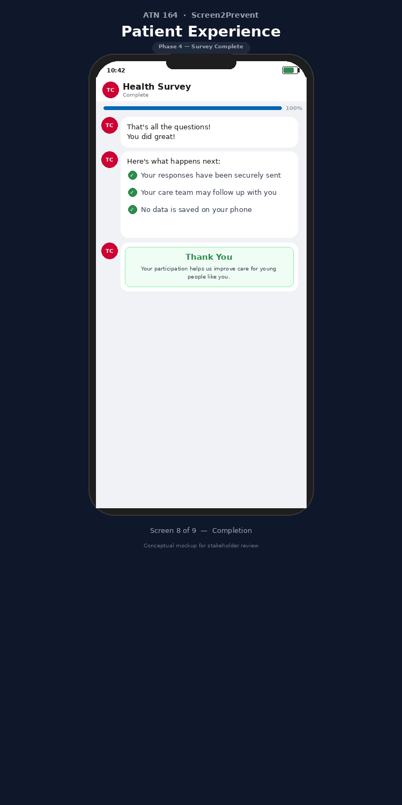
Phase 4 · Step 4.6
8/9
Survey Completion
Celebratory tone: "You did great!" validates the patient's effort
Three explicit confirmations with green checkmarks
"No data is saved on your phone" — final privacy reassurance
Thank-you card acknowledges the patient's contribution to research
Design Note: Progress bar at 100% provides satisfying visual closure.
Confidential — Texas Children's Hospital — ATN 164 Screen2Prevent

Slide 11
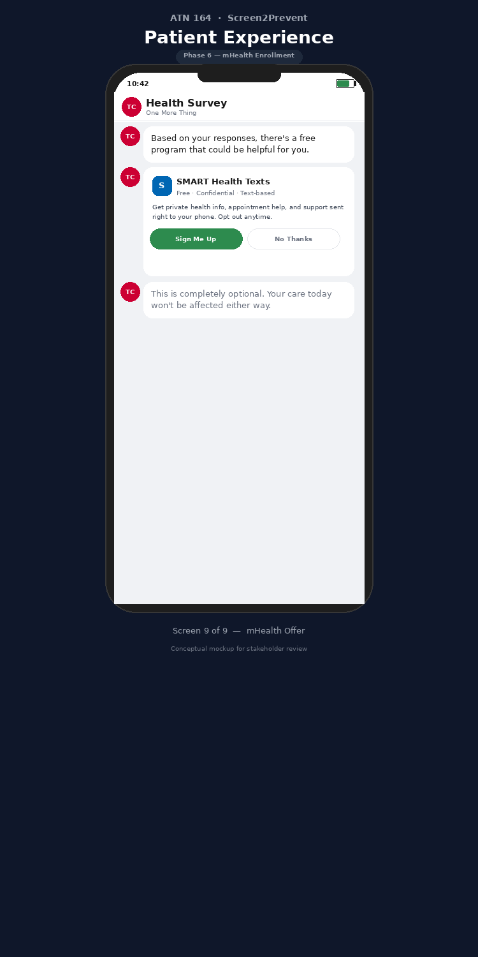
Phase 6 · Step 6.1
9/9
mHealth Enrollment Offer (SMART)
Appears only for patients meeting PrEP eligibility criteria
Program card format with clear value proposition
Equal-weight "Sign Me Up" and "No Thanks" buttons — non-coercive
Explicit opt-out reassurance: "Your care today won't be affected"
Design Note: Per the ATN 164 protocol, the SMART mHealth platform provides text-based PrEP education and care linkage post-discharge.
Confidential — Texas Children's Hospital — ATN 164 Screen2Prevent

Slide 12
Next Steps
1
Stakeholder Review
Circulate these mockups to the ATN 164 PI, ED Medical Director, IT Security, and Compliance for feedback on tone, content, and workflow.
2
IRB Amendment
If the personal device modality requires a protocol amendment, initiate submission. The data collection content is unchanged — only the delivery mechanism is enhanced.
3
Chatbot Vendor Selection
Evaluate HIPAA-compliant platforms (Azure Health Bot, Dialogflow CX, or purpose-built). Must support branching logic, multilingual, and real-time secure data export.
4
Pilot in Single ED Pod
2–4 week pilot to test QR workflow, chatbot usability, connectivity, and staff adoption before full-scale deployment.
Confidential — Texas Children's Hospital — ATN 164 Screen2Prevent

