Slide 1
Border Patrol Security: An American viewpoint
Gabriela Padilla
POLS 7012
Intro to Political Methodologies

Slide 2
Cooperative Election Study 2020
A study that seeks to study how Americans view Congress and hold their representatives accountable during elections, how they voted and their electoral experiences, and how their behavior and experiences vary with political geography and social context.

Slide 3
Cooperative Election Study 2020 cont.
Consisted of 60 teams and a sample of 61,000 cases during the Fall of 2020
-An ongoing study

Slide 4
Cooperative Election Study 2020 cont.
*Research teams purchased a 1,000-person national sample survey
-conducted by YouGov of Redwood City California
*Done in 2 waves
-1st wave, pre-election wave, was conducted in the field from September 29th to November 2nd.
-2nd wave, post-election wave, was conducted in the field from November 8th to December 14th.
Data reason 1 occurred on March 26th, 2021.
(Ansolabehere et al 2020, p. 6 )

Slide 5
Cooperative Election Study 2020 cont.
There are five parts to the 2020 CES Common Content (Ansolabehere et al 2020, p.6 )
1.) sample identifiers (including state and congressional district)
2.) profile questions (largely demographic)
3.) pre-election questions
4.)post-election questions
5.) contextual data (including candidate names and parties, election results, and roll call votes)

Slide 6
Cooperative Election Study 2020 cont.
Criteria for inclusion of a question in the Common Content (Ansolabehere et al 2020, p. 7)
1st What questions would naturally be of interest to scholars researching Congress, representation, and elections?
- Items such as approval of Congress, approval of the individual Senator or House Member, Partisanship, Ideology, views on the economy and war, and voting behavior, as well as demographic characteristics of voters fall into this category.
2nd What questions did a large number of teams want to include in the study?
-For example, a number of research teams expressed interests in studying roll call voting behavior of members of Congress. Another cluster of teams wanted a more extensive battery of questions on religion, which led the CES to expand beyond the usual questions asked by the ANES.
3rd What phenomena can only be measured with a large survey?
-The very large sample for the Common Content provides the opportunity to study legislative constituencies – states and congressional districts – as well as voters within those constituencies, to study very rare or low frequency events or very small populations, and to measure with fairly high accuracy interactions.

Slide 7
Sampling Methodology
Conducted over the internet
YouGov
Interviewed 61,000 adults
Pre-election interviews
September –October 2020
Post-election interviews
November-December 2020

Slide 8
Importing My Data
My Data was imported from the Dataset “CES” located in the Project-set-01 folder. From there, during the tidying process I was able to condense my data even more to only show the variables I was focusing on.
To import into Rscript I loaded the ces data , located in the “Data” folder, from inside the main Project-set-01 folder.
To load the data, I used the load() tool.
load('data/ces-2020/cleaned-CES.RData'

Slide 9
Tidying My Data
Once my data, ces, was uploaded to my Rscript page, there was still some tidying that had to be done.
The code I used to tidy and condense the data was:
“ ces %>%
select(caseid, educ, abb, increase_border_patrols)” (also located on Rscript page)
I had to condense my data to show only the following variables:
Caseid
Education (educ)
State of Residence (abb)
Increase in Border Patrol Support (increase_border_patrol)

Slide 10
Summarizing My Data
From all the data I uploaded and tidied up, I wanted to see the following two things:
I used the following codes to view my summarized data
ces %>%
group_by(educ) %>%
summarize(
increase_border_patrols)
Will be even more tidy and presented in a table in slide Visualization (1)
ces %>%
group_by(abb) %>%
summarize(
increase_border_patrols)
Will be even more tidy and presented in a table in slide Visualization (3)
if there was any correlation between education level and views on an increase of Border Patrols at the U.S border
I hypothesized that interviewers with a lower-level education are more likely to “support” an increase.
If there was any correlation between your state of residence and your views on increase of Border Patrols at the U.S border.
I hypothesized that interviewers in states closer to the U.S border would “support” an increase.

Slide 11
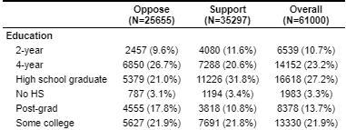
Visualization (1)
Code
table1::table1(~educ| increase_border_patrols, data = ces)
label(ces$educ) <- "Education“
The table above is a visualization of type of education level and its on the increase of Border Patrol at the U.S border.
The data in the table shows support for my hypothesis that interviewers with a lower-education level show greater support for an increase of Border Patrol

Slide 12
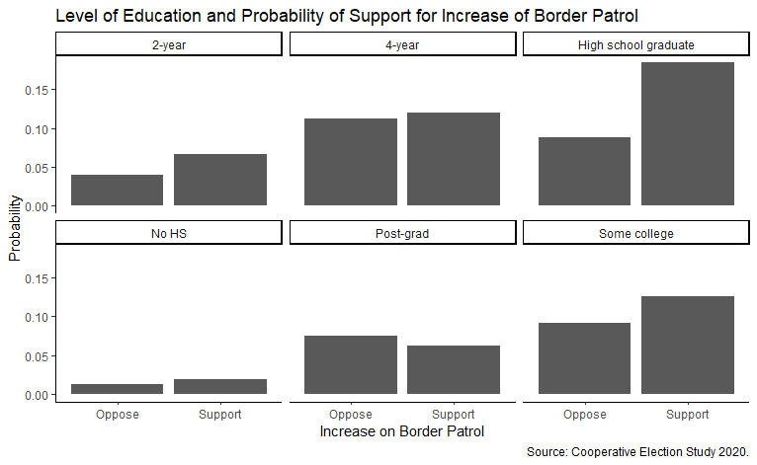
Visualization (2)
Code
ces %>%
filter(!is.na(increase_border_patrols)) %>%
count(increase_border_patrols, educ) %>%
mutate(probability = n / sum(n)) %>%
ggplot(mapping = aes(x = increase_border_patrols, y = probability)) +
geom_col() + facet_wrap(~educ) + labs(x = "Increase Funding on Border Patrol", y = "Probability", title = "A states view on Increasing Border Patrol Spending", caption = "Source: Cooperative Election Study 2020." ) + theme_classic()

Slide 13
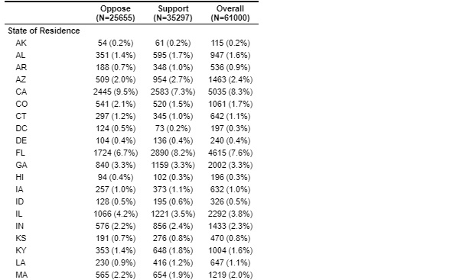
Visualization (3)
Code
table1::table1(~abb| increase_border_patrols, data = ces)
label(ces$abb) <- "State of Residence“
This visual shows a portion of my summarized data for State of Residence and Support of Increased Border Patrol at the U.S border.
By looking at Arizona (AZ), a border state, there is some proof for my hypothesis that states closer to the U.S border support an increase of border patrol.
- Arizona has 954 votes for an increase in Border Patrol.

Slide 14
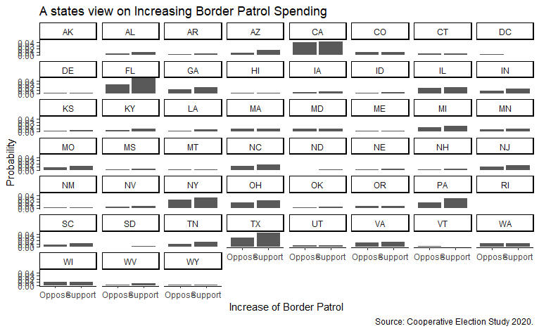
Visualization (4)
Code
ces %>% filter(!is.na(increase_border_patrols)) %>% count(increase_border_patrols, abb) %>%
mutate(probability = n / sum(n)) %>%
ggplot(mapping = aes(x = increase_border_patrols, y = probability)) +
geom_col() + facet_wrap(~abb) + labs(x = "Increase Funding on Border Patrol", y = "Probability", title = "A states view on Increasing Border Patrol Spending", caption = "Source: Cooperative Election Study 2020." ) + theme_classic()
The graph above shows the probability of which states are more likely to support an increase of Border Patrol

Slide 15
Reference
Ansolabehere, Stephen, Brian F. Schaffner, and Sam Luks, COOPERATIVE ELECTION STUDY, 2020: COMMON CONTENT. [Computer File] Release 2: August 4th, 2021. Cambridge, MA: Harvard University [producer] http://cces.gov.harvard.edu

